Slide 1
Mathematical modeling of Methane flow in coal matrix using COMSOL
DEPARTMENT OF
ENERGY AND MINERAL ENGINEERING
COLLEGE OF EARTH AND MINERAL SCIENCES
Hemant Kumar
EGEE 520
04/28/2009

Slide 2
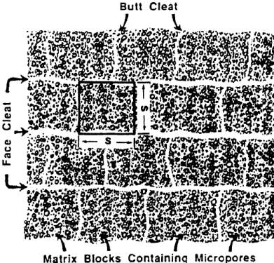
Introduction
Coalbed Methane resides in phyteral pores, micro-pores in the adsorbed state
This adsorption follows the Langmuir isotherm
Fick’s law governs diffusion of Methane in coal matrix
Face and Butt cleats are principal natural pathways for methane-escaping
Gas follows Darcy law while passing through these conduits.

Slide 3
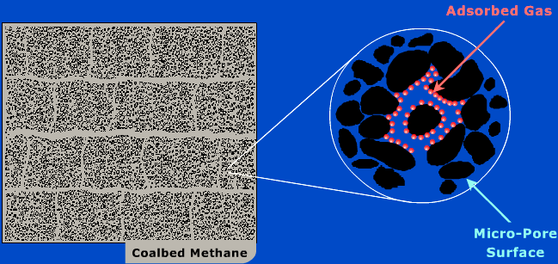
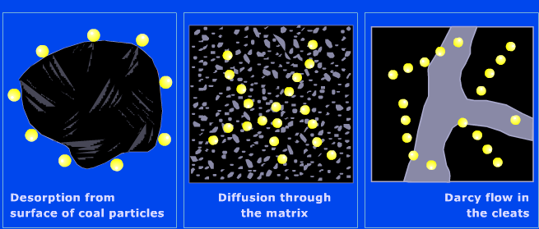
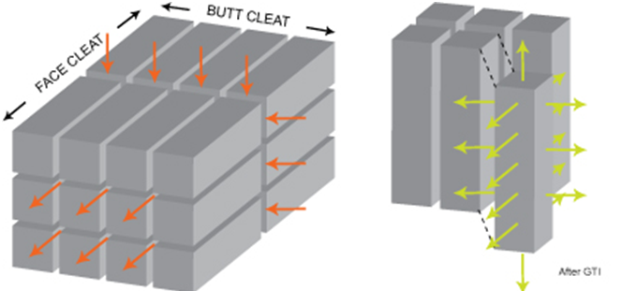
Desorption of methane from micro-pores
2. Diffuses through coal matrix
3. Travels through cleat

Slide 4

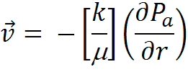

Governing Equation
Fick’s Diffusion
Darcy’s Flow
Real Gas Law

Slide 5

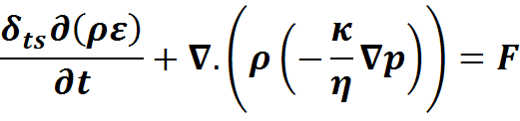
Formulation
Convection and Diffusion
Darcy’s Flow
Real Gas Law
D= Diffusion coefficient
c= Concentration
R= Reaction coefficient
ρ= Density
p= Pressure
κ= Permeability
η= Viscosity
ε= Porosity
Z= Compressibility factor of gas
u= Velocity vector

Slide 6
Atmospheric pressure
Interaction with coal unit
Convection and Diffusion
Darcy’s Flow
Ideal Gas Law
Cleat ( 1E-6 m)
Micro-pore R= 3.7E-4 m
Coal Matrix S= 5E-3 m
Insulated

Slide 7
Assumptions
Micro-pores are assumed to be a constant source of gas with very high concentration (6000 mol/m³)
  Back calculated from total volume of methane gas obtained from 1 ton of coal.
Matrix has a concentration of (50 mol/m³)
  Back calculated from Langmuir’s isotherm at a pressure of 1.2 Mpa
Cleats are straight and made up of porous material
  One end of the cleat is considered at atmospheric pressure and other boundaries were insulated
Temperature remains constant during degasification process
The width and cleat spacing remains constant during the gas flow period
Cleats are straight and there is no tortuocity in them
There is no accumulation of gas in the system
Klinkenberg effect has not been taken in to account

Slide 8
Solution
T= 86400 s

Slide 9
T= 86400 s

Slide 10
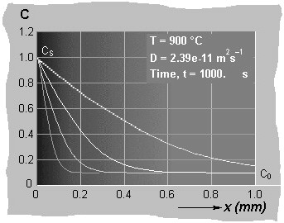
Validation
Break through profile form literature and COMSOL
Concentration profile with distance from the source, matches in both case.

Slide 11
Validation
Concentration of the micro-pores was set Zero and reverse flux pattern was observed
Velocity in the cleat is directly proportional to pressure gradient

Slide 12
Parametric study
D= 10⁻¹⁰
D= 10⁻¹⁵
D= 10⁻²⁰
T = 2000, 3000, 4000, 5000, 6000 s

Slide 13

Parametric study
w= 2W
w= 3W
w= 4W

Slide 14
At (dP)
At 2(dP)
At 3(dP)

Slide 15
Conclusions
2D model was developed for methane flow in coal matrix using COMSOL
Model takes 134 sec to converge
Reasonable breakthrough profile was obtained
Model is in initial stage of development, Experimental data for all parameters will provide a more realistic output in terms of degasification time or rate of degasification
Computer hangs, once finer mesh size and smaller time step is given
Relevant parts has been referenced in Report.

Slide 16

Z
S
Z
Z
Z
Q
Z
N
U
O
I
E
T
S

Slide 17
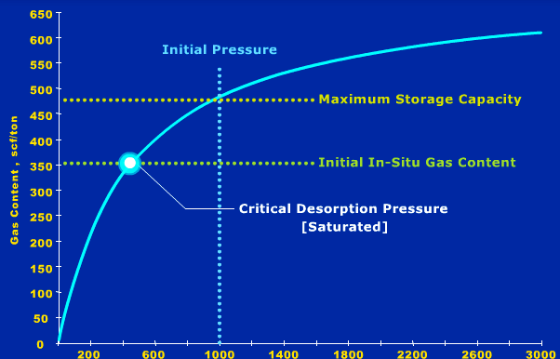


Slide 20
