Slide 1
Coupled Hydro-Mechanical Response of a dual porosity coal seam
EGEE 520
Shugang Wang
Notes:
Mere

Slide 2
Introduction
Dual porosity media
Matrix block 1: high porosity, low permeability
Fracture system 2: low porosity, high permeability
a
b
Migration process of gas in dual porosity coal seams
Notes:
Mere

Slide 3
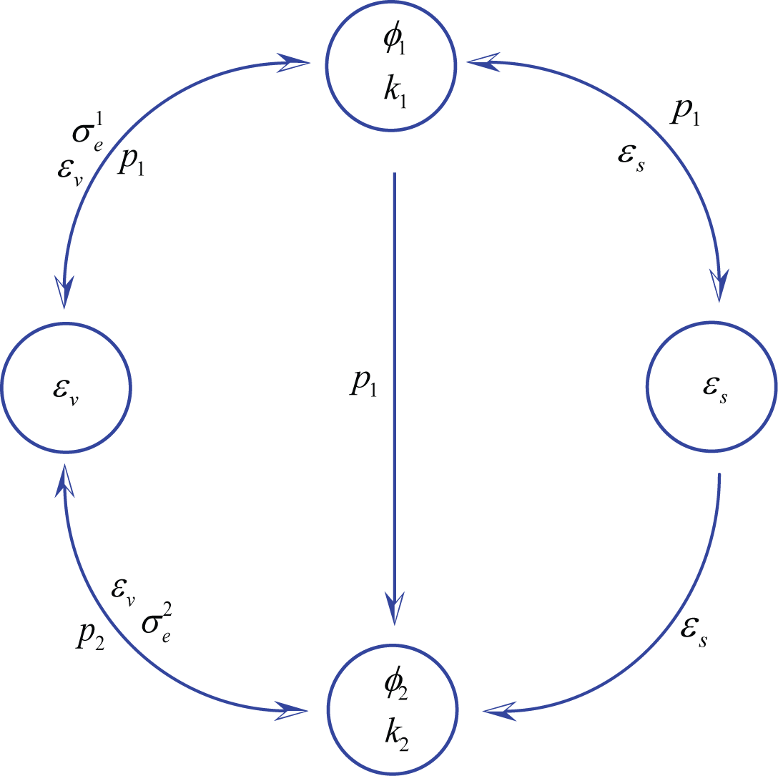
Introduction
Coupled physical behavior in dual porosity coal seams
Volumetric strain
Porosity of matrix
Permeability of matrix
Porosity of fracture
Permeability of fracture
Sorption or desorption
-induced strain

Slide 4
Governing Equations
Mechanical Behavior with hydrological and sorption effects
Hydrological Behavior
Matrix
Fracture

Slide 5
Formulation
Models
Axial Symmetric Stress-Strain → uaxi, w
Diffusion Equation (matrix) → p₁
Diffusion Equation (fracture) → p₂
BCs and ICs

Slide 6
Solution
Gas flow in matrix and fracture
Matrix pore pressure and permeability evolution

Slide 7
Solution
Matrix storativity and volumetric strain
Fracture pore pressure and permeability evolution

Slide 8
Validation
Pressure transient in a typical dual-porosity reservoir
Measured data
Calculation
slope change due to fluid supply from matrix to fractures
(Bai and Elsworth, 2000)
Pressure transient in a dual-porosity coal seam

Slide 9
Parametric study
Bulk modulus ratio
In situ stress
Fracture spacing

Slide 10
Conclusions and future work
Conclusions
Gas sorption or desorption is the primary mechanism for either gas sequestration (sorption) or production (desorption)
The greater the ratio of coal bulk modulus to coal grain modulus, the more rapid the reduction in matrix permeability ratio
The lower the in situ stresses, the more rapid the reduction in matrix permeability ratio
Injection-induced permeability within the fracture system initially increases and subsequently decreases as sorption induced stress builds up
Initial matrix permeability and fracture spacing has important effects on the timing of gas flow in matrix ( 1 -1 and 1 2)
Future work
Consider thermal effects
Image mechanical failure process under constant loading rate
Failure criterion
Damage factor

Slide 11
References
C Zhao, TP Xu, S Valliappan - Computers & structures, 1994
D Elsworth, M Bai - J. Geotech. Eng. Div., ASCE, 1992
GI Barrenblatt, P Zehltov Iu, IN Kochina – J Appl Math Mech, 1960
H Zhang, J Liu, D Elsworth - Int. J. Rock Mech., Min. Sci., 2008
I Gray - SPE Reserv. Eng, 1987
JE Warren, PJ Root - SPE Journal, 1963
JP Seidle, DJ Jeansonne, DJ Erickson - SPE, 1992
J Rutqvist, CF Tsang - Environ Geol , 2002
J Yi, IY Akkutlu, CÖ Karacan, CR Clarkson - Int J of Coal Geol , 2009
M Bai, D Elsworth, JC Roegiers - Water. Resour. Res., 2003
M Bai, D Elsworth, ASCE, 2000
S Valliappan, Z Wohua - J. Numer. Anal. Methods Geomech, 1996
S Harpalani, RA Schraufnagel - Fuel, 1990
S Harpalani, G Chen - Geotech. Geol. Eng, 1997
T Xu, CA Tang, TH Yang, WC Zhu, J Liu - Int. J. Rock Mech. Min. Sci., 2006
WC Zhu, J Liu, JC Sheng, D Elsworth - Int. J. Rock Mech. Min. Sci., 2007
YS Wu, K Pruess, Persoff - Transp. in P. Media. , 1998
Y Wu, J Liu, D Elsworth, in Submittal, 2009
Y Zhao, Y Hu, B Zhao, D Yang - Transp. in P. Media. , 2004
Y Zhao, Z Jin, J Sun – J Appl Math Mech, 1994

