Slide 1
Application of smooth particle hydrodynamics on biomass burning
Egee 520
Spring 2007
Victor Fernandez-Alos

Slide 2
Smooth Particle Hydrodynamics
Invented to simulate astrophysical problems*
Smooth = Weight average over the neighboring particles for stability.
Particle = Capable of moving in space, carry all the computational information.
Hydrodynamics = Combination of adaptive, Lagrangian and particle nature.
* Lucy, 1977; Gingold and Monaghan, 1977.

Slide 3
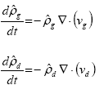
Continuity Equations
Assume that the gas does not condensate.
The dusty gas is included as two interpenetrating fluids which interacts via pressure and drag conditions

Slide 4
SPH equations
In order to build SPH equations which conserve linear and angular momentum, the pressure terms needs to be writing in the forms of..
Gas particles
Dust particles

Slide 5
Energy equations
All the drag dissipation goes into gas thermal energy, therefore the rate of SPH particles is presented.
Heat transport

Slide 6
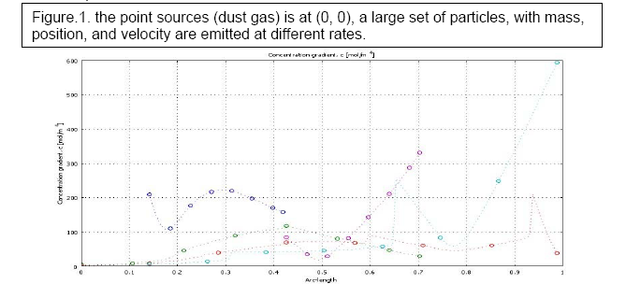
A large set of particles…
ma
gravity
va

Slide 7
Validation

Slide 8
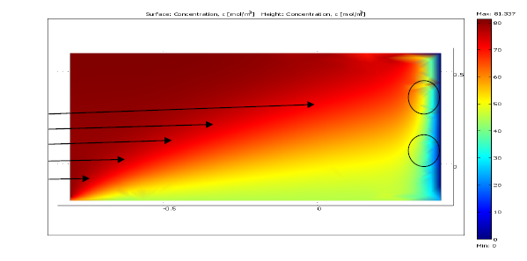
Results
Figure 5, Wildfire propagation, the red zone high concentration of pollutants, dust particles interacting with gas particles.
Eddies
Wind flow
Point Source

Slide 9
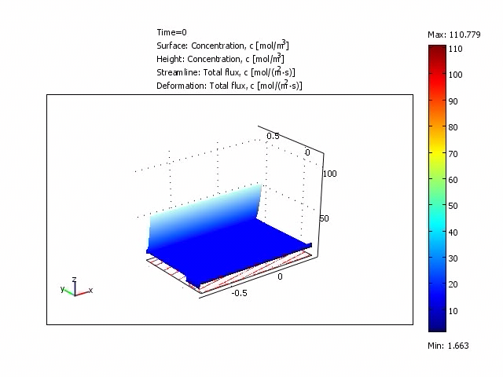
Movie

Slide 10
Conclusion
The collective movement of those particles is similar to the movement of a liquid or a gas flow, therefore it can be modeled by the using the classical Newtonian Hydrodynamic
THANK YOU

