Slide 1

Accessibility Update
September 2026

Slide 2
Reminder…Some Caveats
This only includes Ally scores
Ally only finds about 80% of issues
Does not include textbooks, publisher materials, external content, etc.
Does include unpublished material in Canvas
Remember: Aperture Analytics has your Ally scores for each and every course
Notes:
Cannot find

Slide 3
Current State: Fall 2026

Slide 4
Enrollments impacted above, near, and below benchmark (90% or above)

Slide 5
Enrollments by Accessibility Level

Slide 6
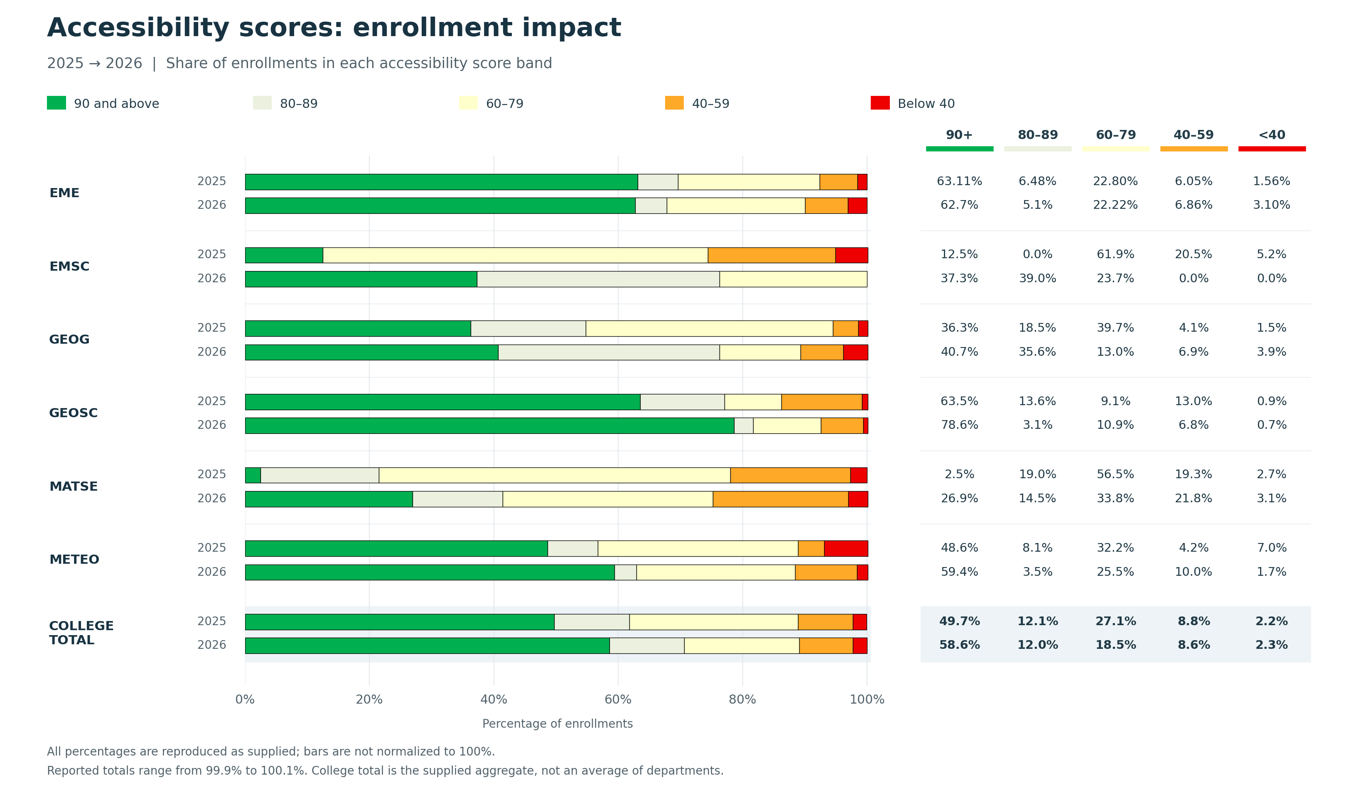
Fall 2025 to Fall 2026

Slide 7
EMS Websites

Slide 8
Training
Training Conducted
  Word Accessibility Training
  PPT Accessibility
  Email Accessibility
Future Training
  Mailchimp Accessibility
  Social Media Accessibility (poss.)
  The Five Minute Fix

Slide 9
Future Plans
Accessibility Site
Short-form and Long-form Videos
Other ideas?

Slide 10
How can we make this less stressful?
What else do people need, or need to know?
How can we make this less overwhelming?
Anything else I need to know?

