Slide 1
Grow Your Skills.
Strengthen Your Impact.
Your Penn State learning & development resources
Linda Ebsworth, Manager, Talent Management Learning & Development
Shelley Miller, Talent Management Specialist

Slide 2


Talent Management -- Human Resources
Supporting Penn State employees in learning, growing, and developing throughout their careers.
Individual Development
Build skills, expand knowledge, and support your professional development.
Leadership Development
Develop the skills and capabilities needed to lead yourself, others, and the University.

Slide 3
Individual Development Programs (IDPs)
SUBJECTS:
Accountability
Career
Change MAanagement
Communications
Conflict Management
Critical Thinking
Customer Relations
D.E.I.B.
Health & Wellbeing
Leadership & Management
Meeting Skills
Personal Effectiveness
Project Management
Teamwork
Time Management
Working at Penn State
Live, Online & Free
Open to all Penn State employees

Slide 4
Your Starting Point to Explore IDPs
Visit the Talent Management Website - Instructor-Led/Upcoming Programs
  ✅ Browse current semester offerings
  ✅ Search by keyword
  ✅ Sort by date
  ✅ Sort by Subject
Found something interesting?
Click the title and you'll be taken directly to the LRN to register.
https://bit.ly/4xWcwU1

Slide 5
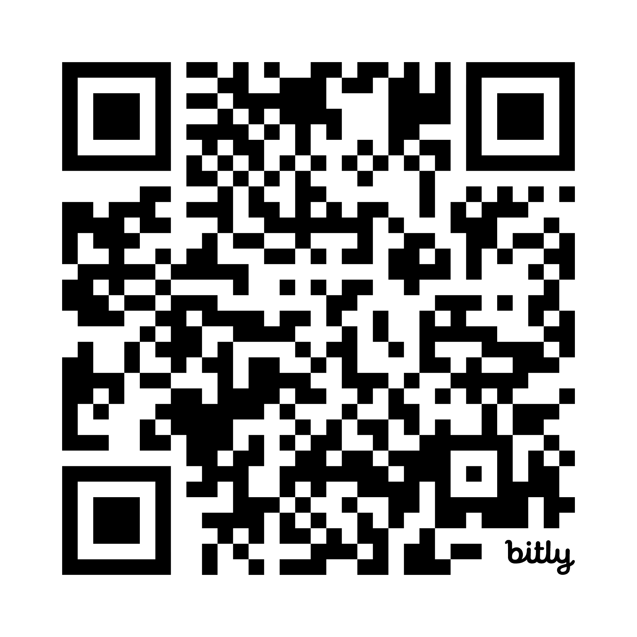
A Few Featured Opportunities
❤️ SupportLinc Wellbeing Webinars
Monthly live webinars focused on:
• Mental Health
• Resilience
• Stress Management
• Work-Life Integration
• Emotional Wellbeing
PSU Employee Assistance Program (EAP)
Offers free legal and financial consultation, fitness coaching, and more!
⚡ Change in 30
Short, practical 45-minute learning sessions focused on navigating change.
  Communicating Change
  Resisting Change
  Energy and Change
EXPLORE THE FULL LIST OF IDPs:
https://bit.ly/4xNppQx

Slide 6
Learning Resource Network:
Penn State’s Staff Learning Hub
Free Program Providers*
Talent Management
Professional, personal & leadership development
IT Learning & Development
Technology, systems & IT skills
Skillsoft & LinkedIn Learning Vendors
Vendors utilized to provide thousands of self-paced online courses, videos & e-Books
Use LRN To…
✅ Register for instructor-led training
✅ Launch self-paced courses & videos
✅ Access e-books & audiobooks
✅ Track learning activities
*Note: There are other providers of events & learning in the LRN. Some are unit/role based and others have a cost – which are not reflected here.

Slide 7
LEADERSHIP PROGRAMS

Slide 8

Leadership Development at Penn State
Growing Leaders at Every Level
Leadership opportunities for:
🌱 Emerging Leaders
👥 New Supervisors
⭐ Experienced Managers
🚀 Future Leaders

Slide 9

Leadership Foundations
Penn State Emerging Leaders (PSEL)
A cohort-based leadership development experience designed to build leadership capability and effectiveness.
Participants:
  ✅ Develop leadership competencies
  ✅ Expand self-awareness
  ✅ Strengthen leadership effectiveness
  ✅ Build connections across the University
Interested? Expression of Interest Form

Slide 10


Leadership Foundations
(Continued)
Management Concepts
Practical leadership and supervisory development
Management Playbook
A growing collection of resources and guidance for leaders.

Slide 11
How Do I Know What's Available?
🌐 Bookmark the Talent Management Learning & Development Website
  Your year-round starting point for Talent Management opportunities.
  http://hr.psu.edu/current-employee/your-career/learn-dev
📅 Watch for Semester Announcements
  Spring Programs: January
  Fall Programs: August
  Arrives via university-wide mass email
📬 Join Our Talent Management Newsletter Listserv
  Receive updates every couple of months.
  No inbox overload. 😊
  l-hr-talentmgmt-subscribe-request@lists.psu.edu
💻 Search the LRN Anytime
  Find live learning opportunities like our instructor-led programs
  And thousands of self-paced resources.

Slide 12
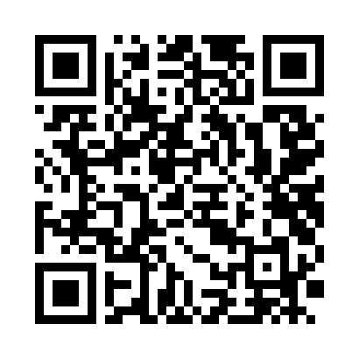
Grow Your Skills…Strengthen Your Impact
Start Exploring Free Professional Development Opportunities
HR Talent Management • Learning & Development
7 | Talent Management • Human Resources

