Slide 1
EMS Faculty, Staff, and Postdocs
Spring Meeting
Thursday, April 17, 2025
3:00 – 4:30 pm
603 Barron Innovation Hub

Slide 2
Welcome!

Slide 3
Introduction of New Hires

Slide 4
New Staff
Undergraduate Education | Dean's Office | Development and Alumni Relations | Dutton Institute | Earth and Environmental Systems Institute
Kelly Hoff Jaclyn Stimely | Brian Bills | Erin Hale Lindsay Levine | Olivia Fessler Wynter Adams | Angie Miller Bethany DiLello Alexandra Lloyd

Slide 5
New Staff 2
Educational Equity | EMS Energy Institute | Energy and Mineral Engineering | Finance
Spencer Belnap | Dawn Weber Steven Bierly | Stephanie Crabtree | Kati Taylor Samantha Yon

Slide 6
New Staff 3
Information Technology | Geosciences | Materials Science and Engineering | Research
Aaron Shbeeb Cole Vaughn | Bill Ballock Chanel Lange-Maney | Viktoria Brown Charles Romig | Jenifer Hoffman

Slide 7
New Postdocs
Earth and Environmental Systems Institute | EMS Energy Institute | Energy and Mineral Engineering
Tiago Outerelo Corvo Nicholas Sullivan | Sikandar Azam Emmanuel Ajiboye Qitao Zhang Venkateswara Rao Chebrolu | Ming Ma

Slide 8
New Postdocs 2
Geography | Geosciences | Materials Science and Engineering
John Kendall | Rebecca Bussard Abhijeet Abhishek Zhinong Wang | Tainara Coutinho de Carvalho Ajinkya Hire Li Li

Slide 9
New Faculty
Earth and Environmental Systems Institute | Energy and Mineral Engineering | Geography
Michael Robbins | Jennifer Clemons Maruf Morshed Amin Kordestany | Jared Whear Alicia Iverson Bing Zhou Yan Lin

Slide 10
New Faculty 2
Geosciences | Materials Science and Engineering
Nicolas Choquette-Levy | Saeed Almishal

Slide 11
Staff Retirees
Dutton Institute | Earth and Environmental Systems Institute | EMS Energy Institute
Sue Spaugh Tina Vancas | Micki Bower | Kelly Rhoades

Slide 12
Staff Retirees 2
Information Technology | Materials Science and Engineering | Meteorology and Atmospheric Science
Todd Shamory | Scott Henninger | Robert Ziegler

Slide 13
Faculty Retirees
EMS Energy Institute | Energy and Mineral Engineering | Geography
Bruce Miller Ronald Wasco | Serguei Lvov | James Detweiler

Slide 14
Faculty Retirees 2
Geosciences | Meteorology and Atmospheric Science
Susan Brantley | Jenni Evans

Slide 15
Announcements

Slide 16
DOJ New Accessibility Rule

Slide 17
New DOJ Rule on Web/ Document/Application Accessibility
Final rule updating regulations for Title II of the Americans with Disabilities Act (ADA)

Slide 18
What is the point of the new rule?
Ensure that the services, programs, and activities offered by State and local government entities to the public via web content and mobile apps are accessible to individuals with disabilities
Yes, this includes Penn State!

Slide 19
Why is it needed?
Closes a gap in the ADA
Digital accessibility previously implied but not explicitly mandated
Creates a uniform approach to ADA compliance

Slide 20

What is the rule we need to follow?
Web Content Accessibility Guidelines (WCAG) 2.1 at the AA level
Guidelines for making content and applications usable for everyone!
Notes:
Reminder that these handles make it easier for everyone—not just people who need the accommodations

Slide 21
What’s covered?
Website text, images, sounds, videos, controls, and animations
Electronic documents, including documents, PDFs, presentation files, and spreadsheets
Applications designed to run on mobile devices
Notes:
Like word or Pages

Slide 22
What are some things that I will have to do?
Use proper headings in all documents
01
Make sure content can be navigated using the keyboard instead of a mouse
04
Include short alternative text or long descriptions for images
02
Properly create PDFs (character recognition/OCR, tagging)
03
Notes:
Don’t save as PDF, instead Export as PDF after you’re sure you have proper headings and alt text. For new files, use create PDF from file so that tagging is included.

Slide 23

What else will I need to do?
Accurate captions for videos (>99%)
Audio description or written description for videos
Colors that have a contrast of 4.5:1
No images that are just text
Credit: Accessibility @ MC Blog, Montgomery College

Slide 24
How long do I have to do this?
April 24, 2026
Notes:
Progress, not perfection, is the goal

Slide 25
Are there any exceptions?
Archived content
  No longer altered, edited, or used
  Organized and stored in a dedicated area identified as an archive
Preexisting conventional electronic documents (unless these documents are needed to participate in services offered)
Third-party content (unless contracted or provided as an agreement with PSU)
Individualized, password-protected documents
Preexisting social media posts
Notes:
The minute you edit, it’s no longer archived
If the older documents are needed, you have to mitigate them
And that means library databases with peer-reviewed Journals that are PDFs
Unless the individual needs an accommodation – individualized means one person—not a class or group of people

Slide 26

What if It’s Impossible?
Equally Effective Alternative Access Plan (EEAAP)
  Comparable time
  Comparable effort

Slide 27
What happens if we don’t do this?

Slide 28
Non-compliance may result in:
Legal penalties
Reputational damage
Most importantly, the exclusion of people with disabilities from accessing Penn State’s digital resources.
Ensuring all content is accessible is crucial to avoiding these consequences and maintaining an accessible digital environment.

Slide 29
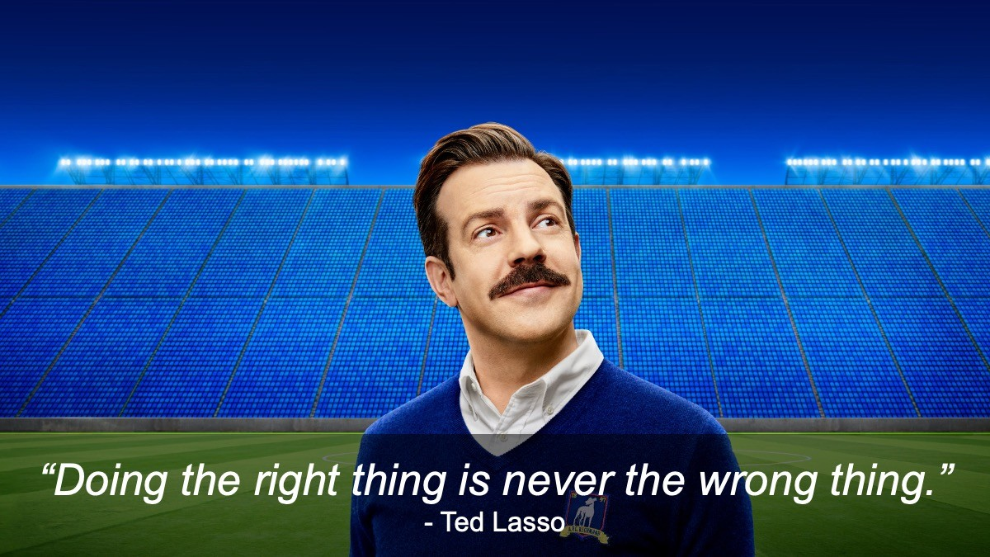
It’s the right thing to do

Slide 30
Strategic Communications

Slide 31
Role of EMS Communicators
Committee of unit webmasters will be convened to participate in trainings beginning in May - Cynde Fleagle will be leading this effort
Responsible for reviewing official unit websites, including the documents and multimedia posted on them, to ensure they meet WCAG 2.1 AA standards

Slide 32
Role of EMS Communicators 2
NOTE: Faculty will be responsible to checking all of their research, centers, and lab websites (with a psu.edu extension) for compliance, including ones hosted on the Penn State Sites platform
Hosting office drop-in hours to advise faculty on accessibility requirements and how to best achieve them

Slide 33
Prevention over Mitigation

Slide 34
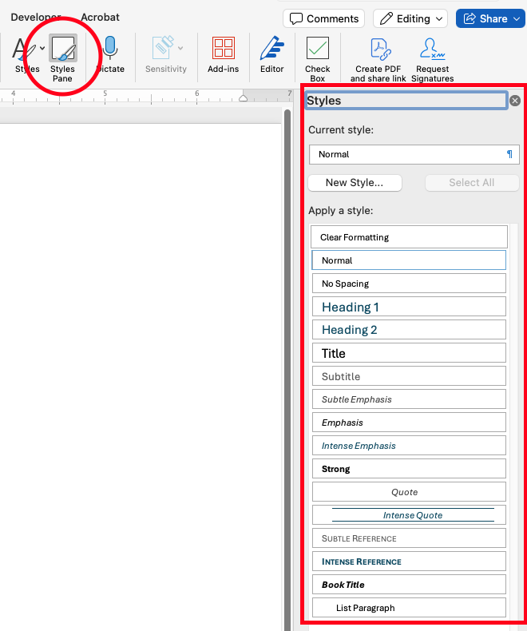
How do I do this?
Use the styles pane to create headings
Add Alternative text to images
Use descriptive text for links instead of the link itself

Slide 35
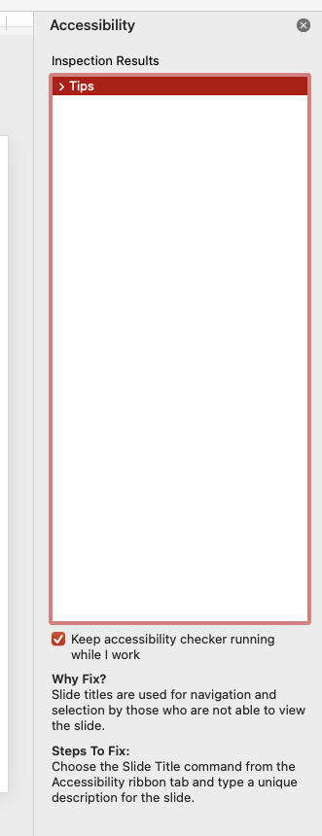
What else?
Use the accessibility checker (Tools > Check accessibility)
Ensure tables are formatted with headers and have a caption
Use the Tab button to see reading order of slides (and to make sure you don’t have any blank boxes hanging out there)

Slide 36
How can I learn more?
Open office hours May 12-16 with Dutton Institute
Training via LRN or PSU IT
Accessibility Learning Path

Slide 37
Progress, not Perfection

Slide 38
Parameters for Prioritization
Dutton Institute will mitigate fully online courses in the online portfolio
Factors Departments should consider for classes:
Largest Enrollment
General Education
Requirement in Major
Offered as Hybrid or Online Course

Slide 39
Other Elements to Consider
Technologies used
Course materials (videos, textbooks, readings, etc.)
Lecture slides
Activities and Assignments
Images, diagrams
Charts, graphs, tables
Technical symbols
Mathematical equations (Equatio)

Slide 40
Questions?
Cynde Fleagle – cys7@psu.edu
Stevie Rocco – stevier@psu.edu
Patty Craig – plc103@psu.edu

Slide 41
Transition Management

Slide 42
State of College and Q&A

Slide 43
Closing Remarks

