Slide 1



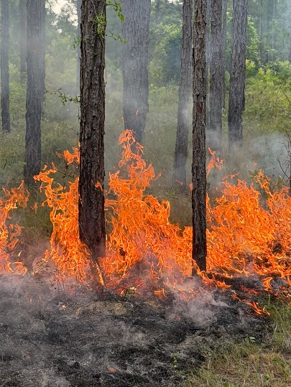

Erica Smithwick Distinguished Professor of Geography
Erica Smithwick
Distinguished Professor of Geography
Director, Earth and Environmental Systems Institute
Director, Penn State Climate Consortium
Penn State University
“This research is funded through the U.S. National Science Foundation (NSF) Fire Science Innovations through Research and Education (FIRE) program, a collaboration among NSF, NASA, DOD SERDP/ESTCP and the Gordon and Betty Moore Foundation to advance wildland fire research.”

Slide 2











The EFNet Team
Erica Smithwick
Penn State
University
Manzhu Yu
Penn State
University
Victoria Donovan
University of Florida
Carissa Wonkka
University of Florida
Kevin Robertson
Tall Timbers
Research Station
Shannon Ranio
Penn State
Winslow Hansen
Cary Institute of Ecosystem Studies
Neil Pederson
Research Scientist
Avriel Diaz
Global Council for Science and the Environment
Robert Scheller
North Carolina
State University
Richard Seager
Lamont-Doherty
Earth Observatory

Slide 3

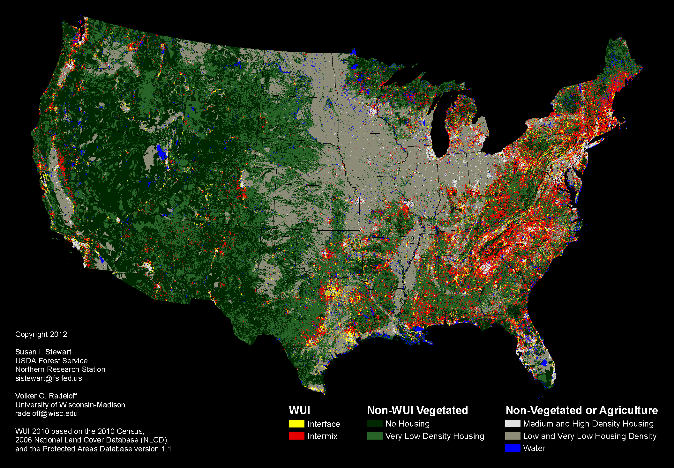
WUI
WUI

Slide 4
Text description of WUI Map
A map of the contiguous United States classifies land according to wildland-urban interface, or WUI, status and other land-cover and housing-density categories.
WUI: Interface areas are shown in yellow and intermix areas in red. These areas are especially dense throughout much of the eastern United States, with additional concentrations along the West Coast and around developed areas in the West.
Non-WUI Vegetated: Areas with no housing are shown in dark green, and very low-density housing areas in lighter green. Large expanses occur throughout the western United States.
Non-Vegetated or Agriculture: Medium- and high-density housing areas are shown in light gray, and low- and very low-density housing areas in gray. These categories cover extensive portions of the central United States and occur elsewhere throughout the country.
Water: Water is shown in blue.
Copyright 2012, USDA Forest Service

Slide 5
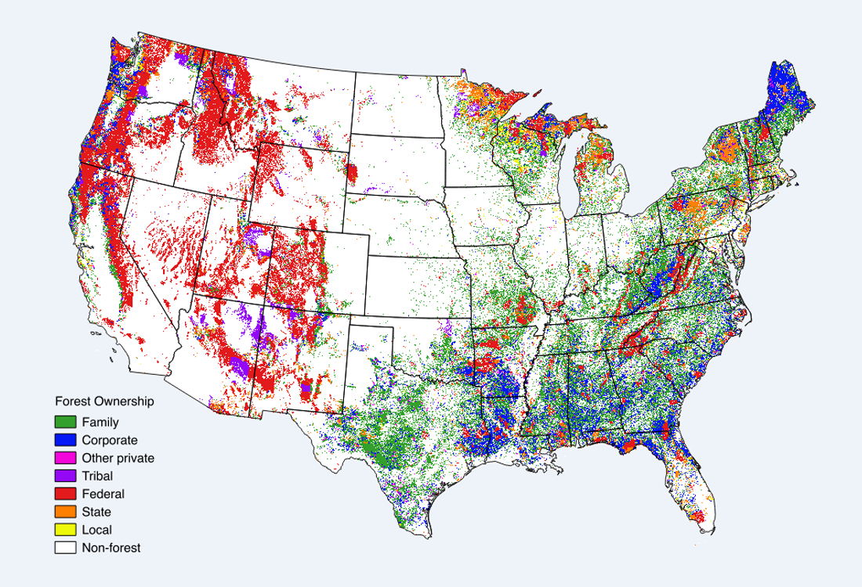
Complex Land Ownership
Complex Land Ownership​
https://www.fs.fed.us/sites/default/files/forest-ownership-map.png

Slide 6
Long-text description of Complex Land Ownership Image
A map of the contiguous United States showing the geographic distribution of forest land by ownership category. State boundaries are outlined. Areas without forest are left unmarked. Forest ownership appears as many small, densely distributed areas across the country.
Family: Forest areas shown in green, widespread especially across the eastern and southern United States and parts of the West.
Corporate: Forest areas shown in blue, concentrated heavily in the Southeast, portions of the Northeast, and scattered areas elsewhere.
Other private: Forest areas shown in magenta, scattered throughout forested regions.
Tribal: Forest areas shown in purple, with notable concentrations in parts of the western United States.
Federal: Forest areas shown in red, with extensive concentrations throughout the mountainous West and additional areas elsewhere.
State: Forest areas shown in orange, scattered across the country, including concentrations in portions of the upper Midwest and Northeast.
Local: Forest areas shown in yellow, scattered in relatively small areas.
Non-forest: Areas shown without a forest-ownership color.
The western United States contains large concentrations of federally owned forest, while the eastern and southern states contain dense mixtures of family, corporate, and other ownership categories.

Slide 7
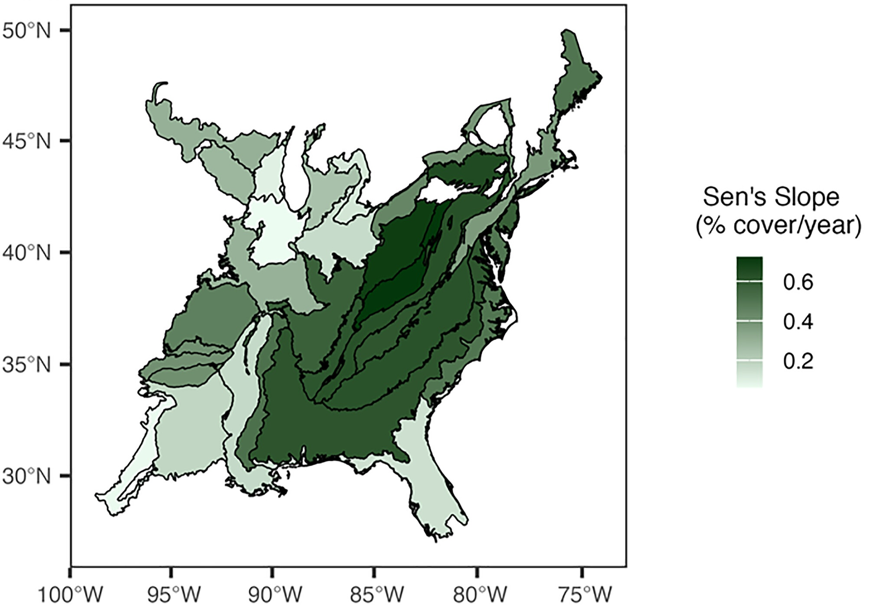

Woody Cover
Woody cover is significantly increasing across every ecoregion in the eastern U.S.
Michaella Ivey
Ivey et al., 2024, Geophysical Research Letters

Slide 8
Text Description of Woody Cover Image
A map of the eastern United States displays geographic variation in Sen slope, measured as percent cover per year. The mapped area extends approximately from 100°W to 75°W longitude and from below 30°N to 50°N latitude.
Areas are divided into irregular geographic regions and shaded according to their Sen slope values. The legend ranges from light shading for lower values to dark shading for higher values. The darkest, highest-value areas form a broad connected region extending from the south-central portion of the map northeastward through the Appalachian region. Lighter values occur in several surrounding regions, particularly toward portions of the western, northern, and southeastern edges of the mapped area.

Slide 9
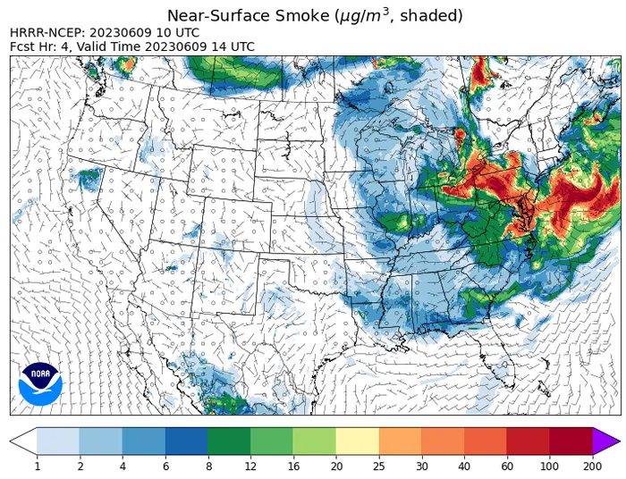
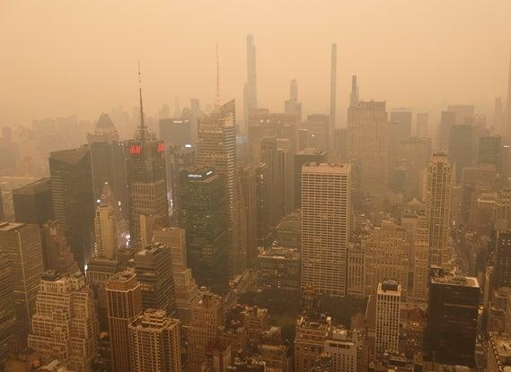
2023 Canadian Wildfire Smoke

Slide 10
Text Description of NOAA map showing smoke cover
A NOAA HRRR-NCEP forecast map shows near-surface smoke concentration in micrograms per cubic meter across the contiguous United States and adjacent areas, valid at 14 UTC on June 9, 2023.
Smoke concentrations are indicated by a scale ranging from 1 to 200 micrograms per cubic meter, with an additional category above 200. Large areas of smoke extend from the upper Midwest and Great Lakes through the eastern United States and into the Atlantic. The highest concentrations, corresponding to approximately 60 to 200 micrograms per cubic meter or greater, occur in portions of the northeastern and Mid-Atlantic United States and over nearby Atlantic waters. Lower concentrations extend south and west through the Midwest, Mississippi Valley, and southeastern states. Much of the western United States has little or no shaded smoke concentration, apart from scattered localized areas.
Wind symbols and state and national boundaries are superimposed on the map. A NOAA logo appears near the lower-left corner.

Slide 11
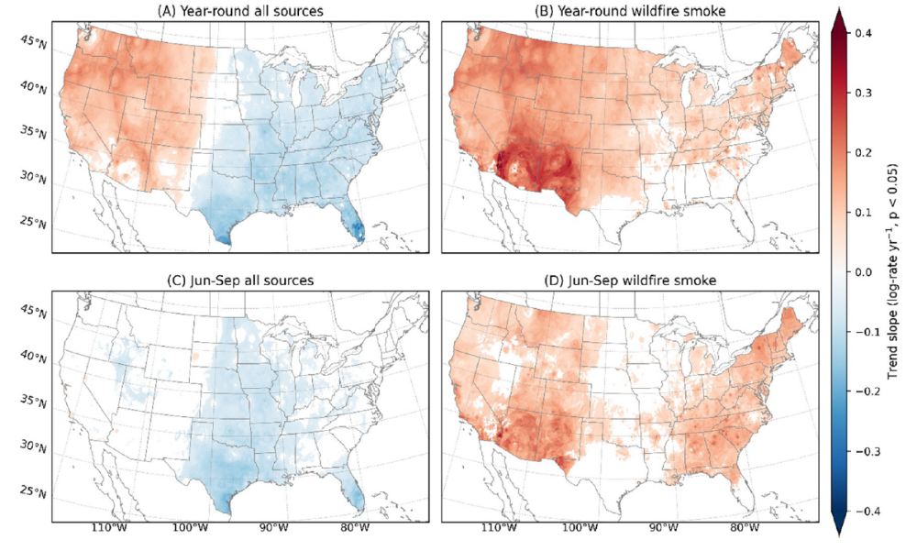
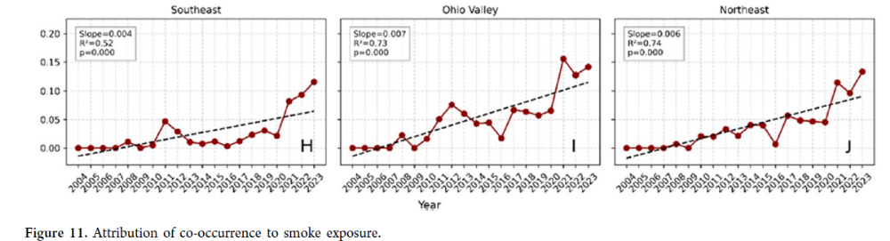
Increasing Wildfire Smoke
Spatiotemporal Trends in PM2.5-ozone co-occurrence frequency (2004-2023)
Yu et al. Environmental Science & Technology 2026

Slide 12
Text description for Increasing Wildfire Smoke images
Four maps Image: Four maps of the contiguous United States comparing trends in smoke from all sources with wildfire smoke. The maps are arranged in two rows.
A. Year-round all sources: Much of the western United States shows increasing trends, while broad portions of the central, southern, and eastern United States show decreasing trends.
B. Year-round wildfire smoke: Increasing trends cover much of the country. The strongest increases appear in parts of the Southwest, with additional increases across the West, central United States, and Northeast.
C. Jun-Sep all sources: Decreasing trends occur across much of the central and eastern United States. Areas of increase are more limited and scattered.
D. Jun-Sep wildfire smoke: Increasing trends are widespread across the western, central, and eastern United States, with variation in intensity.
A vertical scale beside the maps ranges from −0.4 to 0.4. Blue represents negative trends, white represents values near zero, and red represents positive trends.
Line graph image: A line graph labeled Northeast shows annual PM2.5-ozone co-occurrence frequency from 2004 through 2023. A dark red line with circular markers represents annual values, while a black dashed line shows the overall trend.
Values generally rise over the 20-year period, with year-to-year fluctuations. The series begins relatively low and nearly level from 2004 through the late 2000s, then generally increases through the early and mid-2010s. A pronounced decline occurs around 2016, followed by a rebound in 2017. Values fluctuate through 2020, rise sharply in 2021, decline in 2022, and reach their highest displayed level in 2023.
The graph reports a slope of 0.006, R² of 0.74, and p-value of 0.000.
Below the graph on the slide is the caption Spatiotemporal Trends in PM2.5-ozone co-occurrence frequency (2004-2023).

Slide 13
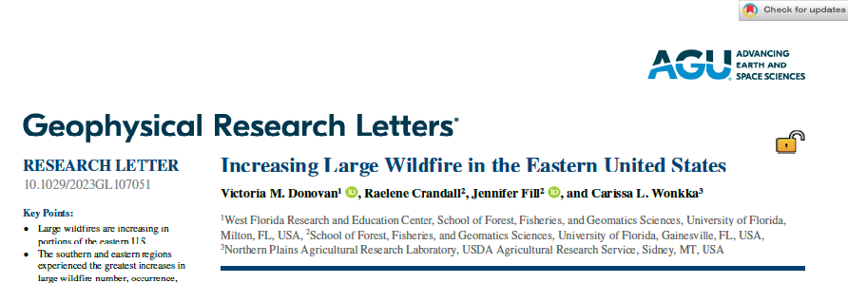
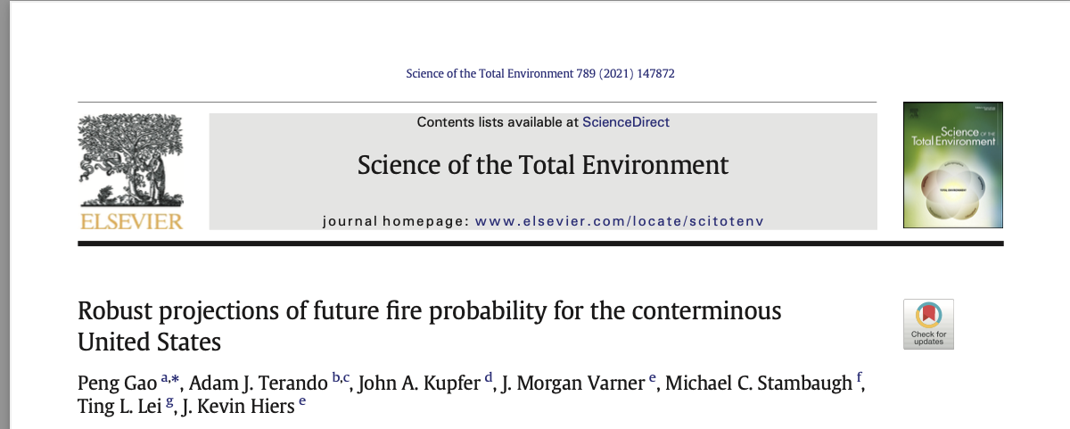
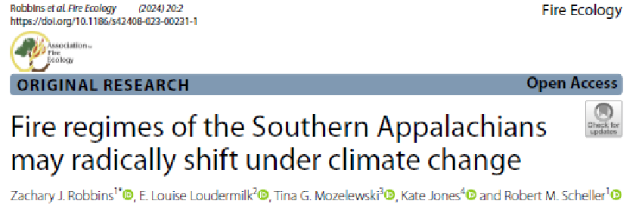
Motivation: Increasing Risk

Slide 14
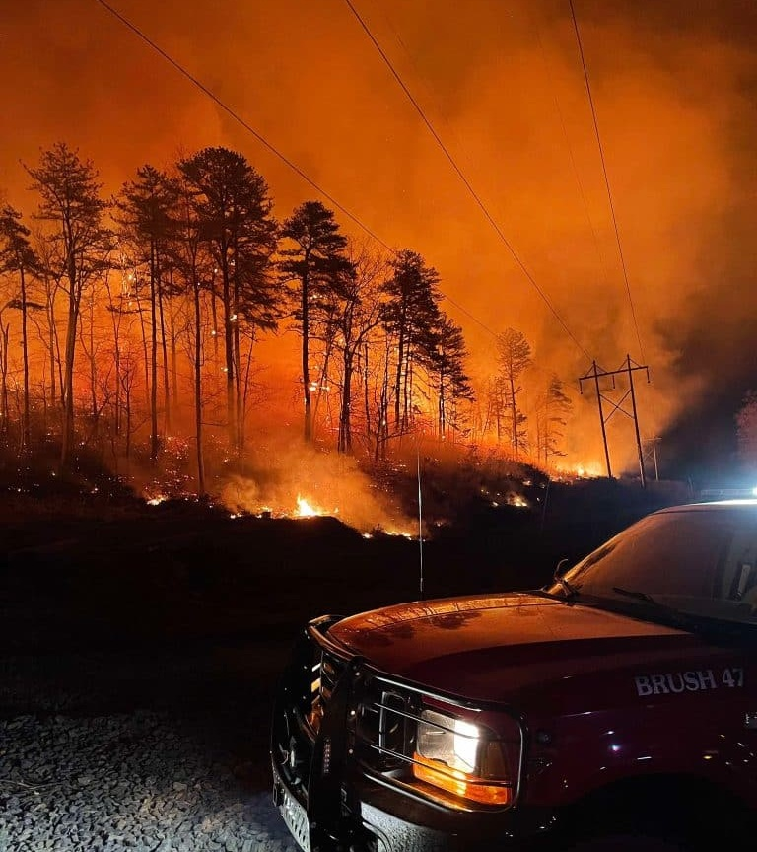
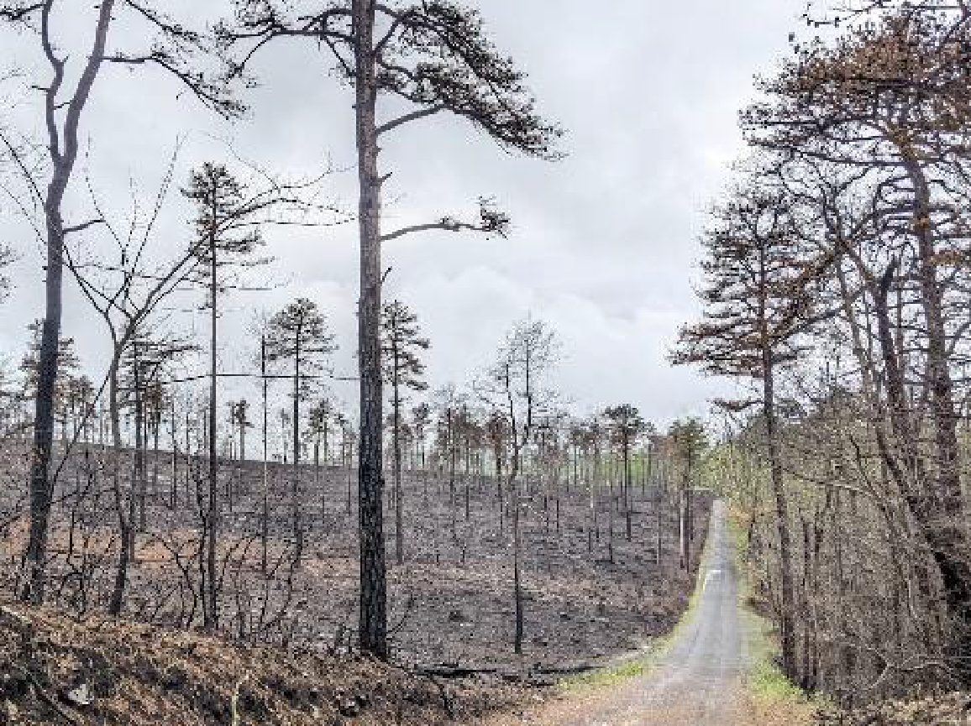
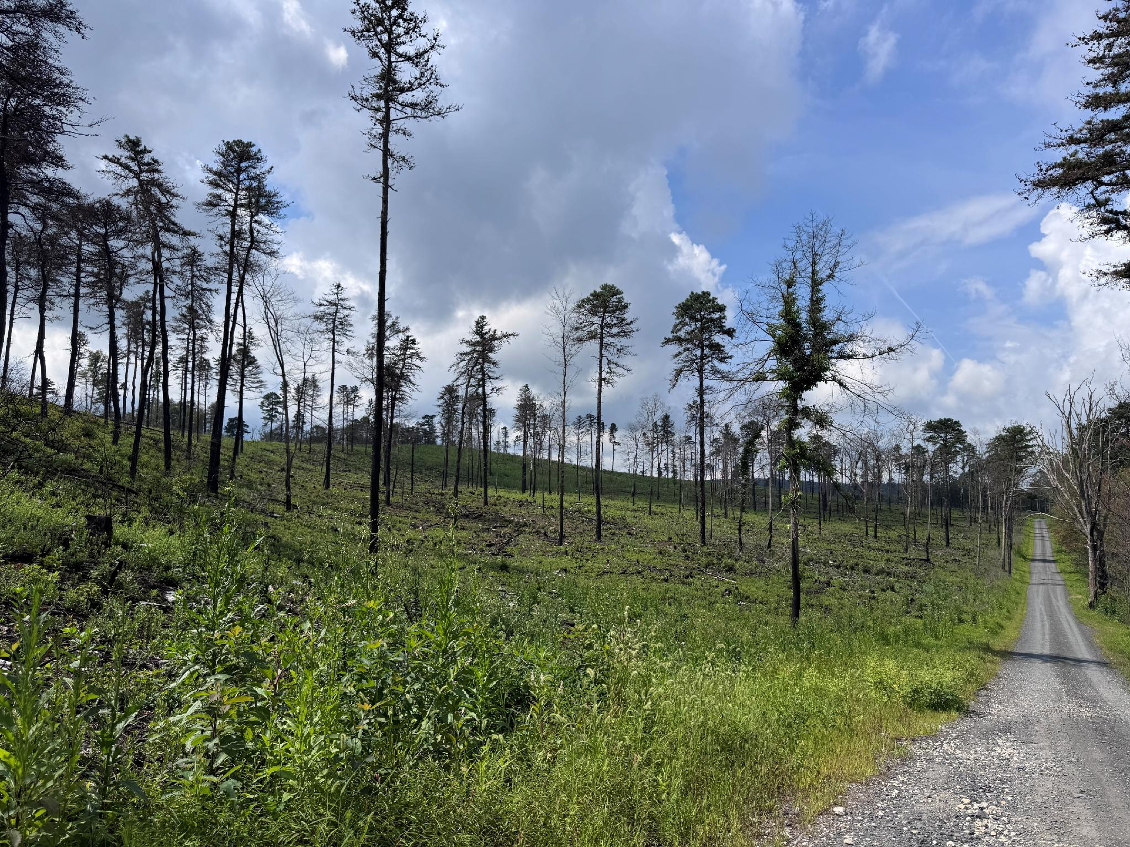
Thompson Hollow Fire, PA
Photo credit: Jesse Kreye and Arun Regmi

Slide 15
Guiding Questions
Under what conditions and where would wildfire risks be elevated or not?
How likely are these conditions in the future? What do we know/not know?
What data/indices/tools are needed to help make better forecasts of risks and impacts?

Slide 16
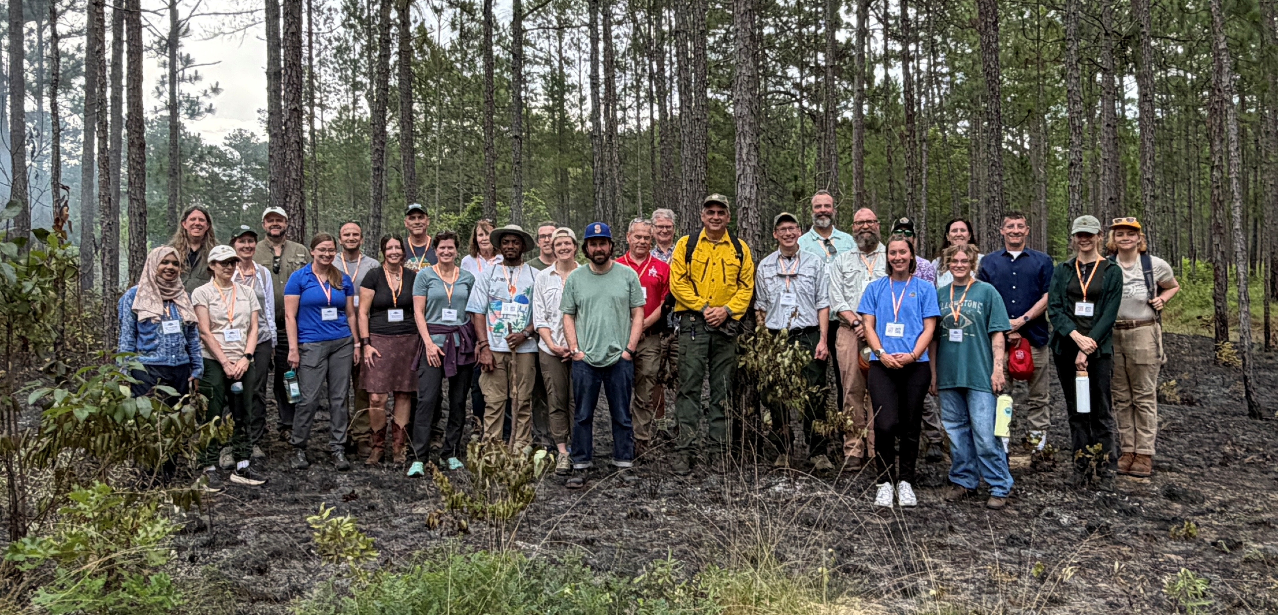
Transdisciplinary Approach [Workshops!]

Slide 17
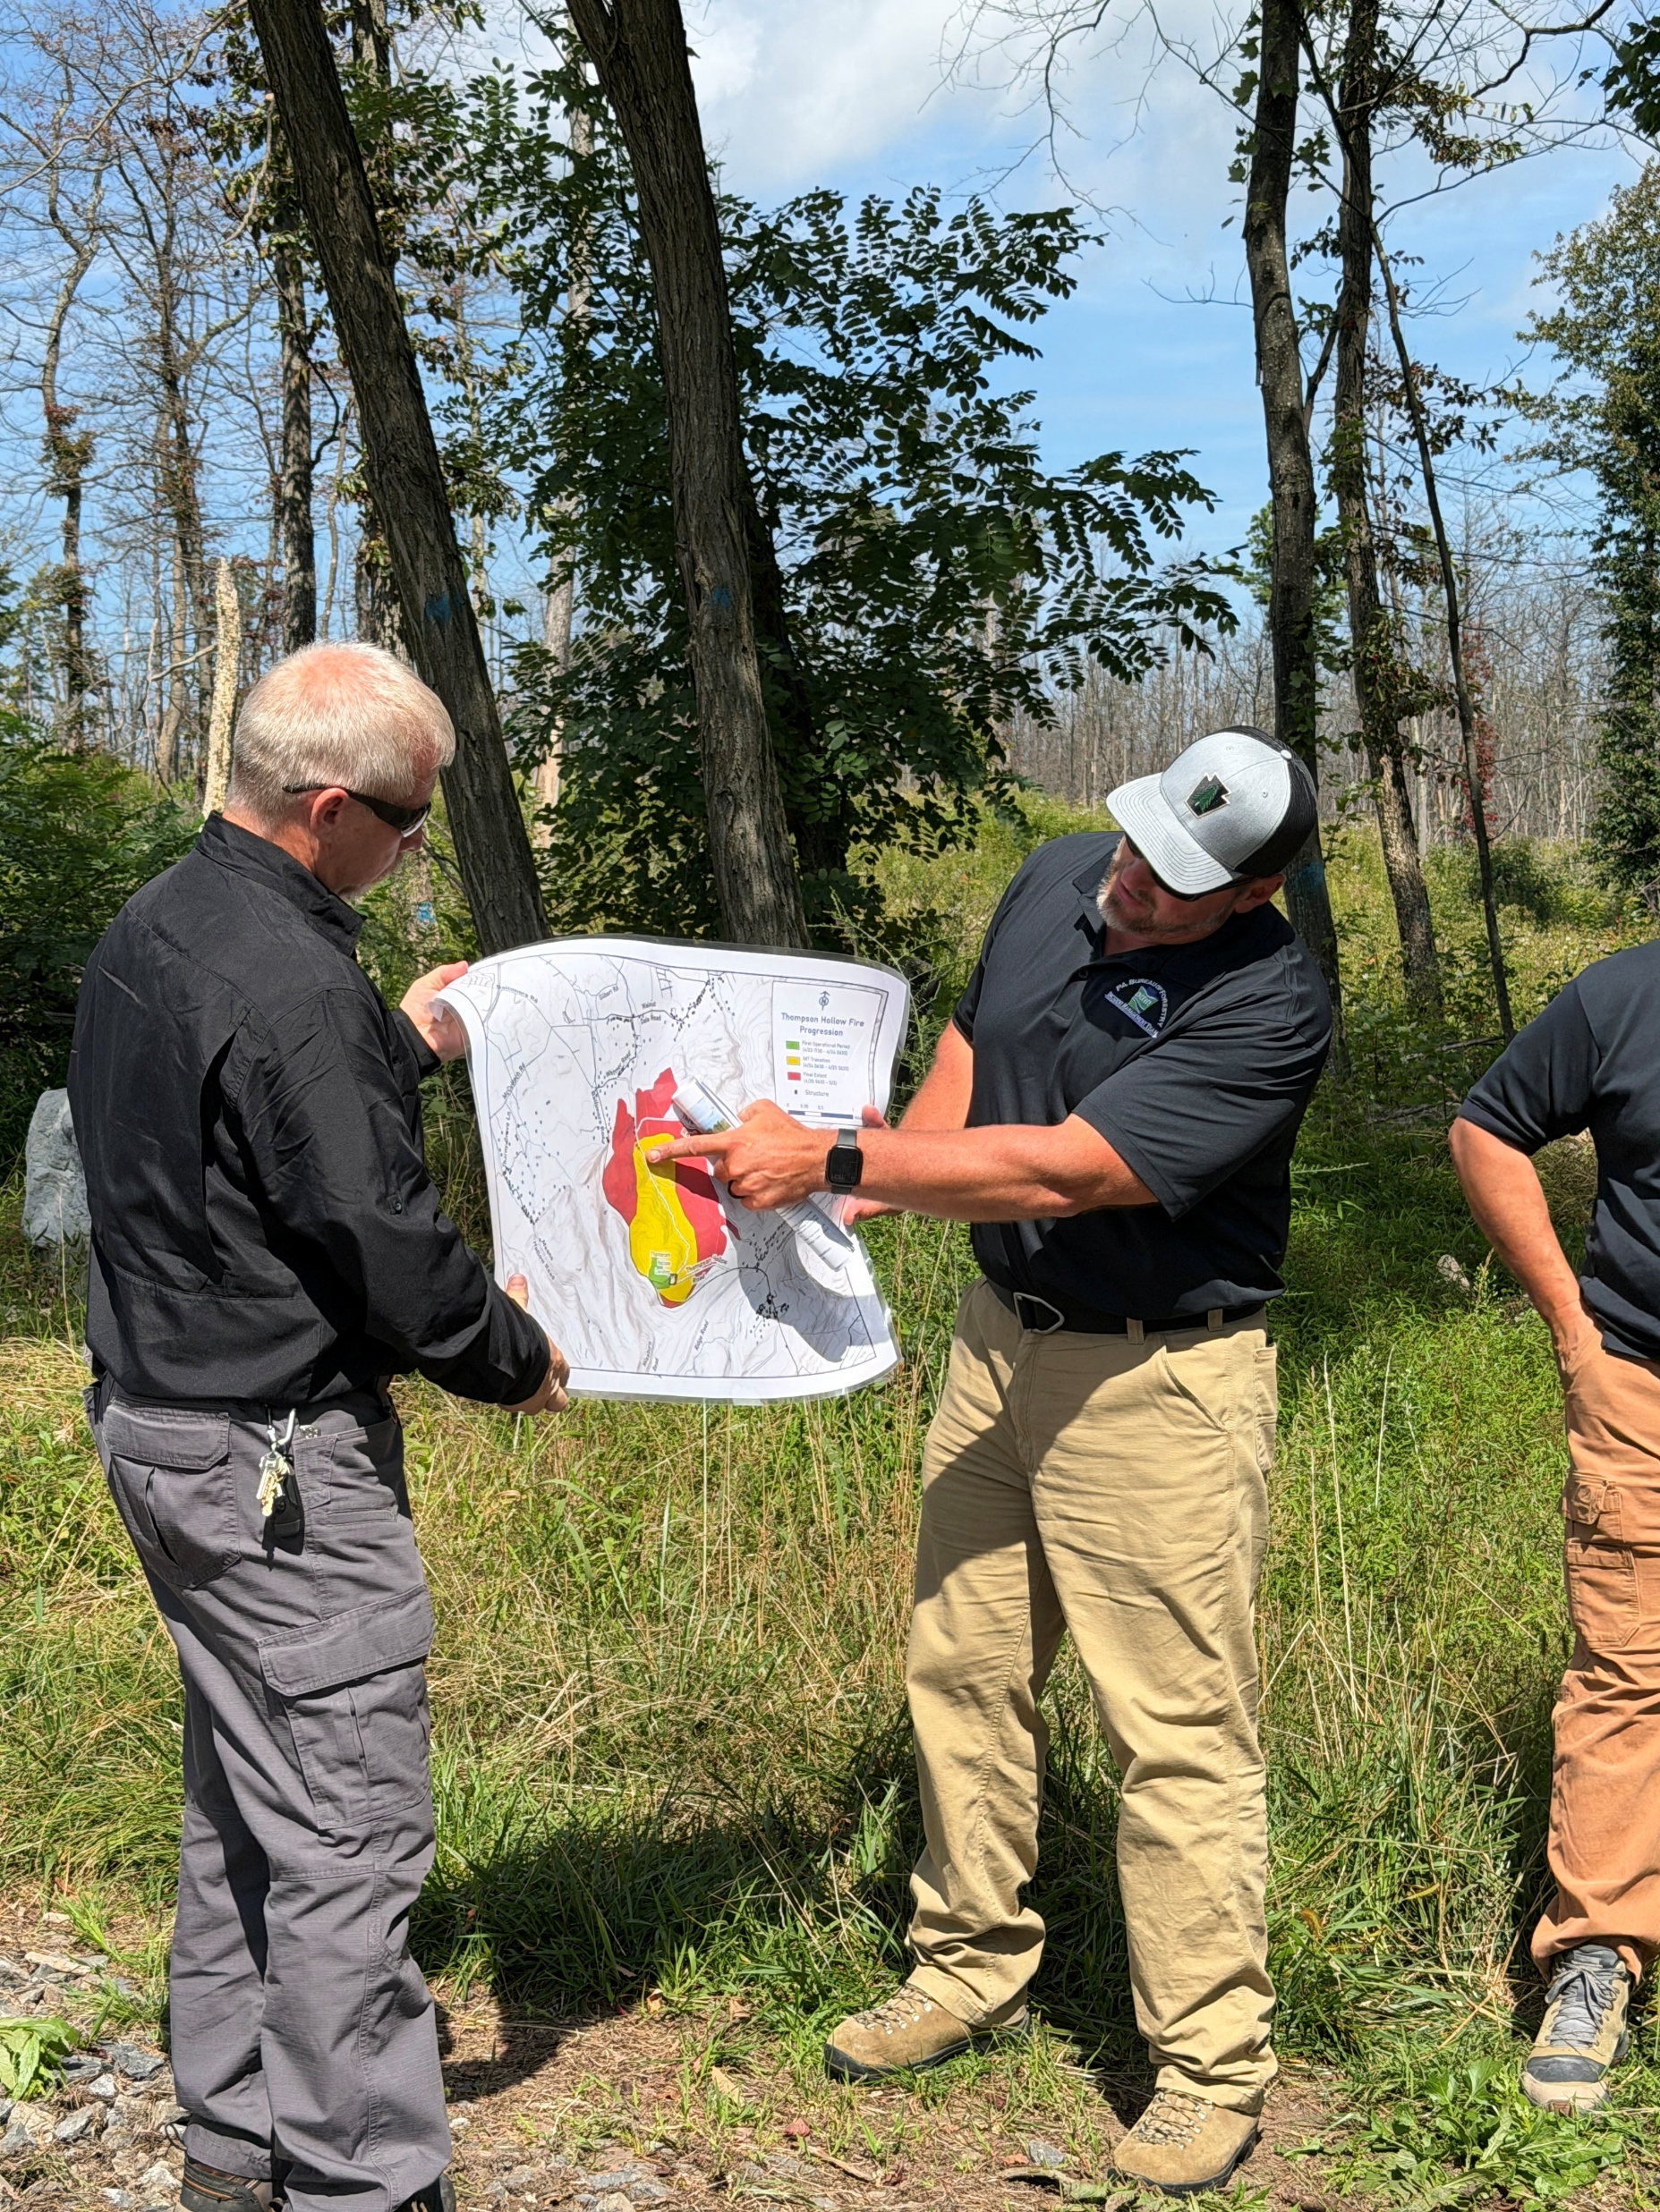
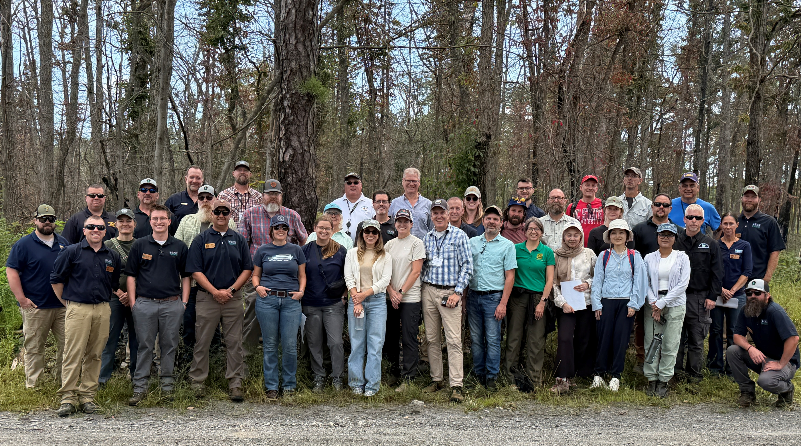
Transdisciplinary Workshop #2

Slide 18

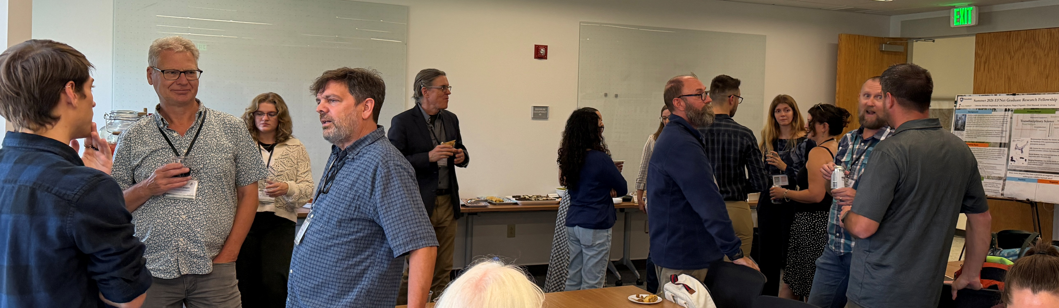
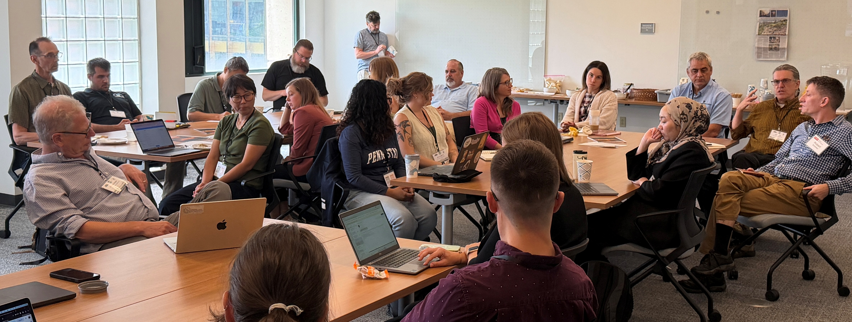

Penn State

Slide 19
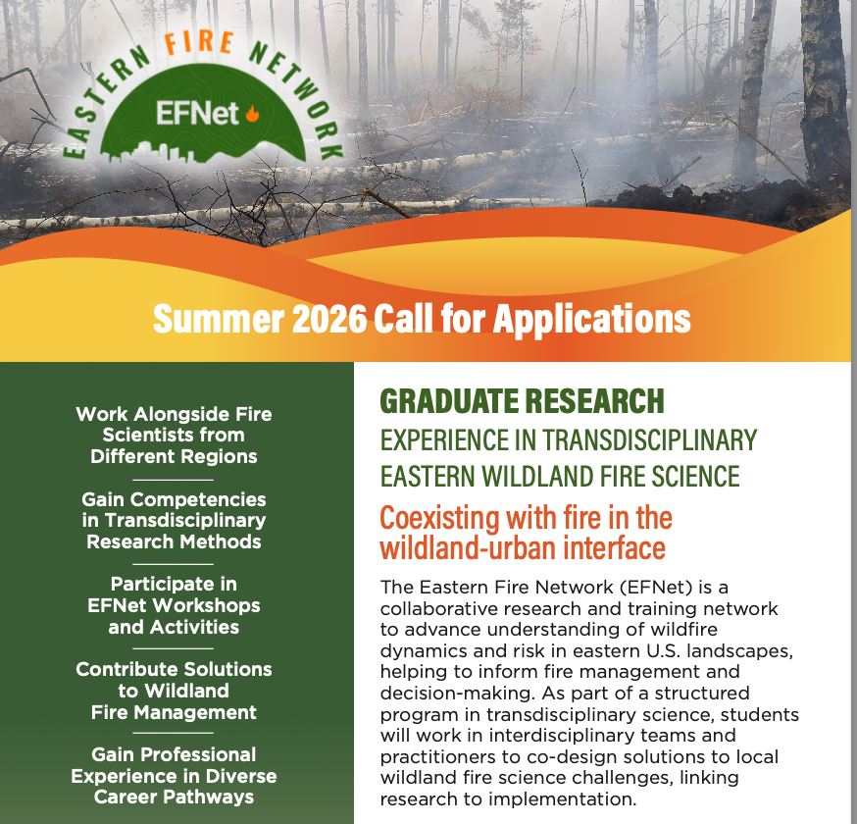
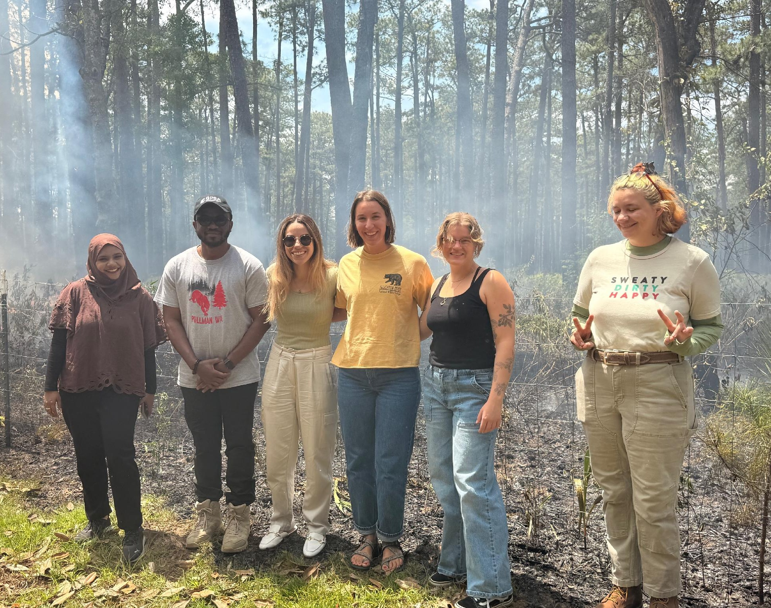

EFNet Grad Fellowship in Transdisciplinary Wildland Fire Science – Cohort #1
Elliott Maxwell – Auburn University (MS)
Okikiola Michael Alegbeleye –Washington State University (PhD)
Katherine Caughron – North Carolina State University (MS)
Azka Touhida – Univ of California Santa Barbara (PhD)
Paige D’Agostin – North Carolina Wilmington (MS)

Slide 20
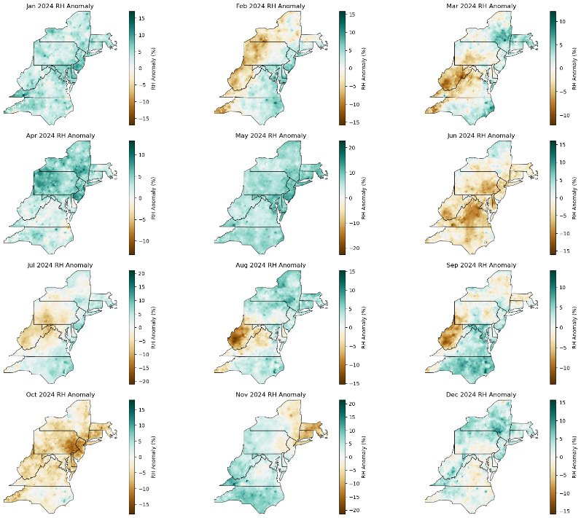
Recent Fire-Weather Associations
Observed RH Anomalies
Preliminary results, M. Tasnim

Slide 21
Text Description of RH Anomalies
Twelve maps of the northeastern United States show monthly relative humidity, or RH, anomalies from January through December 2024. Each map uses a scale in percent, with positive anomalies shown in green, values near zero in light shades, and negative anomalies in brown.
January: Predominantly positive RH anomalies across the region.
February: Negative anomalies dominate western and northern areas, while positive anomalies appear farther east and south.
March: Mixed conditions, with negative anomalies concentrated in western portions and positive anomalies farther north and east.
April: Predominantly positive anomalies, especially across the central and northern portions.
May: Positive anomalies are widespread across nearly the entire region.
June: Negative anomalies cover much of the central and southern portions of the region. This map is emphasized with a large oval.
July: Negative anomalies occur across much of the western and central portions, with positive anomalies more evident toward the south and east.
August: Negative anomalies are concentrated in the west, while positive anomalies occur farther north and east.
September: Negative anomalies occur primarily in western areas, with positive anomalies across much of the south and east.
October: Negative anomalies are widespread across much of the region, particularly central areas. This map is also emphasized with a large oval.
November: Positive anomalies dominate western and southern areas, while negative anomalies occur in parts of the northeast.
December: Positive anomalies occur across much of the region, with some areas near or below normal farther south.
Each map includes state boundaries and an RH anomaly percentage scale. The June and October panels are specifically highlighted on the slide.

Slide 22
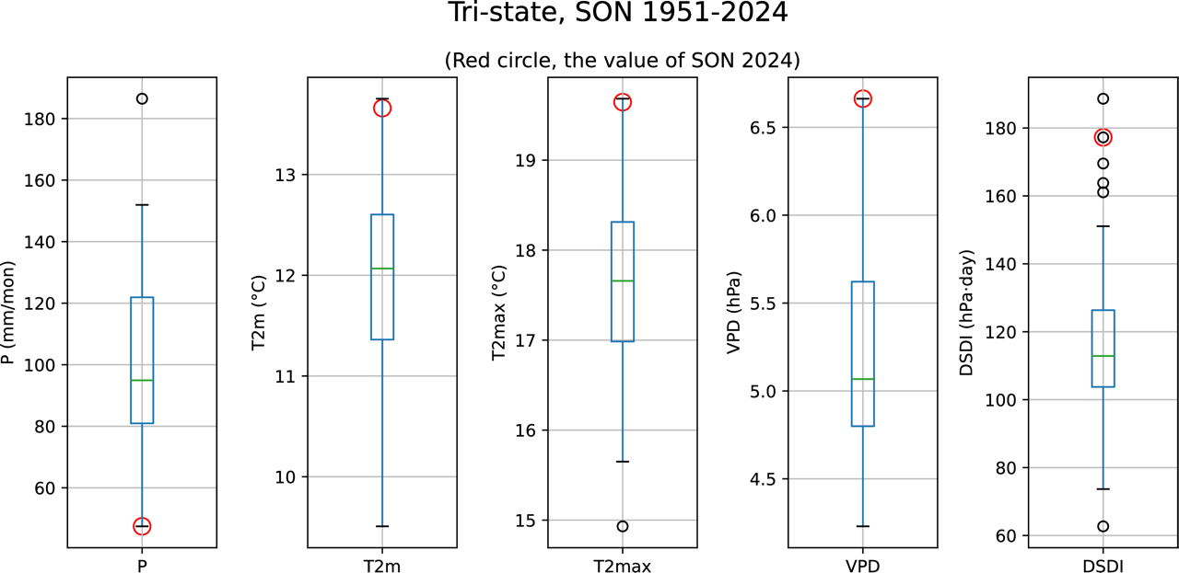
Climate Extremes
Unpublished data, Richard Seager et al.
Notes:
T2max (max daily temperature), VPD, DSDI. This was a season of fires. The plots show the distribution of seasonal means and mark 2024 values. You can see just how extreme the dry conditions and high temperatures were for SON 2024. It is important to note that these extremes did not arise from steady trends in P combined with upward trends in T, Tmax and VPD. Fall P in the region has been increasing but so has T, Tmax and VPD. They combine to give an upward trend in DSDI but it still needed some random weather or climate variability to reach the extremes of fall 2024. (The record fall DSDI was actually 2015.) Nonetheless I would say the warming is making DSDI values like fall 2024 more likely.

Slide 23
Text Description of 1951–2024 Tri-state Fall Climate Measures
Slide titled Climate Extremes contains five box plots labeled P, T2m, T2max, VPD, and DSDI for the tri-state region during SON, or September–October–November, from 1951 through 2024. Red circles identify the 2024 values.
P, precipitation in millimeters per month: The 2024 value is approximately 48 mm per month, near the bottom of the historical distribution and below the lower whisker. The median is approximately 95 mm per month. A high outlier appears near 187 mm per month.
T2m, temperature in degrees Celsius: The 2024 value is approximately 13.7°C, above the upper whisker of the historical distribution. The median is approximately 12.1°C.
T2max, maximum temperature in degrees Celsius: The 2024 value is approximately 19.6°C, above the upper whisker. The median is approximately 17.7°C, with a low outlier near 14.9°C.
VPD, in hectopascals: The 2024 value is approximately 6.7 hPa, above the upper whisker. The median is approximately 5.1 hPa.
DSDI, in hPa·day: The 2024 value is approximately 177 hPa·day and is among several points above the upper whisker. The median is approximately 113 hPa·day. Other displayed outliers extend to approximately 188 hPa·day, with a low outlier near 63 hPa·day.

Slide 24
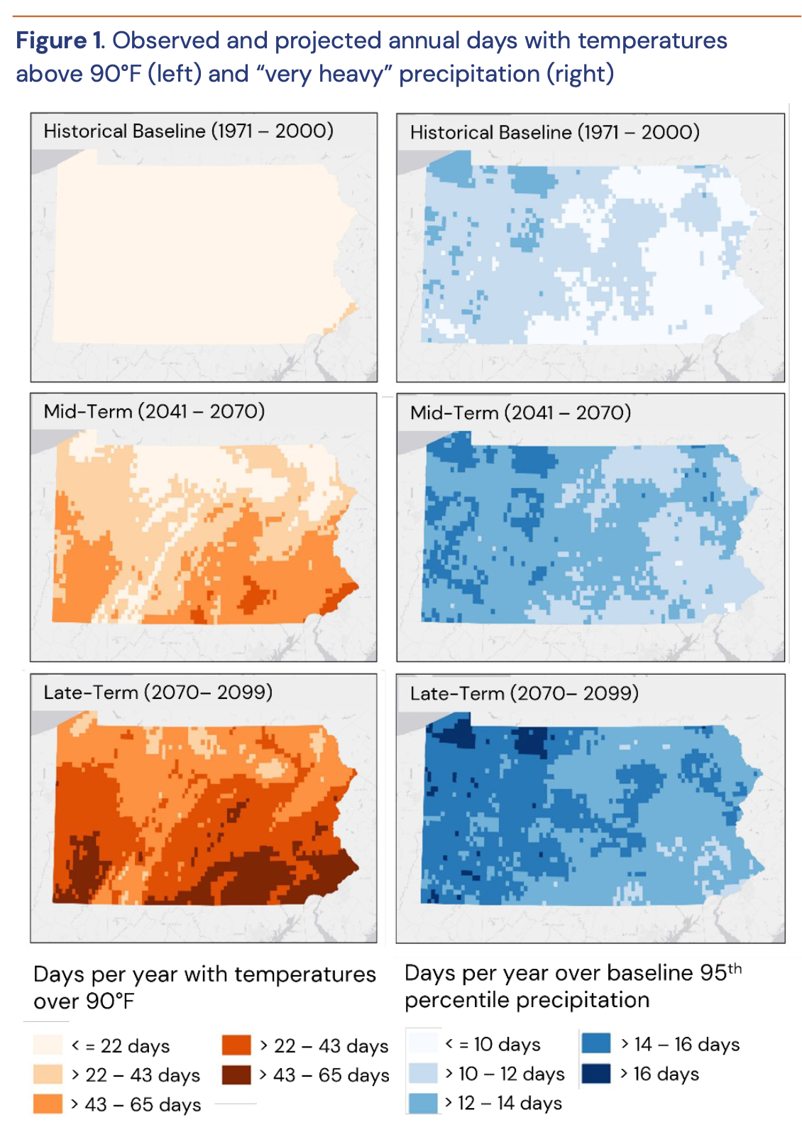
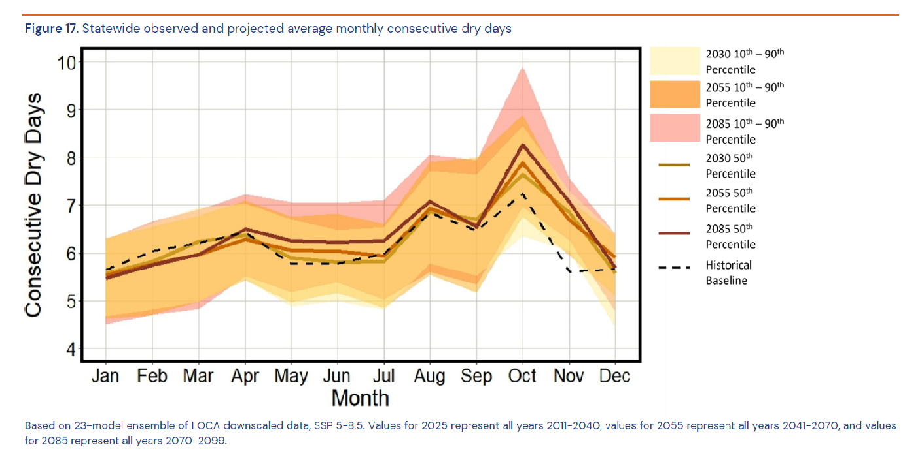
What is the fire weather of the future?
Hotter, wetter → more fuels
“Flashy droughts”
“Dry spells”
PA DEP Climate Impacts Assessment 2025

Slide 25
Text Description of Dry Days Map
Dry Days Maps: Figure 1 contains six maps of Pennsylvania arranged in three rows and two columns. The left column shows annual days with temperatures above 90°F, while the right column shows annual days with precipitation exceeding the historical 95th-percentile threshold. The rows compare the historical baseline of 1971–2000 with mid-term projections for 2041–2070 and late-term projections for 2070–2099.
Historical Baseline, 1971–2000: On the temperature map, nearly all of Pennsylvania has 22 or fewer days per year above 90°F, with a small area of higher values in the southeast. On the precipitation map, much of the state has approximately 10–14 days per year above the baseline 95th-percentile precipitation threshold, with geographic variation.
Mid-Term, 2041–2070: Days above 90°F increase across Pennsylvania. Higher values occur primarily in southern and southeastern areas, with some locations reaching more than 43 days per year. Very heavy precipitation days also increase, with much of the state showing approximately 12–16 days per year and some areas exceeding 16 days.
Late-Term, 2070–2099: Days above 90°F increase further. Much of Pennsylvania has more than 43 days per year, with portions of southern and southwestern Pennsylvania reaching the highest category of more than 65 days. Very heavy precipitation days also increase, with widespread areas above 14 days per year and several areas exceeding 16 days.

Slide 26
Text Description of Dry Days Line Chart
Dry Days Line Chart: Figure 17 is a line chart showing statewide observed and projected average monthly consecutive dry days from January through December. A dashed black line represents the historical baseline. Solid lines represent projected median values for 2030, 2055, and 2085, while shaded bands show the 10th-to-90th percentile ranges for each projection period.
The historical baseline begins at about 5.6 consecutive dry days in January, rises gradually to about 6.3 in April, then falls below 6 days from May through July. It increases to nearly 7 days in August, declines slightly in September, and reaches its highest point at slightly above 7 days in October. It then drops to about 5.6 days in November and remains near that level in December.
The projected median lines generally follow a similar seasonal pattern. Differences from the historical baseline are most pronounced in autumn. All three projected medians peak in October, with the 2085 median highest at just over 8 consecutive dry days. The uncertainty ranges are also widest around October, particularly for 2085, when the upper end approaches 10 consecutive dry days.

Slide 27

Prepare PA: Vision and Mission

Slide 28
Prepare PA is a climate resilience network that connects state agencies, non-profits, businesses, colleges and universities, local governments, and individuals across the Commonwealth of Pennsylvania.
  VISION:
  To catalyze a resilient, equitable, and thriving Pennsylvania by coordinating climate action, amplifying local capacity, and fostering cross-sector partnership.
  MISSION:
  To prepare Pennsylvania through innovation and collaboration to thrive in a changing climate—by equipping communities with the knowledge, tools, and support needed to mitigate risks, adapt to environmental uncertainties, and build long-term resilience.​

Slide 29
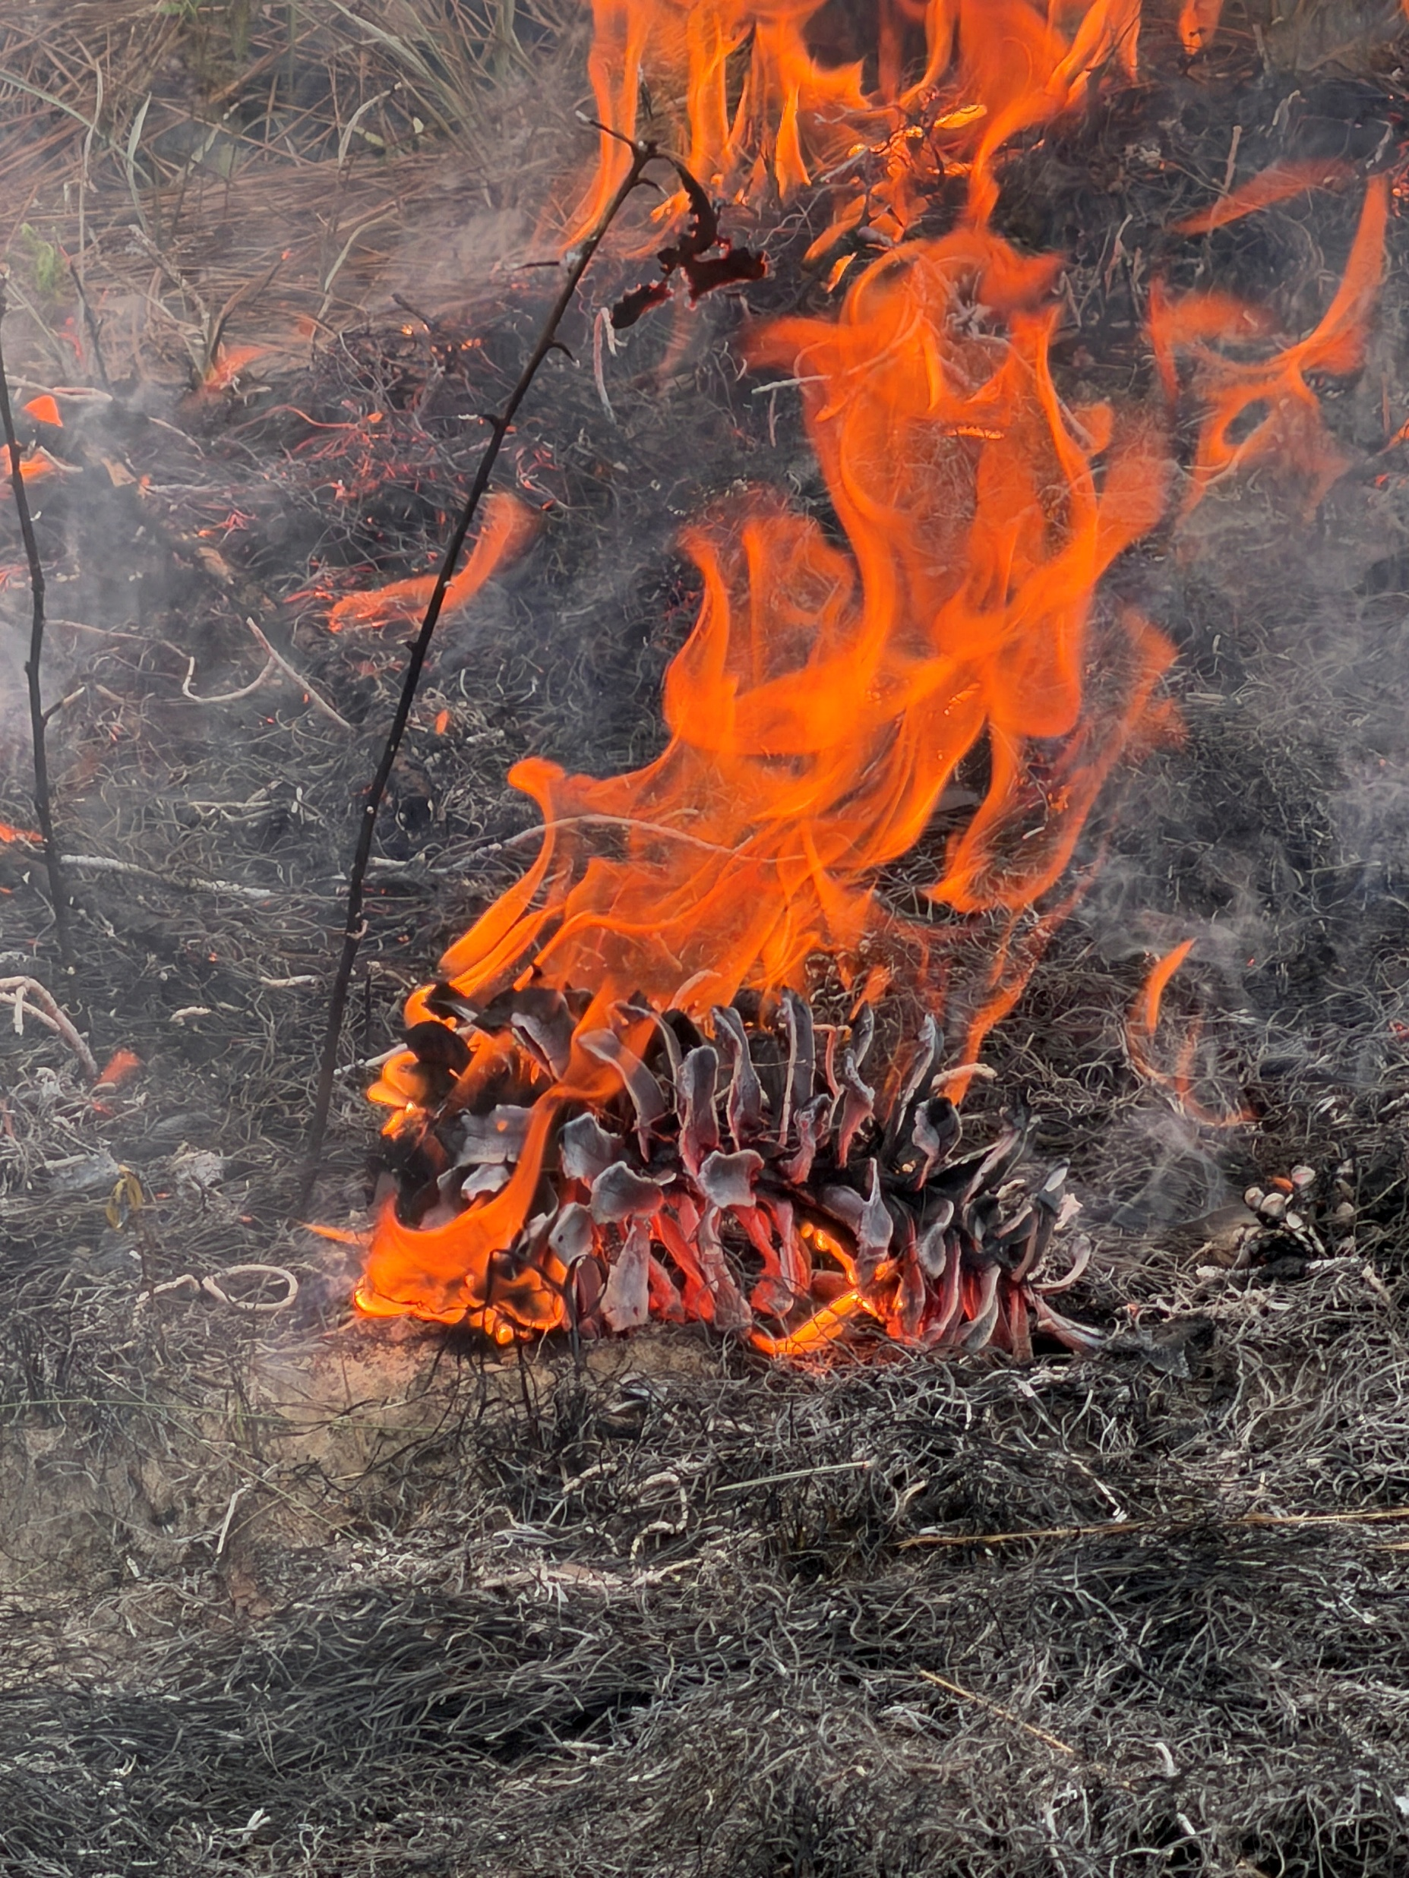
Final Thoughts
EFNet is a transdisciplinary network to catalyze a research agenda to understand future wildfire risks and impacts
Prepare PA is a transdisciplinary network to catalyze resilient Pennsylvania landscapes and communities
How can these networks and research best support policy and management decision-making?

