Slide 1
EMS Faculty, Staff, and Postdocs
Spring Meeting
Thursday, April 4th, 2024
3:00 – 4:30 pm
22 Deike Building

Slide 2
Welcome!

Slide 3
Introduction of New Hires

Slide 4
New Staff
Associate Dean for Undergraduate Education | Earth and Environmental Systems Institute | Energy Institute
Julianne Mortimore Kayla Pedmo | Ava Lee Jessica Fetchko Yashika Gupta | Aime Jones

Slide 5
New Staff
Energy and Mineral Engineering | Geosciences | Materials Science and Engineering
Carmel Kamens Diane Herr Joanna Maatta Lan Ziegler | Jennifer Houser Laura Rush Sara Peterson | Dustin Spicer

Slide 6
New Postdocs
Earth and Environmental Systems Institute | Energy Institute | Geography
Susan Kotikot | Sai Liu | Halie Kampman

Slide 7
New Postdocs
Geosciences | Materials Science and Engineering | Meteorology
Gabriela Chiquito Gesualdo Xiwei Guo Ellen Olsen Anna Waldeck Ophélie Michele Karen Mcintosh Donggeon Kim | Guo-Dong Zhao Fei Yang Kena Zhang Jadupati Nag Nigel Lee En Hew Shixian Zhang | Gill-Ran Jeong Yunsong Liu Yueqi Jiang

Slide 8
New Faculty
Associate Dean for Undergraduate Education | Earth and Environmental Systems Institute | Geography
Kevin Haworth Jingchun Chen | Femeena Pandara Valappil Lidiia Iavorivska | Daniela Aiello Belén Norona Zhenlong Li Victoria Nimmo

Slide 9
New Faculty
Geosciences | Materials Science and Engineering | Meteorology | Museum
Isabel Fendley Rachel Housego | Maziar Montazerian Carlos Lopez Nairiti Sinha | Benjamin Ahlswede Karl Schneider | Chris Widga

Slide 10
Staff Retirees
Associate Dean for Educational Equity | Ryan Family Student Center | Energy Institute | Geosciences
Lori Robinson | Linda Spangler | Elizabeth Wood | Dennis Walizer

Slide 11
Faculty Retirees
Geography | Museum
Todd Bacastow William Easterling Alan Taylor | Julianne Snider

Slide 12
Employee Assistance Program
Your other “Medical” benefit
Penn State University

Slide 13
What is SupportLinc?
The SupportLinc Employee Assistance Program (EAP) is a health benefit, separate from your medical insurance, offered by your employer to help you manage life’s daily challenges.
SupportLinc can refer you to professional counselors, services and resources that will help you and your eligible family members resolve a broad range of personal and work-related concerns.

Slide 14
What is new with SupportLinc?
Administered by CuraLinc Healthcare, SupportLinc offers PSU employees and their eligible family members:
Coaching – boost your emotional fitness, learn healthy habits, etc.
Mobile App – get confidential help and guidance on-the-go from a licensed counselor
Text therapy – exchange text messages Mon through Fri with a licensed counselor
Animo platform – strengthen your mental health using Animo’s self-guided content, games, and daily inspiration
Virtual Support Connect – a digital support platform that offers unlimited moderated sessions hosted by licensed counselors on subjects like grief, mindfulness, preventing burnout and more

Slide 15






What other services are included?
Work-life benefits
Legal consultation
Free in-person or telephonic consultation with a licensed attorney
No employment law
Financial consultation
Expert guidance and consultation from financial professionals
Identity theft consultation
Free consultation with an identity theft recovery professionals
Tailored recovery action plan
Dependent care referrals
Expert referrals to child and adult/elder care providers, facilities and other resources
“Convenience” referrals
Guidance and referrals to a variety of daily living resources: home improvement, entertainment services, pet care, auto repair, wellness, travel, handymen, volunteer opportunities etc.

Slide 16
Interactive toolkits
Mindfulness
(www.mindfulness.tools)
Practical tools and exercises for incorporating mindfulness into everyday life.
Meditation
(www.meditate.tools)
Easy-to-use collection of resources that includes guided meditations, tip sheets and more.
Resiliency
(www.resiliency.tools)
Skill development resources to help you ‘bounce back’ from challenging situations.
Sleep fitness
(www.sleepfitness.tools)
Information and resources to help you learn good sleep habits and achieve healthy sleep.

Slide 17






Getting started
Call: 1-888-501-3532
Visit: www.supportlinc.com
Log in or create account
(code: pennstate)
QR Code:
SupportLinc
Support for everyday issues. Every day.

Slide 18
Earth and Mineral Sciences,
Museum & Art Gallery
Chris Widga
Museum Director

Slide 19
A Museum is a service Organization

Slide 20
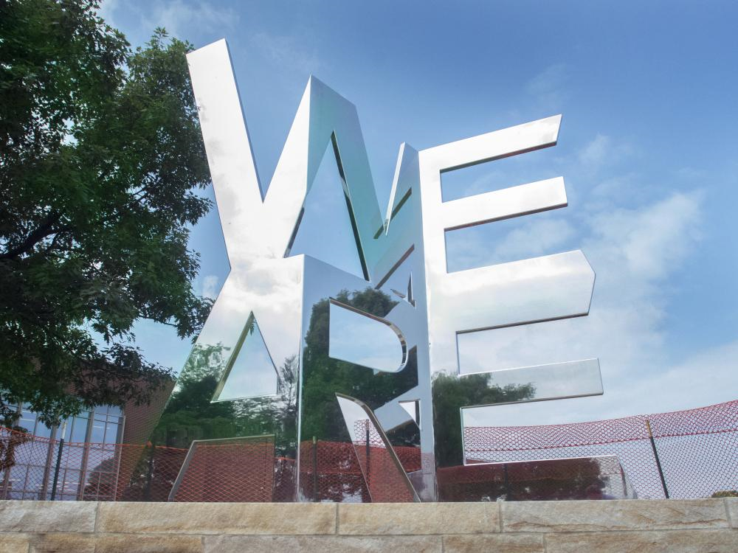
Who is our service audience?
Five departments
Students
“Discovery” Majors
Faculty/Researchers
Alumni/Donors
Physical/Virtual

Slide 21
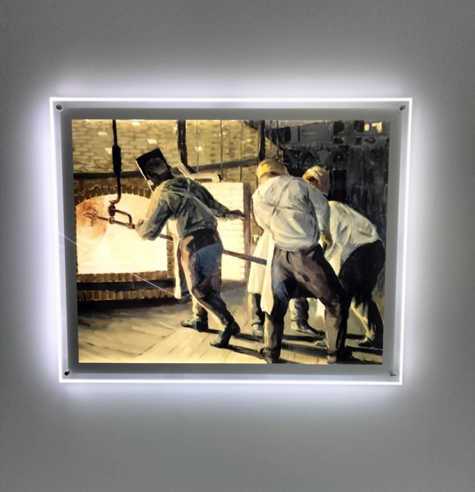
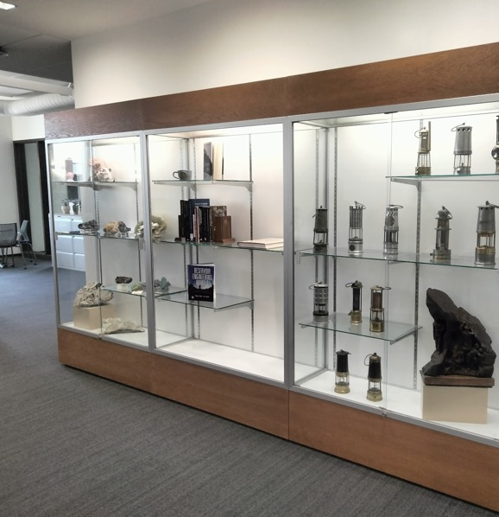
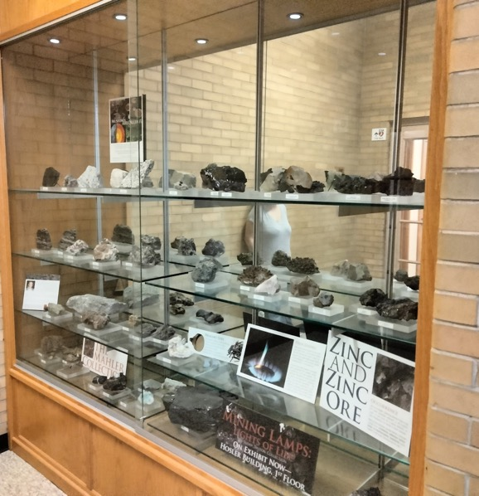
Where am I?

Slide 22

A Museum is a Service Organization
Museum
Outreach and Education
Collections and Research
Needs of Audiences & Constituents
Exhibits and Programs

Slide 23
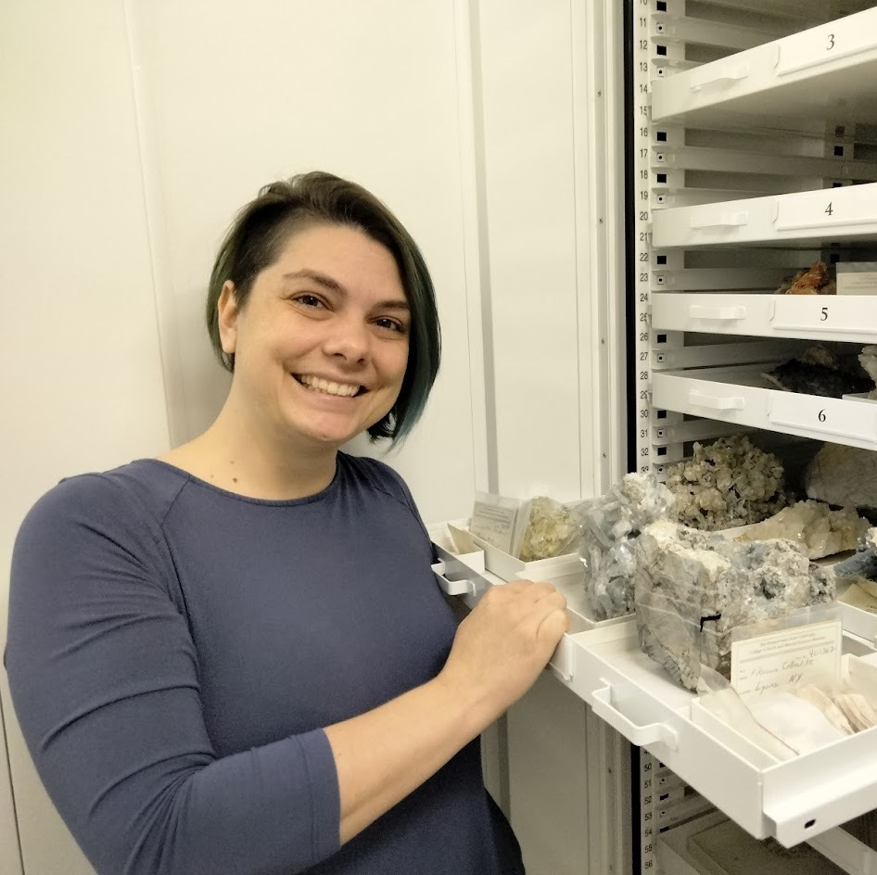
Museum Resources
Research Collections
>19,000 objects representing PSU-EMS research
Earth Materials, History of Technology, Synthetic Materials (+)
Steidle Collection of Industrial Art

Slide 24
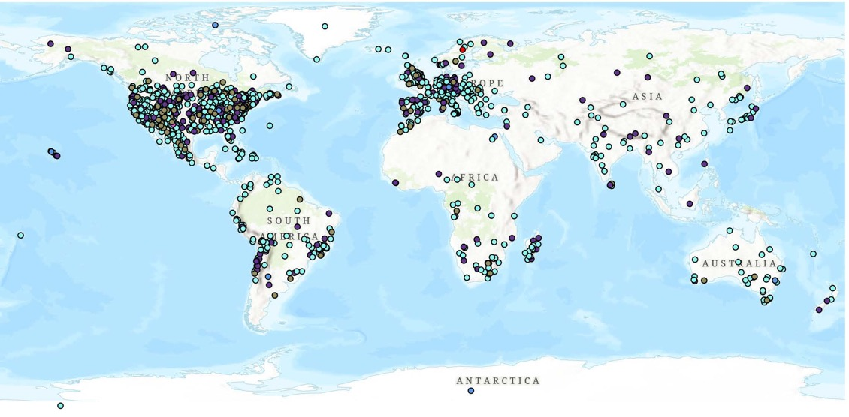
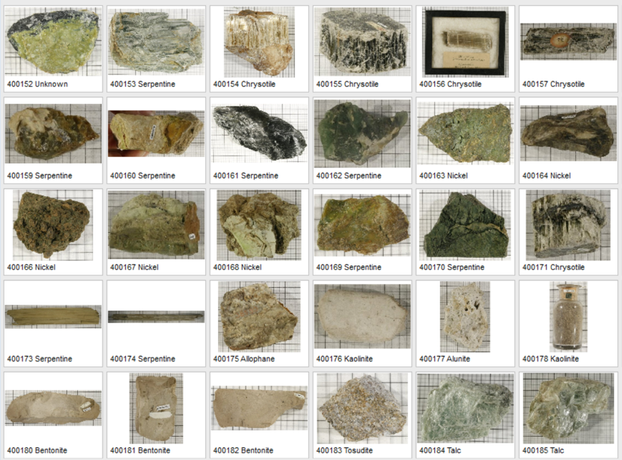

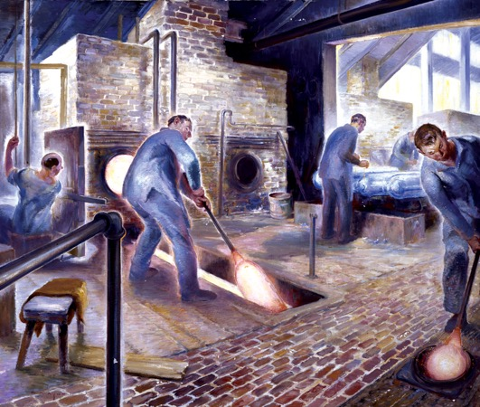
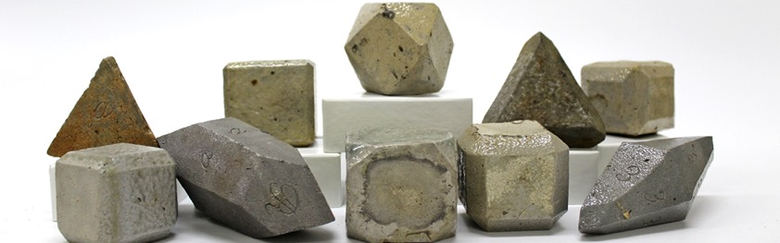
Global Scope
Research Collections
History of Technology and Teaching
Art, Science, and Industry

Slide 25
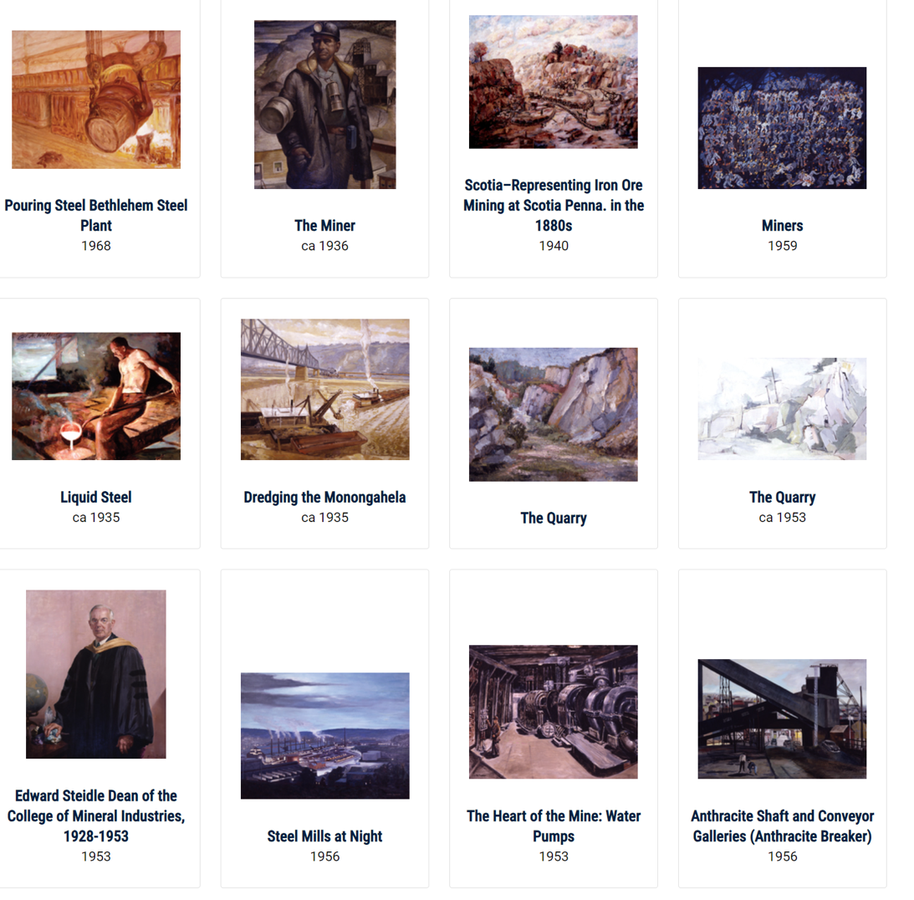
Museum Resources
Digital Resources
  Steidle Collection of Industrial Art
  (Future) Earth & Synthetic Materials Collection
  (Future) K-12 Educational modules
  More?

Slide 26
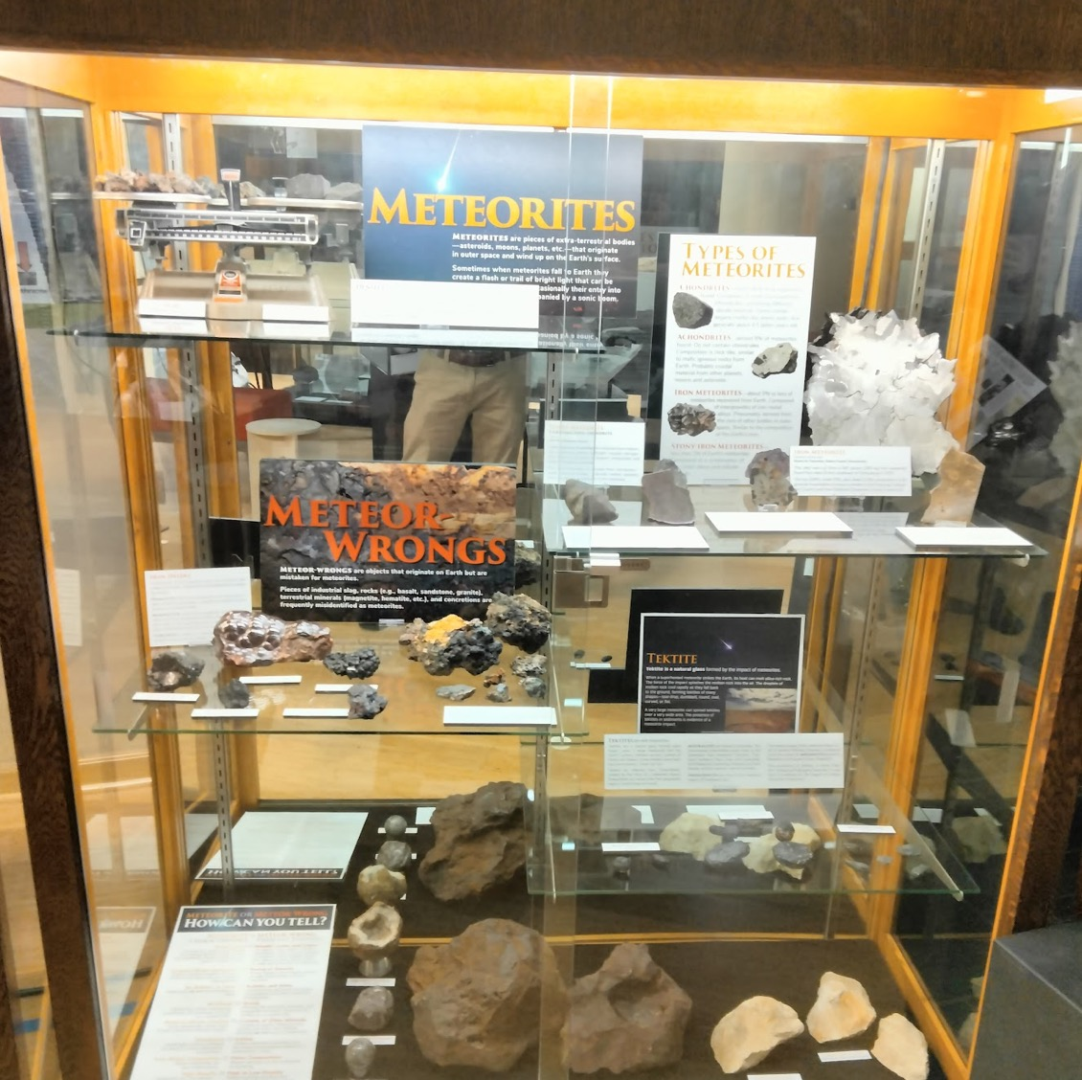
Museum Resources
Physical exhibits
OR
“Experiential, immersive, object-based informal science learning”

Slide 27
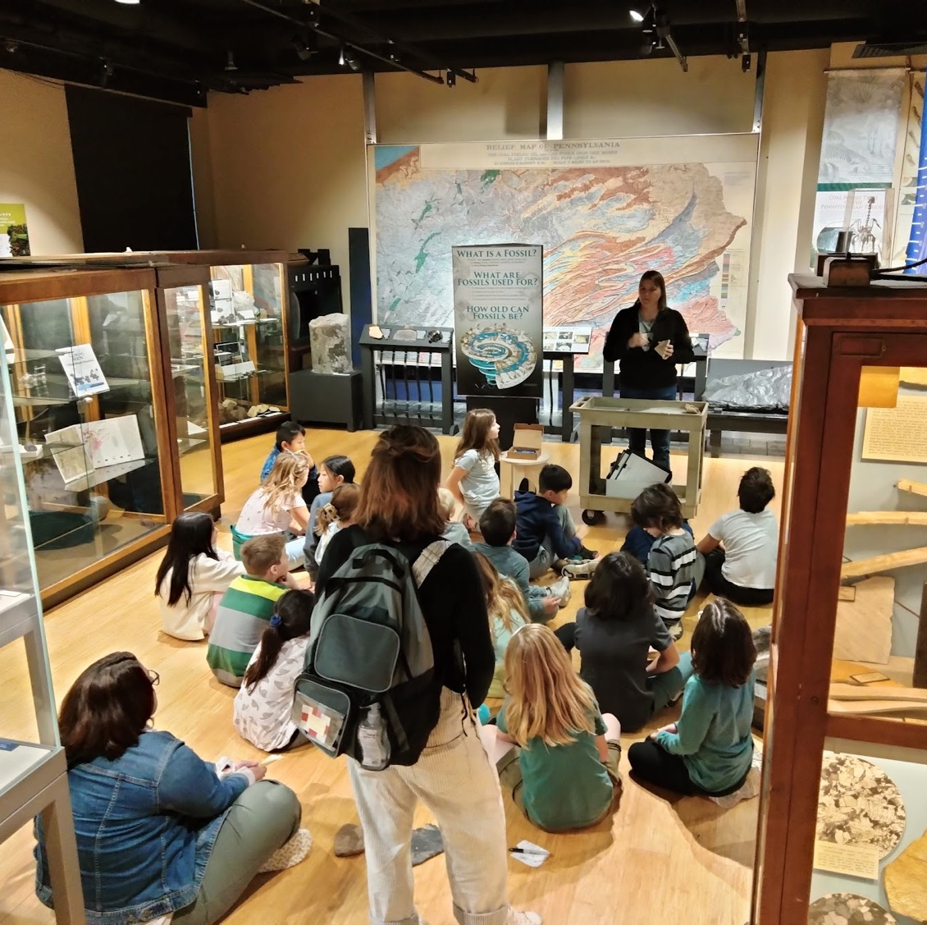
Museum Resources
Events and Outreach Activities
  State College 4th Graders (yes, all of them)
  Museum consortium events that amplify reach

Slide 28
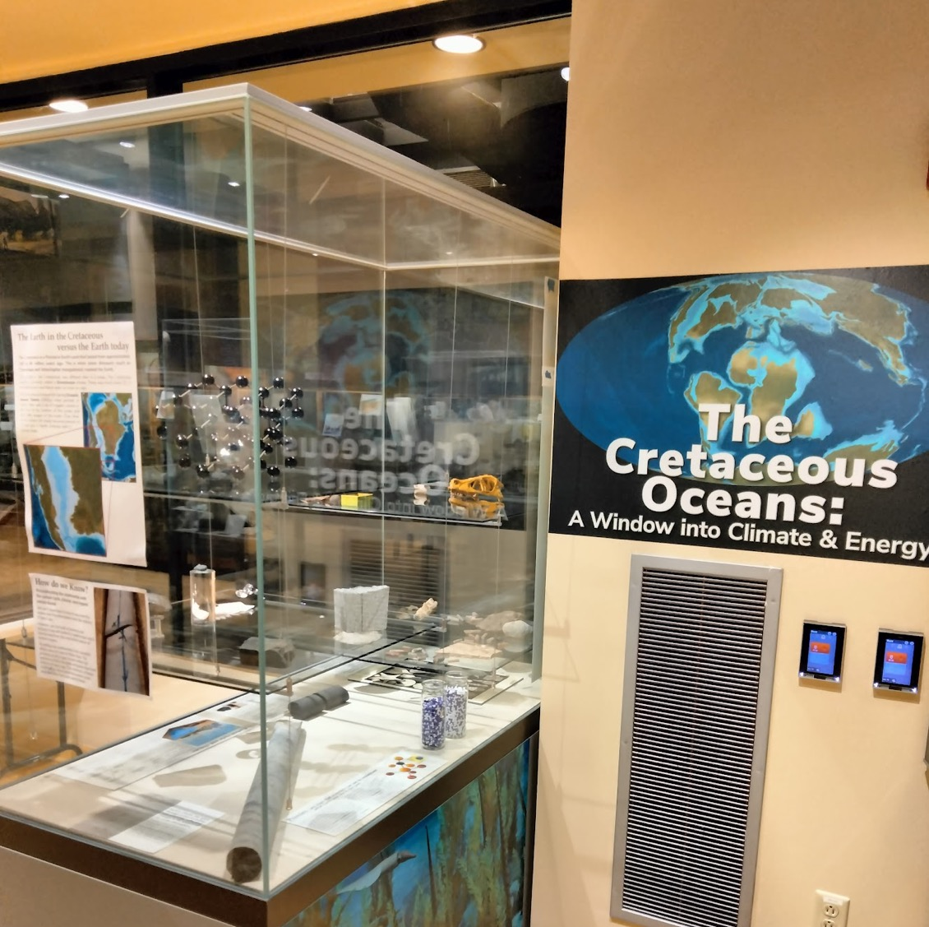
Museum Resources
Broader Impacts
  Public programming and SciComm
  Storyline development
  Exhibit Design and fabrication
  Audience evaluation
>4000 visitors per year

Slide 29
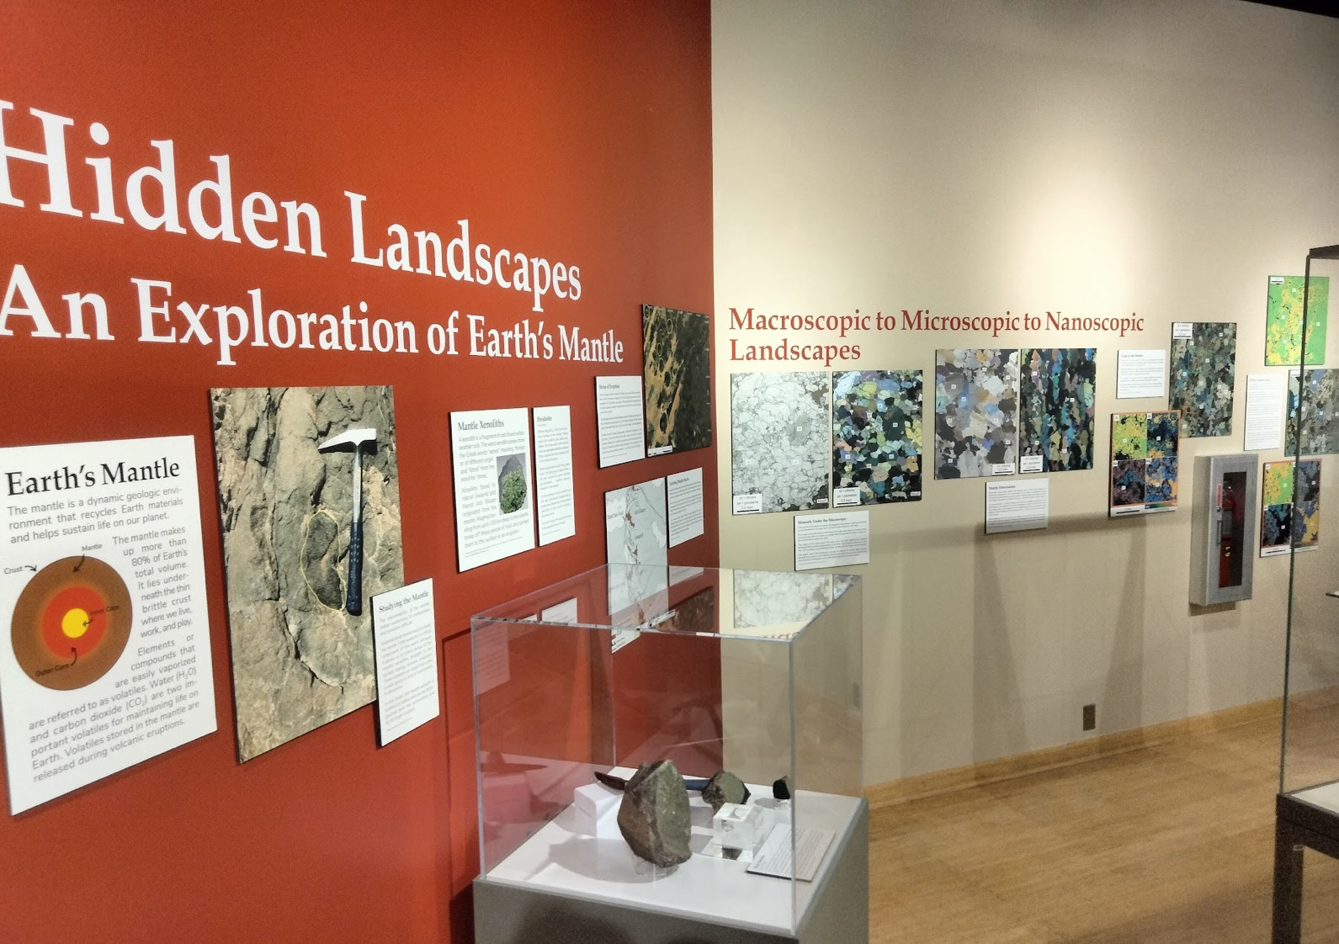
What services can we provide?
Exhibit/Curriculum integration
Broader Impact projects
Repository agreements
SciComm experiences
Experiential learning
Flexible platform to “try stuff out” in a physical space

Slide 30
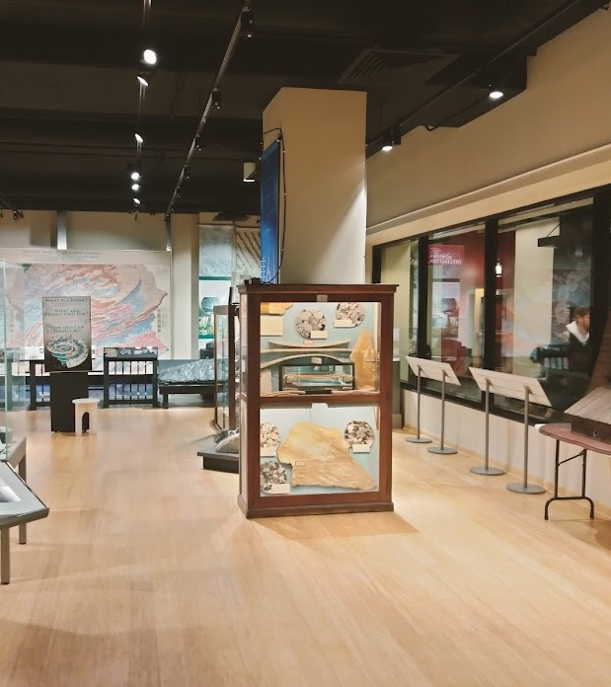
Questions?
The EMS Museum & Art Gallery
  6 Deike (ground floor)
  M-W-F 10-5; T-Th 1030-430
Chris Widga (director)
  cxw5766@psu.edu
  408 Deike
Patti Wood Finkle (curator)
  pwf5120@psu.edu
  Center for Education, Research, and Collections (CERC)
  Special Services Building (en route to airport)

Slide 31
Sustainability – Tim White

Slide 32
The University Libraries
Linda Musser, Head of the
Fletcher L. Byrom Earth and Mineral Sciences Library

Slide 33

University Libraries’ Mission
The Libraries seek to inspire intellectual discovery and learning through robust information resources
and academic collaborations in teaching and research that connect the Penn State community and citizens of Pennsylvania to the world of knowledge and new ideas.

Slide 34
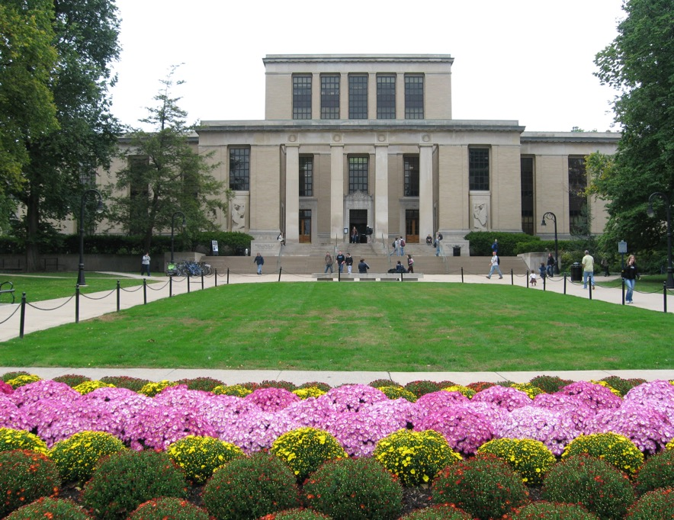
Quick Facts about the PSU Libraries
We have large and diverse collections, nearly 9 million titles.
There is a library at every PSU campus.
PSUL is home to:
  University Archives,
  Records Management,
  Media and Technology,
  Adaptive Technology,
  Penn State Press,
  PA Center for the Book,
  Center for Black Digital Research,
  Teaching and Learning with Technology.
As a land grant, we serve the public as well as the PSU community.

Slide 35
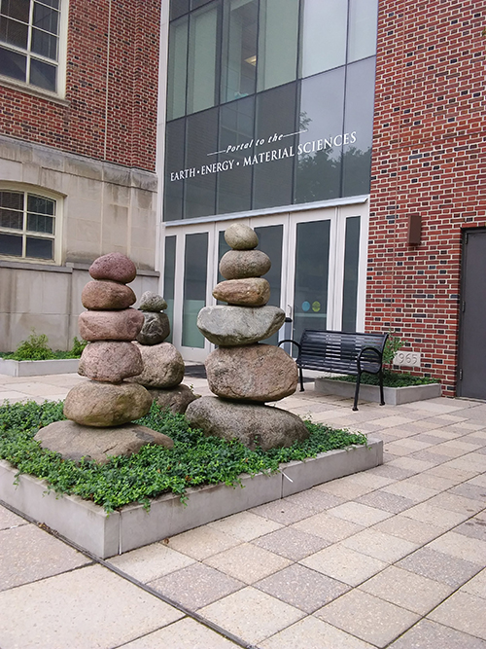
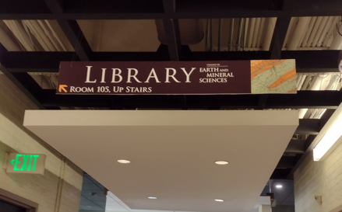
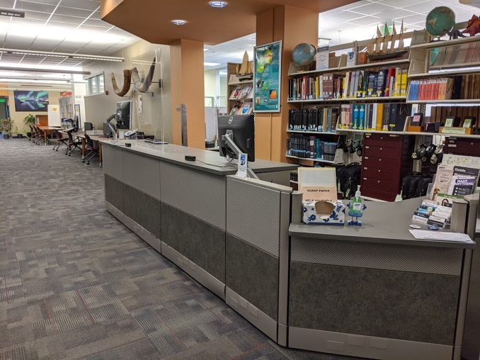
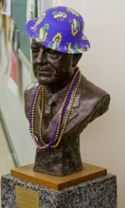
Quick Facts about the EMS Library
The EMS Library is administratively part of the University Libraries but based in the College of EMS.
Located in 105 Deike Building, above EMS Museum

Slide 36
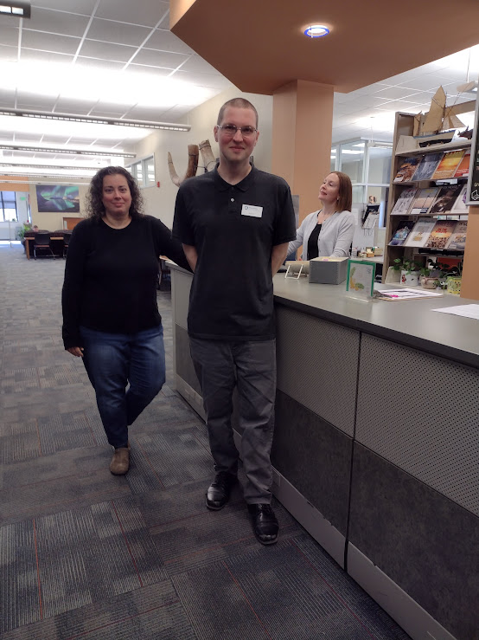
EMS Library – Services and Staff
Course reserves – we purchase textbooks and prepare e-reserves
Collections -purchase items relevant to EMS needs and interests
Interlibrary loan - borrowing from other libraries
Equipment to loan - laptops, headphones, etc.
What the Libraries Can Do For You (staff outreach program)
Expertise – Ask-a-Librarian service
Liz Long, Aaron Procious, and Megan Fletcher

Slide 37
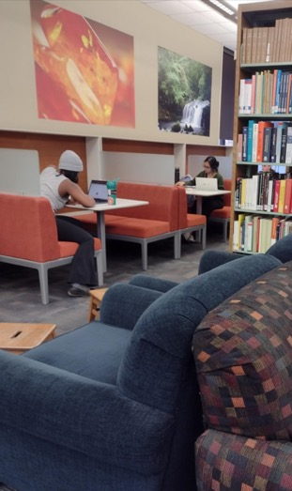
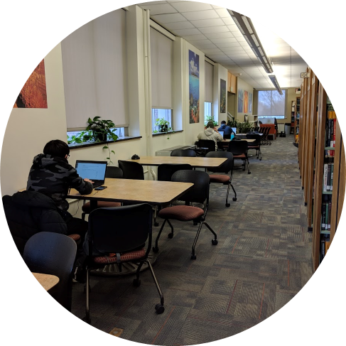
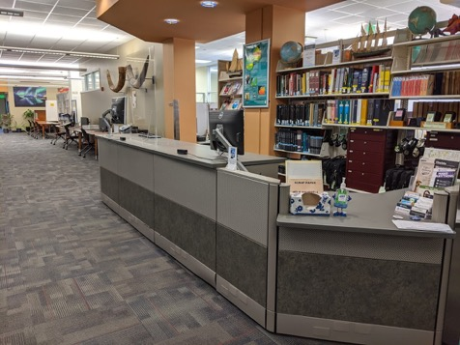
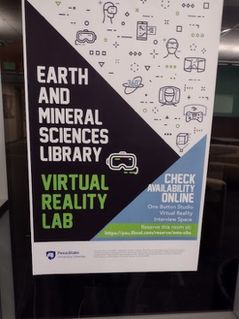
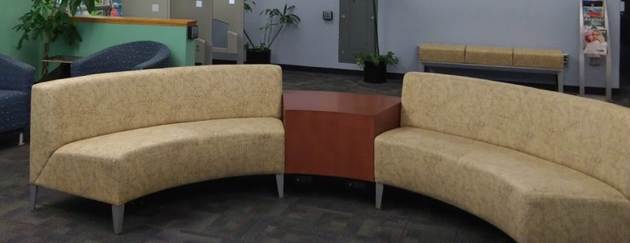
EMSL Spaces
VR and One Button Studio
Interview space
Group study rooms
Computer lab
Quiet and group study spaces

Slide 38
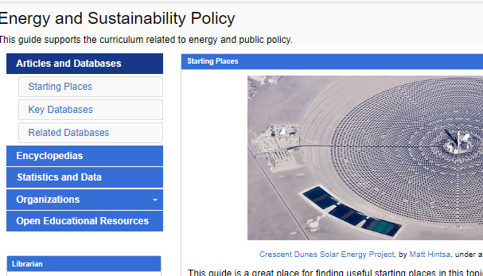
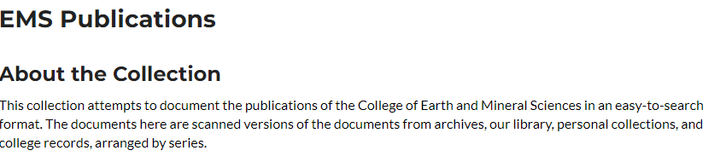
Libraries Support Research and Teaching
Subject and course guides
Instruction on information resources and use
Institutional repository (ScholarSphere)
Copyright support
Open publishing – OAER as well as Read-and-publish agreements
Data and textual analysis
Data management

Slide 39
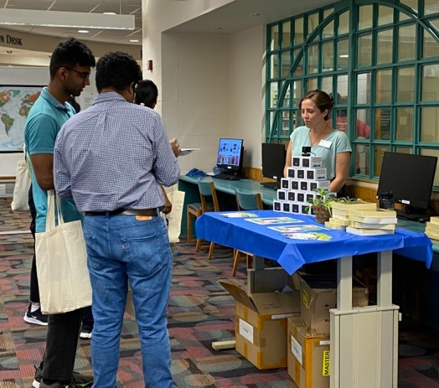
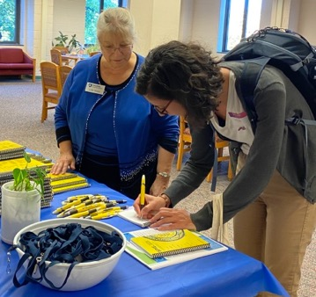
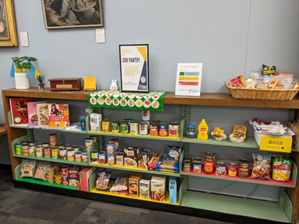
Partnerships to support students
We employ students.
We offer student scholarships.
We offer internships and assistantships.
We offer awards for undergraduate student research.
Graduate student mixer
Graduate student writing retreat
Finals week De-Stress Fest.
Cub pantry (a subsidiary of Lion’s Pantry)

Slide 40
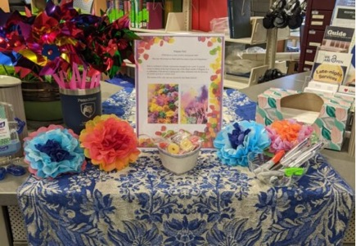
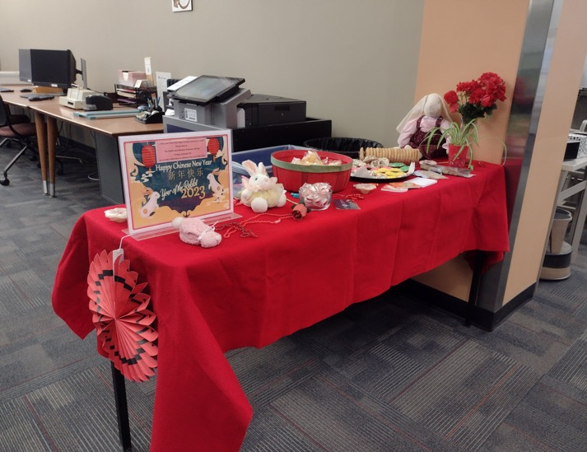
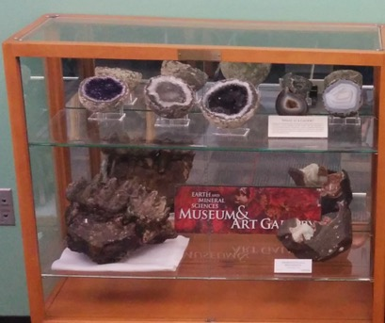
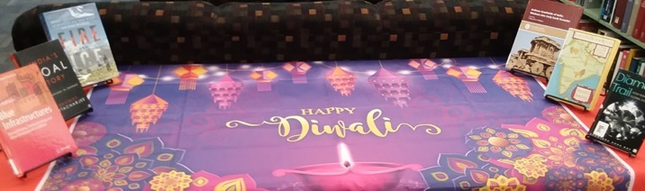
More Partnerships
Events related to other cultures and customs – Diwali, Lunar New Year, etc.
EMS Reads
TEEMS
NSO space
EMS Museum
EMS committees

Slide 41
Potential future collaborations?
The Libraries seek to inspire intellectual discovery and learning through robust information resources
and academic collaborations in teaching and research
that connect the Penn State community and citizens of Pennsylvania to the world of knowledge and new ideas.
-- Mission statement of the University Libraries
My contact information: lindamusser@psu.edu

Slide 42
Closing Remarks
Please join us in the EMS Museum and Art Gallery for drinks and appetizers following the meeting!

