Slide 1
EMS Faculty and Postdocs Meeting
Tuesday, September 17, 2024
603 Barron Innovation Hub

Slide 2
Agenda
Welcome
Levon Esters, Vice Provost for Graduate Education and Dean of the J. Jeffrey and Ann Marie Fox Graduate School
Megan Evans, Interim Director/Communications Coordinator, Centre County United Way
Jena Jenkins, POEMS Co-Chair
Introduction of New Faculty and Postdocs
Introduction of 2024-2025 EMS Caucus of Senators, EMS Graduate Council Members, EMS Tenure-Line Faculty Advisory Committee, and EMS Non-Tenure-Line Faculty Advisory Committee
College Update and Questions
Closing Remarks

Slide 3
Welcome

Slide 4
Levon Esters,
Vice Provost for Graduate Education and Dean of the J. Jeffrey and Ann Marie Fox Graduate School

Slide 5


Megan Evans
Interim Director
Director of Communications & Agency Relations
megan@ccunitedway.org

Slide 6
1
WHY UNITED WAY ?
Penn State declared Centre County United Way as the University’s “Charity of Choice” over 40 year ago.
Penn State runs its own campaign every year and consistently raises 40% of the overall campaign total each year!
We could not have the impact we do in the community
without the support of Penn Staters!
Penn State University

Slide 7
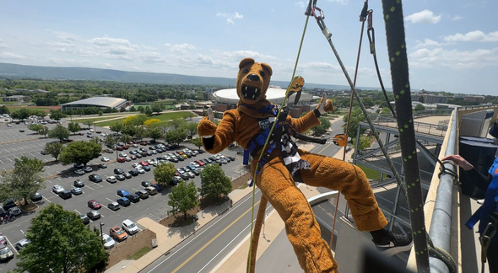
HOW TO GIVE?
NEIGHBORS HELPING NEIGHBORS
2
  Special Events
    Over the Edge
    Unit Events
      IT Golf
      LA Office Olympics
  Payroll Deduction - you set the amount that comes out of your paycheck each month! $1 a month makes a difference – imagine what $5 could do!
  One time donation –
  Send a check or donate online.
Penn State University

Slide 8

4
OUR PARTNERS
Centre County United Way partners with 24 local agencies.
Penn State University
We fund programs those agencies provide to our neighbors.
United Way raises money in Centre County that is invested in local programs to assist
Centre County residents.

Slide 9
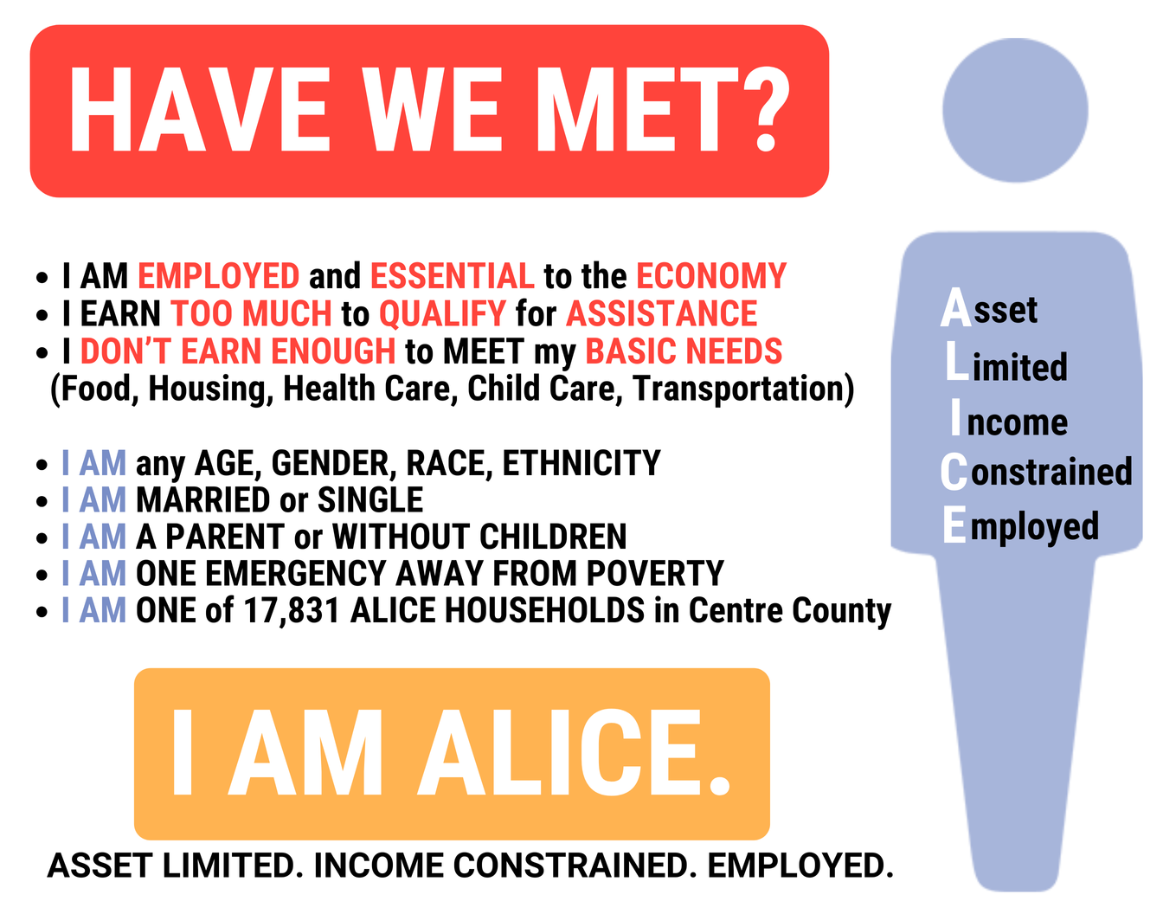

WHO DO THEY SERVE?
3
30% of the households in
Centre County are ALICE.
17% of the households in Centre County
are in poverty,
47% of Centre County Households
are Struggling to Survive.
Penn State University

Slide 10
5
WHO DECIDES WHERE THE $$ GOES?
VOLUNTEERS help our staff of 3 raise money – and they also decide how much each agency receives to run their programs.
FUNDS DISTRIBUTION happens in March and April.
A great way to learn more about the services available to our neighbors.
It also allows you to get a better understanding of the needs we have in this county that are not so obvious.
Penn State University

Slide 11
HOW CAN YOU GET INVOLVED?
6
  Board of Directors - all year
  Committees - all year
    Board Development
    Campaign
    Communications
    DEIB
    Finance
    Funds Distribution
    HR
  Events (day of)
    Campaign Events
    Day of Caring - 1st Thursday in October
    Penn State Golf - September 16, 2024
    Penn State Over the Edge - October 8, 2024
    Taste of the Town - Nov 24, 2024
  Events (planning)
    Taste of the Town - July thru December
  Funds Distribution- March/April
Penn State University

Slide 12
Penn State University
LIVE UNITED
ccunitedway.org

Slide 13
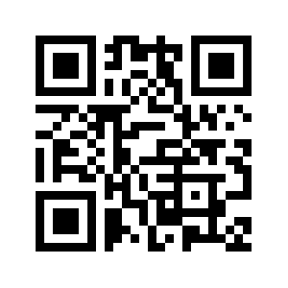
PoEMS: Postdocs of EMS
Fall 2018 ALLWE survey showed that postdocs lacked community and belonging.​
​
Our goal is to foster community amongst the postdocs and provide opportunity for social connection and professional development.
PoEMS has been going for about ~3 years now.
ems.psu.edu/poems

Slide 14
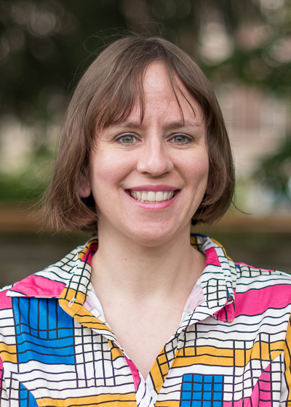
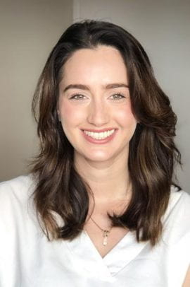
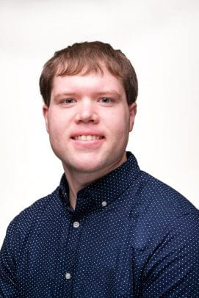
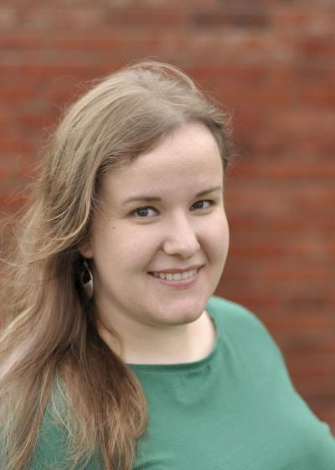
PoEMS Executive Council
Jena Jenkins (Chair)
Gabriela Gesualdo (Co-Chair)
Drew Polasky
(Treasurer + Webmaster)
Virginia Silvas (Diversity Committee Rep)

Slide 15
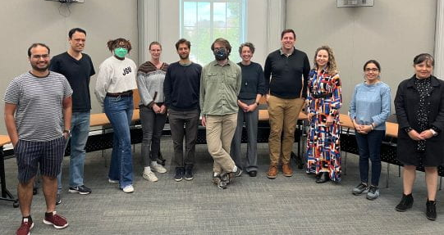
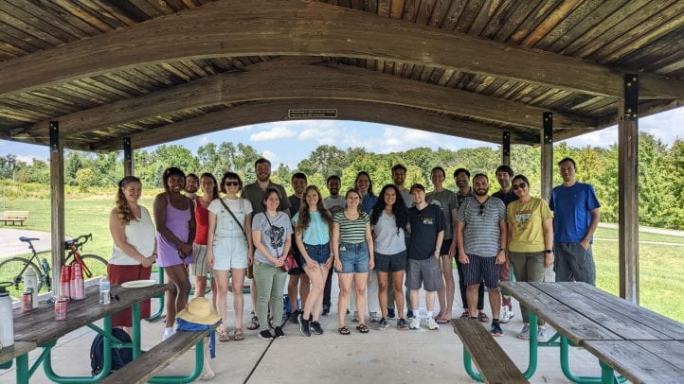
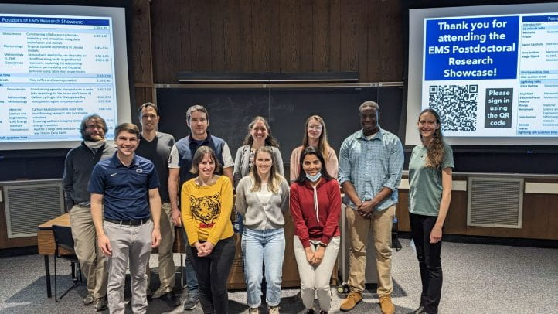
Past PoEMS Events
Formal events (EMS-supported)
Fall kick-off Picnic (annual)
Mentoring panel (2022)
Research Symposium (2023)
Social events
Apple Picking (2022 + 2023)
Minigolf (2023)
Hiking (2024)

Slide 16
We'd love to hear from you!
If you are a postdoc, please let us know if there's anything you'd like to see from PoEMS
If you are advising a postdoc, please let them know about PoEMS
Our website contain resources for postdocs and more info about PoEMS:
ems.psu.edu/poems

Slide 17
Introduction of New Faculty

Slide 18
Earth and Environmental Systems Institute
Nicholas Sullivan – Postdoctoral Scholar

Slide 19
Energy Institute
Qitao Zhang – Postdoctoral Scholar

Slide 20
Energy and Mineral Engineering
Sourav Das – Postdoctoral Scholar
Maruf Morshed – Assistant Teaching Professor
Amin Kordestany – Assistant Teaching Professor

Slide 21
Geography
Jared Whear – Assistant Research Professor
John Kendall – Postdoctoral Scholar
Alicia Iverson – Lecturer and GeoGraphics Lab Manager
Bing Zhou – Assistant Teaching Professor

Slide 22
Geosciences
Rebecca Bussard – Postdoctoral Scholar

Slide 23
Materials Science and Engineering
Tiago Outerelo Corvo – Postdoctoral Scholar
Ajinkya Hire – Postdoctoral Scholar
Li Li – Postdoctoral Scholar

Slide 24
Introductions of 2024-2025 EMS Caucus of Senators, Graduate Council Members, and Faculty Advisory Committees

Slide 25
2024-2025 EMS Caucus of Senators
Jennifer Baka
Kevin Bowley
Hamid Emami-Meybodi
Beth King
John Mauro
Brandi Robinson
John Wang

Slide 26
2024-2025 EMS Graduate Council
Nasim Alem
Arash Dahi Taleghani
Joshua Inwood
Alternates:
  Hojong Kim
  Mohammad Rezaee

Slide 27
2024-2025 EMS Tenure-Line Faculty Advisory Committee
Allison Beese
Trevor Birkenholtz (Chair)
Joshua Inwood
Brian King
Zhen Lei
Bronwen Powell
Victoria Sanchez
Peter Wilf
Colin Zarzycki

Slide 28
2024-2025 EMS Non-Tenure-Line Faculty Advisory Committee
Brandi Gaertner (Co-Chair)
Joshua Garber
April Millet
Joel Morrison
Robert Nicholas
Ronald Redwing (Co-Chair)
Erich Schienke
Steve Seman

Slide 29
College Update & Questions

Slide 30
Closing Remarks

