Slide 1

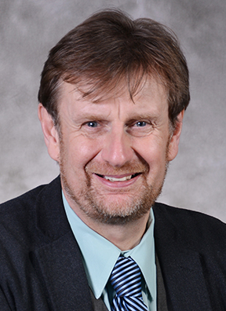
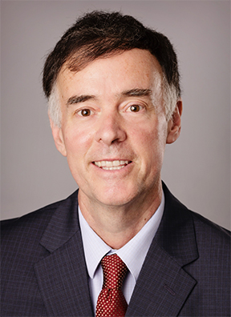

Celebration of Accomplishments
Celebrate the accomplishments of Clive Randall and Karl Zimmerer and the achievements and completion of the Assessment of the Living, Learning, and Working Environment - ALLWE
Clive Randall
Evan Pugh University Professor
Karl Zimmerer
American Academy of Arts and Sciences
3:30 - 5:30 p.m.
Thursday, September 12
603 Barron Innovation Hub
All EMS faculty, staff, postdocs, and graduate students are invited to attend.

Slide 2
Celebration of Accomplishments

Slide 3
Clive Randall
Evan Pugh University Professor of Materials Science and Engineering

Slide 4
Karl Zimmerer
Elected as a member of the American Association of Arts and Sciences

Slide 5

Celebrating ALLWE
Assessment of the Living, Learning, and Working Environment College of Earth and Mineral Sciences
2018-2024

Slide 6
By the numbers
4 tri-chairs
57 committee members attending lots of zoom meetings!
8 administrative stewards
51 action items across 5 priority themes
  43 have been operationalized
  2 were superseded by other initiatives
  6 need additional work to become operationalized
60 acronyms

Slide 7
By the numbers
Between 2018 and 2024
Female tenure-line faculty increased from 24.3% to 34.3%
Female post-docs increased from 13.5% to 41.7%
Female undergraduates at UP increased from 28.7% to 33.2%
URM tenure-line faculty increased from 4% to 10%
No decrease in the number of URM NTL faculty (even though overall numbers decreased)
Black/African American graduate students increased from 2.8% to 3.7%

Slide 8
More highlights
Innovative AESEDA Co-hire Program
President’s Postdoctoral Fellows Program
EMS Reads
Graduate Engagement Network
POEMS
Physical Spaces to Foster Community
BUILD Training

Slide 9
Ongoing action items
Creating a diverse community and a welcoming and inclusive environment, including increasing support for underrepresented faculty
Reinforcing a climate of respect for staff
Fostering the reporting of problematic behavior and zero tolerance for retaliation
Strengthening mentoring for graduate students and postdocs
Providing guidance and support for leaders and participants of field camps
Promoting well-being
Highlighting heritage month celebrations

Slide 10
Next steps
ALLWE implementation steering committee dissolved and members invited to join EMS Diversity Council
EMS Diversity Council continues ALLWE initiatives
Administrative oversight continues to sit with Administrative Stewards and EMS Executive Council
University Surveys monitored to gather data and insights
Commitment to DEIB reflected in the upcoming strategic planning cycle
EMS community involved in continuing inclusion efforts

Slide 11
Thank you!
Enjoy the wonderful food!

