Slide 1
Implementation

Slide 2
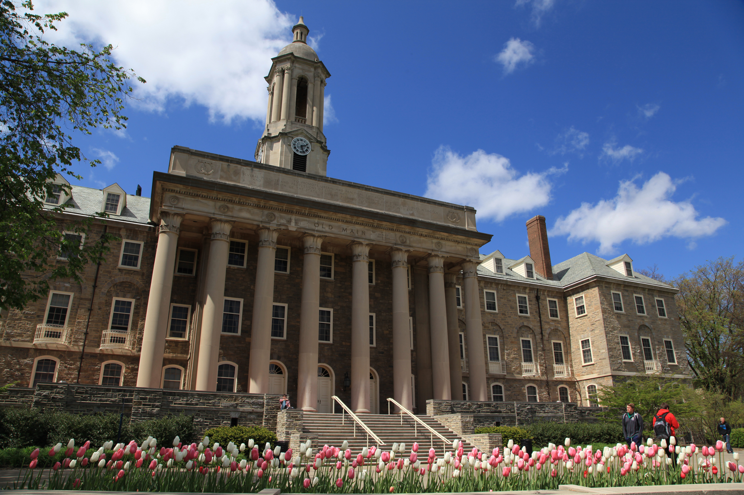

Implementation
2018
The College of Earth and Mineral Sciences Conducted an Assessment of the Living, Learning, and Working Environment (ALLWE) Survey

Slide 3
Implementation
The Environmental Assessment Working Group is Formed
Tri-Chairs: Rosie Long, Raymond Najjar, and Victoria Sanchez
Members: Joel Morrison, Kelly Rhoades, John Mauro, Rachel Conaway, Chris Forest, Jo Ann Lehtihet, Jane Sutterlin, Patricia Craig, Michael Gordon, Brandi Kamermans, Carolynne Hultquist, Jamesa Stokes, Elizabeth Hajek, Vivian Rennie, Liam Cummings, Christopher Fowler.
2018
The College of Earth and Mineral Sciences Conducted an Assessment of the Living, Learning, and Working Environment (ALLWE) Survey

Slide 4
Implementation
Survey Results are Received in August 2019
ALLWE Implementation Steering Committee is formed to develop recommendations and an action plan
ALLWE Implementation Plan was approved by EMS Executive Council and launched, in late spring 2020 – at the height of the pandemic!
The Environmental Assessment Working Group is Formed
Tri-Chairs: Rosie Long, Raymond Najjar, and Victoria Sanchez
Members: Joel Morrison, Kelly Rhoades, John Mauro, Rachel Conaway, Chris Forest, Jo Ann Lehtihet, Jane Sutterlin, Patricia Craig, Michael Gordon, Brandi Kamermans, Carolynne Hultquist, Jamesa Stokes, Elizabeth Hajek, Vivian Rennie, Liam Cummings, Christopher Fowler.
2018
The College of Earth and Mineral Sciences Conducted an Assessment of the Living, Learning, and Working Environment (ALLWE) Survey

Slide 5
Implementation
2019: ALLWE Implementation Steering Committee is Formed
Tri-Chairs: Rosie Long (2018 – 2022), Nicola Kiver (2022 – 2024), Raymond Najjar, and Victoria Sanchez
Members: Matt Bauerlin, Danielle Dedeaux, Bernardo Elizondo, Joshua M. Garber, Bernd Haupt, Khaleah Jackson, Kelly Lombardo, Jane McCandless, Alexander Massa, Joel Morrison, Cierra Naglowsky, Lynn Persing, Nicholas Prince, Aaron Procious, Stevie Rocco, Emily Shiels, Virginia Silvas, Nathan Smith, Sanjay Srinivasan, Jasmine Walker, Maria Wherley, Rahil Mohd Zaid
Previous Members: Athbi Alfarhan, Emily Aubertine, Carl Fredrick G. Aquino, Damian Archer, Frey (Jeffrey) Brownson, Tim Charatan, Hannah Chop, Jane Cook, Roger Downs, Tim Charatan, Elise Gowen, Rachel Gutierrez, Ahmed Hamed, Josh Inwood, Sofia Johnson, Meranda Kaiser, Brian King, Andrew Kleit, Elizabeth Kupp, JoAnn Lehtihet, Chris Long, Kayla McCauley, Kelly Matuszewski, Heather Moore, Shruti Natal, Hannah Perrelli, Prakash Purswani, Kelly Rhoades, Hillary Smith, Georgia Soares, Samantha Staskiewicz, Jane Sutterlin, Alisha Wellington, Sarah Wugofski, Cas Zemba
Survey Results are Received in August 2019
ALLWE Implementation Steering Committee is formed to develop recommendations and an action plan
ALLWE Implementation Plan was approved by EMS Executive Council and launched, in late spring 2020 – at the height of the pandemic!
The Environmental Assessment Working Group is Formed
Tri-Chairs: Rosie Long, Raymond Najjar, and Victoria Sanchez
Members: Joel Morrison, Kelly Rhoades, John Mauro, Rachel Conaway, Chris Forest, Jo Ann Lehtihet, Jane Sutterlin, Patricia Craig, Michael Gordon, Brandi Kamermans, Carolynne Hultquist, Jamesa Stokes, Elizabeth Hajek, Vivian Rennie, Liam Cummings, Christopher Fowler.

Slide 6
Implementation
2020
Streamlined access to resources to report wrongdoing to the College
2019: ALLWE Implementation Steering Committee is Formed
Tri-Chairs: Rosie Long (2018 – 2022), Nicola Kiver (2022 – 2024), Raymond Najjar, and Victoria Sanchez
Members: Matt Bauerlin, Danielle Dedeaux, Bernardo Elizondo, Joshua M. Garber, Bernd Haupt, Khaleah Jackson, Kelly Lombardo, Jane McCandless, Alexander Massa, Joel Morrison, Cierra Naglowsky, Lynn Persing, Nicholas Prince, Aaron Procious, Stevie Rocco, Emily Shiels, Virginia Silvas, Nathan Smith, Sanjay Srinivasan, Jasmine Walker, Maria Wherley, Rahil Mohd Zaid
Previous Members: Athbi Alfarhan, Emily Aubertine, Carl Fredrick G. Aquino, Damian Archer, Frey (Jeffrey) Brownson, Tim Charatan, Hannah Chop, Jane Cook, Roger Downs, Tim Charatan, Elise Gowen, Rachel Gutierrez, Ahmed Hamed, Josh Inwood, Sofia Johnson, Meranda Kaiser, Brian King, Andrew Kleit, Elizabeth Kupp, JoAnn Lehtihet, Chris Long, Kayla McCauley, Kelly Matuszewski, Heather Moore, Shruti Natal, Hannah Perrelli, Prakash Purswani, Kelly Rhoades, Hillary Smith, Georgia Soares, Samantha Staskiewicz, Jane Sutterlin, Alisha Wellington, Sarah Wugofski, Cas Zemba
Survey Results are Received in August 2019
ALLWE Implementation Steering Committee is formed to develop recommendations and an action plan
ALLWE Implementation Plan was approved by EMS Executive Council and launched, in late spring 2020 – at the height of the pandemic!

Slide 7
Implementation
2021
Each Department within EMS appoints first ever DEI Associate Heads
2020
Streamlined access to resources to report wrongdoing to the College
2019: ALLWE Implementation Steering Committee is Formed
Tri-Chairs: Rosie Long (2018 – 2022), Nicola Kiver (2022 – 2024), Raymond Najjar, and Victoria Sanchez
Members: Matt Bauerlin, Danielle Dedeaux, Bernardo Elizondo, Joshua M. Garber, Bernd Haupt, Khaleah Jackson, Kelly Lombardo, Jane McCandless, Alexander Massa, Joel Morrison, Cierra Naglowsky, Lynn Persing, Nicholas Prince, Aaron Procious, Stevie Rocco, Emily Shiels, Virginia Silvas, Nathan Smith, Sanjay Srinivasan, Jasmine Walker, Maria Wherley, Rahil Mohd Zaid
Previous Members: Athbi Alfarhan, Emily Aubertine, Carl Fredrick G. Aquino, Damian Archer, Frey (Jeffrey) Brownson, Tim Charatan, Hannah Chop, Jane Cook, Roger Downs, Tim Charatan, Elise Gowen, Rachel Gutierrez, Ahmed Hamed, Josh Inwood, Sofia Johnson, Meranda Kaiser, Brian King, Andrew Kleit, Elizabeth Kupp, JoAnn Lehtihet, Chris Long, Kayla McCauley, Kelly Matuszewski, Heather Moore, Shruti Natal, Hannah Perrelli, Prakash Purswani, Kelly Rhoades, Hillary Smith, Georgia Soares, Samantha Staskiewicz, Jane Sutterlin, Alisha Wellington, Sarah Wugofski, Cas Zemba

Slide 8
Implementation
2021
EMS DEI awards program first introduced
Awards for Undergraduates, Graduate Students, Postdocs, Faculty, Staff
2021
Each Department within EMS appoints first ever DEI Associate Heads
2020
Streamlined access to resources to report wrongdoing to the College

Slide 9
Implementation
2022
EMS "Start of Semester" email detailing reporting methods/information sent to members of the College
2021
EMS DEI awards program first introduced
Awards for Undergraduates, Graduate Students, Postdocs, Faculty, Staff
2021
Each Department within EMS appoints first ever DEI Associate Heads

Slide 10
Implementation
2022
EMS Undergraduate Student Council "Stall Stories" and EMS Undergraduate Newsletter incorporate valuable information and resource links to support members of the College in need of help
2022
EMS "Start of Semester" email detailing reporting methods/information sent to members of the College
2021
EMS DEI awards program first introduced
Awards for Undergraduates, Graduate Students, Postdocs, Faculty, Staff

Slide 11
Implementation
ALLWE've Achieved by the Numbers in EMS
2022
EMS Undergraduate Student Council "Stall Stories" and EMS Undergraduate Newsletter incorporate valuable information and resource links to support members of the College in need of help
2022
EMS "Start of Semester" email detailing reporting methods/information sent to members of the College
51 action items across 5 priority themes
43 of the 51 action items have been operationalized
Only 6 need additional work to become operationalized

Slide 12
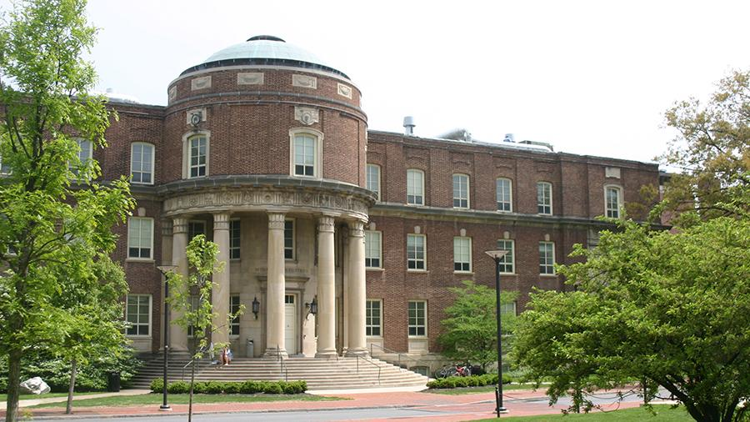
Implementation
ALLWE've Achieved by the Numbers in EMS
2022
EMS Undergraduate Student Council "Stall Stories" and EMS Undergraduate Newsletter incorporate valuable information and resource links to support members of the College in need of help
2019 to 2024
Proportion of female tenure-line faculty increased from 24.3% to 34.3%
51 action items across 5 priority themes
43 of the 51 action items have been operationalized
Only 6 need additional work to become operationalized

Slide 13
ALLWE've Achieved by the Numbers in EMS
2019 to 2024
Proportion of international tenure-line faculty increased from 5.9% to 17.1%
2019 to 2024
Proportion of female tenure-line faculty increased from 24.3% to 34.3%
51 action items across 5 priority themes
43 of the 51 action items have been operationalized
Only 6 need additional work to become operationalized

Slide 14
ALLWE've Achieved by the Numbers in EMS
2019 to 2024
Proportion of female post-docs increased from 13.5% to 41.7%
2019 to 2024
Proportion of international tenure-line faculty increased from 5.9% to 17.1%
2019 to 2024
Proportion of female tenure-line faculty increased from 24.3% to 34.3%

Slide 15
ALLWE've Achieved by the Numbers in EMS
2019 to 2024
Proportion of female undergraduates at University Park increased from 28.7% to 33.2%
2019 to 2024
Proportion of female post-docs increased from 13.5% to 41.7%
2019 to 2024
Proportion of international tenure-line faculty increased from 5.9% to 17.1%

Slide 16
ALLWE've Achieved by the Numbers in EMS
2019 to 2024
Proportion of Black/African American graduate students increased from 2.8% to 3.7%
2019 to 2024
Proportion of female undergraduates at University Park increased from 28.7% to 33.2%
2019 to 2024
Proportion of female post-docs increased from 13.5% to 41.7%

Slide 17
ALLWE've Achieved by the Numbers in EMS
2019 to 2024
Number of URM non-tenure line faculty remained steady despite overall decrease in number of NTL faculty
2019 to 2024
Proportion of Black/African American graduate students increased from 2.8% to 3.7%
2019 to 2024
Proportion of female undergraduates at University Park increased from 28.7% to 33.2%

Slide 18
ALLWE've Achieved by the Numbers in EMS
Community
2020
POEMS (Postdocs of EMS) formed
2019 to 2024
Number of URM non-tenure line faculty remained steady despite overall decrease in number of NTL faculty
2019 to 2024
Proportion of Black/African American graduate students increased from 2.8% to 3.7%

Slide 19
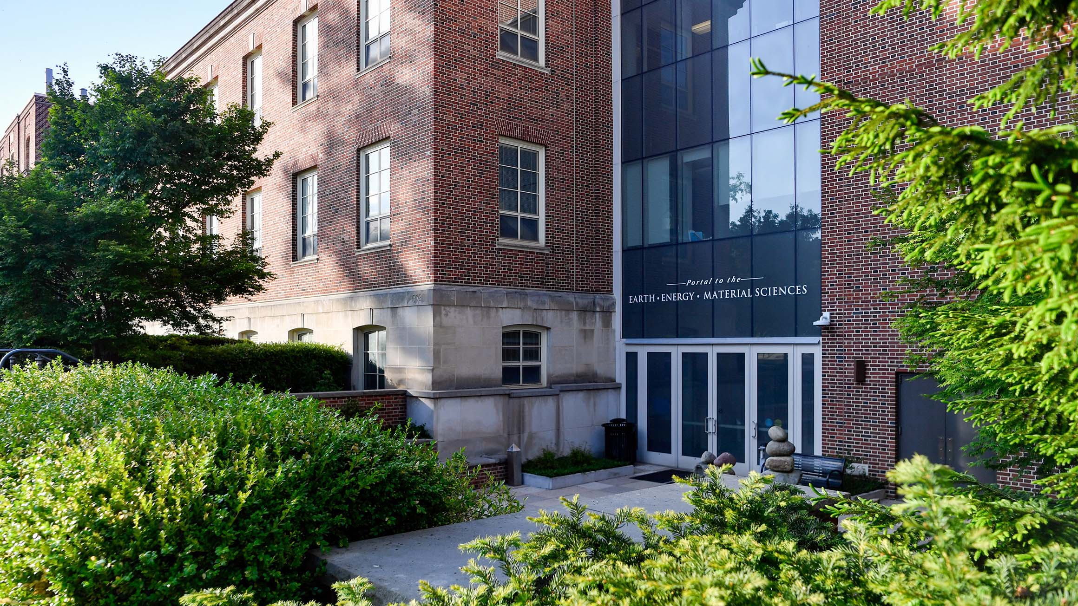
ALLWE've Achieved by the Numbers in EMS
Community
2020
History of Women in EMS project conducted for EMS 125th Anniversary
2020
POEMS (Postdocs of EMS) formed

Slide 20
Community
2021, 2022
Departments of Geoscience and Meteorology and Atmospheric Science participate in URGE
2020
History of Women in EMS project conducted for EMS 125th Anniversary
2020
POEMS (Postdocs of EMS) formed

Slide 21
Community
POEMS supports Science Buzz initiative sponsored by EESI
2021, 2022
Departments of Geoscience and Meteorology and Atmospheric Science participate in URGE
2020
History of Women in EMS project conducted for EMS 125th Anniversary

Slide 22
Community
2020, 2022, 2024
EMS reads designed to explore topics of DEI in the Earth Sciences
POEMS supports Science Buzz initiative sponsored by EESI
2021, 2022
Departments of Geoscience and Meteorology and Atmospheric Science participate in URGE

Slide 23
Community
2021
EMS Rainbow Network launched
2020, 2022, 2024
EMS reads designed to explore topics of DEI in the Earth Sciences
POEMS supports Science Buzz initiative sponsored by EESI

Slide 24
Community
2021
Cub Pantry opens in the EMS Library
2021
EMS Rainbow Network launched
2020, 2022, 2024
EMS reads designed to explore topics of DEI in the Earth Sciences

Slide 25
Community
2021
RFSC remodeled
2022
EESI remodeled
2021
Cub Pantry opens in the EMS Library
2021
EMS Rainbow Network launched

Slide 26
Community
2021 - 2025
EESI Earth Talks emphasize discussion of the need for diversity in the Earth Sciences
2021
RFSC remodeled
2022
EESI remodeled
2021
Cub Pantry opens in the EMS Library

Slide 27
Community
Opening Fall 2024
Community Room in Deike Building for Underrepresented Undergraduate and Graduate Students to help foster community
2021 - 2025
EESI Earth Talks emphasize discussion of the need for diversity in the Earth Sciences
2021
RFSC remodeled
2022
EESI remodeled

Slide 28
Community
2023-2024
Women and Gender Diversity in EMS Inclusivity Lounge held in EMS Library
Opening Fall 2024
Community Room in Deike Building for Underrepresented Undergraduate and Graduate Students to help foster community
2021 - 2025
EESI Earth Talks emphasize discussion of the need for diversity in the Earth Sciences

Slide 29
Community
2023, 2024
EMS Library and Sustainability Council Student Committee created "Dodge the Dumpster" to collect school supplies to support students in need
2023-2024
Women and Gender Diversity in EMS Inclusivity Lounge held in EMS Library
Opening Fall 2024
Community Room in Deike Building for Underrepresented Undergraduate and Graduate Students to help foster community

Slide 30
Community
2024
WAFS fellows hold Ask a Scientist booth and EMS-related outreach activities in State College Pride, Arts Fest
2023, 2024
EMS Library and Sustainability Council Student Committee created "Dodge the Dumpster" to collect school supplies to support students in need
2023-2024
Women and Gender Diversity in EMS Inclusivity Lounge held in EMS Library

Slide 31
Community
2024
ADGER creates Graduate Student Collaboration Space to allow for cross-department Graduate Student networking
2024
WAFS fellows hold Ask a Scientist booth and EMS-related outreach activities in State College Pride, Arts Fest
2023, 2024
EMS Library and Sustainability Council Student Committee created "Dodge the Dumpster" to collect school supplies to support students in need

Slide 32
Community
Coming Fall 2024
EMS partners with other STEM College to establish faculty affinity support networks
2024
ADGER creates Graduate Student Collaboration Space to allow for cross-department Graduate Student networking
2024
WAFS fellows hold Ask a Scientist booth and EMS-related outreach activities in State College Pride, Arts Fest

Slide 33
Community
Accomplice-ship
Extensive resources for active allies posted on College of EMS website
Coming Fall 2024
EMS partners with other STEM College to establish faculty affinity support networks
2024
ADGER creates Graduate Student Collaboration Space to allow for cross-department Graduate Student networking

Slide 34
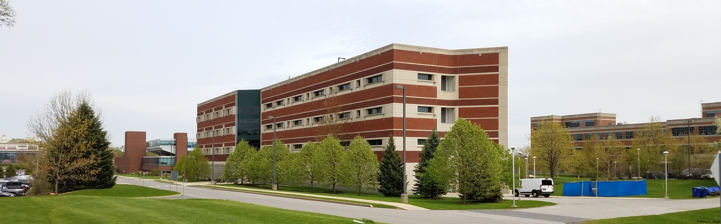
Community
Accomplice-ship
The Ryan Family Student Center rebrands TOTEMS as TEEMS, adds intentional community focused programming and conducts targeted outreach to underrepresented students
Extensive resources for active allies posted on College of EMS website
Coming Fall 2024
EMS partners with other STEM College to establish faculty affinity support networks

Slide 35
Accomplice-ship
2021
The Ryan Family Student Center establishes a weekly EMS Undergraduate Newsletter and CANVAS site to disseminate important news to EMS undergraduates
The Ryan Family Student Center rebrands TOTEMS as TEEMS, adds intentional community focused programming and conducts targeted outreach to underrepresented students
Extensive resources for active allies posted on College of EMS website

Slide 36
Accomplice-ship
2021
Dutton Institute antiracism book club formed
2021
The Ryan Family Student Center establishes a weekly EMS Undergraduate Newsletter and CANVAS site to disseminate important news to EMS undergraduates
The Ryan Family Student Center rebrands TOTEMS as TEEMS, adds intentional community focused programming and conducts targeted outreach to underrepresented students

Slide 37
Accomplice-ship
2021
Harassment-Free program for the Association of American Geographers implemented
2021
Dutton Institute antiracism book club formed
2021
The Ryan Family Student Center establishes a weekly EMS Undergraduate Newsletter and CANVAS site to disseminate important news to EMS undergraduates

Slide 38
Accomplice-ship
Meteorology and Atmospheric Science Graduate Student Organization creates affinity group to support women in meteorology
2021
Harassment-Free program for the Association of American Geographers implemented
2021
Dutton Institute antiracism book club formed

Slide 39
Accomplice-ship
2022
OMBUDS access expanded to allow students access to OMBUDS person outside of their core department and to serve Postdocs
Meteorology and Atmospheric Science Graduate Student Organization creates affinity group to support women in meteorology
2021
Harassment-Free program for the Association of American Geographers implemented

Slide 40
Accomplice-ship
2023
Group-watch and discussion sessions around the multi-part BUILD program introduced to the College
2022
OMBUDS access expanded to allow students access to OMBUDS person outside of their core department and to serve Postdocs
Meteorology and Atmospheric Science Graduate Student Organization creates affinity group to support women in meteorology

Slide 41
Accomplice-ship
Diversity
2019
Operationalized participation in “Changing the Future” leadership mentoring program for Women in STEM
2019
Operationalized participation in “Changing the Future” leadership mentoring program for Women in STEM
2023
Group-watch and discussion sessions around the multi-part BUILD program introduced to the College
2022
OMBUDS access expanded to allow students access to OMBUDS person outside of their core department and to serve Postdocs

Slide 42
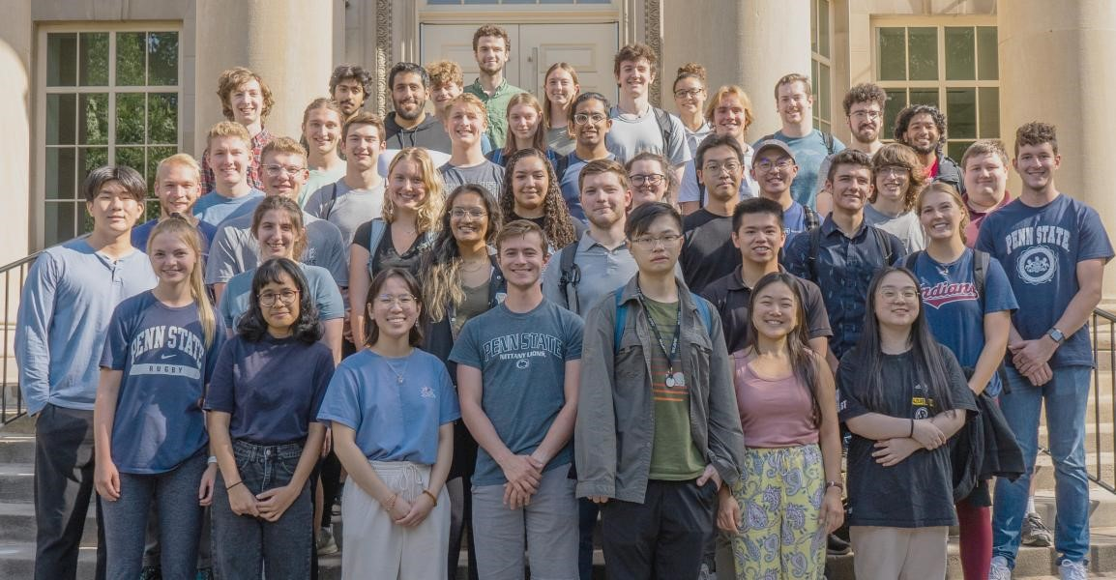
Accomplice-ship
Diversity
2021 - 2024
EMS participated in creation of the Penn State President’s Postdoctoral Fellowship Program. Successfully brought in a Postdoc Fellow in first cycle. Successfully hired into tenure track, University’s first success
2019
Operationalized participation in “Changing the Future” leadership mentoring program for Women in STEM
2023
Group-watch and discussion sessions around the multi-part BUILD program introduced to the College

Slide 43
Diversity
2022
Faculty Diversity ad hoc group formed and completed. Recommended guidelines have been incorporated into faculty and administrator searches
2021 - 2024
EMS participated in creation of the Penn State President’s Postdoctoral Fellowship Program. Successfully brought in a Postdoc Fellow in first cycle. Successfully hired into tenure track, University’s first success
2019
Operationalized participation in “Changing the Future” leadership mentoring program for Women in STEM

Slide 44
Diversity
2022
EESI Environmental Scholars Program designed to diversify graduate student pool in EMS
2022
Faculty Diversity ad hoc group formed and completed. Recommended guidelines have been incorporated into faculty and administrator searches
2021 - 2024
EMS participated in creation of the Penn State President’s Postdoctoral Fellowship Program. Successfully brought in a Postdoc Fellow in first cycle. Successfully hired into tenure track, University’s first success

Slide 45
Diversity
2022
MATSE DEI fund established in honor of 115th MATSE anniversary
2022
EESI Environmental Scholars Program designed to diversify graduate student pool in EMS
2022
Faculty Diversity ad hoc group formed and completed. Recommended guidelines have been incorporated into faculty and administrator searches

Slide 46

Diversity
Mental Health Support
2019
EME organized social gatherings for students sponsored by Aramco
2022
MATSE DEI fund established in honor of 115th MATSE anniversary
2022
EESI Environmental Scholars Program designed to diversify graduate student pool in EMS

Slide 47
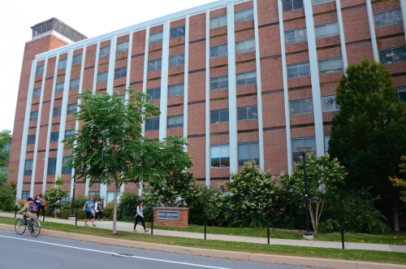
Mental Health Support
2021
Quiet room in RFSC has health and wellness information for students
2019
EME organized social gatherings for students sponsored by Aramco
2022
MATSE DEI fund established in honor of 115th MATSE anniversary

Slide 48
Mental Health Support
2023
Graduate Student Peer Mentoring/Engagement Program launched to increase support and networking to support work-life balance
2021
Quiet room in RFSC has health and wellness information for students
2019
EME organized social gatherings for students sponsored by Aramco

Slide 49
Mental Health Support
Intra-College Bonding
2021
Geosciences established Community Event Listserv
2023
Graduate Student Peer Mentoring/Engagement Program launched to increase support and networking to support work-life balance
2021
Quiet room in RFSC has health and wellness information for students

Slide 50
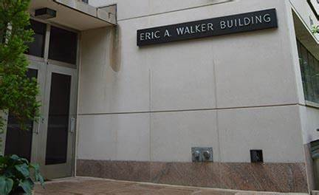
Mental Health Support
Intra-College Bonding
2022
Women and Gender Diversity in EMS and Undergraduate Student Council sponsors bystander intervention program
2021
Geosciences established Community Event Listserv
2023
Graduate Student Peer Mentoring/Engagement Program launched to increase support and networking to support work-life balance

Slide 51
Intra-College Bonding
2022
EESI holds scholar lunches so Environmental Scholars can share research with their peers
2022
Women and Gender Diversity in EMS and Undergraduate Student Council sponsors bystander intervention program
2021
Geosciences established Community Event Listserv

Slide 52
Intra-College Bonding
2023
Graduate mentoring/engagement program established first-year graduate student welcome retreat
2022
EESI holds scholar lunches so Environmental Scholars can share research with their peers
2022
Women and Gender Diversity in EMS and Undergraduate Student Council sponsors bystander intervention program

Slide 53
Intra-College Bonding
Society for Supporting Women in Meteorology hosts coffee get-together events to discuss challenges women face in meteorology
2023
Graduate mentoring/engagement program established first-year graduate student welcome retreat
2022
EESI holds scholar lunches so Environmental Scholars can share research with their peers

Slide 54
Intra-College Bonding
EMS graduate listserv established to easily disseminate information to all EMS graduate students
EMS POEMS listserv established to easily disseminate information to all EMS postdocs
Society for Supporting Women in Meteorology hosts coffee get-together events to discuss challenges women face in meteorology
2023
Graduate mentoring/engagement program established first-year graduate student welcome retreat

Slide 55
Intra-College Bonding
Weekly EMS Digest established to easily disseminate important news to EMS Faculty, Staff, and Postdocs
EMS graduate listserv established to easily disseminate information to all EMS graduate students
EMS POEMS listserv established to easily disseminate information to all EMS postdocs
Society for Supporting Women in Meteorology hosts coffee get-together events to discuss challenges women face in meteorology

Slide 56
Intra-College Bonding
Moving Forward
ALLWE's ongoing activities becoming part of the EMS Diversity Council mission | Administrative Stewards continuing to provide oversight
Weekly EMS Digest established to easily disseminate important news to EMS Faculty, Staff, and Postdocs
EMS graduate listserv established to easily disseminate information to all EMS graduate students
EMS POEMS listserv established to easily disseminate information to all EMS postdocs

Slide 57
Intra-College Bonding
Moving Forward
ALLWE's ongoing activities becoming part of the EMS Diversity Council mission | Administrative Stewards continuing to provide oversight
Weekly EMS Digest established to easily disseminate important news to EMS Faculty, Staff, and Postdocs

