Slide 1







Megan Evans
Interim Director
Director of Communications & Agency Relations
megan@ccunitedway.org

Slide 2


Our Mission
The mission of the Centre County United Way is to improve lives by prioritizing needs and mobilizing human and financial resources to positively impact the education, financial stability, and physical & emotional health of our neighbors.

Slide 3
We are often asked....
What exactly does United Way do?

Slide 4
The answer is simple:
We help organizations that help people.
That’s our most important goal. To help as many of our neighbors in Centre County have access to programs that focus on the building blocks of a happy and healthy life — education, financial stability, and health.
We help babies, kids, teens, adults, grandparents, and families.
We help people who need shelter, food, a friend. People who have disabilities and illnesses.
People who want to make their lives better.
People who just need a hand up. People who need hope.
How do we help so many people with so many different needs? Here’s the key — we partner with local health and human service agencies where our neighbors in need go for help, places like Centre Helps, Strawberry Fields, Tides, Easterseals, Centre Volunteers in Medicine, Housing Transitions, Park Forest Preschool and MORE!
Instead of focusing on one single need or issue, we focus on hundreds — helping our community as a whole.
So not only does your donation to Centre County United Way go to the need that is closest to your heart, it also goes to the needs that may be less obvious but no less important.

Slide 5

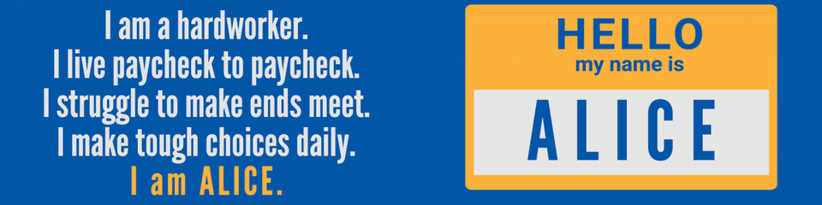


Have you met ALICE?
Asset Limited - Income Constrained - Employed
  30% OF CENTRE COUNTY HOUSEHOLDS ARE STRUGGLING TO MEET THEIR BASIC NEEDS DESPITE WORKING ONE OF MORE JOBS. (state average 28%)
  17% are living below the federal poverty line. (state average 12%)
  47% of our neighbors are struggling.
ALICE isn’t hiding! ALICE is a cashier, a waiter, a childcare worker, and other members of our essential workforce. ALICE earns just above the Federal Poverty Level but less than what it costs to make ends meet. These struggling households are forced to make impossible choices each day.

Slide 6
So how does Centre County United Way provide financial support?
Well, that’s where YOU come in.
This level of help is possible because thousands of people and businesses
across Centre County generously make donations.
And the beauty is the money raised here stays here — in our community —
helping the people who actually live here.
And this is where it gets really cool.
In the same way that all kinds of people donate and get help from Centre County United Way,
all kinds of people decide how the money is distributed to the partner agencies.
More than 100 of our neighbors volunteer their time each year to review these nonprofits
in the areas of quality programming, outcomes, finance, and administration.
This volunteer effort makes Centre County United Way extremely efficient —
and keeps operating costs low so that more people can be helped.
Everything we do at Centre County United Way is done with the betterment of our community in mind.
Great things happen when we LIVE UNITED!

Slide 7




How do we fit in?
  United Way Worldwide (UWW) is the “parent” organization, located in Alexandria, Virginia, lead by Angela Williams.
  Founded in 1887 in Denver, Colorado by a woman, a priest, 2 ministers and a rabbi. Talk about diversity!
  UWW, through local United Way organizations, is engaged in more than 1,100 communities in 37 countries and territories.
  Across the world, United Way is local leaders, local donors and volunteers investing in local solutions to improve the lives of neighbors. UWW does not control how local United Ways operate.
  Local United Ways pay an annual fee for membership which is a percentage of the campaign dollars raised locally.
  UWW provides training, marketing materials, advocacy, and leadership to local United Way organizations.
  The United Way of Pennsylvania (UWP) is a 501(c)(3) which was created in 1966 as Community Services of PA and re-named in 1979.
  UWP offices are located in Harrisburg.
  It is a membership organization whose purpose is to assist and champion the efforts of local United Ways.
  UWP engages and connects local United Ways with resources that will help them address their community needs.
  UWP serves as the voice for member local United Ways on state public policy issues that relate to community impact work in education, income, and health.
  UWP provides trainings and an annual statewide conference to members across the state.
  UWP members pay an annual membership fee.
  Centre County United Way (CCUW) is the local United Way organization that serves all of Centre County, PA.
  There are 51 local United Way organizations in PA - not all are members of UWP - but MUST BE a member of United Way Worldwide.
  We run an anual campaign to fund specific programs offered by our partner agencies.
  We also run the Dolly Parton Imagimation Library program for Centre County youth.
  We do more than raise money! We bring people togther to tackle challenges in our communities.

Slide 8

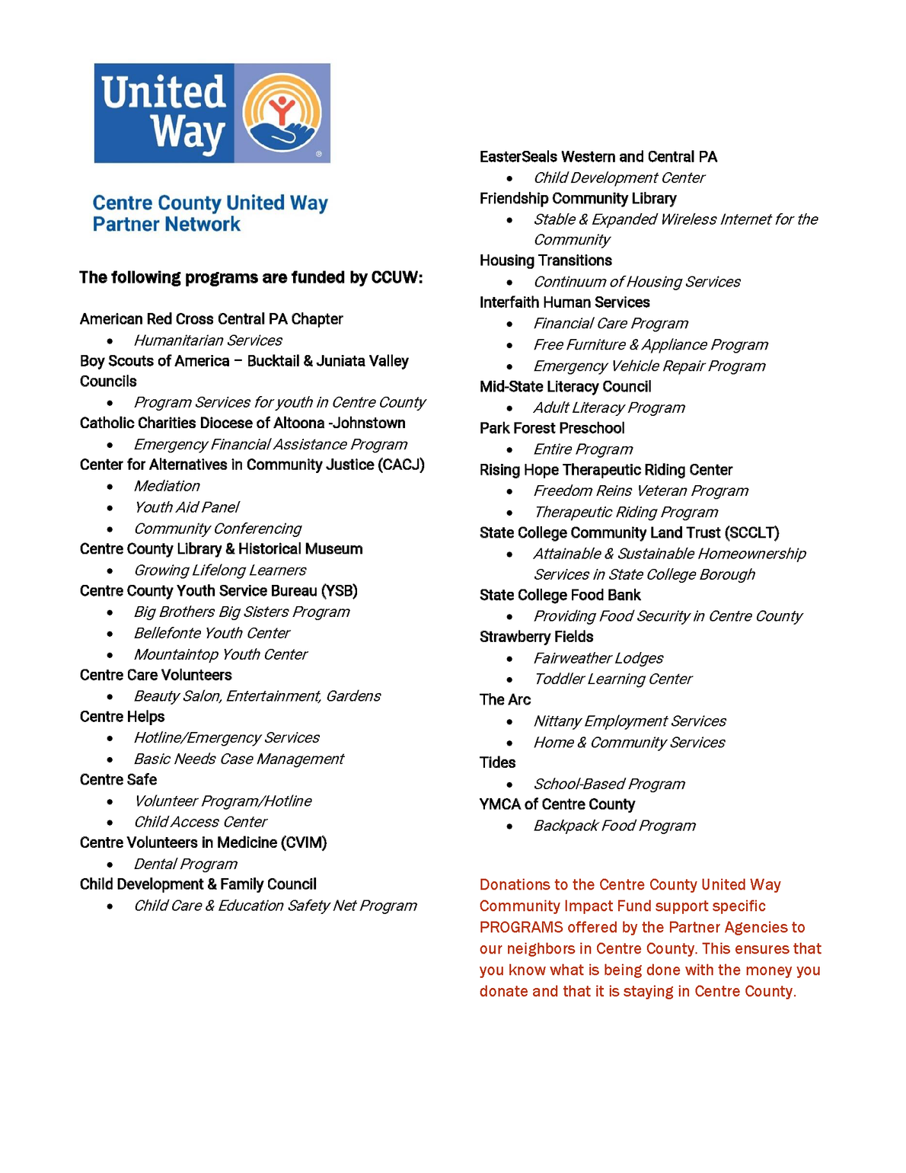


Our Partner Agencies
We parter with local health and human service agencies who provide programs to our neighbors that address health, eduction, and financial stability
The money we raise through the annual campaign is allocated to our partner agencies to fund specific programs.

Slide 9



Volunteer Opportunities
Result
  Board of Directors - all year
  Committees - all year
    Board Development
    Campaign
    Communications
    DEIB
    Finance
    Funds Distribution
    HR
  Events (day of)
    Campaign Events
    Day of Caring - 1st Thursday in October
    Penn State Golf - September 16, 2024
    Penn State Over the Edge - October 8th
    Taste of the Town - Nov 24, 2024
  Events (planning)
    Taste of the Town - July thru December
  Funds Distribution- March/April

Slide 10
Result
The Board
BOARD of DIRECTORS
Responsibilities and Expectations
  Establish and monitor financial policies and pratices
  Select and support the Executive Director; review his/her performance
  Regularly review and, if appropriate, revise the mission and vision of the organizationsw
  Approve programs/projects that are consistent with the mission of the organization
  Approve partner agency allocations
Participation
  Attend scheduled board meetings and be an active participant on the board
  Actively serve as a member of at least one committees
  Prepare in advance for board and committee meetings/discussions
  Participate in annual and strategicplanning
Fundraising/Financial
  Be an active participant in fundraising activities, including the campaign
  Make a personal financial commitment within your means
Public Relations/Community Outreach
  Support the mission of the Centre County United Way and ensure the organization is responsive to the population it serves
  Promote the United Way and serve as a liaison within your place of employment, civic group, and religious organization
  Enhance the Centre County United Way’s public standing and brand identity - LIVE UNITED
Primary Staff Support: Executive Director

Slide 11
Committees
Result
CAMPAIGN COMMITTEE
Charge
Provide leadership and direction for all aspects of the Untied Way campaign.
The co-chairs are responsible for planning campaign strategies and directing their mplementation,
goal development and recruitment of a motivated, committedcore of result-oriented volunteers to serve. The Chair maintains a
high profile throughout the campaign and interacts frequently with the volunteers. Accountable to the Board Chair and Board of Directors.
Composition
Co-chairs appointed by the Board of Directors on recommendation from the Board Development Committee. Co-chairs rotate off the committee on an everyother-
year cycle so that one chair holds seniority. Thus, total time commitment to serve as co-chair is two years.
Responsibilities:
  Preside at Campaign Cabinet Meetings.
  Appoint division chairs who are responsible for the effective solicitation of assigned prospects.
  Work with staff to assure appropriate training of all campaign volunteers.
  Approve a coordinated timetable for campaign organization, kick-off, reporting and follow-up.
  Approve a communication plan to market the campaign in the most effective manner possible.
  Develop and implement the goals and objectives of the CCUW strategic plan as it relates to the campaign.
  Monitor each campaign division’s progress toward its goal in keeping with the campaign timetable.
  Attend and represent the Campaign Cabinet at board and executive committee meeting.
Primary Staff Support: Campaign and Relationship Manager

Slide 12
Committees
Result
FUNDS DISTRIBUTION & OVERSIGHT COMMITTEE
Charge: Guide the logistics of funds distribution
Composition:
Board member as chair and at least five members, who may or may not be Board members.
Responsibilities:
·Guide the development of annual panel structure and processes, including terms of service for panel chairs, panel membership composition, processes for assessment of written applications, and processes for developing panel recommendations
·Develop approach for Chairs’ Meeting to determine funds distribution recommendations
The Funds Distribution Oversight Committee shall guide the logistics of funds distribution. Recommended allocations to CCUW Partner Agencies will be made directly to the Board of Directors by the annually appointed group of panel chairs. The panel chairs shall be appointed by the Funds Distribution Oversight Committee. Recommend allocations to each partner organization will be based upon the undesignated pool available from the previous campaign as approved by the Finance Committee. An ad hoc committee may be appointed by the chair to provide advice and counsel to the Board of Directors as needed on matters concerning Special Initiatives Funding. (Special Initiatives Funding shall be defined as all special projects funding for human service agencies which falls outside of annual member organization allocations). This Committee shall also review requests for admission by new agencies and make recommendations to the Board.
Primary Staff Support: Director of Communications and Agency Relations

Slide 13
How do we raise money?
  Workplace Campaigns at local businesses - Ja Nae
  Direct Mail Solicitations to businesses not doing a Workplace Campaign - Ja Nae
  Direct Mail Solicitations to Centre County residents - Megan
  Direct Mail Solicitations to Penn State retirees - Megan
  Special Events - Celesta Powell
    Taste of the Town
  Penn State Campaign - All Staff
    Penn State IT Golf Tournament
    Over the Edge
    Other Special Events by Unit (flower sales, 50/50, office Olympics)

Slide 14






What are CCUW Affinity Groups?
  Tocqueville - yearly donation of $10,000 or more
  Leadership Circle - yearly donation of $1,000 or more
  Women United - focus on women and children, grant program
  Emerging Leaders - newly formed!!

Slide 15

Dolly Parton’s Imagination Library
Our FIRST direct service program launched on April 1, 2024
when we partnered with Dolly Parton’s Imagination Library!
This program is specifically for Centre County youth ages Birth - 5 years old.
Children who enroll in the Centre County Imagination Library receive a free book in the mail, every month, at no cost to the family.
Centre County United Way is responsible for managing the registation database and funding the program.
The cost of sending one book to one child is $2.20- making the cost for a full year of books, $26.40!

Slide 16



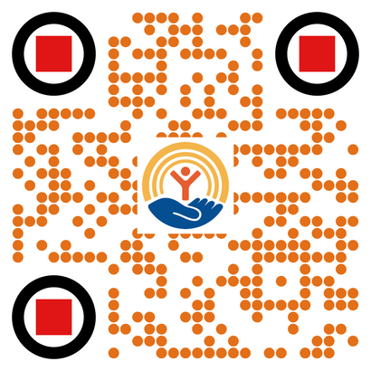
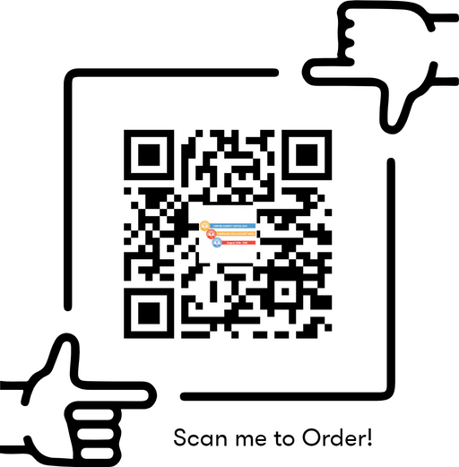
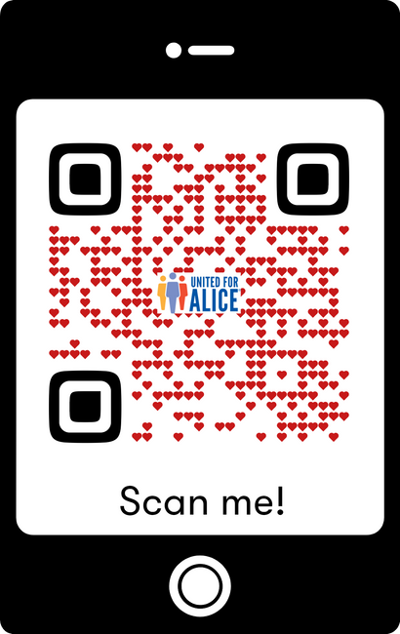
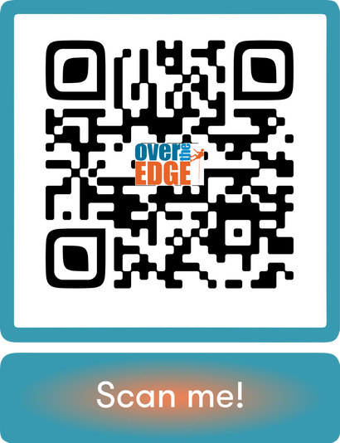
Scan to DONATE
Scan to VOLUNTEER

