Slide 1
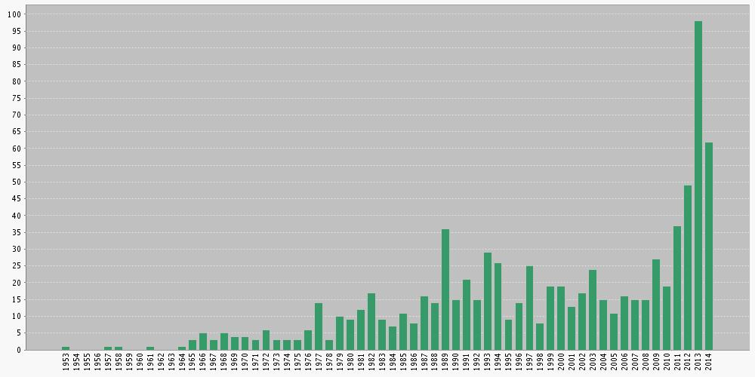
Number of scholarly articles with “hydraulic fracturing” in their title
(1953-2014)
Source: Web of Knowledge (ISI), October 7, 2014

