Slide 1
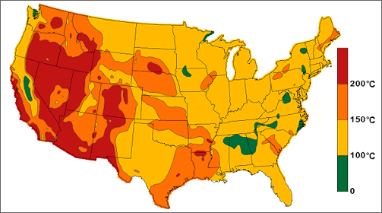
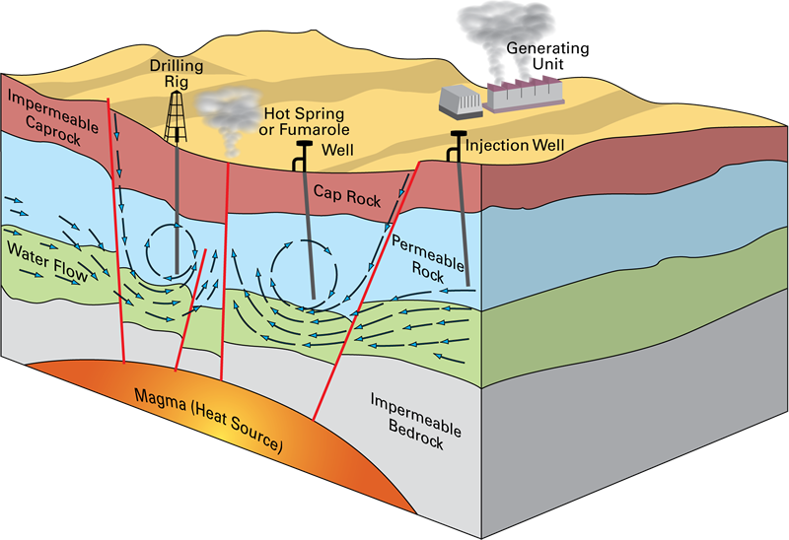
Resource Assessment
By: Jeff Horst
EGEE 497
Geothermal

Slide 2
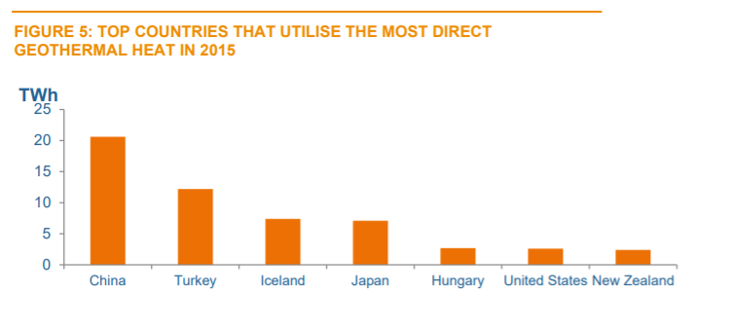
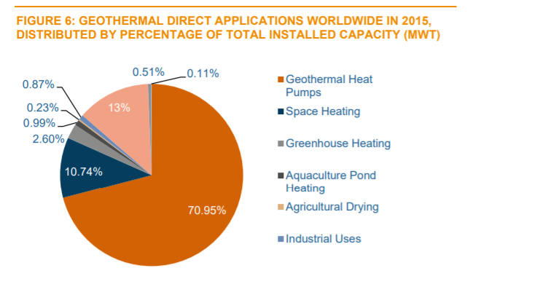
Geothermal Overview:
Geothermal energy is a sustainable, carbon free, renewable resource that provides a continuous uninterrupted supply of heat that can be used to heat homes and office buildings
Assessing a resource is a fundamental activity that is used in all energy enterprises to measure the amount of potential heat, but more significantly to see if the assessment is economically feasible
The scale at which this effort is carried out can be local, such as assessing the long-term energy availability from a single hot spring, or it can be extremely broad, such as a national resource assessment.

Slide 3
Assessing a geothermal resource:
A systematic analysis needs to be conducted in order to determine whether or not a geothermal plant is viable
Systematic considerations:
-Economic viability (most significant)
- local geothermal gradient
-drilling costs
-competition with other energy sources
-local markets
-regional markets
-national markets
-scale

Slide 4
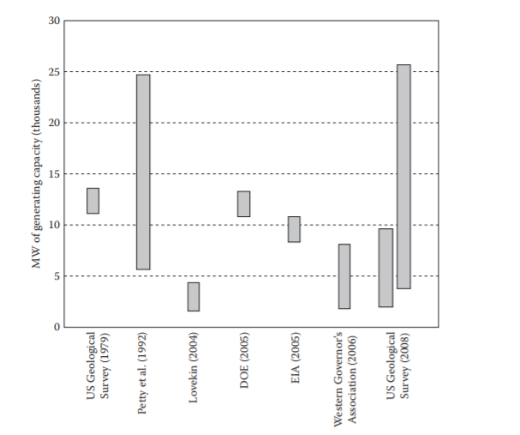
Case Study: Resource assessment for California
Resource Evaluation Timeline:
The first national assessment carried out in 1975 (White and Williams 1975)
The second systematic assessment of the geothermal resource in the United States was by Muffler in 1979
Several other assessments have been carried out on a variety of scales, most of them regional or state-wide
It is possible that different studies will produce widely different estimates of a resource, and yet they each may be correct.

Slide 5
The Driving Equation:
$$Q_{r}=ρ ∗C∗V∗\left(T_{r}−T_{0}\right)$$
$$\left[J\right]=\frac{g}{cm^{3}}∗\frac{J}{g∗K}∗cm^{3}∗K$$
Where:
$Q_{r}$= the heat available in the reservoir [J]
$ρ$= the density of the rock making up the reservoir [$g/cm^{3}$ ]
$C$= the heat capacity of the reservoir rock [J/g-K]
V= the volume of the reservoir $\left[cm^{3}\right]$
$\left(T_{r}−T_{0}\right)$= the difference between the reservoir temperature $T_{r}$ and the end-state temperature $T_{0}$

Slide 6
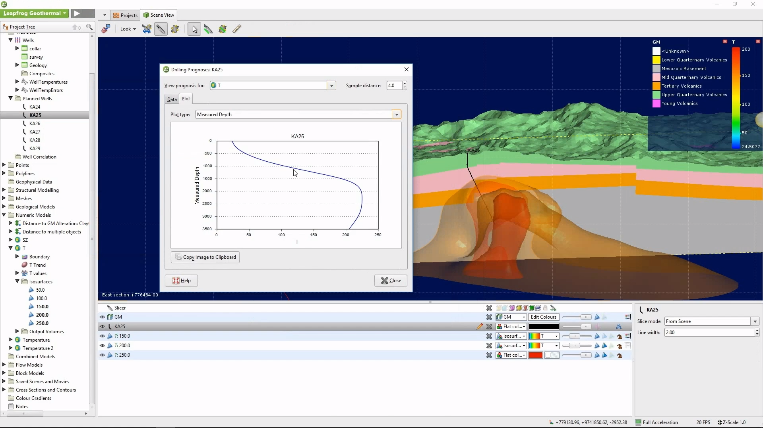
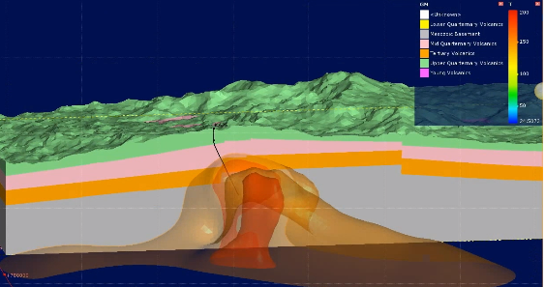
Resource Base and Reserves:
It is important to know how much of a material or substance exists in order to conduct global mass balance calculations.
From a regulatory perspective, it may be important to establish the extent of a resource that is potentially extractable in order to determine how best to manage development of the resource in a way that is also environmentally intelligent.
From an economic perspective, it may be that an estimate is needed to determine how much of a resource can be extracted using a specific kind of technology in order to establish the economic potential of a development project

Slide 7
Uncertainty:
A site may be suitable for development using available technology but cannot be economically brought online because it is too remote from a transmission system.
Some reservoirs may not be economically viable under existing tax and incentive structures but would be with a small change in either regulatory framework
The combined total of theoretically accessible and theoretically inaccessible sources of heat are called the resource base
The development of high-efficiency binary cycle generating systems is an example of such a technological breakthrough that allowed the economic development of moderate temperature geothermal reservoirs, thus changing both the reserve and the resource estimates for geothermal power generation.
Definitions:
The resource: is that portion of the resource base that is technologically accessible, whether or not it is currently economically suitable for development under current market conditions.
The reserve: is that portion of the resource base that is accessible and can be economically developed.

Slide 8
Reservoir Volume:
Geothermal reservoirs exist in the subsurface at depths of hundreds to thousands of meters, and it is thus difficult to obtain detailed information about their geometry
“If we consider only the area in the cross section of the reservoir that is at temperatures in excess of 250°C, the area is equivalent to ∼42,000 m2. If, however, the most eastern well had not been drilled, and the remaining three eastern wells had not exceeded depths of 1400 m, the constrained area of the reservoir could have been estimated to be as much as ∼70,000 m2. This hypothetical example provides insight into the importance of having data that provide constraints on the extent of the temperature distribution in the subsurface. In the absence of well-defined constraints, it is important to understand what the limitations of a dataset may be and to consider the implications for the accuracy of the assessments. Note, too, that this example represents a two-dimensional section through a three-dimensional volume. To accurately establish the volume of the reservoir, with minimal uncertainty, it is necessary to have an array of wells that delineate the three-dimensional distribution of the relevant isotherms. Because of the cost involved, it is often prohibitive to conduct such an extensive drilling program and estimates of the resource volume will have to rely on best guesses.”
“In many cases, there may be little or no subsurface data available from a drilling and exploration program, although evidence may exist that a geothermal reservoir is present. The presence of a flowing hot spring is an example of such an occurrence. Strategies for dealing with instances in which subsurface information is inadequate have been developed for some geological settings that allow conservative estimates to be made of reservoir volume. “
“Using the fluid chemistry, as described in Chapter 6, it is possible to compute a water temperature that should approximate the temperature of the hydrothermal reservoir. Using that temperature and the measured water temperature of the spring, a range for the maximum circulation depth of the spring can be determined, if the local geothermal gradient is approximately known.”

Slide 9
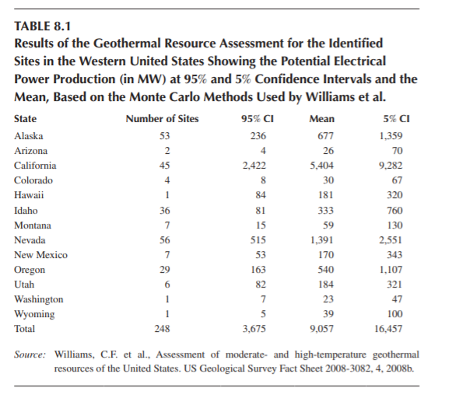
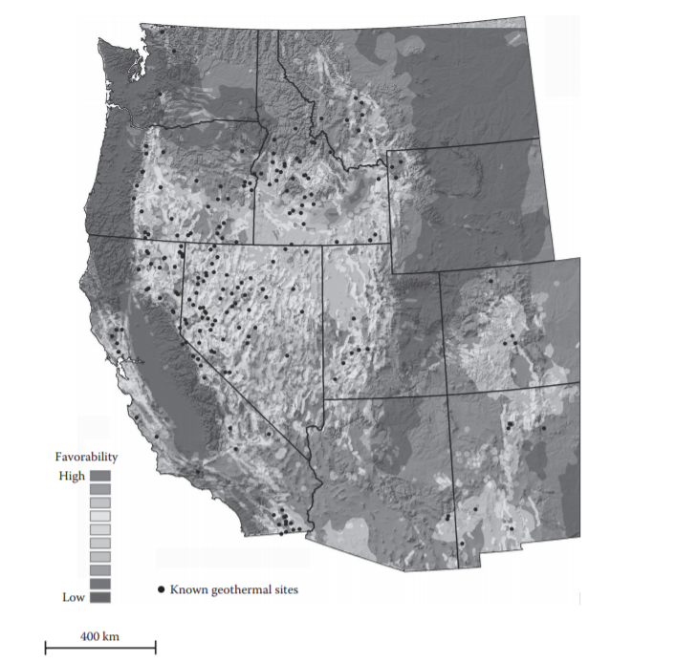
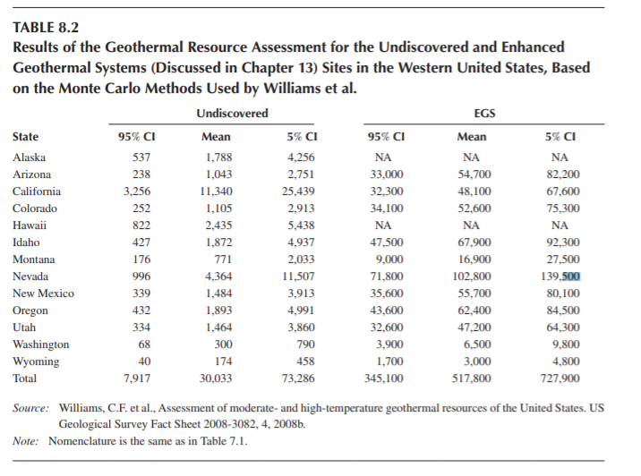
Case Study:

Slide 10
References:
White, D.E. and Williams, D.L., 1975. Assessment of geothermal resources of the United States—1975. US Geological Survey Circular 726, p. 155.
Williams, C.F., Reed, M.J., and Mariner, R.H., 2008a. A review of methods by the US Geological Survey in the assessment of identified geothermal resources. US Geological Survey Open File Report 2008-1296, 27 pp.
Reed, M.J., and Mariner, R.H., 2007. Geothermometer calculations for geothermal assessment. Geothermal Resources Council Transactions, 31, 89–92
Nathenson, M., 1975. Physical factors determining the fraction of stored energy recoverable from hydrothermal convection systems and conduction-dominated areas. US Geological Survey, Open-File Report 75-525, p. 50.
Nerc. (n.d.). Geothermal energy - what is it? Retrieved from

