Slide 1
Optimization of Well Stimulation Fluids in the Marcellus Shale Gas Development
Using Integrated Technologies
Choyong Hyun Khaled Enab
Chris Madu Li Hang
Jason York Richard Olawoyin
INTEGRATIVE DESIGN: EME 580
SPRING 2011

Slide 2

Problem Statement
EME 580
Increase the economic attractiveness of the unconventional gas sources to the private sector by ;
decreasing risks,
increasing reliability,
help operators substantially lower operational costs
meet increasingly stringent environmental regulations,
recycle water to reduce demand on local supplies.
A solution that lessens the environmental impact of gas drilling, and reduce the current treatment cost to service providers.

Slide 3

Integrated Planning Approach
EME 580
Our IPA reveal synergies that;
reduced life-cycle costs of infrastructure,
reduced greenhouse gas emissions,
reduced energy usage from conventional sources,
enhance other environmental benefits,
reduce environmental impact without sacrificing performance.

Slide 4

Efficient Centralized Solutions
EME 580
Our central design offers:
Efficient well completion techniques and fracture fluids design
Higher recovery of fracture and produced water for reuse and less need for fresh water to be trucked to and from a site.
Treated distillate can be immediately reused or stored for ongoing fracture operations
Generating revenue that can help reduce overall treatment costs from beneficial byproduct such as the production of industrial salt and road de-icing salt and also clean water.

Slide 5
The Big Concern!
EME 580
Health risks arising from water source contamination
Disposal in the environment is an awful option
Large amounts of fresh water usage and large amounts of wastewater generated with limited disposal options.
Water for fracturing operations is or will soon become difficult / expensive to obtain

Slide 6
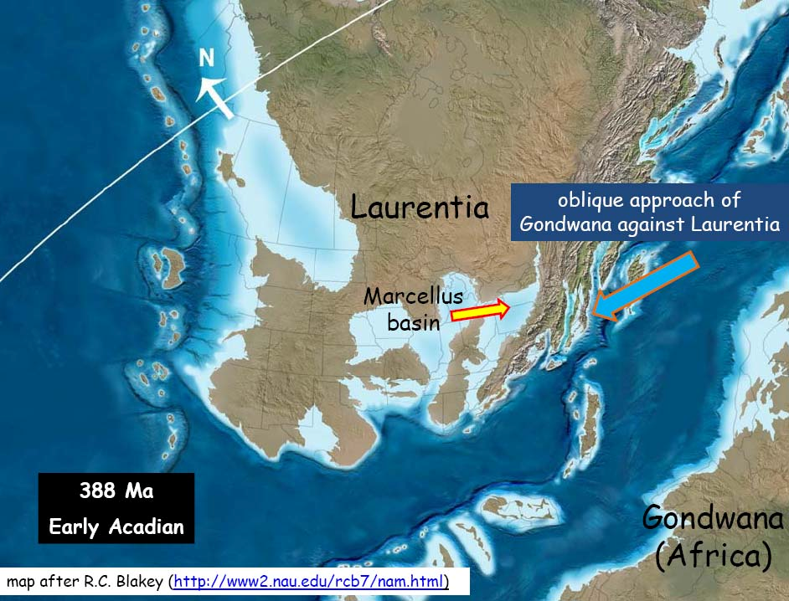

Slide 7
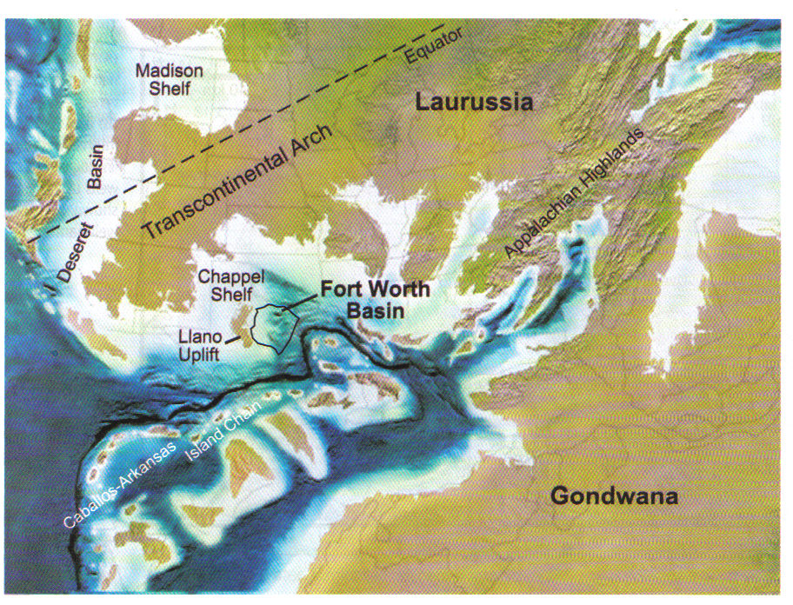
Early Mississippian 360 MYA
North American Structural Suture is zipped in the Appalachian Basin. The Acadian Orogeny is over.
The onset of the Ouachita Orogeny triggers Barnett Black Shale Deposition.
Modified from AAPG Bull. 4/2007, p. 584

Slide 8
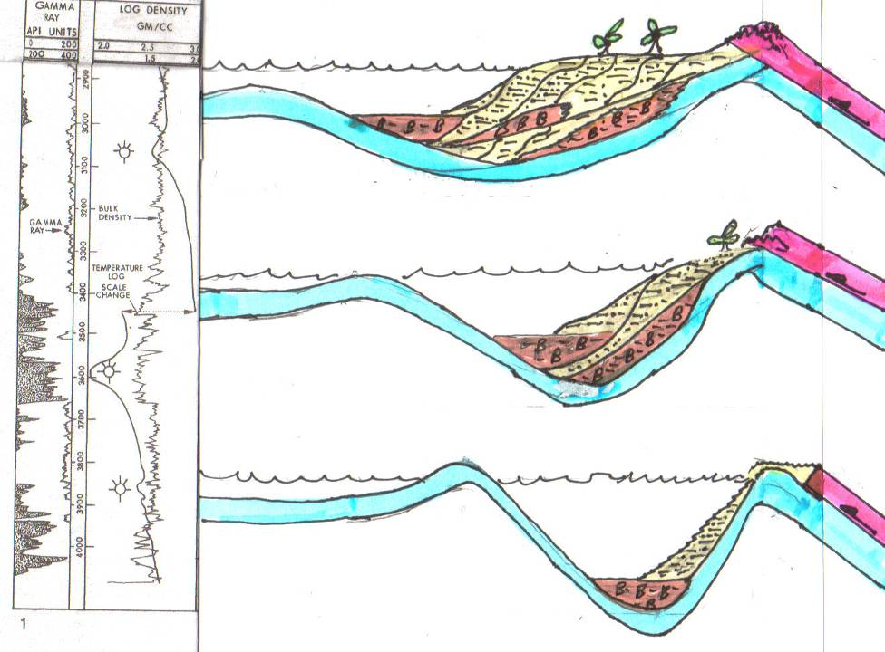
WEST
EAST
Ohio Shale
PHASE THREE – Erosion of highlands rapidly fills shallowing basin, Trough and Bulge features migrate further west.
Marcellus Shale
Rhinestreet Shale
Bulge and Trough Migrate West
PHASE TWO–Collision ends and NA Plate rebounds. Deep, Anoxic, Sediment Starved Basin shallows and both Bulge and Trough migrate westward.
Rhinestreet Shale
Overriding African Plate
Peripheral Bulge Cincinnati Arch
Proximal Trough
PHASE ONE – Initial Collision - African Plate Overrides and Depresses NA Plate – Generating a very Deep, Anoxic, Sediment Starved Basin Termed a Proximal Trough and associated Peripheral Bulge.
Marcellus Shale

Slide 9

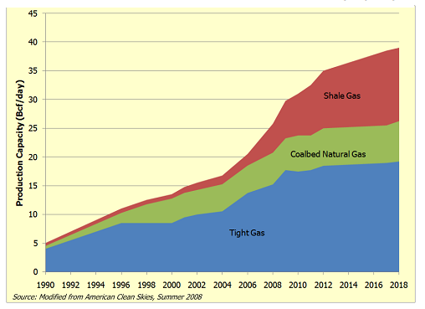
Why Unconventional?
EME 580
In the Appalachian Basin - Head East Towards the Allegheny Front where the Thickest Accumulations of Marcellus Organic Rich Shale were deposited in the proximal trough...
Because the Marcellus was deposited early in the collision… … less sediment input led to Higher TOC’s, which informed our choice of project area to be the Bradford County, PA
Three factors have come together to make shale exploration economically viable:
Horizontal drilling
Hydraulic fracturing
Natural gas prices

Slide 10

Why Now?
EME 580
Meets our American goals:
relatively clean,
reliable,
affordable,
jobs,
royalties,
taxes,
national security.
Remember 2012

Slide 11
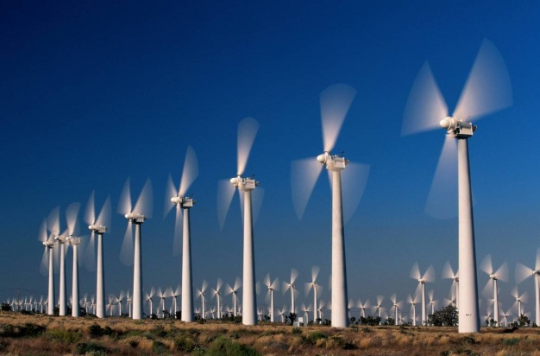

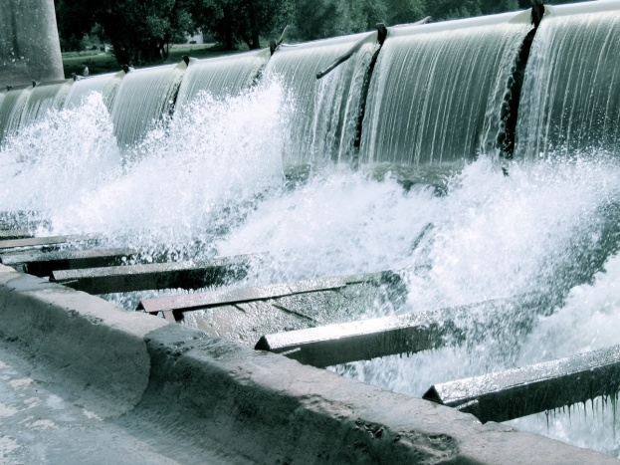
Energy Equivalents
Natural Gas vs. Other Sources
EME 580
Energy Source Impact on Environment
One Natural Gas Well ½ acre
Wind Farm 100-300 acres
Wood 402 acres or
44,000 100-foot tall trees
Hydro Every 367 gas wells saves one
Glenn Canyon Dam
One gas well produces one billion cubic feet of gas (Bcf)
equivalent to 292,000,000 kilowatt hours.

Slide 12
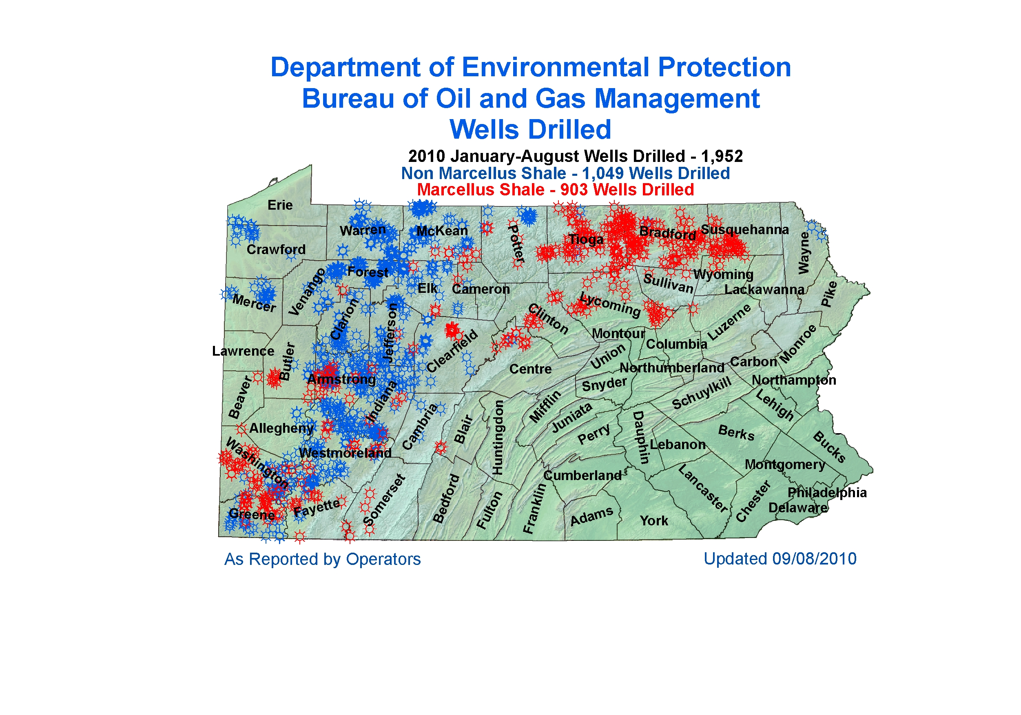

Slide 13
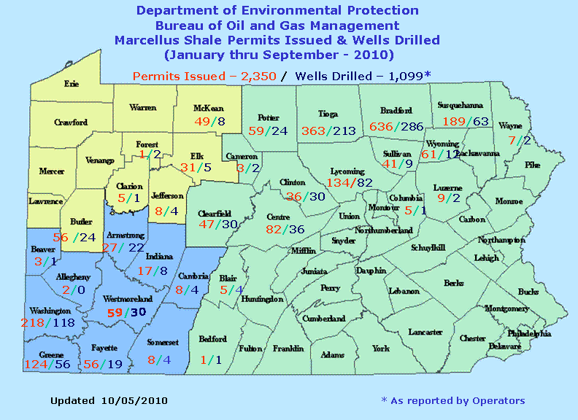
Marcellus Shale Action in PA
26%

Slide 14
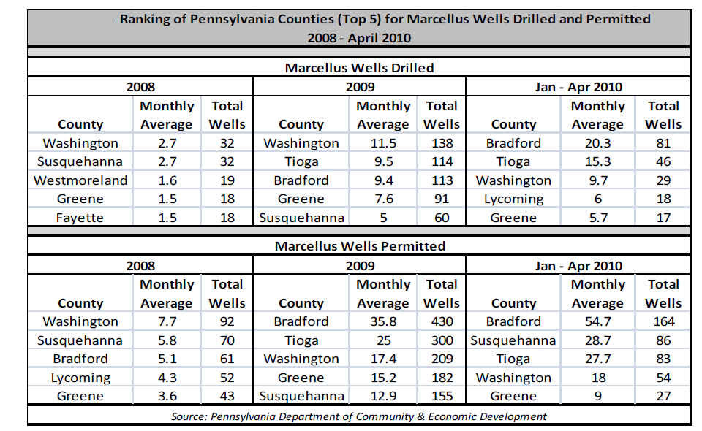
26%

Slide 15
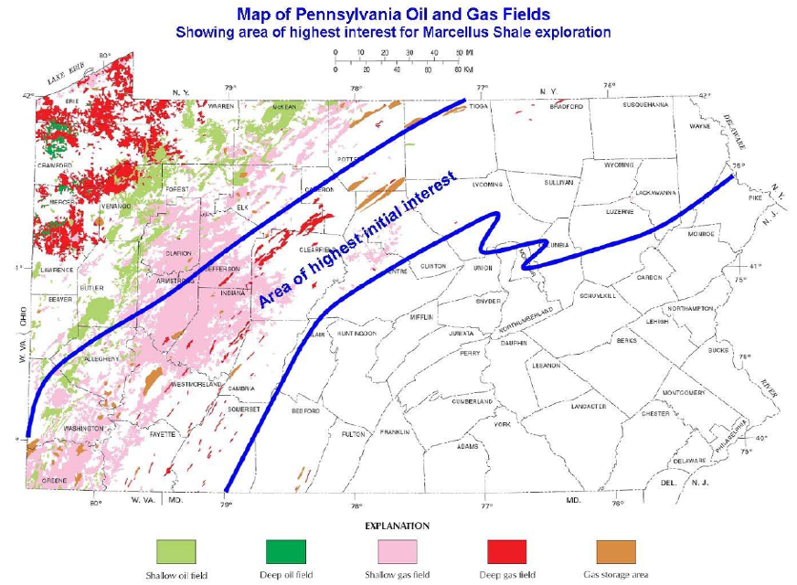
The Big Concern!
EME 580

Slide 16
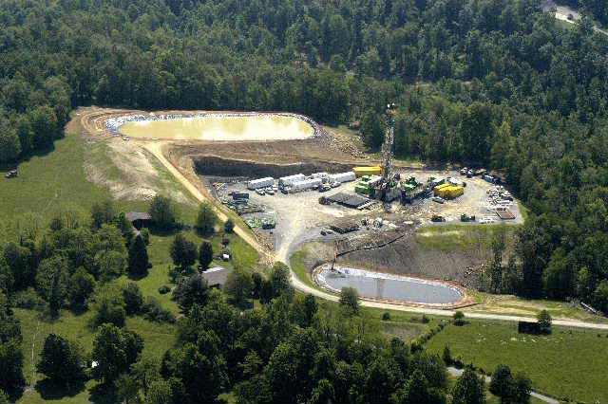
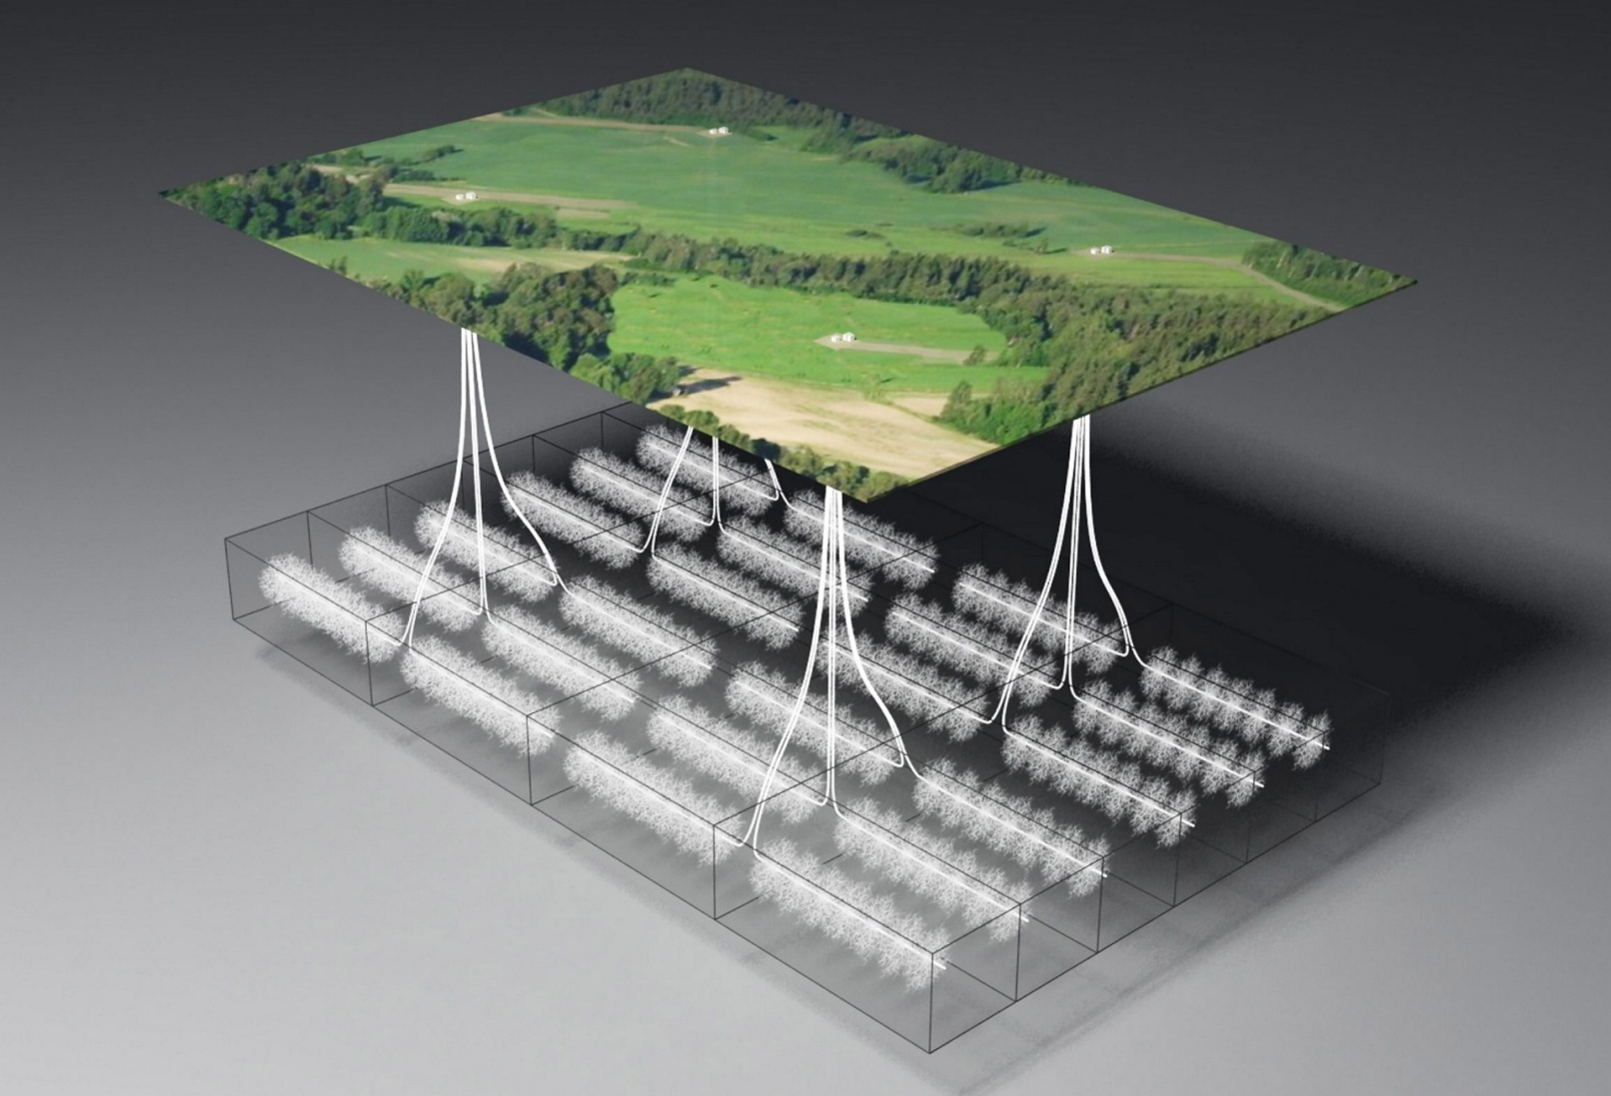
Marcellus Shale Development Plan
EME 580
Photo: Chesapeake / Statoil

Slide 17
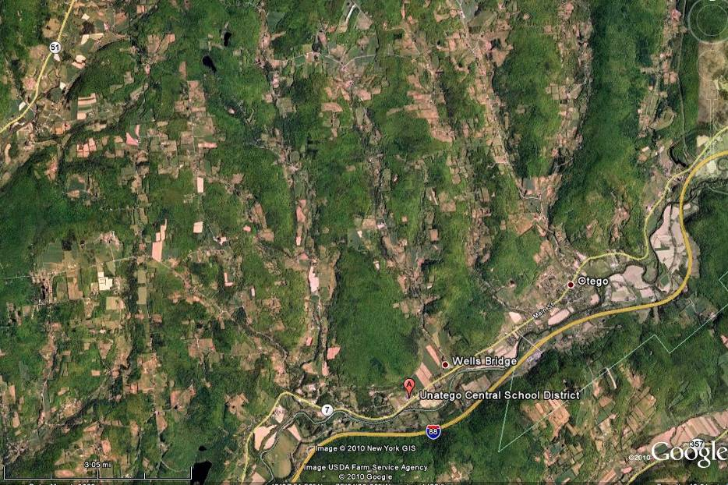
Ideal Arrangement of Spacing Units

Slide 18
Well Simulation
EME 580
Reservoir Properties
DEPTH | 8620 Ft
Thickness | 180 Ft
I | 5280 Ft
J | 5280 Ft
Permeability (horizontal) | .01 md
Permeability(vertical) | .001
Porosity | 5 %
Temperature | 210 F
Initial Pressure | 4000 psi
Rock compressibility | .000001

Slide 19
Strategy
EME 580
Our Goal was finding the best technique to drain 640 acre feet using one well and have a high recovery
We have tried five different techniques:
Horizontal well
Dual horizontal
Dual horizontal with distance.
Two dual horizontal wells
Multilateral well.

Slide 20
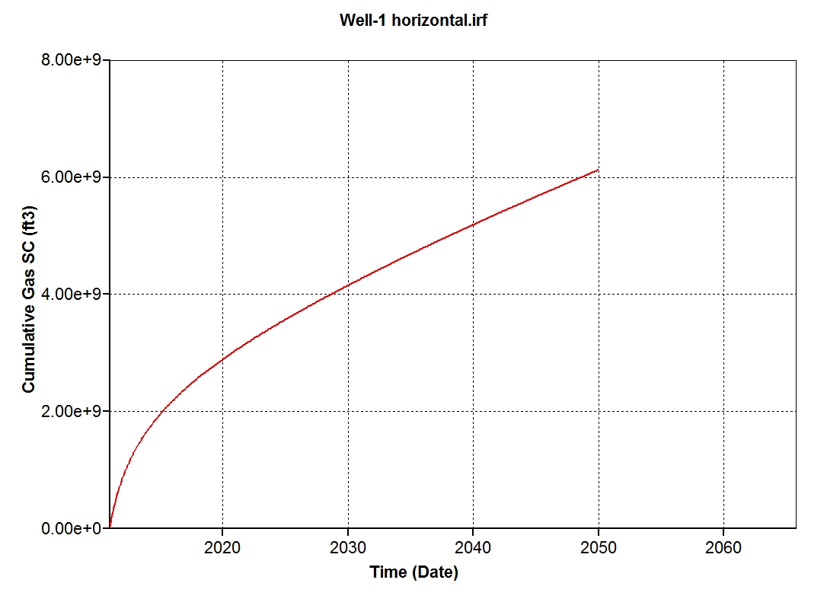
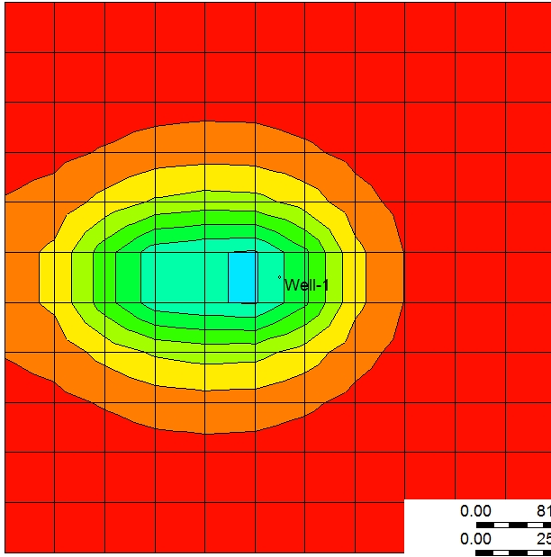
Horizontal well
EME 580
8710 ft. vertically 1440 feet horizontally cumulative gas (6.2 * 10⁹ft³).
Pressure distribution after 40 years

Slide 21
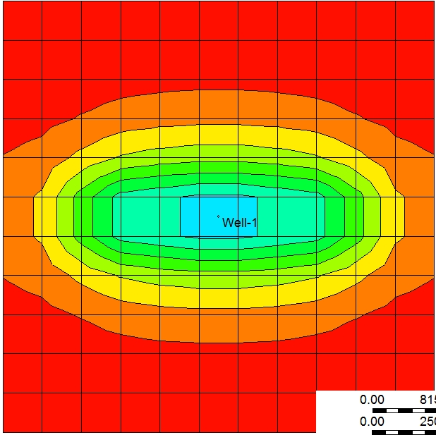
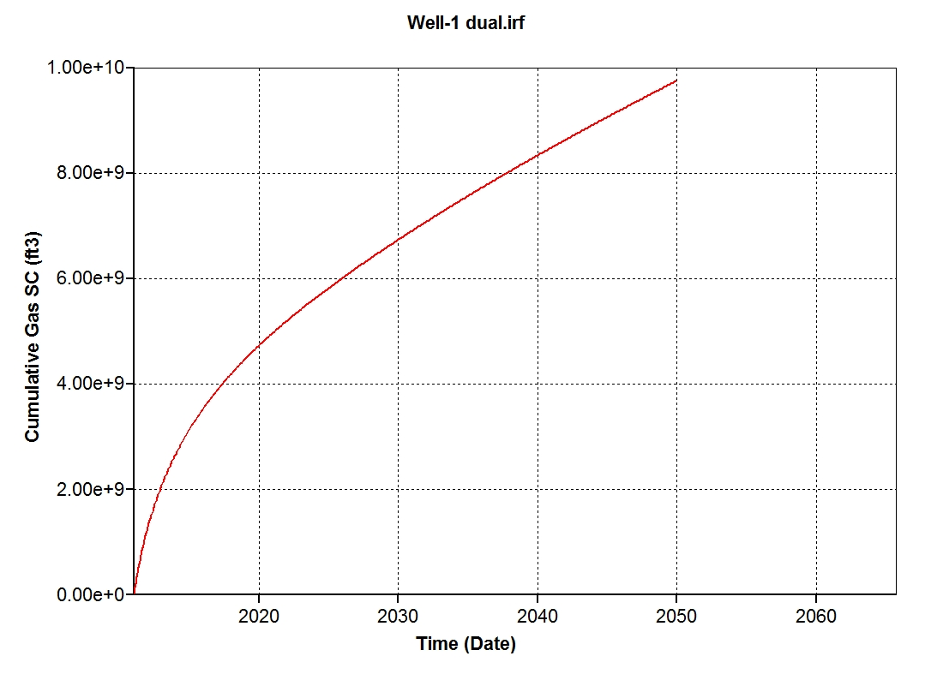
Dual horizontal well
EME 580
8710 feet vertically , 1440 Ft horizontally in both directions , cumulative gas is 9.7*109 ft3
Pressure distribution after 40 years

Slide 22
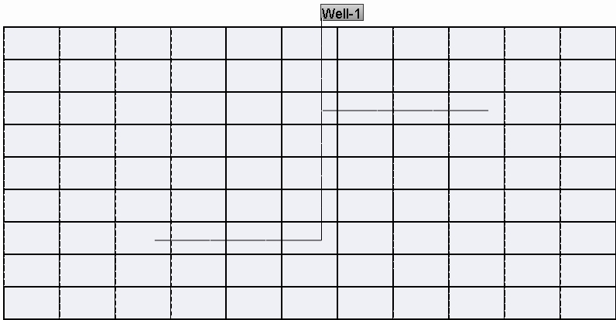
Dual horizontal with 80ft distance
EME 580
8670 feet vertically 1440 feet horizontally
8750 feet vertically 1440 feet horizontally

Slide 23
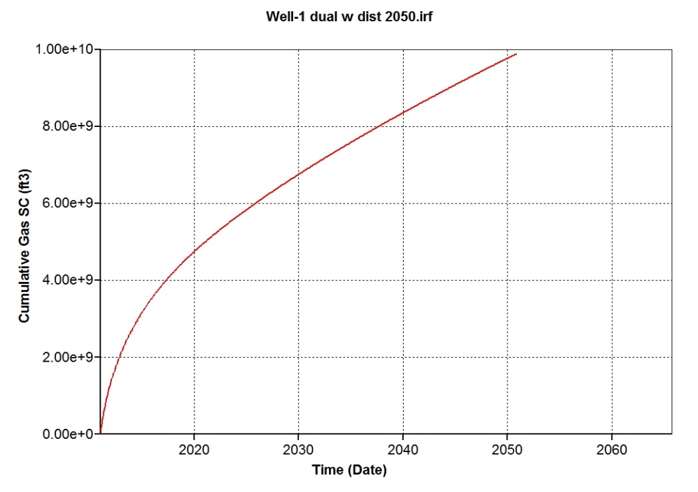
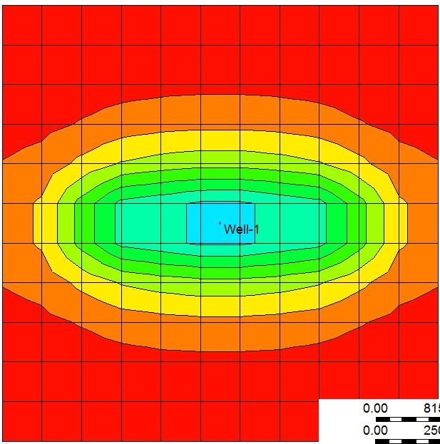
Dual horizontal with 80ft distance
EME 580
The cumulative gas is 9.9*109 ft3
Pressure distribution after 40 years

Slide 24
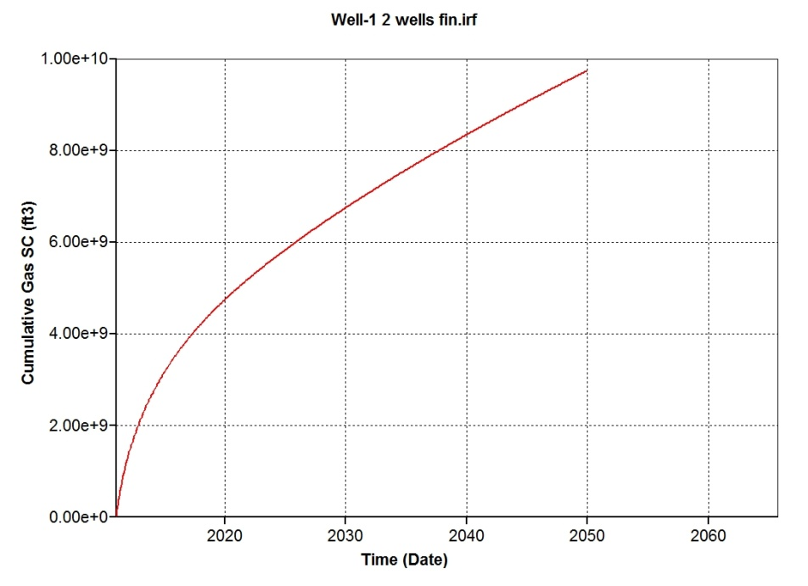
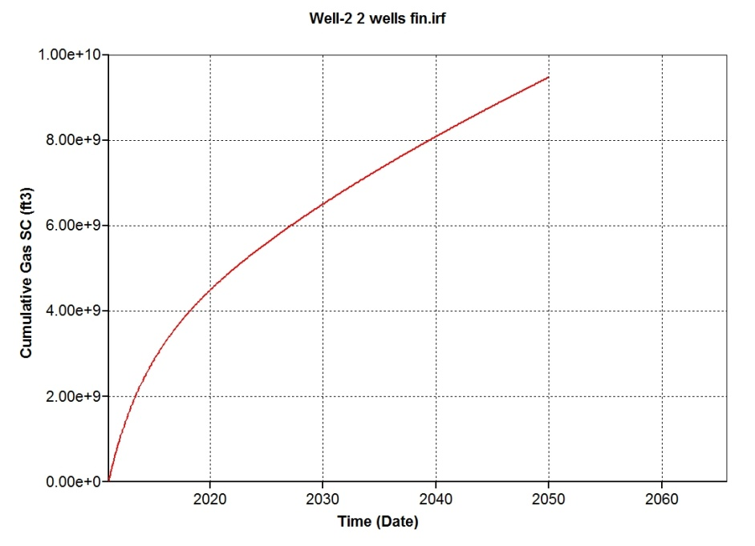
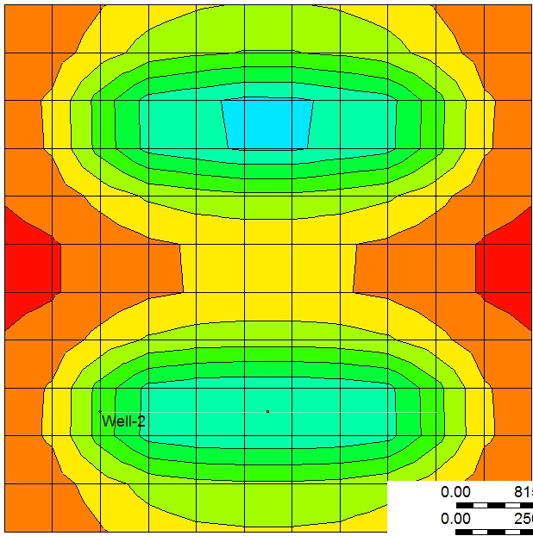
Two dual horizontal wells in the 640 acre ft.
EME 580
The cumulative gas 1.92*1010 ft3
Pressure distribution after 40 years

Slide 25
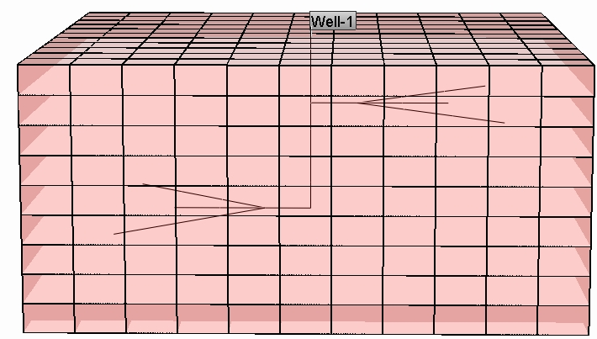
Multi-lateral well
EME 580
8670 feet vertically 1440 ft. horizontally with two branches each is 2037 ft.
8750 feet vertically 1440 ft. horizontally with two branches each is 2037 ft.

Slide 26
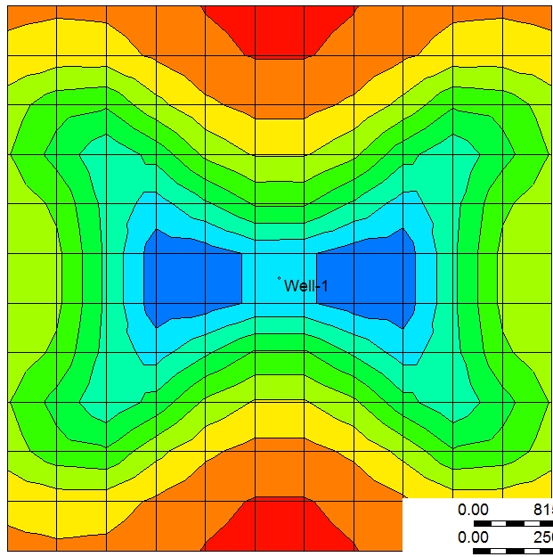
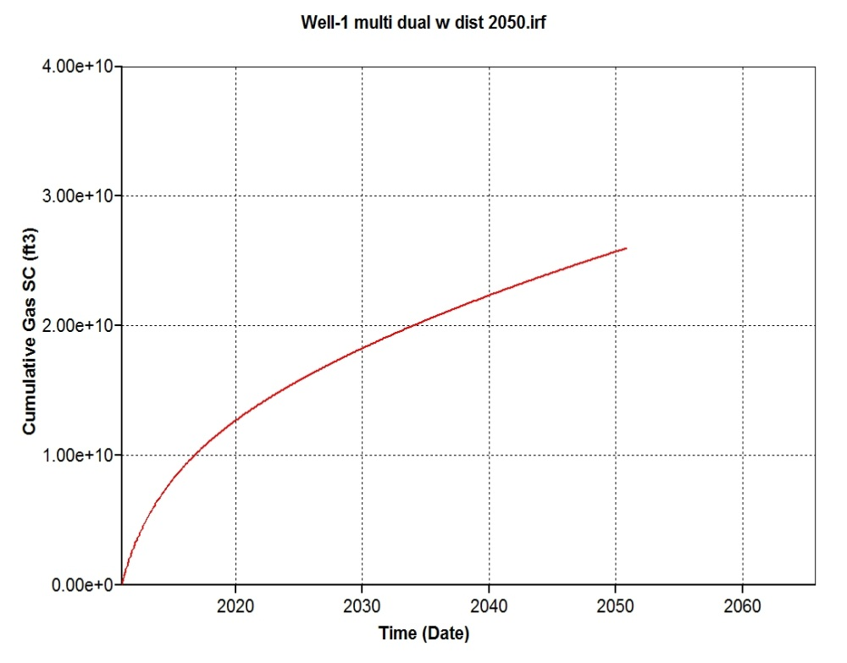
Multi-lateral well
EME 580
The cumulative gas is 2.6*1010 ft3
Pressure distribution after 40 years

Slide 27
Drilling
EME 580
The difference between horizontal well and the multilateral is almost 1.98*10¹⁰ft³
The difference between two wells in 640 acre feet and multilateral is 6.8*109ft3

Slide 28
Drilling Fluid
EME 580
Silicate based drilling mud
Optimum inhibition characteristics.
High penetration rates.
Reduced trouble time and superior wellbore integrity.
Optimum solids removal performance.
Minimal environment impact.

Slide 29
Drilling fluid composition
EME 580
Potassium carbonate (40 kg/m3),
Sodium chloride,
Sodium silicate liquid (8% ),
xanthan gum (YP 25 lb./100ft2),
poly anionic cellulose (8 kg/m3),
starch ( API-FL < 5ml/30 min),
biocide (1kg/m3),
calcium carbonate fine (25 kg/m3) and
calcium carbonate med (25 kg/m3).

Slide 30
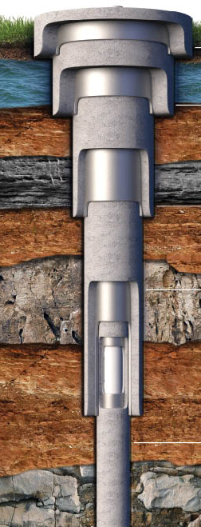
Casing
EME 580
50 feet long (24 inches) which is used in preventing the top of the will from caving
500 feet long (20 inches) connecting the conductor casing and this part is to protect and isolate the near surface ground water
2000 feet (14inches) which protect the fresh water deposits near the surface of the well from the contamination which can happen by leaking of hydrocarbon or salt water
6070 feet long (6inches) to connect the production casing with the surface

Slide 31
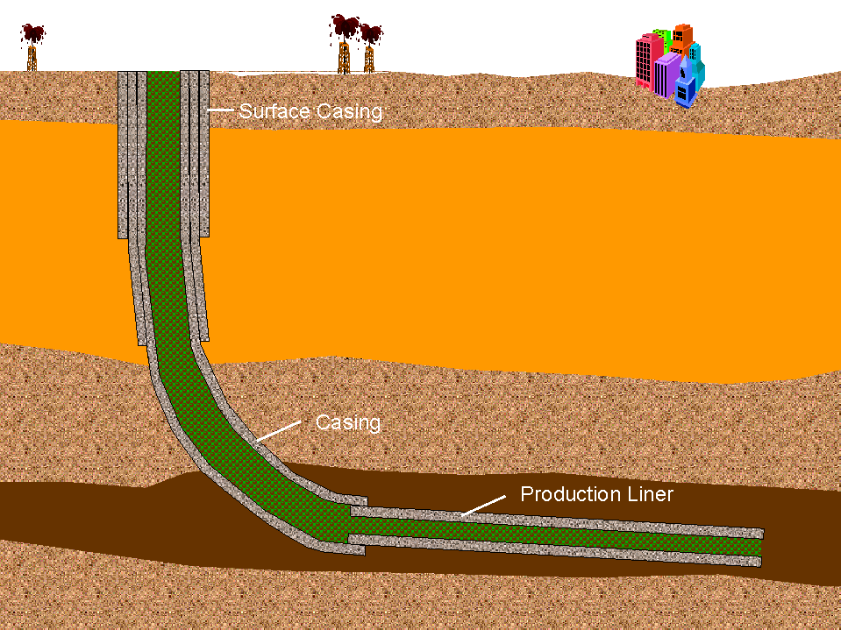
Cementing
EME 580
We decide to use the bentonite cementing.
decrease the slurry cost
causing reduction in the cement strength and thickening time.

Slide 32
Minimizing negative impacts through fracture fluid Design
EME 580
Target fracture fluid :
  Enhances production,
  Facilitates post fracture fluid recovery,
  Consumes less amount of water,
  Cost-friendly
Key Technogoly (Novelty of Fluid Design)
  Microemulsion(ME)
  Proppant transportation modifier(PTM)

Slide 33
Additive Selection
EME 580
Thickening agent : Hydrozypropylguar gels (HPG) without breaker
  Cost friendly and performance is proven from numerous fracs
Friction Reducer : salt tolerant (up to 12% NaCl) Anionic Polycrylamide
  Most effective friction reducer exhibits in the Marcellus shale with high salinity.

Slide 34
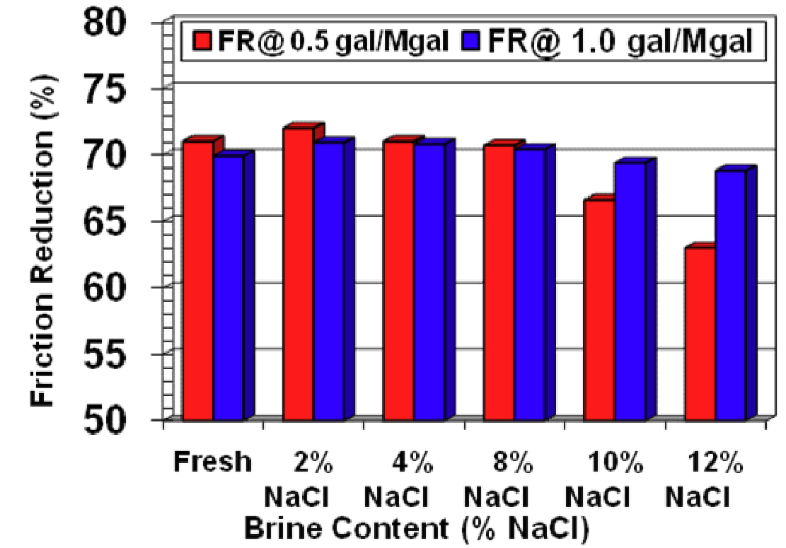
Additive Selection
EME 580
The percentage of friction reduction
Caused by adding salt-toerlant
Source: SPE 125987

Slide 35
Additive Selection
EME 580
Biocide : DBNPA
(20% active dibrominated nitrilopropionamide)
  highly effective on reducing SRB, easy to apply and considered one of the safest biocides for the environment
Iron Controller
  Iron-reducing and chelating agents consist of acidic chemicals such as citric acid, acetic acid, and ethylenediaminetrataacetic acid (EDTA)
  prevents polymer degradation

Slide 36
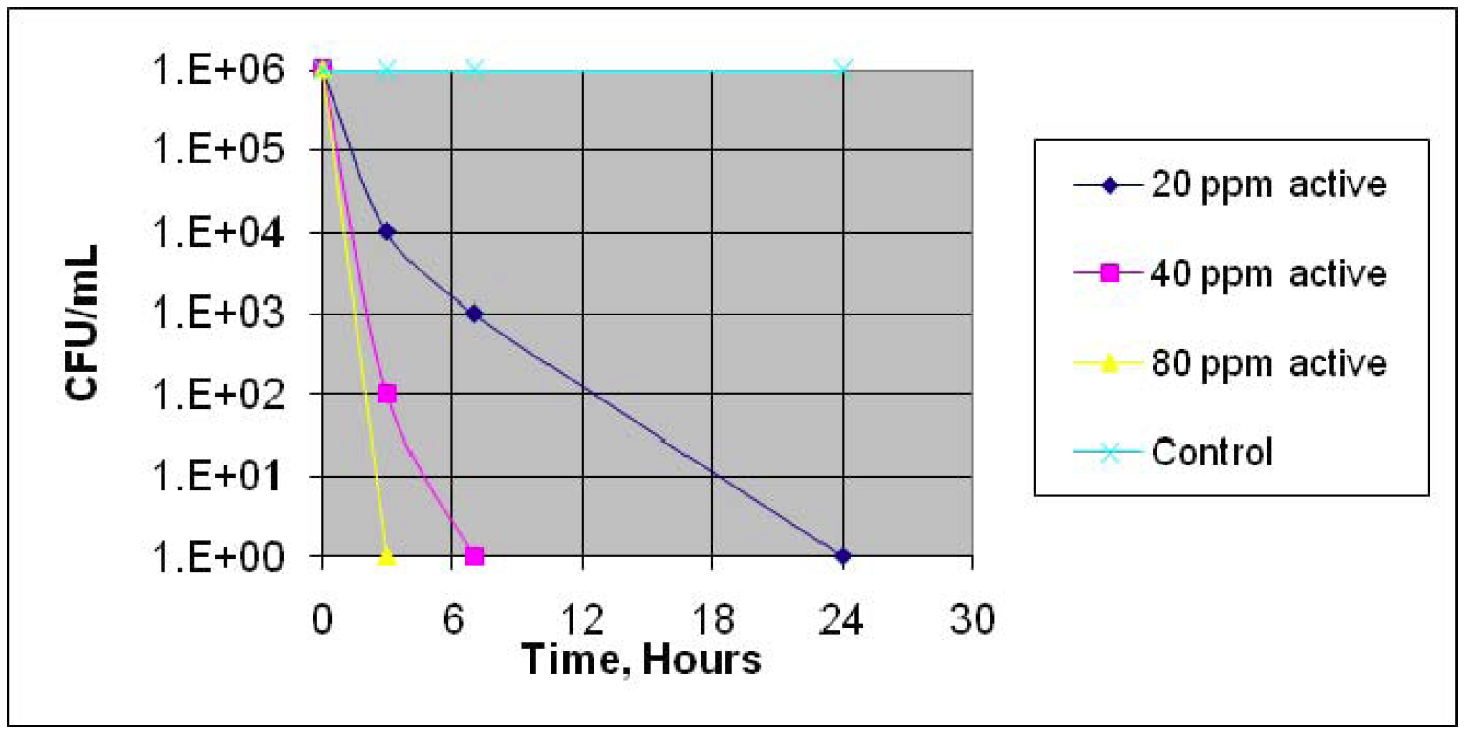
Additive Selection
EME 580
Effctiveness of 20% active DBNPA biocide against SRB
Source : Fracture-Stimulation in the Marcellus Shale, 2009

Slide 37
Additive Selection
EME 580
Clay Stabilizer : 2% Potassium chloride + 2gpt clay stabilizing agent (CS)
  Essential because of clay abundance
  Cost effective than 4% KCL
Scale inhibitor – anionic phosponates
  Most commonly used and cost effective
  Compatible with other additives

Slide 38
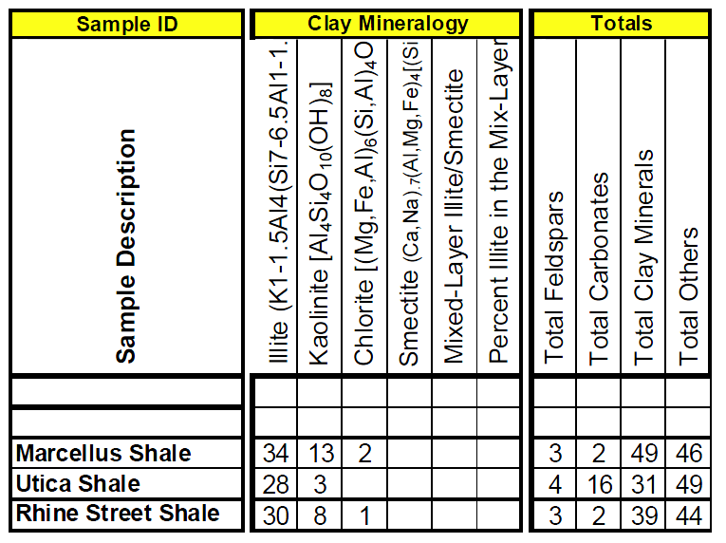
Additive Selection
EME 580
Clay and Mineralogy
Source: SPE 119900

Slide 39
Additive Selection
EME 580
Corrosion inhibitor – N,n,dimethyl formamide
  Performs well at our temperature range of 100-300F
  Cost effective
Breaker – peroxydisulfate
  Breaks down the viscosity of the gelling agent to aid in releasing the proppant and enhance the volume of flowback water after completion.
  Most commonly used and cost effective

Slide 40
Additive Selection
EME 580
Sulfactant : nonionic microemulsion containing linier and branched alcohol ethoxylates + 2% ethoxylated alcohol fluorosurfactant
  Enhances flowback recovery up to 86%
  Lowers interfacial tension drastically
Proppant Transportation modifier (PTM) : N/A
  Information gathered from TIORCO chemical
  Too expensive, impossible apply buoyancy changing technique with current gas price
  No company producing PTM for commercial use.
  Ceramic proppant is better regarding cost

Slide 41
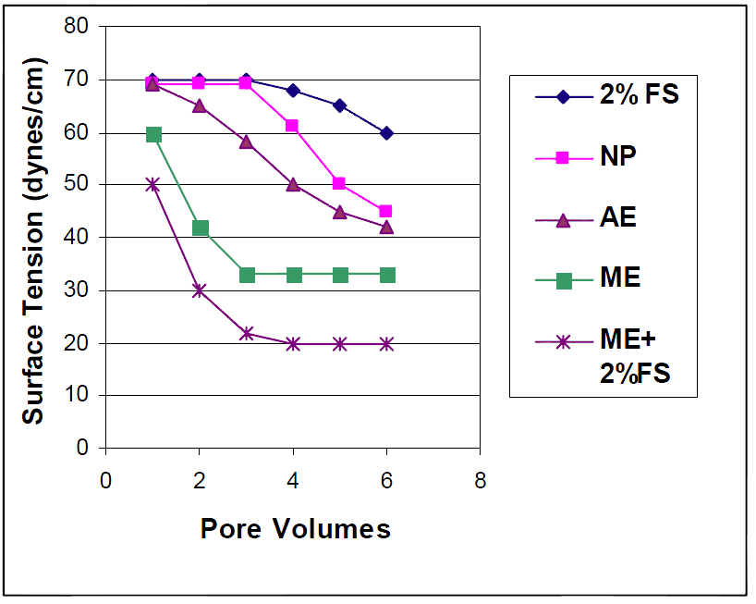
Additive Selection
EME 580
Surface tension test of Surfactant

Slide 42
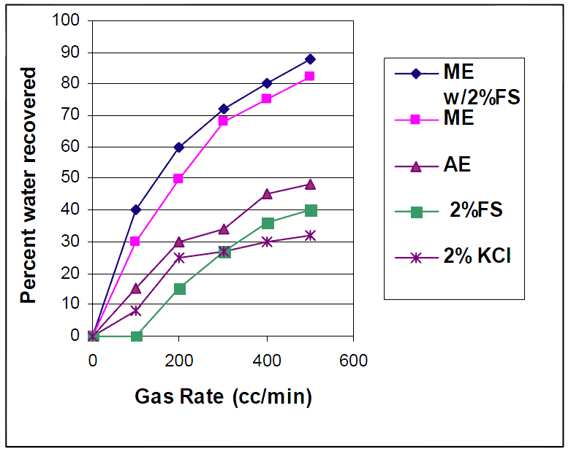
Additive Selection
EME 580
Water recovery test of Surfactant

Slide 43
Additive Concentration
EME 580
Type | Concentration (%)
HPG | 0.05
Friction reducers | 0.06
Surfactant | 0.085
Breaker | 0.009
Clay stabilizers | 0.005
Scale inhibitor | 0.013
Iron Controller | 0.005
Biocides | 0.03
Corrosion Inhibitors | 0.001

Slide 44
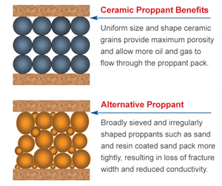
Proppant Selection
EME 580
Ceramic Proppant

Slide 45
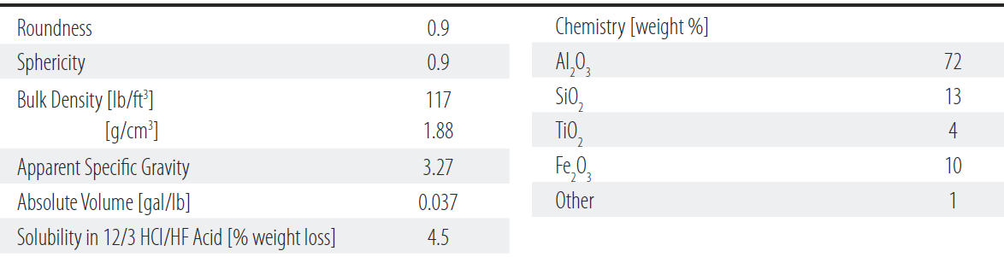
Proppant Selection : Ceramic proppant
EME 580
CarboProp : 40/70 mesh
  Frequently selected for moderate depth oil and gas wells and has excellent crush resistance in a broad range of applications.
  Source : Carbo ceramics

Slide 46
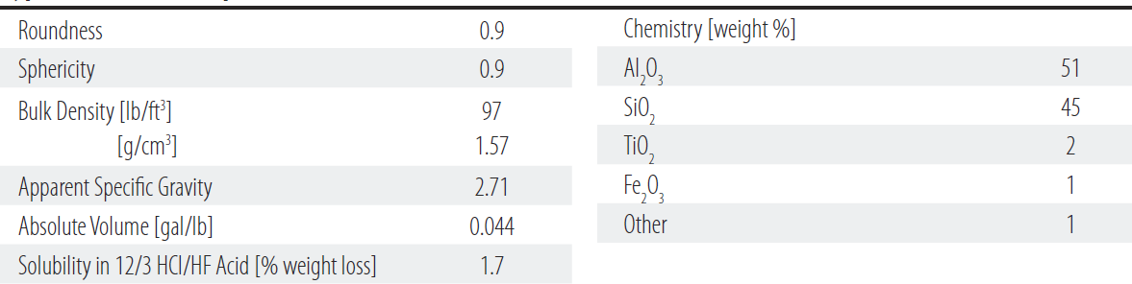
Proppant Selection :
Ceramic proppant
EME 580
CarboLite : 40/70 mesh
  Lightweight proppant, cost friendly among other lightweights
  provides high fracture conductivity
  Source : Carbo ceramics

Slide 47
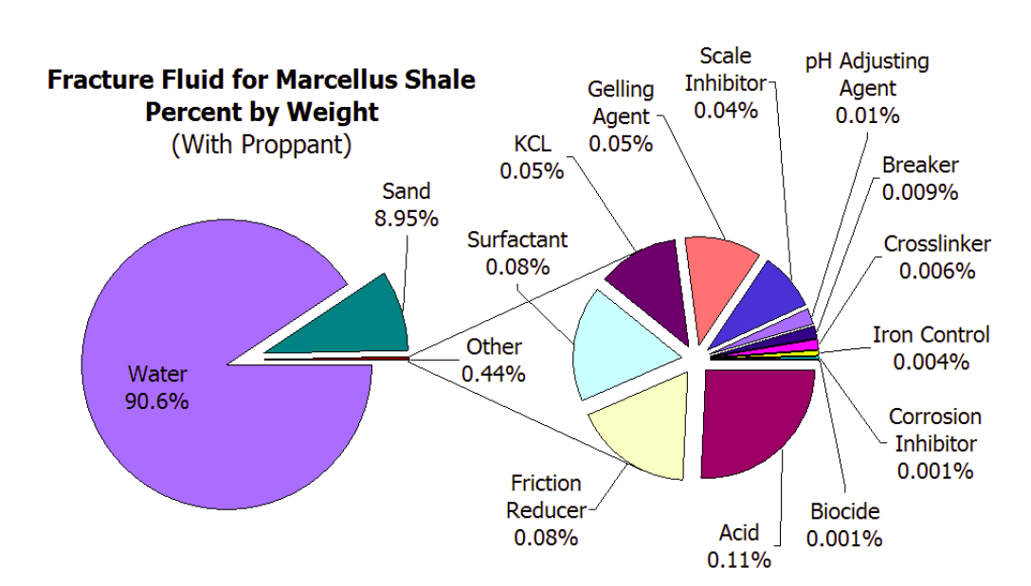
Fracturing Fluid Composition
EME 580
(from Arthur and others, 2008)
0.44% of 3 million gallons = 13,200 gallons

Slide 48
Fracture Design Treatment Schedule
EME 580
Stage # | Stage Type | Elapsed Time min:sec | Fluid Type | Clean Volume (gal) | Prop Conc (ppg) | Stage Prop. (klbs) | Slurry Rate (bpm) | Proppant Type
Wellbore Fluid |  |  | Fresh Water | 8426
1 | Main frac pad | 13:36 | Fresh Water | 20000 | 0.00 | 0.0 | 35.00
2 | Main frac slurry | 82:52 | LINEAR_30_GW-32 | 100000 | 0.50 | 50.0 | 35.00 | CarboProp 40/70
3 | Main frac slurry | 156:54 | LINEAR_30_GW-32 | 100000 | 2.00 | 200.0 | 35.00 | CarboLite 20/40
4 | Main frac slurry | 534:34 | LINEAR_30_GW-32 | 500000 | 2.50 | 1250.0 | 35.00 | CarboLite 20/40
5 | Main frac slurry | 1035:17 | LINEAR_30_GW-32 | 650000 | 3.00 | 1950.0 | 35.00 | CarboLite 20/40
6 | Main frac flush | 1048:54 | Fresh Water | 20000 | 0.00 | 0.0 | 35.00
7 | Shut-in | 1049:54 | SHUT-IN | 0 | 0.00 | 0.0 | 0.00
Design clean volume (bbls) 33095.2 Design proppant pumped (klbs) 3450.0
Design slurry volume (bbls) 36711.5

Slide 49
Fracture Propagation into the Formation

Slide 50
Flow back Characteristics
EME 580
Constituent | Concentration (mg/L)
TDS | 17,800 – 261,000
TSS | 36 – 1115
Alkalinity | 46 – 489
pH | 5.68 – 7.11
Technology | Maximum Feed TDS (mg/L) | Energy Use (kWh/100 bbl)
Capacitive Deionization | 5,000 | 20
Electrodialysis | 40,000 | -
Reverse osmosis | 35,000 | 15-30
Evaporation | 100,000 | 400
Membrane distillation | 250,000 | 600-700
Crystallizer | 300,000 | 1000-1300
Forward Osmosis (Integrated Plan) | 350, 000 + | ~ (-10)

Slide 51
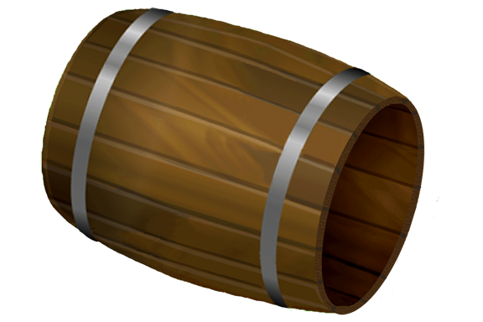
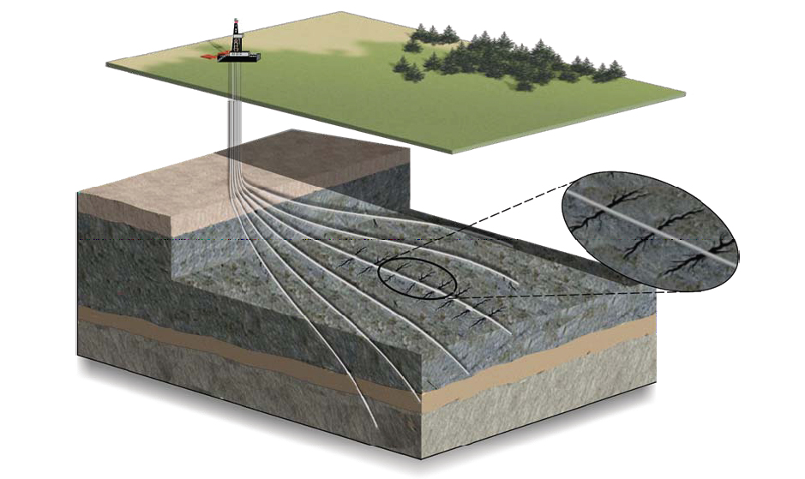
Characterization of Post-Fracture Flow-back water
EME 580
3,600,000 Gallons (approximately 85, 714 barrels) of hydraulic fracture fluids used for a single horizontal well frac job
A load recovery of approximately 86 % of the injected fluid is achievable due to the fracture design (fluid type, fluid viscosity, proppant type and pump volume) which amount to 73,714 barrels of waste water generated.

Slide 52
Post-Fracture Flow-back Analysis: 20 days
EME 580
FB Date | TDS (mg/L) | Ca (mg/L) | Mg (mg/L) | CaCO3 (mg/L) | Na (mg/L) | K (mg/L) | Fe (mg/L) | Ba (mg/L) | Sr (mg/L) | Mn (mg/L) | SO4 (mg/L) | Cl (mg/L)
14-Apr | 224.38 | 15 | 2.73 | 49.44 | 18 | 1.65 | 0.25 | 0.23 | 0.46 | 0.06 | 3 | 183
26-Apr | 84839 | 7100 | 603 | 23286 | 22800 | 326 | 3.93 | 2000 | 1400 | 6.69 | 0 | 50600
27-Apr | 89861 | 7640 | 651 | 24952 | 24300 | 346 | 7.8 | 1990 | 1510 | 7.07 | 8.87 | 53400
27-Apr | 105169 | 8490 | 714 | 27432 | 25100 | 352 | 9.7 | 1870 | 1670 | 7.44 | 156 | 66800
28-Apr | 116266 | 10500 | 893 | 33879 | 29400 | 410 | 35.3 | 1980 | 2200 | 9.1 | 139 | 70700
29-Apr | 123902 | 11700 | 996 | 38419 | 31100 | 437 | 16.2 | 2480 | 2860 | 9.5 | 2.94 | 74300
30-Apr | 164081 | 16700 | 1400 | 52071 | 41700 | 579 | 23.5 | 2230 | 2570 | 13 | 165 | 98700
1-May | 140169 | 14000 | 1150 | 44358 | 34300 | 477 | 28.7 | 2290 | 2590 | 11 | 22.7 | 85300
2-May | 146539 | 16700 | 1380 | 53473 | 39400 | 535 | 30.2 | 3000 | 3380 | 13.1 | 0.19 | 82100
3-May | 161636 | 17100 | 1410 | 54446 | 40400 | 543 | 35.2 | 2950 | 3280 | 13.3 | 4.97 | 95900
4-May | 164902 | 16700 | 13000 | 103026 | 37000 | 496 | 32.9 | 3850 | 4310 | 12.3 | 1.15 | 89500
Time | Flowback | Flowback Recovery,
1-5 days: | 100-150 bbl/hr | 10~ 25%
5-10days: | 20 – 60 bbl/hr | 8 ~ 12%
10-20 days | 5-10 bbl/hr | 1~5%
Company*******
Site: Springfield Township,
Bradford County

Slide 53
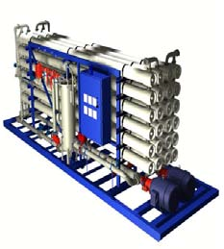
Engineering Considerations:
EME 580
System Capacity:
The Forward Osmosis process, operating on a hydraulic fracturing flow-back water will treat
14, 400 Barrels = 604, 800 gpd
with an “average” chemical composition of;
4,300 mg/l barium,
21,850 mg/l calcium,
14,000 mg/l magnesium,
and 3,400 mg/l strontium,
These would produce, at 40% solids sludge cake, 67,000 lb of
barium sludge and 281,815 lb of calcium/strontium/magnesium sludge /day.
Exclusive of the incoming hydraulic fracture flowback water and treated water storage tanks, we have estimated that a 604, 800 gpd FO process system would require a hydro-pneumatic tank and a vessel for the FO system.

Slide 54
Engineering Considerations:
EME 580
Our design takes into consideration the flowback recovery per hour in our system,
which is 600bbl/hr for the centralized system, but 150bbl/hr for a single well pad.
The tank size required would be a 25,000 gallon tank, covering approximately 1,202 square feet and cost $52,255.
In other to prevent corrosion, we would install an epoxy lining which would increase the cost
to $64,610 and it would have a design working pressure of 125# ASME.

Slide 55
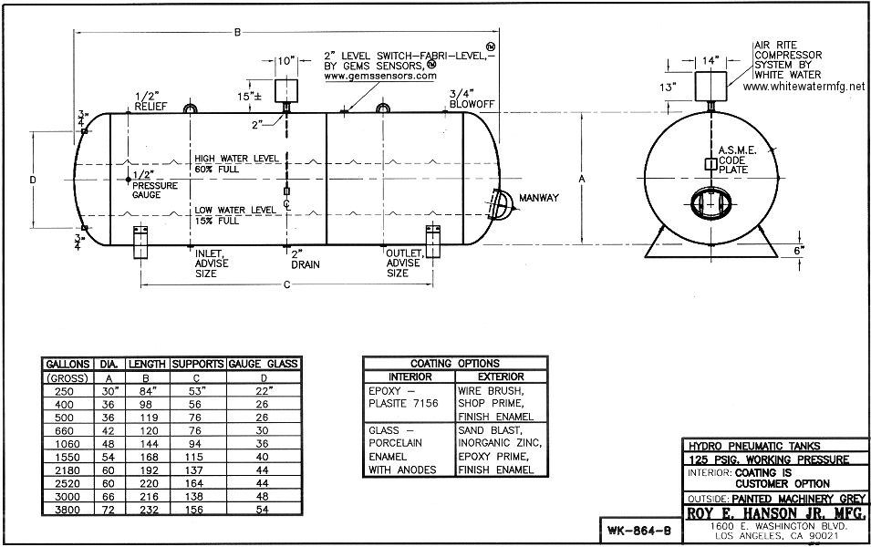
Hydro-pneumatic
Engineering Considerations:
EME 580

Slide 56
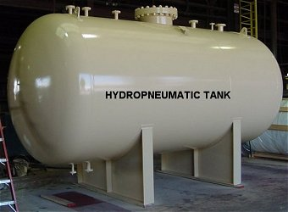
Engineering Considerations:
EME 580
Hydro-pneumatic Functions
It is a part of a water delivery system set to deliver water in a preset pressure range.
It uses the pressure setting to monitor a pump from turning on too often.
It buffers or lowers pressure surges,
much like a power surge protector

Slide 57
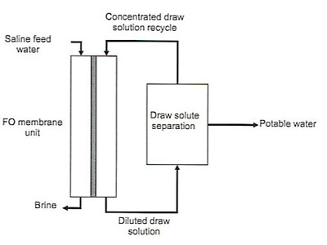
Forward Osmosis
EME 580
An engineered osmotic-driven membrane process that utilizes osmotic pressure of concentrated solutions to remove clean water from impaired water sources.
http://ysm.research.yale.edu/article.jsp?articleID=343&printable=1
Cath et all 2006

Slide 58
Forward Osmosis over Water Treatment Methods
EME 580
Forward Osmosis was Chosen for this Portable Centralized Water Treatment Facility because:
  Higher Efficiency Treatment Process
  Decreased Propensity for Membrane Fouling
  No Hydraulic Power Necessary for Water Separation from TDS
  Reduced Costs for Water Usage and Treatment
  Potential to Reduce Environmental Impacts
  Possibility for Energy Generation

Slide 59
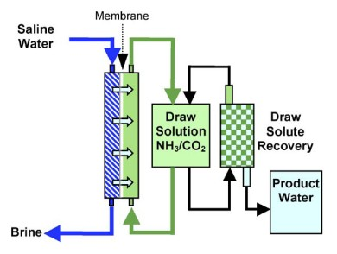
Forward Osmosis
EME 580
Block Diagram for Experimental Forward Osmosis Water Treatment Design
  Ammonium Bicarbonate Draw Solution
  TFC Membrane
Waste
Water
(source: Raphael Semiat and David HassanJune 2008)

Slide 60
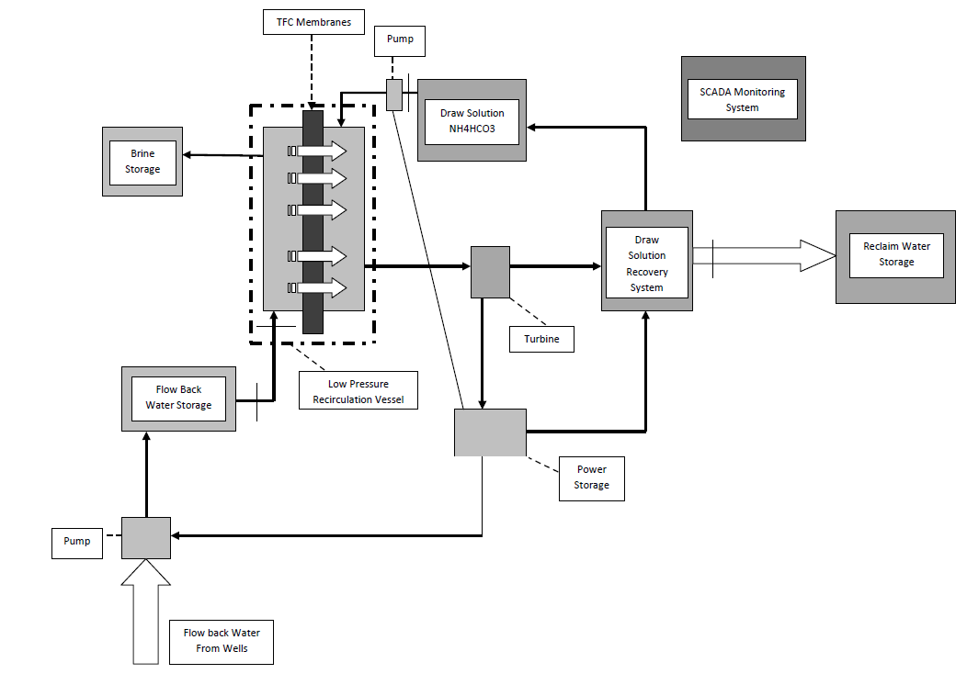

Block Diagram for our Novel Centralized Water Treatment System

Slide 61
Forward Osmosis
EME 580
Main Purposes of our Novel Portable Centralized Forward Osmosis Water Treatment System.
  Increase water treatment efficiency and reclaim water recovery.
  Generate Power for our System via Blue Energy
  Eliminate Environmental Concerns of Water Usage and Transportation by Reusing Reclaim Water in Future Well Fracturing
  Decrease Economic Costs associated with Water Treatment and Water Usage
  Designed for Portability
  Scaled to Handle One to Numerous Wells at a Time

Slide 62
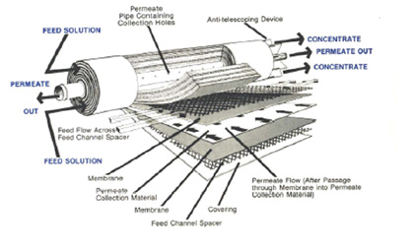
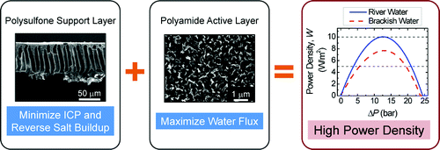
Thin-Film Composite MP Membrane
EME 580
Ability to Produce High Power Densities over other FO membranes.
Intrinsic Water Permeability A of 5.81 (L m⁻² h⁻¹ bar)
Solute Permeability B of 0.61(L m⁻² h⁻¹)
Structural Parameters S of 370 (um)
Peak Power Density W_{peak} of 7.33(W/m²)
Water flux (Jw ) = 30 L/m2h
Osmotic pressure differential (Δπ) = 25bars
TFC MP Membranes Placed in Spiral-wound Membrane Modules which will be Housed in a Low Pressure Recirculation Vessel
Life span 5 years.
Yin et al (2011)
http://www.kochmembrane.com/images/spiral_3.jpg
http://pubs.acs.org/doi/abs/10.1021/es104325z?prevSearch=%2528ThinFilm%2BComposite%2BPRessure%2BRetarded%2529%2BNOT%2B%255Batype%253A%2Bad%255D%2BNOT%2B%255Batype%253A%2Bacstoc%255D&searchHistoryKey=

Slide 63
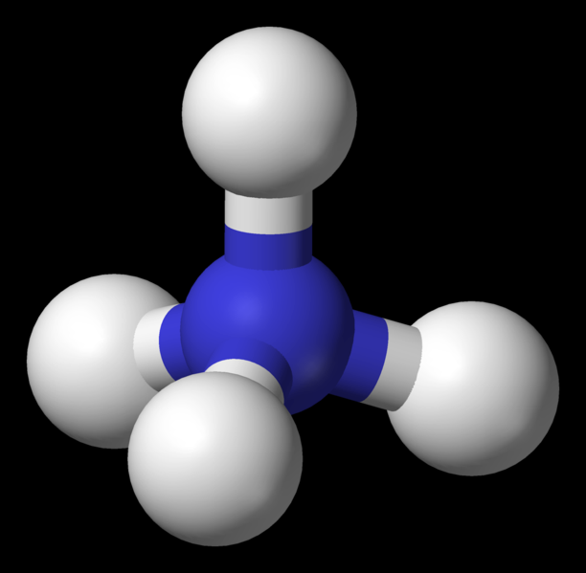
Ammonium Bicarbonate Draw Solution
EME 580
The 36% NH4CO3 draw solution is pumped into the low pressure recirculation vessel, using a ½ to ¾ horsepower, 1.8 bbl/min centrifugal transfer pump.
Ammonium Bicarbonate used because of its effective high osmotic efficiency and easy separation from water at low temperatures (68⁰F)
SCADA monitoring will allow the system to generate the ideal concentration of Ammonium Bicarbonate to achieve our optimal flow rate of 10bbls/min. This will be achieved be controlling the amount of Ammonium Bicarbonate dissolved in water in main Draw Solution Storage tank.
http://en.wikipedia.org/wiki/File:Ammonium-3D-balls.png

Slide 64
System Components
EME 580
4 inch by 4 inch, 17 bbl/min centrifugal transfer pump to pump water from wells into
A elevated 25,000 gallon Hydropneumatic Tank
A 40ft x 8ft x 8ft dual insulated dry goods shipping container will be used to house our Forward Osmosis Unit
A low pressure recirculation vessel will house the 120 1m² Spiral Wound TFC MP Membrane Modules and Ammonium Bicarbonate Draw Solution
The dissolved solids will be removed from into120 gal Excalibur ®intermediate bulk container (IBC)
The dilute draw solution flows through a 1.2 kW turbine generating the power for our system. Energy will be stored in a minimum 1.2 kW capacitor.
The dilute draw solution then flows into a single vacuum distillation column and reboiler for separation of reclaim water from ammonium and carbon dioxide gases.
Reclaim passes into a storage container to be reused for future well fracturing
SCADA Monitoring System to maintain optimal flow rate of 10bbl/min

Slide 65
Forward Osmosis
EME 580
Overall View of Forward Osmosis Centralized Water Treatment Process

Slide 66
Forward Osmosis Process Schematic
EME 580
Water Flux Capacity Power 3,600 L/m²h
Power Density 1,200W/m²

Slide 67
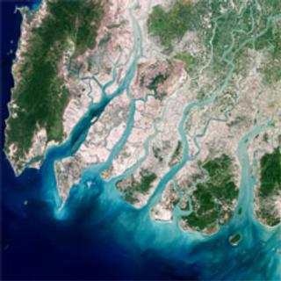
BLUE ENERGY GENERATION
EME 580
WHAT IS BLUE ENERGY?
  This is the energy generated when both fresh and salt water converge.
  This energy generation is made possible by the osmosis process, hence also referred to as Osmotic energy.
  The driving factor is the salinity gradient.
  There are two practical osmotic methods.

Slide 68
FACTORS FAVORING BLUE ENERGY GENERATION
Renewable source of energy
Efficiency in small-scale generation
High Salinity nature of waste water
The need to mitigate environmental hazards
Environmental-friendly non-combustion energy conversion
Future concerns of non-renewable energy sources
Environmental impacts of fossil fuels
Clean Source of energy
24 hour power generation i.e. Does not depend on sunlight or wind.
High oil and gas prices

Slide 69
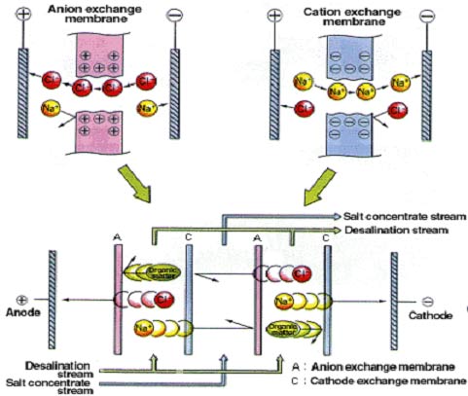

REVERSE ELECTRODIALYSIS (RED)
Technology centers around ion exchange membranes (CEM and AEM)
Salt water separated from fresh water between two such membranes develops a charge that leads to a potential difference
Electron transfer and electrical power generation.
Being investigated in the Netherlands, and Westus (a Dutch water technology research institute )
  Figure: Schematic representation of reverse electrodialysis; C is a cation exchange membrane and A is an anion exchange membrane.

Slide 70

PRESSURE RETARDED OSMOSIS (PRO)
Two solutions of different salinity are brought into contact by a semi-permeable membrane.
Salinity gradients cause water transport across membranes
Pressurization of the volume of transported water is used to generate electrical power in a turbine.
Reasons
  Complex RED membrane designs
  RED primary dependence on membrane size
  Low temperature differential in the SGPS system
  The danger of salt water leaching into fresh ground water in the SGSP.
  SGPS sunlight requirement
Illustration of generation of energy by Pressure retarded osmosis method by Statkraft’s prototype plant

Slide 71

BLUE ENERGY PARAMETERS: THE THEORY
The Osmotic Processes:
  Semi-permeable membrane
  Osmotic pressure differential (Δπ)
  Hydraulic pressure (ΔP):applied pressure on the more concentrated or draw solution (DS) part of the system.
  ΔP< Δπ so that flow is maintained in the direction of the DS
  Net water flux (J_{w}) : the flow through the membrane expressed as flow/area
    J_{w} = A(Δπ- ΔP) (1)
    [where A is the water permeability coefficient of the membrane]

Slide 72
Salt permeability
Salt permeability Coefficient (B)
  Gives a measure of the membrane’s ability to allow reverse salt diffusion(from RO experiments)
  This effect reduces osmotic pressure
  The smaller the ‘B’ the better the system
    B = A(1-R)(ΔP-Δπ) / R (2)
    Where R , the salt rejection is given by
    R = 1 – (C_{D,M} / C_{F,M}) (3)
    _{Where} CD,M is the salt concentration of the draw solution at the membrane _{surface and} CF,M is the salt concentration of the feed solution at the membrane

Slide 73

Concentration Polarization
Concentration or depletion of solutes near an interface
Also reduces effective osmotic pressure difference
Occurs externally (external concentration polarization-ECP) on the dense layer side and internally (internal concentration polarization-ICP) in the support layer side.
ECP modulus is given by:
  π_{D,M} /π_{D,b} = exp (- J_{w} /k) (4)
  Where π_{D,M} is the osmotic pressure at the membrane surface ; π_{D,b} is the bulk osmotic pressure of the draw solution and k is the mass transfer coefficient
Taking into consideration the ECP and ICP effects, and assuming that C_{F,b} / C_{D,M} = π_{F,b,} /π_{D,m} the water flux equation results to:
J_{w} = A[π_{D,b} exp (- J_{w} /k) [1 - (π_{F,b} /π_{D,b} )exp (J_{w} K )exp (J_{w} /k)] / [1 + B/ J_{w} [exp (J_{w} K ) – 1]] – ΔP] (5)
And K is the solute resistivity for diffusion with the porous layer, and it is given by:
    K = t τ / Dє (6)
    Where t is thickness, τ is tortuosity, and є is the porosity of the support layer, and D is the bulk diffusion coefficient

Slide 74
POWER DENSITY (W) IN PRO
Water flux through the membrane and the hydraulic pressure differential across the membrane are the major variables for power density(W) calculation
Power density is given by:
  W = J_{w} ΔP (7)
In the case where J_{w} is unknown, we can solve for it from equation (5) or equation (1) depending on the available membrane and solution parameters
Substituting equation (1) into (7) we will have:
  W = A(Δπ- ΔP) ΔP (8)
By differentiating (8) with respect to ΔP we will see that W reaches maximum when ΔP= Δπ /2
This implies that maximum W is given by:
  W_{max} = A (Δπ ²/4) (9)

Slide 75

FORWARD OSMOSIS (FO) THEORY
FO theory is same as the osmosis process
This process requires no external pressure for movement across membranes.
Why adapt the FO for power generation.
  Elimination of external pressure
  Reduce cost by eliminating external pressure and pressure exchanger systems
  Pressure generated in draw solution c an be utilized in place of external pressure
  Assuming draw solution can attain the minimum required hydraulic pressure
  Supports the objective of small-scale power generation
  Available FO membranes that can be used to develop similar PRO situations

Slide 76

THIN-FILM COMPOSITE (TFC) MEMBRANE
An asymmetrical membrane comprising a porous support layer and a dense active layer.
Dense layer faces the draw solution side of the system.
Using the TFC-PRO membrane developed by Yin et al (2011)
Figure : SEM micrographs of a TFC-PRO membrane : (A) cross section with a fingerlike macrovoid structure (B) magnified view of thepolyamide active layer surface, and (C) magnified view of the skin layer at the top of the porous support with dense, spongelike morphology.

Slide 77

COMPARISON OF DIFFERENT TFC MEMBRANES
Figure : Plots of modeled water flux, Jw, and power density, W, (bottom) as a function of applied hydraulic pressure, ΔP, for TFC-PRO LP#1 (left),MP#1 (center), and HP#1 (right) membranes and their respective characteristic parameters (top): intrinsic water permeability, A; solute permeability coefficient, B; and support layer structural parameter, S. Osmotic pressure of synthetic seawater is 26.14 bar, as determined by OLI Stream Analyzer software, and osmotic pressures of synthetic river water and 1,000 ppm TDS brackish water are 0.045 and 0.789 bar respectively (Yin et al, 2011) .

Slide 78
MEMBRANE PARAMETERS
The parameters for this membrane are given as:
  Water permeability coefficient (A) = 5.81L/m²hbar
  Salt or solute permeability coefficient (B) = 0.61L/m²h
  Structural parameter (S) = 370µm
  Power density (W) = 10W/m²
  Water flux (J_{w} ) = 30 L/m²h
  Osmotic pressure differential (Δπ) = 25bars
  Hydraulic pressure differential (ΔP) = 12.5bars
Advantages:
  The high salt rejection of the membrane
  The highest attainable power density by any membrane
  Has an expected life –span of 5 years

Slide 79
OTHER DESIGN CONSIDERATIONS
Ammonium bicarbonate (NH₄HCO₃) draw solution.
  Favourable considering its high salty nature and it requires just 68 degrees fahrenheit to boil away the ammonia and carbon dioxide
  The reversible nature of the reaction to recover NH₄HCO_{3.}
  Cheap and available
  Concentration flexibility
Maintaining the required osmotic pressure differential required by the system
Utilizing pressure pumps to raise the pressure draw solution as it enters the membrane exchange section.
The SCADA (supervisory control and data acquisition) system is installed across the whole system

Slide 80
MEMBRANE DESIGN CAPACITY
Our membranes are arranged in a cylindrical pack which maximizes space
The size of our membrane, taking into consideration the portability requirement will have the following dimensions; length of 4m, width of 1.91m, and a height of 1.6m
This system is going to incorporate approximately 120 1m² membranes
From the given parameters the system’s total water flux capacity and power density will be 3,600 L/m²h and 1,200W/m² respectively
Our system is controlled to attain a water flux capacity of over 17,000 L/m²h(approximately 150 bbl/h) by increasing the osmotic pressure of the system.

Slide 81
TURBINE CONSIDERATIONS
To convert the power density from the system into electricity
Turbine with minimum capacity of 1.2 kW
The turbine systems incorporates a generator
Affordable ($1,200-$5,000)and doesn’t require deep depths for maximum efficiency.
High efficiency turbine
Portable and sizable to fit perfectly in the system

Slide 82
POWER STORAGE CONSIDERATIONS
Capacitor storage system
Ability to save power for years
Used to provide the heat required to raise the heat of the thermolytic mixture
Can also be used to power some of the pumps in the system
High efficiency
Minimum capacity of 1.2kW

Slide 83
DESIGN ASSUMPTIONS
Concentrations of feed solution and draw solution are maintained at considerably stable values
Osmotic pressures remain the same during the desalination and power generation processes
The SCADA takes care of any unwanted changes in solution properties
The system is 100% efficient
The experimental parameters are suitable for the entire system
The draw solution can attain the required hydraulic pressure for maximum power generation.

Slide 84
CONTINGENCY PLAN
The membranes are arranged in a way that they are easily replaceable in the event of any malfunctioning whatsoever
The osmotic concentration of the system is maintained by the control of the concentration of the draw solution
In order to meet other power demands that might exceed the expected supply, a step-up transformer can be installed
Unused capacitors are available at the site, to take care of any excess power produced
In the case of unwanted rise in temperature in the container, a ventilation system is provided to maintain the temperature in the container
All the components of this system are maintained on a regular basis to ensure that they are all functioning at their expected capacities

Slide 85

Associated Costs Evaluation
EME 580
Administration & Royalty Cost
Expense incurred in controlling and directing an organization. Salaries (Accountants, Engineers, and Laymen) and costs of general services fall under this heading. This is considered as 15% of total expenses for this study. Royalty is a payment made for the use of natural resource. It is considered as 12.5% for this project.
Lease Cost
Usually, Lease cost is stated per acre per year.
From county to county, it varies with the exactly
location and the price of natural gas. In Bradford
country, this cost ranges from $500‐$2500/acre
is taken as $1500/acre
in this project.
. It
County Name | Lease Cost ($/acre)
Bradford Fayette Susquehanna Greene Clearfield | 1500 1150 2500 3000 2500

Slide 86


Associated Costs Evaluation
EME 580
Drilling and Completion Cost
  Drilling Permit Fee
  This permit is submitted to Pennsylvania Department of Environment Protection (DEP), who enforces the regulations. The application fee now is calculated based on the depth and length of the well. In this project with average D=7000 ft and L= 4000 ft the application fee was calculated to be $2150.
Horizontal Well Drilling and Completion
The average cost for making a horizontal well is $3.5 million ~ $4.0 million. This single well cost includes fracturing services cost which is around$350,000 , rigs leasing cost for $22,000 per day. Also, this cost includes pad construction, gas pipelines and local hiring.

Slide 87

Associated Costs Evaluation
EME 580
Water Management Cost
Fresh Water Consumption Cost
Water Supply
We consider municipal water supply as an adequate and dependable supply of water to support well drilling and well stimulation activities. the cost can vary greatly from one municipality to another. The current rates quoted in Bradford county range from $5 to $14 per 1000 gal, but it can be considered negligible in comparison to the cost of trucking.
Recycled Water
Using forward osmosis filtration to recycle waste
water into a high quality fluid for use in frac jobs.
On each well, over 80% of the waste water can be recycled to provide approximately
25% of the water required for hydraulic
fracturing.
$36,000/well
$25,000/well

Slide 88


Associated Costs Evaluation
EME 580
Wastewater Disposal Cost
Conventional way :
$0.15 to $0.3 /gal
Commercial Industrial Wastewater Treatment Plants

Slide 89
Associated Costs Evaluation
EME 580
Wastewater Disposal Cost
Disposal Facility Name | Location | Disposal Cost | Throughput Capacity
Castle Environmental Inc. (name changed to Advanced Waste Services of Pennsylvania in 2010) | New Castle, PA | $0.025–$0.050/gal | Daily volume on 6/28/10 was ~260,000 gal/day; this was slightly lower than average
Hart Resource Technologies | Creekside, PA | $0.0525/gal | 18,000 gal/day of produced water; 45,000 gal/day of flowback; total from 11/08 to 10/09 = 23.2 million gal
Pennsylvania Brine Treatment | Franklin, PA | $ 0.055/gal | 140 gpm; total from 11/08 to 10/09 = 53 million gal
Tunnelton Liquids | Saltsburg, PA | $0.045/gal | Total of 1 million gal/day; ~100,000 gal/day of oil and gas water; ~900,000 gal/day of acid mine drainage

Slide 90


Associated Costs Evaluation
EME 580
Wastewater Disposal Cost
Capital Cost of FO System
A cost estimate for Forward Osmosis System application was developed using the Water Treatment Estimation Routine (WTER) developed by the United States Department of the Interior, Bureau of Reclamation.
Commercial scale units are trailer mounted systems capable of recycling up to 4 barrels per minute; 168 gallons per minute - 242,000 gallons per day. The portable FO system only contains 280 cylinder shaped membrane elements placed in 6 pressure vessels which reduces physical space requirements but maintains large membrane surface area up to 4000m². The capital cost of each system is about $100,000.

Slide 91

Associated Costs Evaluation
EME 580
Wastewater Disposal Cost
Annual operating cost of FO System
The annual operating cost of the FO system would be about $0.60/kgal of produced water. This relatively high cost results from the low value assumed for flux across the membrane. If guarantee a constant driving force across the membrane, the FO flux may increase 70%, the unit water costs will drop by 36% to about only $0.38/kgal.

Slide 92
Associated Costs Evaluation
EME 580
Total Costs Comparison
Total Costs for a single well
per year = C _{administration & Royalty} _{& lease} + C _{Drilling activities} + C _{Water}
_{management}
C_{Conventional}
～
$6.41 million
C_{Using FO System}
～
$5.33 million
Cost Discrepancy Due to Water Management
～
$1.08 million
(Assume that each well needs about 5 Million gallons water for drilling and fracturing activities.)

Slide 93

Field Applicability of the Forward Osmosis Unit:
EME 580
The forward osmosis unit design, for the approximately 10 bbl/min unit would consist of a large TFC membrane 16 inch by 40 inch spiral-wound elements
36% NH₄CO₃ draw solution is pumped into the unit using a ½ to ¾ horsepower, 1.8 bbl/min centrifugal transfer pump.
The entire system which consists of pumps and ancillary equipment (lights, trailer , etc) would be powered by a 25 kilowatt cell, but in our case, we would generate this needed power from the system.
The 10 bbl/min FO unit can be effectively operated by a single person, or for efficiency, two operators (each taking a 12 hour shift) will be on location.

Slide 94
Benefit of the Forward Osmosis Unit:
EME 580
The forward osmosis reclamation process satisfies the following conditions for practical and cost-effective waste reclamation process:
the amount or volume of ‘new’ freshwater required for completion fluid is greatly reduced,
no new waste streams are created,
the volume of drilling waste to be disposed of is reduced,
an otherwise wasted chemical energy source is utilized to reclaim the reserve pit waste water, and
the system is operated on the well location without disrupting normal operational practices, which reduces the operator’s overall logistical concerns and environmental exposure.

Slide 95

Regulations:
EME 580
The Pennsylvania’s Oil and Gas Act, 1984
(Act 223), Title 58. Sec. 601.102.
Permit the optimal development of the oil and gas resources of Pennsylvania consistent with the protection of the health, safety, environment and property of the citizens of the Commonwealth.
Protect the safety of personnel and facilities employed in the exploration, development, storage and production of natural gas or oil or the mining of coal.
Protect the safety and property rights of persons residing in areas where such exploration, development, storage or production occurs.
Protect the natural resources, environmental rights and values secured by the Pennsylvania Constitution.

Slide 96

Regulations:
EME 580
The Clean Streams Law P.L 1987,
Act 394 of 1937, as amended:
Conserve and improve the purity of the waters of the Commonwealth for the protection of public health, animal and aquatic life, and for industrial consumption, and recreation;
Providing protection of water supply and water quality;
Providing for the jurisdiction of courts in the enforcement thereof;
Providing additional remedies for abating pollution of waters;
Imposing certain penalties;
Regulating discharges of sewage and industrial wastes;
Placing responsibilities upon landowners and land occupiers
and to maintain primary jurisdiction over surface exploration in Pennsylvania”.

Slide 97
Benefit of the Forward Osmosis Unit:
EME 580
Save about three-quarters of a billion gallons of fresh water per year.
Eliminates 66,600 bbls of waste water per horizontal well of trucking related road damages and emission, leading to reduction in the carbon footprint of the industry.
Approximately 175 truck loads can be eliminated per fracture job
4,375 gallons of diesel emissions eliminated per 66,600 bbls of waste water reclaimed.
Save approximately 6.2 million gallons of diesel use each year.
Considering the fact that there are about 25 known shale basins in the United States where the forward osmosis technology alongside the power generation can be employed.
Conversely, the forward osmosis technology is not limited to shale development but is applicable in conventional oil and gas plays also.

Slide 98
Conclusion
EME 580
The naturally low permeability shale must be fractured to guarantee higher productivity and the fracturing process involves the use of millions of gallons of water that must be recovered as flow back or produced waste water. Public and regulatory pressure is demanding that operators in the oil and gas industry improve water management practices.
Exploring several results of laboratory and field testing from early commercial jobs indicate that,
flexible, portable and scalable Forward Osmosis units are applicable to resourcefully and efficiently reclaim water-based waste for valuable reuse as a high quality completion fluid.

Slide 99
Recommendations:
EME 580
It is recommended that future design and development of the forward osmosis blue energy integrated system (FOBES) for waste water treatment should consider improved material use and better energy generation methodologies from the chemical potential energy between waste water and an improved draw solution.
Additional improvement on the selected membrane would be helpful in enhancing the efficiency of the integrated process.
Investments into the development of forward osmosis membranes with higher solute rejection and higher water flux are highly recommended.

