Slide 1
Introduction
Coal combustion/gasification
Carbon reactions:
Synthetic gas
Fuel gas
Activated carbon
Metallurgical processes
Regeneration of coked catalysts
Abundant and widely distributed
Substitute to oil
Substitute to natural gas
Processing controlled to remove
CO2 Capture
Gas cleaning

Slide 2
Governing Equations
Modeling mass and heat transfer during gasification
Governing Equations
Mass Transfer:
C_{j} concentration of specie j in the reactor
u_{j} velocity of the particle
D_{j} diffusion coefficient of the specie in the medium
R_{C,j} rate of production or depletion of specie j from chemical reactions.
Heat Transfer:
R_{C} convective heat transfer
R_{R} radiation heat transfer
R_{Rxn} source of energy due to chemical reaction

Slide 3
Formulation
Feedstock
Fuel: Coal Water Slurry (CWS) 65% Coal and 35% H2O
ρ_{cws} = ρ_{coal} * 0.65 + 0.35*ρ_{w}
Gasifying agent: Oxygen
Feed rate
CWS: 60 l/h
Molar flow rate: Coal 0.14 mol/s H2O 0.42 mol/s
O2: 24.5 m³ / h
Molar flow rate: 0.28 mol/s
Temperature
T0 = 1000 K
Boundary conditions
Mass
1, 4 Insulation/Symetry; 3 Concentration; 2 Convective flux
Heat
1, 4 Insulation/Symetry; 3 Temperature, 2 Convective flux
3
1
4
2

Slide 4
Formulation
Diffusion Coefficient
Mixture of steam and O2, at 1000 K and 2 MPa
D = 0.000059 m² s⁻¹
Gas mixture density (Steam and O2)
Heat Capacity
O2 Heat Capacity at 1000K: C_{p} = 1085 J kg⁻¹ K⁻¹
Thermal Conductivity
O2 Thermal Conductivity at 1000 K: λ = 0.074 W m⁻¹ K⁻¹
Reaction rate:
Heat
Species:
Reactions:

Slide 5
Formulation
Chemical reactions
Water vaporization (kw, Hw)
Coal devolatilization: Coal -> Volatiles + C (v) (kv, Hv)
Volatile composition: 40.02 % CO, 27.5 % CO₂, 20.12 % H₂ and 12.36 % CH4
Char combustion and gasification:
C + ½ O₂ ====> CO (1) (k1, H1)
C + H₂O ====> CO + H₂ (2) (k2, H2)
C + CO₂ ====> 2 CO (3) (k3, H3)
C + 2 H2 ====> CH₄ (4) (k4, H4)
Volatiles Combustion
H₂ + ½ O₂ =====> H₂O (5) (k5, H5)
CH₄ + 2 O₂ ====> CO₂ + H₂O (6) (k6, H6)
CO + ½ O2 ====> CO₂ (7) (k7, H7)
Water gas shift reaction
CO + H₂O ====> H₂ + CO₂ (8) (k8,H8)

Slide 6
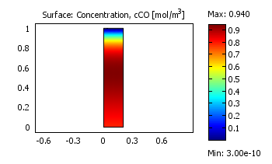
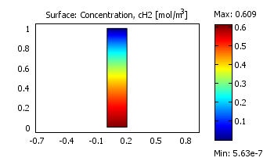
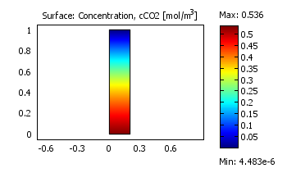
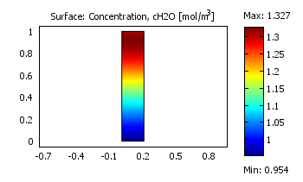
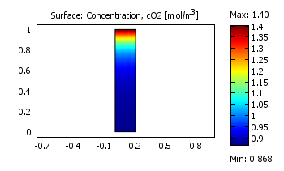
Results

Slide 7
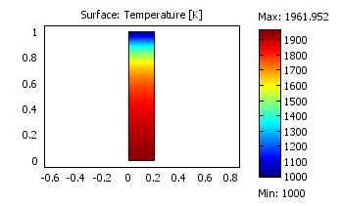
Results
Heat Transfer

Slide 8
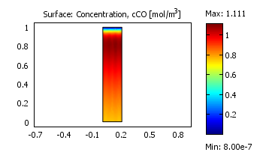
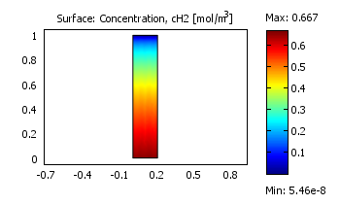
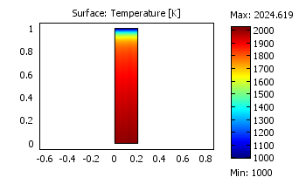
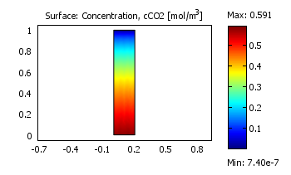
Parametric Study
O2 Concentration increase from
1.4 mol/cu meter to 2.4 mol/cu meter

Slide 9
References
Choi, Y.C., et al., Numerical study on the coal gasification characteristics in an entrained flow coal gasifier. Fuel, 2001. 80(15): p. 2193-2201.
Liu, X.J., W.R. Zhang, and T.J. Park, Modelling coal gasification in an entrained flow gasifier. Combustion Theory and Modelling, 2001. 5(4): p. 595 - 608.

Slide 10
Thank You!
Questions?

