Slide 1
Biomass Pyrolysis Heat Transfer in an Electric Furnace Reactor
Presented by:
Brad Hartwell
Bob Snow
April 29, 2008

Slide 2
Introduction
Pyrolysis – thermal decomposition in an oxygen-free environment
Pyrolyzing biomass produces different fuels
Bio-oil - heating oil; refined into diesel
Syn-gas – hydrogen extraction; processed into any fuel

Slide 3
Aim of Study
Want to see effects of the following on heat transfer
Particle size
Furnace wall temperature
Heat transfer solution can be used to find optimal reactor operating conditions

Slide 4
Governing Equations
Navier-Stokes fluid flow over a sphere:
Convection-conduction heat transfer:
Coupling: v is input into CC and T is input into NS (ρ, μ)
Pine
N2 gas
z
r

Slide 5
Formulation
No Stress
5 cm
No slip
T = 1000 K
20 cm
Pine
r = 2 cm
N2 gas
v: 1.25 cm/s
N2 gas
z
r

Slide 6
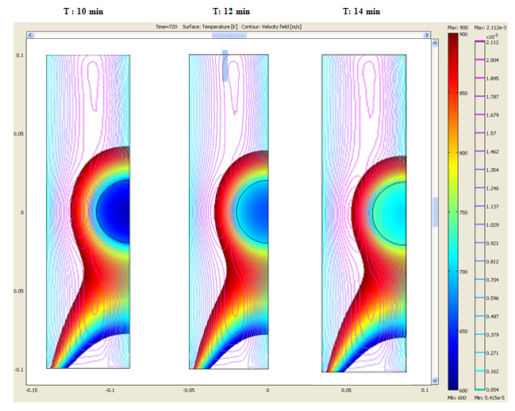
Solution
625 K 675 K 700 K
*Sample r = 2 cm

Slide 7
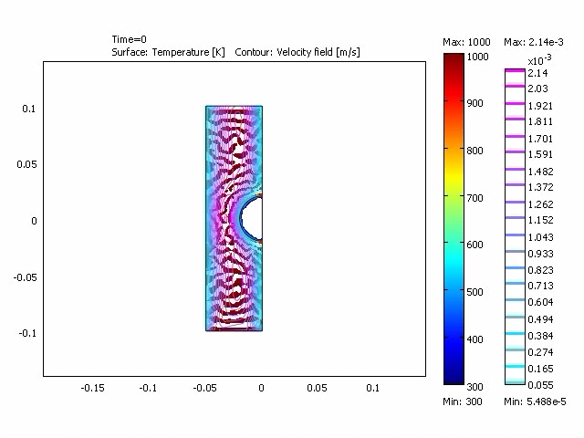
Solution cont.

Slide 8
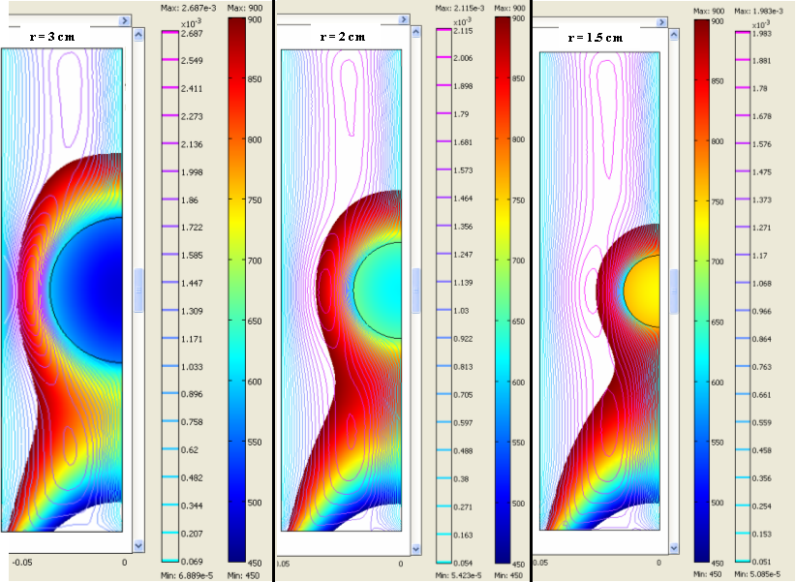
Parametric Study
Figure 3: Effect of particle size on solution after 10 minutes

Slide 9
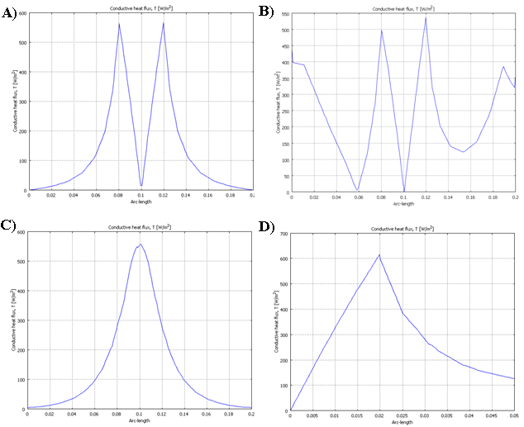
Validation
Conductive flux along: A) z-axis (r=0); B) z-axis r=0 for cond-conv
C) z-axis (r=0.021); D) r-axis (z=0).

Slide 10
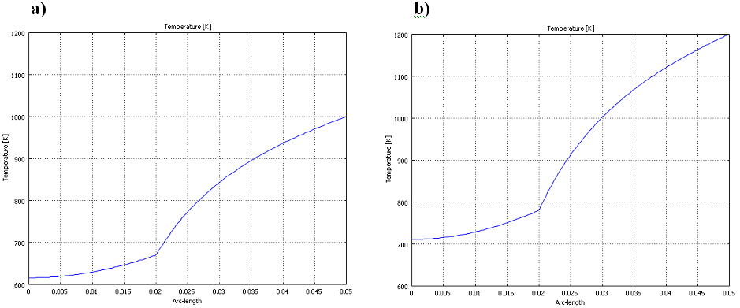
Parametric Study
Figure 4: Cross-sectional solution (along r-axis at z=0) of particle after 10 min. for furnace wall temperatures of a) 1000 K and b) 1200 K

Slide 11
Conclusion
Increased size of particle both slows down the heat transfer and reduces the final internal temperature of the particle.
Although the time of reaction is decreased with an increase in furnace temperature further investigation into an optimal temperature will need to be done.
Thermal degradation of the particle is the next step to be considered when modeling this reaction.

Slide 12
References
1. Demirbas, A. and Ia, Effect of temperature on pyrolysis products from biomass. Energy Sources Part a-Recovery Utilization and Environmental Effects, 2007. 29(4): p. 329-336.
2. Lede, J., et al., Properties of bio-oils produced by biomass fast pyrolysis in a cyclone reactor. Fuel, 2007. 86(12-13): p. 1800-1810.
3. Yaman, S., Pyrolysis of biomass to produce fuels and chemical feedstocks. Energy Conversion and Management, 2004. 45(5): p. 651-671.
4. Dominguez, A., et al., Production of bio-fuels by high temperature pyrolysis of sewage sludge using conventional and microwave heating. Bioresource Technology, 2006. 97(10): p. 1185-1193.
5. Park, E.S., B.S. Kang, and J.S. Kim, Recovery of oils with high caloric value and low contaminant content by pyrolysis of digested and dried sewage sludge containing polymer flocculants. Energy & Fuels, 2008. 22(2): p. 1335-1340.
6. Babu, B.V., A.S. Chaurasia, and Ch, Heat transfer and kinetics in the pyrolysis of shrinking biomass particle. Chemical Engineering Science, 2004. 59(10): p. 1999-2012.
7. Chaurasia, A.S. and B.D. Kulkarni, Most sensitive parameters in pyrolysis of shrinking biomass particle. Energy Conversion and Management, 2007. 48(3): p. 836-849.
8. Cai, J.M. and R.H. Liu, Parametric study of the nonisothermal nth-order distributed activation energy model involved the Weibull distribution for biomass pyrolysis. Journal of Thermal Analysis and Calorimetry, 2007. 89(3): p. 971-975.
9. Senneca, O., Kinetics of pyrolysis, combustion and gasification of three biomass fuels. Fuel Processing Technology, 2007. 88(1): p. 87-97.
10. Zhang, X.D., et al., Study on biomass pyrolysis kinetics. Journal of Engineering for Gas Turbines and Power-Transactions of the Asme, 2006. 128(3): p. 493-496.
11. Thipkhunthod, P., et al., Describing sewage sludge pyrolysis kinetics by a combination of biomass fractions decomposition. Journal of Analytical and Applied Pyrolysis, 2007. 79(1-2): p. 78-85.
12. Zhang, J., et al., Product analysis and thermodynamic simulations from the pyrolysis of several biomass feedstocks. Energy & Fuels, 2007. 21(4): p. 2373-2385.
13. Shao, J., et al., Pyrolysis characteristics and kinetics of sewage sludge by thermogravimetry Fourier transform infrared analysis. Energy & Fuels, 2008. 22(1): p. 38-45.
14. Miao, X.L., et al., Fast pyrolysis of microalgae to produce renewable fuels. Journal of Analytical and Applied Pyrolysis, 2004. 71(2): p. 855-863.
15. Di Blasi, C., et al., Pyrolytic behavior and products of some wood varieties. Combustion and Flame, 2001. 124(1-2): p. 165-177.
16. Chen, G., et al., Biomass pyrolysis/gasification for product gas production: the overall investigation of parametric effects. Energy Conversion and Management, 2003. 44(11): p. 1875-1884.
17. Miao, X.L., Q.Y. Wu, and Wd, High yield bio-oil production from fast pyrolysis by metabolic controlling of Chlorella protothecoides. Journal of Biotechnology, 2004. 110(1): p. 85-93.
18. Zhang, Y., et al., Peculiarities of rapid pyrolysis of biomass covering medium- and high-temperature ranges. Energy & Fuels, 2006. 20(6): p. 2705-2712.
19. Dominguez, A., et al., Conventional and microwave induced pyrolysis of coffee hulls for the production of a hydrogen rich fuel gas. Journal of Analytical and Applied Pyrolysis, 2007. 79(1-2): p. 128-135.
20. Ischia, M., et al., Pyrolysis study of sewage sludge by TG-MS and TG-GC-MS coupled analyses. Journal of Thermal Analysis and Calorimetry, 2007. 87(2): p. 567-574.

