Slide 1
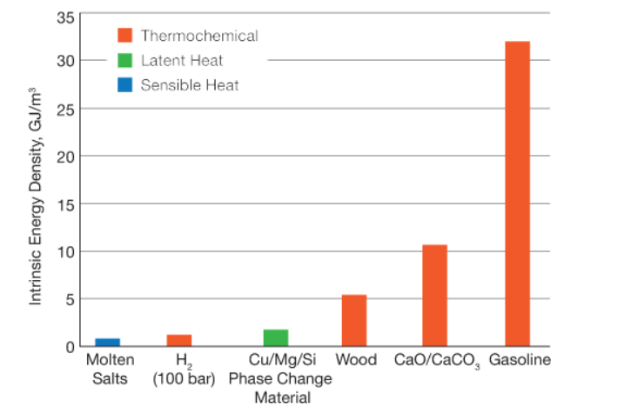
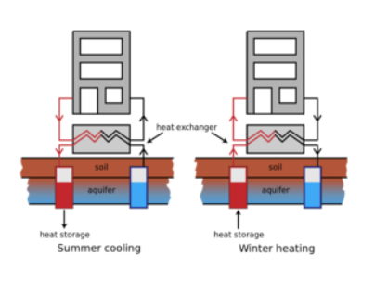
Underground thermal storage
EGEE 497
Pages 39-68
Geothermal
Jeff Horst

Slide 2
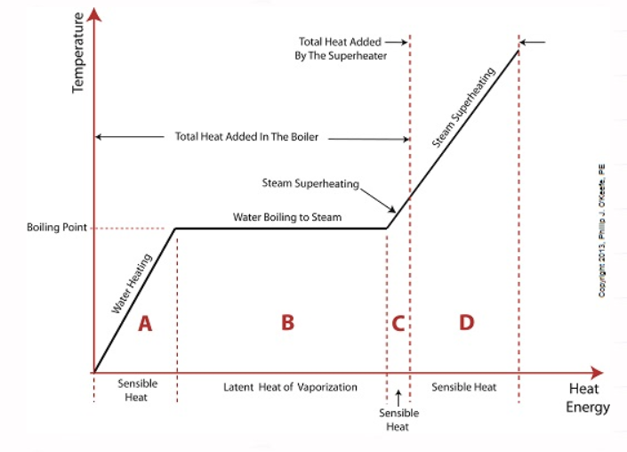
Fundamentals:
Thermal storage entails the storage of two types of thermal energy:
Heat (thermal energy above the ambient temperature
Cold (thermal energy below the ambient temperature
The main thermal energy storage types are sensible, latent and electrochemical.
Sensible – raising the temperature of a storage medium (water, rocks, soil)
Latent – changing the phase of the storage medium (water/ice)
Thermothermochemical – chemically reacting a storage medium (pair MgSO4 and Zeolite )

Slide 3
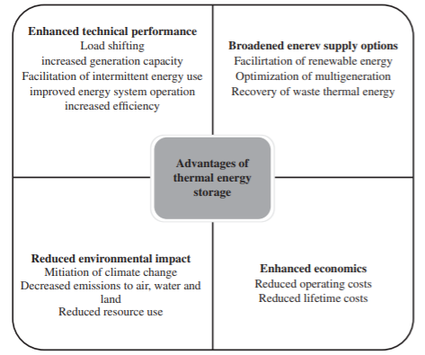
Advantages of TES
Improved operation of systems in which thermal storage is applied
Load Shifting
Increased Efficiency
Improved operation of thermal equipment
Facilitation of use of intermittent energy sources
Facilitation of use of renewable energy sources
Reduced environmental impact
Enhanced economics

Slide 4
TES Operation and Performance
Cycles:
Seasonal/long-term
Weekly/medium-term
Diurnal/ short-term
Strategical charging and discharging
Full storage
Partial Storage

Slide 5
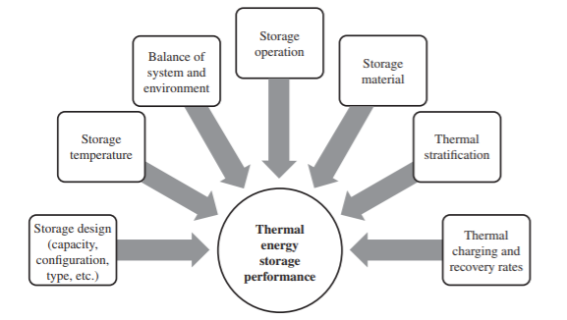
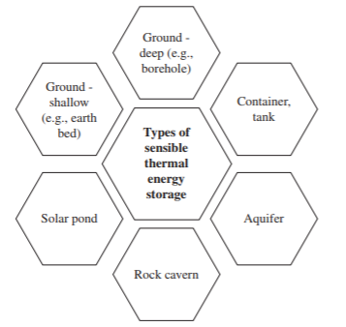
TES Types - Sensible
Sensible TES
-Sensible TES systems undergo changes in sensible heat, associated with temperature change. Some characteristics preferred for a sensible heat storage medium are: high specific heat capacity; long-term stability under repeated charging and discharging cycles; compatibility between storage medium and its containment; and low cost. Sensible heat storage systems are sometimes classified based on heat storage media as liquid (e.g., water, oil) and solid (e.g., rock, ground).

Slide 6
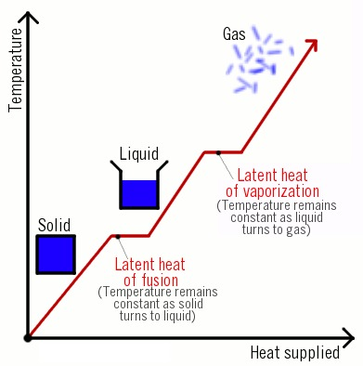
TES Types - Latent
2. Latent TES
- Phase change materials include inorganic and organic materials, large fatty acids, aromatics salt compounds that absorb a large amount of heat during melting (e.g., eutectic salts, salt hydrates, Glauber’s salt), and paraffin waxes.
-The latter are common because they have good stability and do not degrade notably over repeated storage cycles.
-Cold latent TES typically uses the following storage media: water, eutectic salts, glycol, brine, and ice slurry
-Phase-change materials (PCMs) provide greater energy storage capacity with smaller temperature fluctuations compared with sensible storage. PCMs also are potentially advantageous for use in solar walls

Slide 7
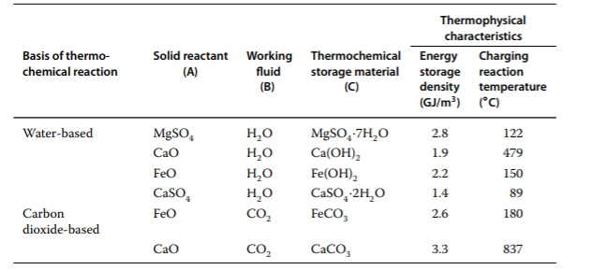
TES Types – Thermochemical
3. Thermochemical storage utilizes chemical reactions to store and release heat. It is based on a chemical reaction that can be reversed:
C + heat ⇄ A + B
Substance C is the thermochemical material for the reaction and can be a hydroxide, hydrate, carbonate, or ammoniate, while A and B are reactants, which can be water, carbon monoxide, ammonia, and hydrogen. Usually material C is a solid or a liquid and A and B can be any phase
-The three main processes of a general TES cycle
Charging
Storing
Discharging
- The working pair MgSO4 and Zeolite have been shown to have reasonable energy densities and thermal properties for seasonal thermochemical heat storage

Slide 8
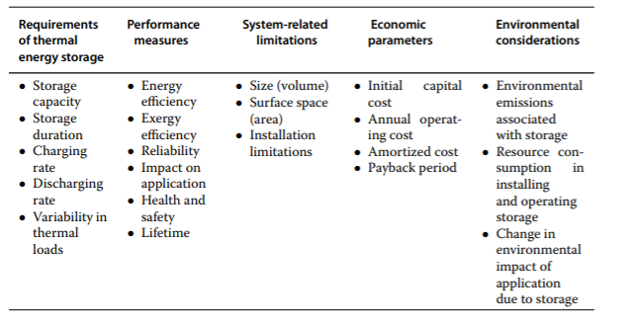
Thermal Energy Quality

Slide 9
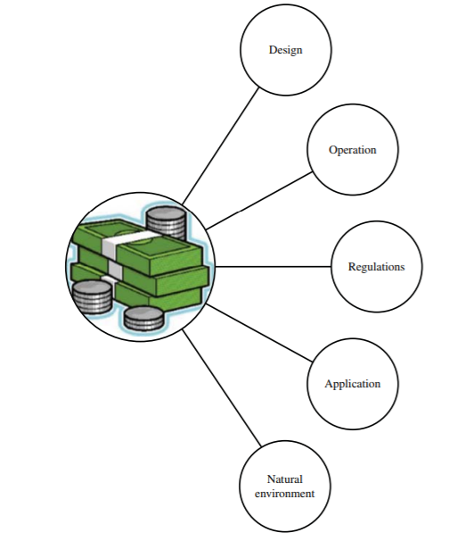
TES Economics
TES systems often provide energy cost savings relative to the primary generating equipment required to satisfy the same service (loads, periods, etc.), but often with higher initial capital costs. The economics of TES systems normally requires that their annualized capital and operating costs not exceed the costs of the primary equipment.
• temporal variations of heating, cooling and electrical loads;
• storage system design characteristics (e.g., type, size);
• storage operation characteristics (e.g., efficiency, control);
• costs (e.g., electricity consumption costs, time-of-use cost adjustments, electricity demand charges, TES costs);
• other economic factors (e.g., financial incentives)

Slide 10
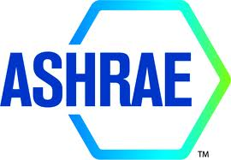
Testing Standards
ASHRAE and ANSI provide testing standards for some types of TES (ASHRAE 2000). These include ASHRAE standard 943 (Method of Testing Active Sensible TES Devices Based on Thermal Performance) and ANSI/ASHRAE standard 94.1-1985 (Method of Testing Active Latent Heat Storage Devices Based on Thermal Performance). Note that these were originally combined in ASHRAE TES standard 94-77: Methods of Testing Thermal Storage Devices Based on Thermal Performance.
The Canadian Standards Association published information on the design and installation of underground TES systems for commercial and institutional buildings (CSA 2002), which includes information on testing.

Slide 11
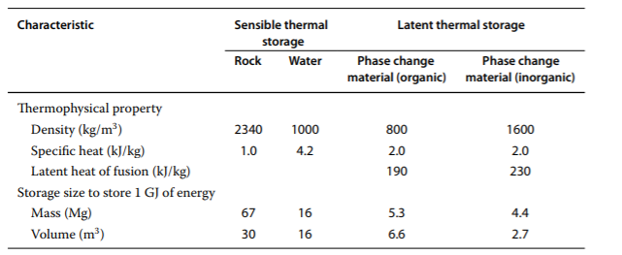
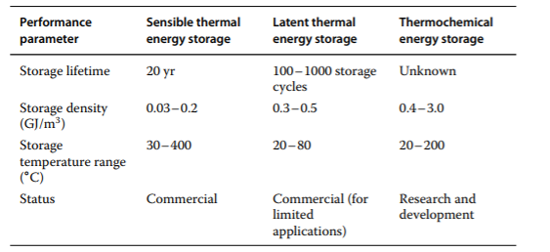
Comparing thermal energy storage types

Slide 12
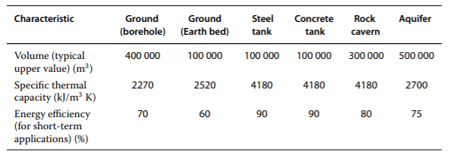
Types and characteristics of underground TES
Soil and earth bed
Borehole
Aquifer
Rock Cavern
Container/tank
Solar Pond

Slide 13
References:
Rosen, M., & Koohi-Fayegh, S. (2017). Geothermal energy: Sustainable heating and cooling using the ground. Chichester, West Sussex, United Kingdom: John Wiley & Sons.
Mangor, J., & Ayling, B. F. (2017). Geothermal energy. Minneapolis, MN: Core Library, an imprint of Abdo Publishing.
Solar Thermochemical Energy Storage. (2017, July 03). Retrieved from https://www.aiche.org/resources/publications/cep/2017/july/solar-thermochemical-energy-storage
(n.d.). Retrieved from http://large.stanford.edu/courses/2013/ph240/lim1

