Slide 1
EESiPV: Electrochemical Energy Storage integrated Photovoltaics EME 580 Group 5: Solar
Rebecca Hott
Mark LaBarbera
Jeff Rayl
Kuangyuan Zhang

Slide 2
Problem Statement:
Design and evaluation of an integrated photovoltaic and electrochemical storage system for continuous, stable and sustainable grid-connected power generation; including life cycle assessment on economic, policy and environmental impacts."

Slide 3
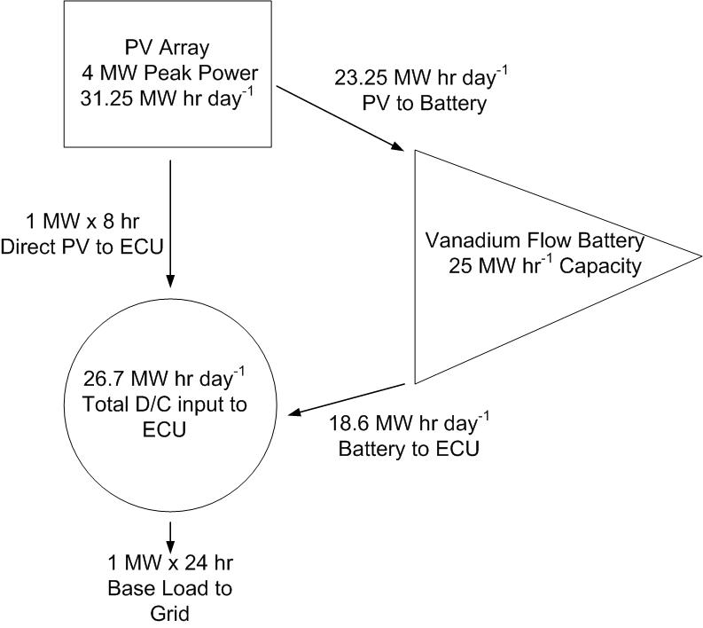
System Design Requirements:

Slide 4
Final System Design:
Phoenix, Arizona:
BP 3235N – 22,100 panels → 5.194MWdc peak
FS3 77.5 – 51,200 panels → 3.968MWdc peak
Raleigh, North Carolina:
BP 3235N – 27,300 panels → 6.416MWdc peak
FS3 77.5 – 48,000 panels → 3.720MWdc peak
Buffalo, New York:
BP 3235N – 45,500 panels → 10.693MWdc peak
FS3 77.5 – 60,800 panels → 4.712MWdc peak

Slide 5
System Results: pc-Si Monthly Average PV Generation

Slide 6
System Results: CdTe Monthly Average PV Generation

Slide 7
System Results: pc-Si System Average Daily Energy

Slide 8
System Results: CdTe System Average Daily Energy

Slide 9
Photovoltaic Generation Conclusions:
Seasonal variations in the solar resource leads to difficult system sizing for a single yearly quantity of base-load generation; seasonal quantities for energy generation with a minimum of 1MWh continuous production
Solar resource forecasting required for accurate energy generation predictions
Phoenix (high irradiance): high summer temperatures cause performance losses (especially in CdTe system)
Raleigh (medium irradiance): provides the most consistent year round energy
Buffalo (low irradiance): low angle of incidence in winter months requires significantly oversized array for the summer

Slide 10
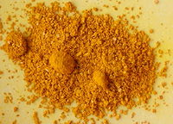
Vanadium Redox Flow Cell Electrolyte Composition
Reagents
+
+
Thermal Redox Reaction
Positive Electrolyte 3.5 M [V_{total}]
Separate positive and negative storage tanks
Each 225,000 liters (HDPE)
H₂SO₄ concentration 0.5-3.5
H2SO4 & V2O5 are acute health risks
Charged 3.5 M H₂SO₄
Discharged 0.5 M H₂SO₄
Thermal Redox Reaction
Negative Electrolyte 3.5 M [V_{total}]
V⁺²_{(aq)}
V⁺³_{(aq)}
Charged 3.5 M H₂SO₄
Discharged 2.5 M H₂SO₄

Slide 11
Vanadium Redox Flow Cell Electro-active Species
Positive Half-Reaction
VO₂⁺ + H₃O⁺ + H⁺ + e- → VO²⁺ + 2H₂O
H₃O⁺ + V⁺² → V⁺³ + H₂O + e⁻
VO₂⁺ + V⁺² +2 H₃O⁺ → VO⁺² + V⁺³ + 3 H₂O
Δ_{r}G° = -117.7 kJ mol⁻¹ E°_{eq} = 1.24 V
Negative Half-Reaction
Positive Half-Reaction
e⁻_{(circuit)} + H₃O⁺_{(aq)} +
+ 2H₂O
H⁺_{(membrane)}
Negative Half-Reaction
H₃O⁺_{(aq)} +
V⁺²_{(aq)}
V⁺³_{(aq)}
+ H₂O + e⁻_{(circuit)}
Charge
Discharge

Slide 12
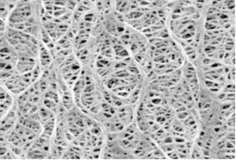
Vanadium Redox Flow Cell Proton Exchange Membrane
Carbon Felt
Electrode
Polyethylene Separator
Nafion ionomer
Carbon Felt
Electrode
Nafion Proton
Exchange Membrane
Porous Polyethylene
Separator Protects Nafion
from VO⁻² ions
V⁺² + V⁺³
3.5 M [V]_{total}
0.5 – 3.5 M H₂SO₄
VO⁺² + VO₂⁺
3.5 M [V]_{total}
0.5 – 3.5 M H₂SO₄
575 square meters

Slide 13
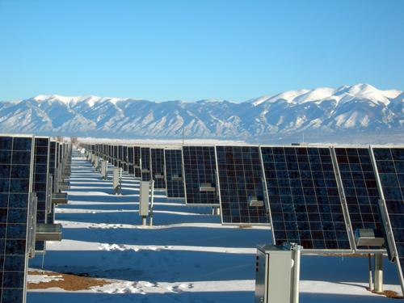
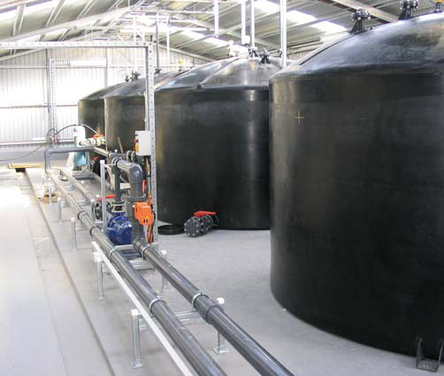
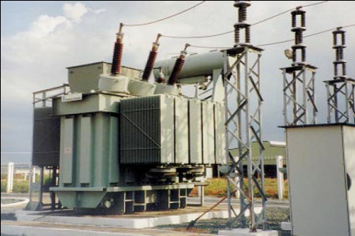
Vanadium Redox Flow Cell Balance of Plant
2 x 225,000 liter HDPE Tanks (indoor storage)
4 meter tall 4.24 meter diameter
575 m² active area total
500 Cells x 1.15 m²
Series & Parallel stack switching
Electronically controlled switching
Maximize Efficiency by minimizing ΔV between input from ECU+PV array and VRB Stack

Slide 14
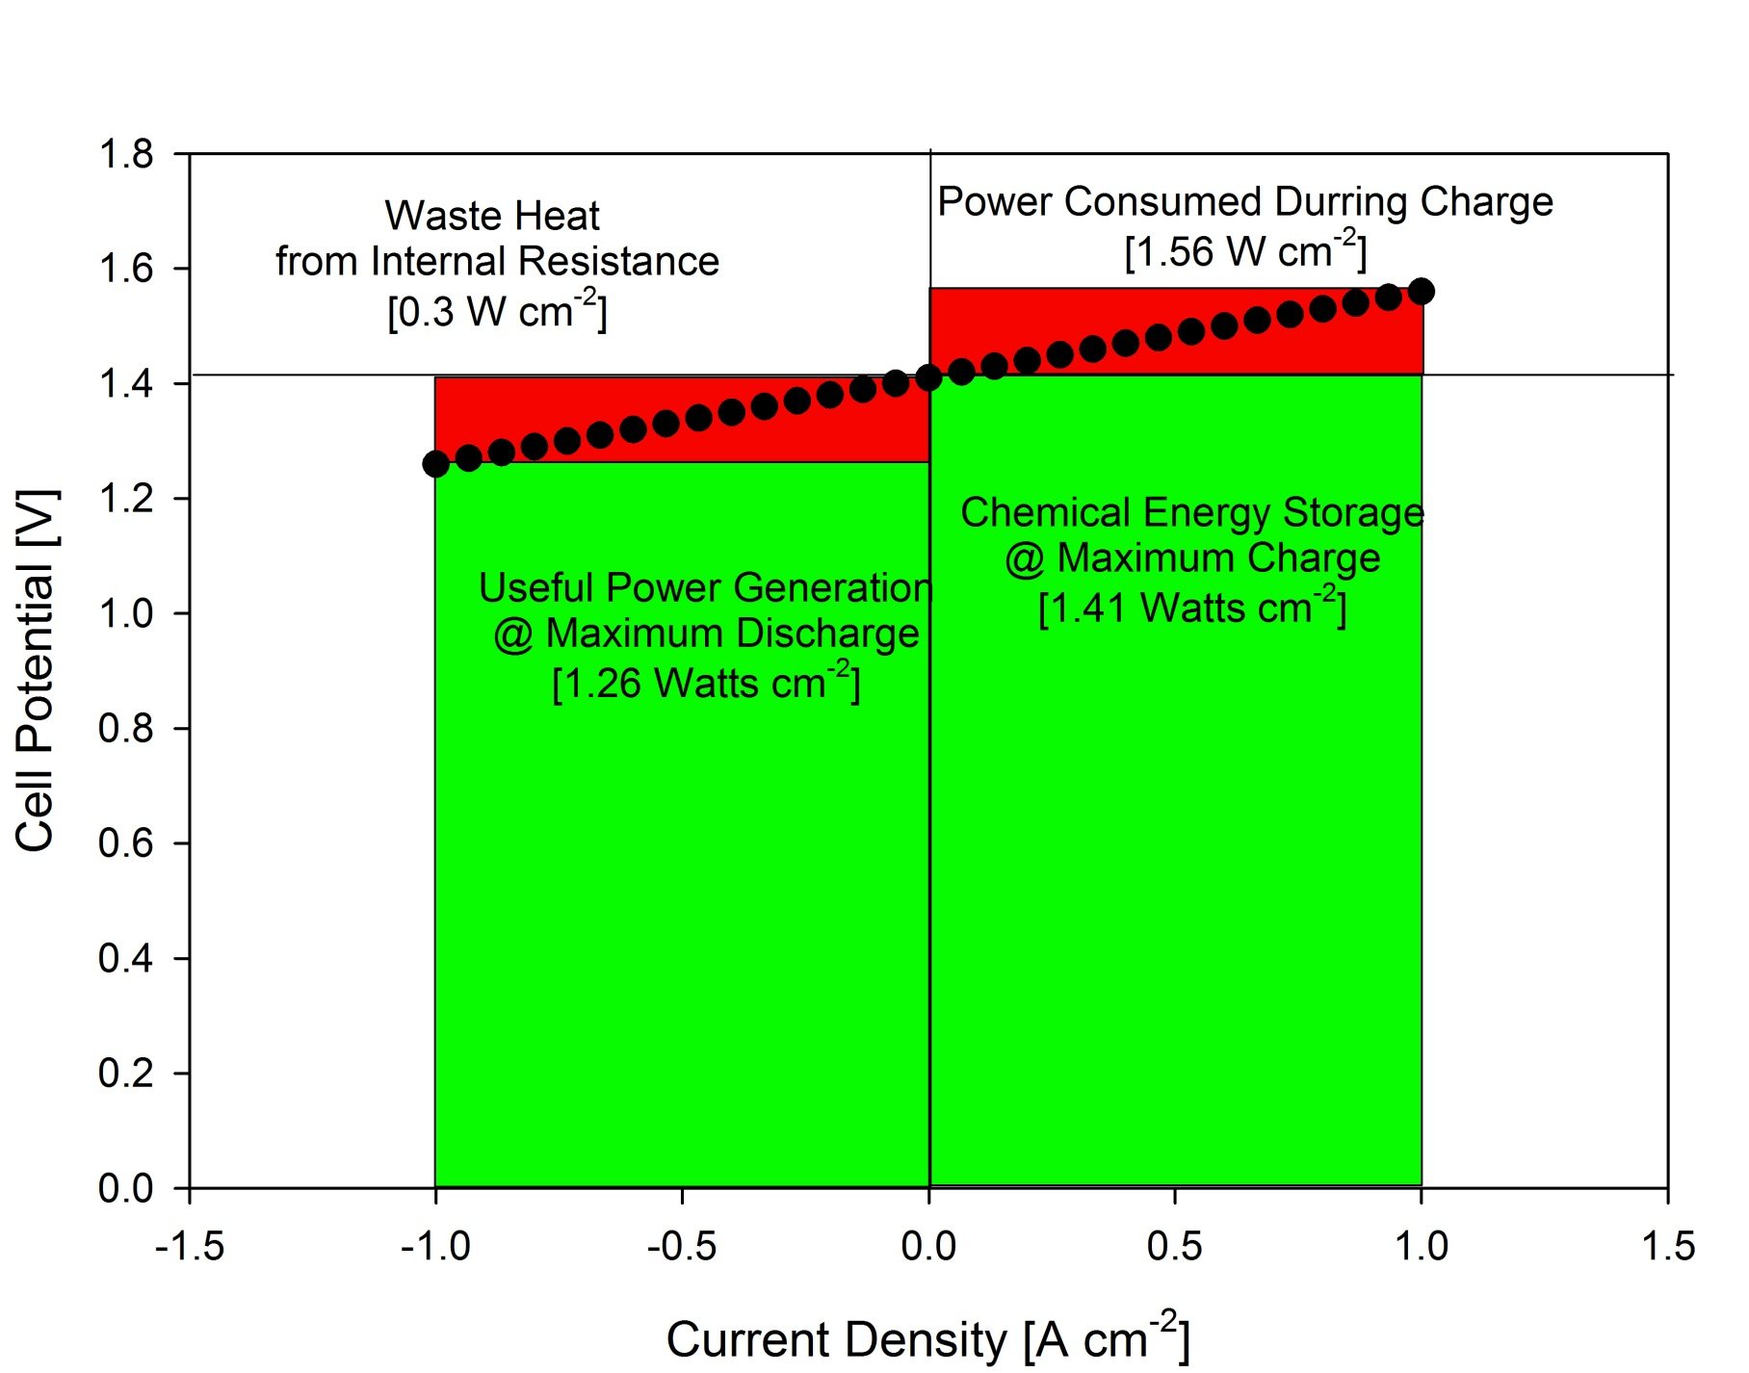
Vanadium Redox Flow Cell Electrochemical Performance

Slide 15
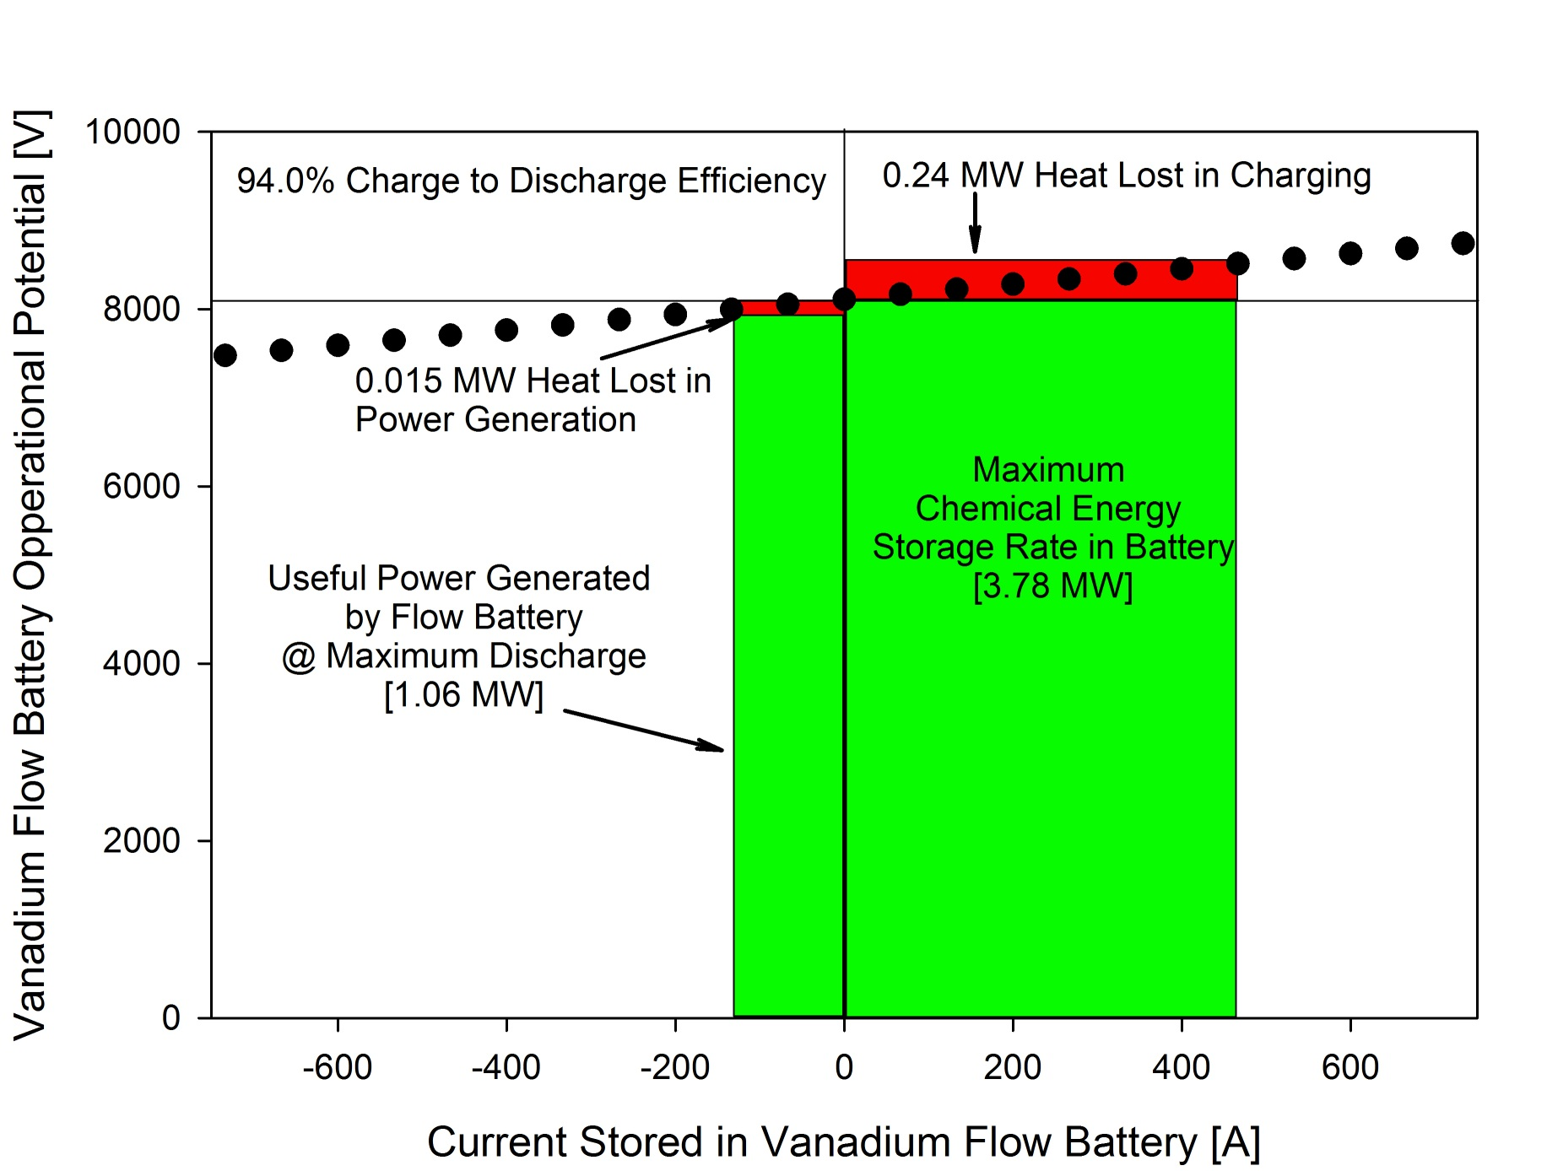
Vanadium Redox Flow Cell Electrochemical Performance

Slide 16
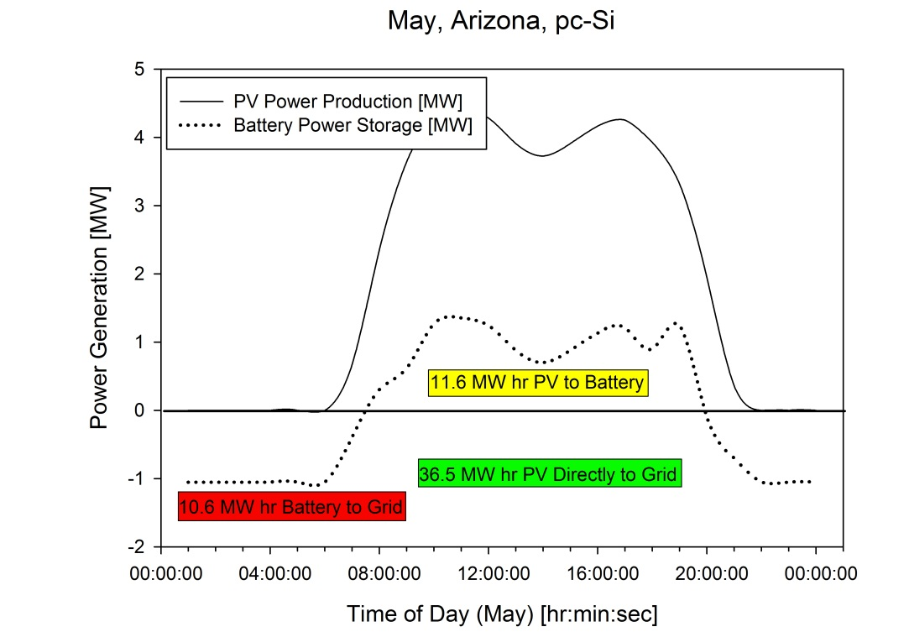
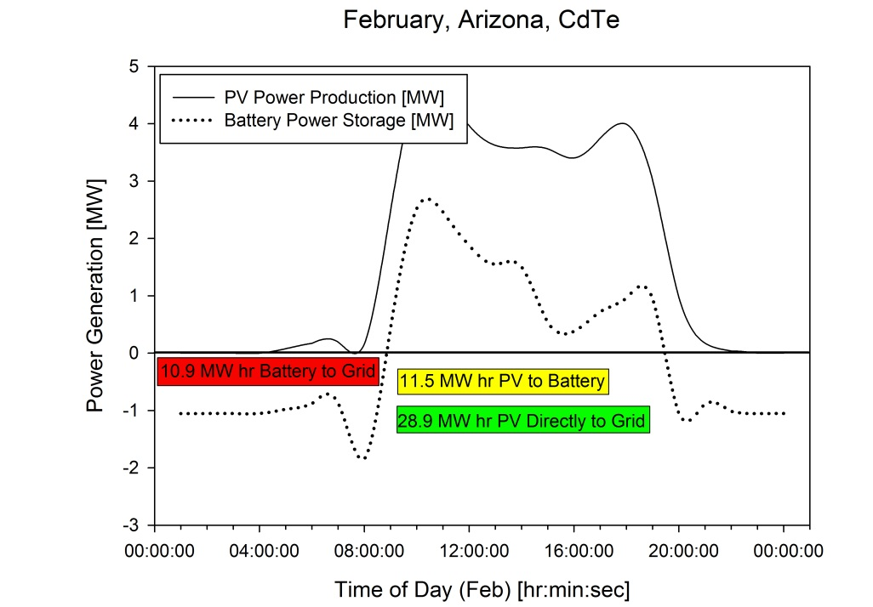
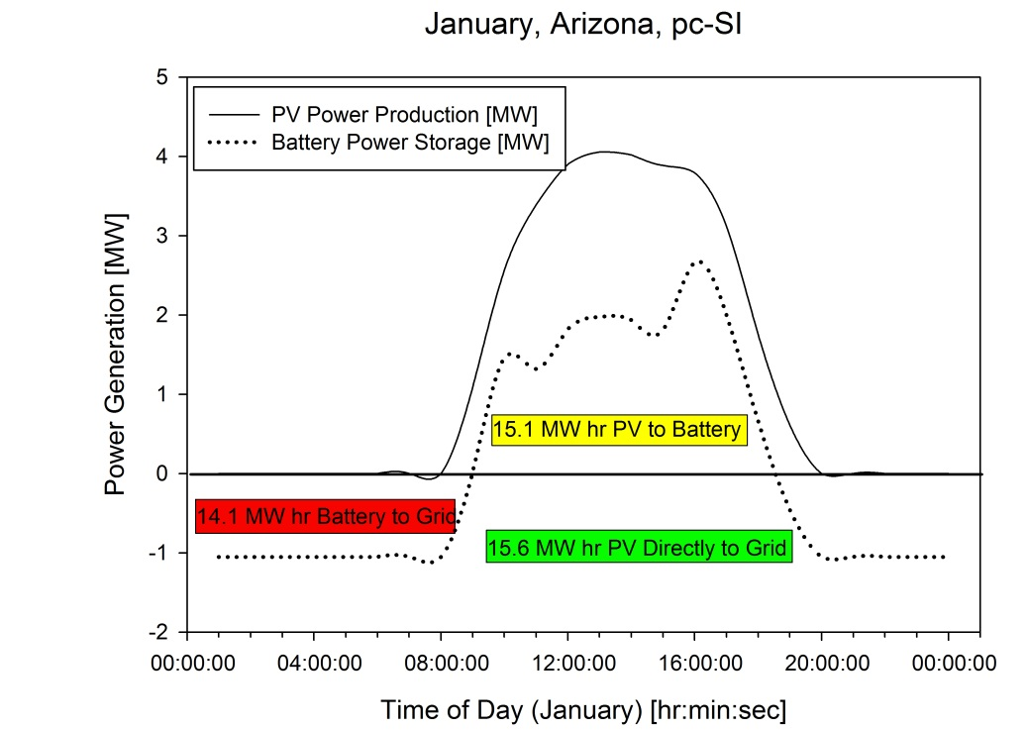
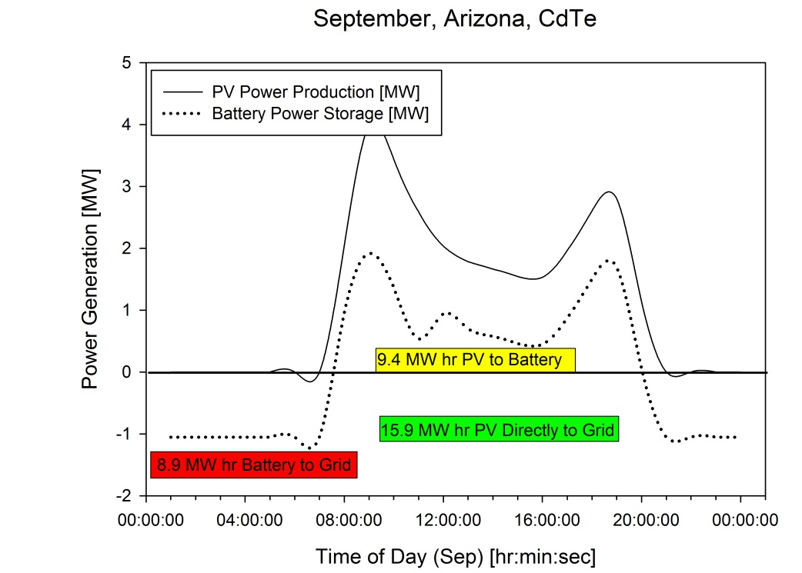
Photovoltaic – Battery Integration

Slide 17
Electricity pricing & tariffs

Slide 18
Federal, State & Local incentives* by DSIRE
Pheonix, AZ | Raleigh, NC | Buffalo, NY
Renewable Energy Production Tax Credit *（below yearly number） | Renewable Energy Tax Credit | NYSERDA - Clean Energy Business Growth and Development(max $200,000 incentive)
Renewable Energy Business Tax Incentives | Renewable Energy Equipment Manufacturer Tax Credit | NYSERDA - Renewable, Clean Energy, and Energy Efficient Product Manufacturing Incentive Program
Property Tax Assessment for Renewable Energy Equipment | Duke Energy - Standard Purchase Offer for RECs: Solar RECs: $30.00 per MWh | Residential Solar Tax Credit
Solar and Wind Equipment Sales Tax Exemption | NC Energy Star Plus | NYSERDA - PV Incentive Program Local Option - Solar, Wind & Biomass Energy Systems Exemption
Energy Equipment Property Tax Exemption | Progress Energy Carolinas SunSense Commercial PV Incentive Program: $0.18/kWh Residential Solar Sales Tax Exemption 100% exemption from state sales tax
year1 | $0.04$/KWh
year2 | $0.04$/KWh
year3 | $0.035$/KWh
year4 | $0.035$/KWh
year5 | $0.03$/KWh
year6 | $0.03$/KWh
year7 | $0.02$/KWh
year 8 | $0.02$/KWh
year 9 | $0.01$/KWh
year10 | $0.01$/KWh

Slide 19
Cost-benefit, sensitivity analysis(BP Panel)

Slide 20
Cost-benefit, sensitivity analysis(First Solar)

Slide 21
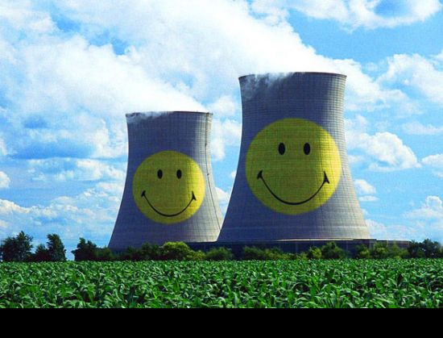
Carbon offsets
Assuming that the solar energy is displacing an equivalent amount of conventionally produced electricity from the local grid; For coal, 900 grams of CO2 is emitted to generate 1 KWh.
Based on our capital costs:

Slide 22
Economic conclusion and Future speculation
Years to Break even | Phoenix, BP | Raleigh, BP | Buffalo, BP | Phoenix, FS | Raleigh, FS | Buffalo, FS
No Benefit | 16 | N | 9 | 16 | 24 | 8
10 years incentive | 14 | N | 8 | 13 | 17 | 7
10 years+FiT | 12 | 17 | 7 | 11 | 14 | 6
By advantage of solar resource, Phoenix passes the Cost-Benefit test. For the
relative high electricity price, the design in Buffalo is the most economical
favorable, although with the least solar resource. Raleigh, in absence of abundant solar resource or higher price, could not pass C-B test without great incentive for BP Panel. In general, First Solar fits our design better than BP panel in three sites.
Future speculation:
Electricity cost projections
Potential incentive
Carbon offset
Material scaring projections

Slide 23
Life Cycle Assessment
This ‘’cradle to grave’’ evaluation was performed on the 3 main products involved in our EESiPV system
CdTe PV module, pc-Si PV module, and Vanadium Redox Flow Cell
Standards for performing this assessment comply with the ISO 14000 series
Values from -4 (high benefit) to +4 (high impact) were assigned to the product’s impact on material resources, energy use, global warming and human health for each of the five phases
Notes:
ISO = International Standards Organization

Slide 24
CdTe PV Module
Material Acquisition:
Cadmium is obtained by smelting zinc or lead ores
Cadmium is considered toxic, but extremely small amounts are used
Tellurium is recovered during the electrolytic refining of copper
This is an energy intensive phase
Emissions are also greatest during this phase
Manufacturing
Also an energy intensive phase with numerous air emissions
Transportation
By large trucks; tailpipe emissions are associated with this phase
Use
Produces energy
Acidic/Basic solutions along with water for cleaning purposes
Disposal
Parts of a PV module will both be disposed of in a landfill and recycled
Cadmium poses a threat to human health and environmental conditions if disposed of in a landfill

Slide 25
CdTe PV Module
 | Material Acquisition | Manufacturing | Transportation | Use | Disposal
Material Resources | 4 | 3 | 1 | 0 | 2
Energy Use | 3 | 4 | 1 | -4 | 2
Global Warming | 3 | 2 | 1 | 0 | 1
Human Health | 3 | 1 | 1 | 0 | 1
Column Total: | 13 | 10 | 4 | -4 | 6
 |  |  |  | Total: | 29
Notes:
The five phases are across the top. The four impact areas are on the side

Slide 26
pc-Si PV Module
Material Acquisition:
Silicon for wafer production is obtained in one of two ways
Off-grade from the semiconductor industry
Direct solar grade (SoG-Si) for photovoltiac-only purposes
Silicon is not considered toxic
This is an energy intensive phase
Emissions are also greatest during this phase
Manufacturing
Also energy intensive with numerous air emissions
Transportation
By large trucks; tailpipe emissions are associated with this phase
Use
Produces energy
Acidic/Basic solutions along with water for cleaning purposes
Disposal
Parts of a PV module will both be disposed of in a landfill and recycled

Slide 27
pc-Si PV Module
 | Material Acquisition | Manufacturing | Transportation | Use | Disposal
Material Resources | 4 | 3 | 1 | 0 | 2
Energy Use | 4 | 4 | 2 | -4 | 2
Global Warming | 4 | 3 | 2 | 0 | 1
Human Health | 2 | 2 | 1 | 0 | 0
Column Total: | 14 | 12 | 6 | -4 | 5
 |  |  |  | Total: | 33
Notes:
The five phases are across the top. The four impact areas are on the side

Slide 28
Vanadium Redox Flow Cell
Material Acquisition:
Vanadium can be extracted numerous ways such as from the mining or recovery of petroleum residues
H2SO4 can be obtained as waste from other industrial processes
This is an energy intensive phase, but less energy is used to acquire materials and manufacture these flow cells than lead-acid batteries
Manufacturing
Is both an industrial and on-site issue
Transportation
By large trucks; tailpipe emissions are associated with this phase
Use
Vanadium Oxide (V2O5) is a toxic and harmful chemical. It possess irritant properties and is dangerous to the environment. It has a NFPA 704 Health Value of 3.
Disposal
The cell is disassembled after operation and materials are either re-used or deposited in a landfill
Studies have been completed where 50 percent of the materials are allocated to re-use and 50 percent are allocated to hazardous waste and landfill disposal

Slide 29
Vanadium Redox Flow Cell
 | Material Acquisition | Manufacturing | Transportation | Use | Disposal
Material Resources | 2 | 2 | 1 | 3 | 1
Energy Use | 3 | 4 | 2 | 0 | 1
Global Warming | 2 | 3 | 2 | 0 | 2
Human Health | 4 | 3 | 2 | 3 | 3
Column Total: | 11 | 12 | 7 | 6 | 7
 |  |  |  | Total: | 43
Notes:
The five phases are across the top. The four impact areas are on the side

Slide 30
Questions?

Slide 31
Reference
US Energy Information Administration(http://www.eia.gov/)-Electricity price(2001-2010)
Carbonfund.org for Carbon offset
DSIRE(Database of State Incentives for Renewable Energy) for Federal, State & Local incentives
Ecobusinesslinks.com for BP and First Solar PV price
Fthenakis, V. M. & Kim, H. C. "CdTe photovoltaics: Life Cycle environmental profile and comparisons” Science Direct: Thin Solid Films, 2007, 515, 5961-5963
Fthenakis, V. M.; Kim, H. C. & Alsema, E. "Emissions from Photovoltaic Life Cycles” Environmental Science & Technology, 2008, 42, 2168-2174
Lankey, R. L. & McMichael, F. C. "Life Cycle Methods for Comparing Primary and Rechargeable Batteries” Environmental Science & Technology, 2000, 34, 2299-2304
Raugei, M.; Bargili, S. & Ulgiati, S. "Life cycle assessment and energy pay-back time of advanced photovoltaic modules: CdTe and CIS compared to poly-Si Science Direct: Energy, 2007, 32, 1310-1318
Rydh, Carl J. “Environmental assessment of vanadium redox and lead-acid batteries for stationary energy storage” Journal of Power Sources, 1999, 80, 21-29
Jugnbluth, Niels. “Life Cycle Assessment of Crystalline Photovoltaics in the Swiss ecoinvent Database” Progress in Photovoltaics: Research and Applications, 2005, 13, 429-446

