Slide 1
Renewable Sources of Electricity for Penn State University Park
Osahon Abbe & Olaide Oyetayo,

Slide 2
University Park Electricity Consumption
Annual Electricity Consumption in UP is
320, 000MWh
10.7 percent of the electricity from wind energy
5.2 percent of the electricity comes from biomass
Penn State currently has contracts with three companies to supply green power.
http://energy.opp.psu.edu/energy-programs/procurement/green-power/green-power

Slide 3
Problem Statement
A comparison of biomass and wind energy as potential alternative source of electricity for Penn State University Park, and the techno-economic feasibility analysis of the chosen option for implementation on the campus.

Slide 4
OBJECTIVES
Explore two renewable sources of electricity for University Park Campus.
Detailed comparison of Biomass and Wind Energy
Resource Availability in Pennsylvania
Optimal wind speed to generate power vs PA wind speed
Annual Biomass Resource in PA
Efficiency/Cost

Slide 5
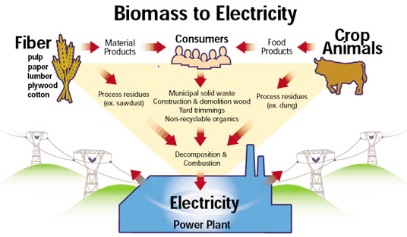
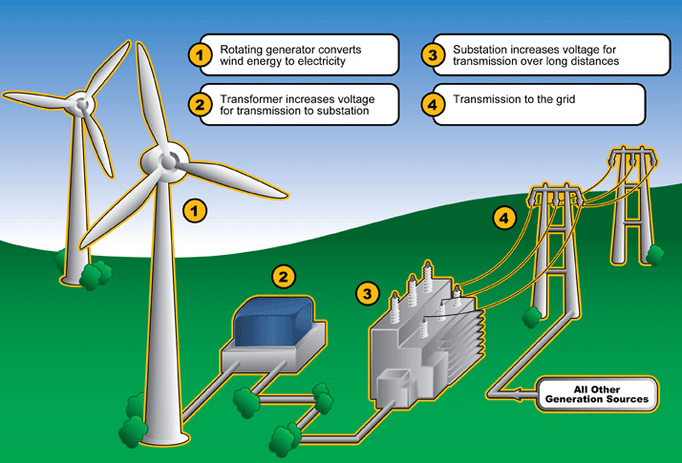
Burning Biomass produces steam which generates electricity
Electricity generated from turbines powered by the wind
http://www.energy.ca.gov/biomass/index.html
http://www.greenwindsolar.com/about_wind_energy.php

Slide 6
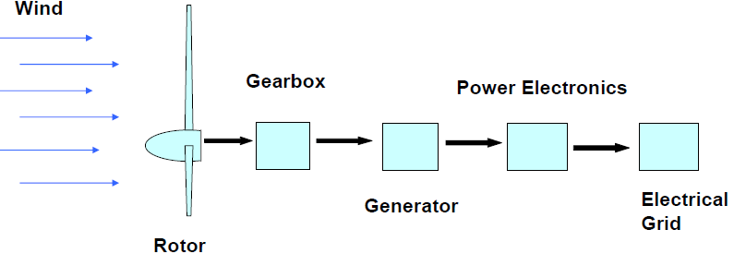
Wind Energy
Unequal solar heating produces wind
Wind creates a lift that spins the turbine blades and rotor
Kinetic energy in wind is converted to mechanical energy in the turbine which is then converted into electrical energy in a generator.

Slide 7
Wind Energy
Power in the wind
P=1/2*ρAV³
ρ : density of air (Kg/m³)
A: swept rotor area (m²)
V: wind speed (m/s)
P: Power (watts)
Efficiency
Governed by Betz’s Law: proscribes turbine max efficiency (59.3%)
Turbine efficiency range between 25-45 percent

Slide 8
Wind Energy
Wind Speed
Cut-in speed: minimum speed needed for a wind turbine to generate “usable” power (7-10mph).
Rated speed: minimum speed needed for a wind turbine to generate designated rated power (25-35mph).
Energy generated increases by a cube of wind speed.
E.g. doubling wind speed increases energy by a factor of eight (2³=8)
14 mph needed to generate enough electricity that is competitive with coal-fired.
This will be used as a guide to determine whether there is enough wind in PA for our purpose.

Slide 9
Wind Power Growth
Federal wind production tax credit (PTC) incentive
Environmental concerns
Improvements in wind energy technology
Turbines are 100 time powerful than in the 80s
More competitive because cost declined
More investments
Government incentives

Slide 10
Types of wind turbines over the years…

Slide 11
Wind Power Growth
GE 2.5MW Wind Turbine Series evolution.

Slide 12
Wind Turbines
Design Variables
Rotor Diameter
Generator Capacity
Hub height
Rotor blade Design

Slide 13
Advantages
No direct emissions of pollutants (SO_{x} , NO_{x} , CO₂, mercury)
Facilitates rural development-farmers receive royalty payment for use of their lands.
Green jobs
Does not require water for operation

Slide 14
Disadvantages
High dependency on wind consistency
Deaths of birds and bats
Need for new transmission infrastructure
“Eye sore” to some
Storage is expensive and still under development
Noise pollution

Slide 15
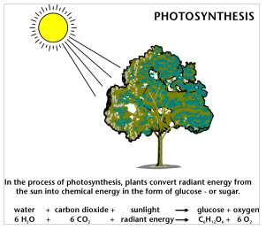
Biomass
Solar energy stored in chemical bonds of organic materials
Renewable since we can grow more
The chemical energy is released as heat when biomass is burned.

Slide 16
Biomass Types
Type | Energy Content (Btu/lb)
Dry Wood | 7600-9600
Wood (20% moisture) | 6400
Agricultural Residue | 4300-7300
Sludge Wood | 5000
Municipal Solid Waste | 5000
Landfill Gas | 250

Slide 17
Biomass Conversion
Combustion: Burning of biomass to create steam which is converted to electrical energy by steam turbines
Gasification: Heating biomass in an oxygen-starved environment to produce gases (CO and H₂). These gases have higher combustion efficiencies.
Co-firing: Combustion of two different fuels at a time. Usually biomass is fired with coal to reduce emissions.
Cogeneration: Simultaneous production of electricity and heat from a single fuel.

Slide 18
Advantages
Comes from renewable sources
Reduces dependency on fossil fuels
Reduction of waste that end up in landfills
Can generate electricity at any time.
Little to no net gain of atmospheric CO₂

Slide 19
Disadvantages
Some biomass plants have relatively high NO_{x} emission rate compared to other combustion technologies.
High CO emission compared to coal plants
Particulate Emissions (no biomass facilities currently have advanced particulate emissions control)
Environmental impact of collection, transportation, and processing.

Slide 20
Resource availability in centre county

Slide 21
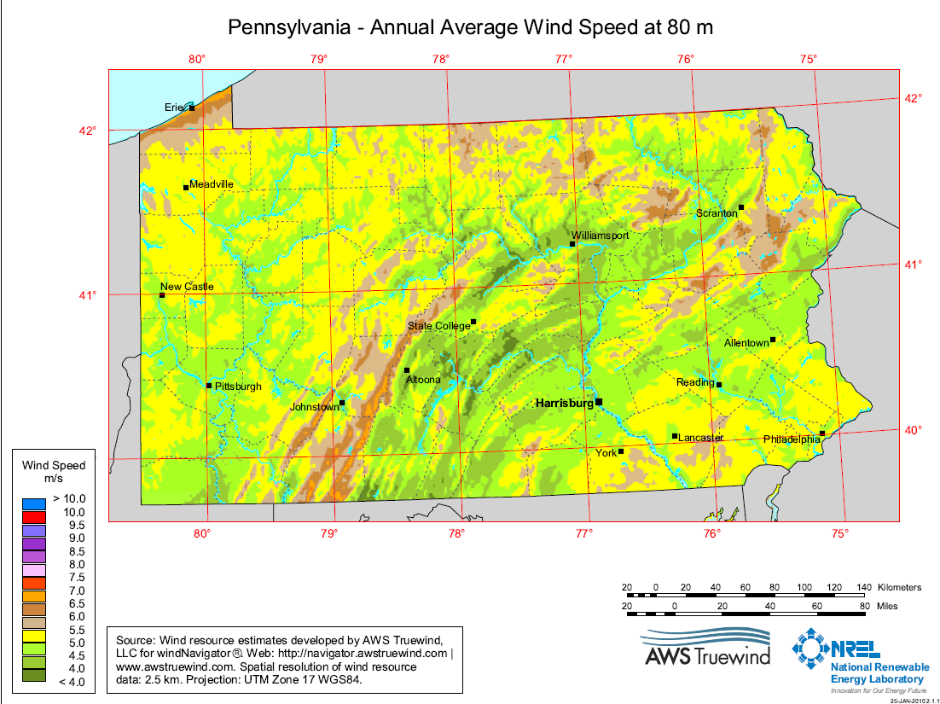
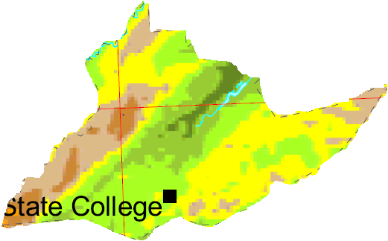

Slide 22
Areas that cannot be developed:
Federal lands
State Lands
Airfields, urban, wetland and water areas.
3 km surrounding
those areas
(1.864mile)
State Game Lands (yellow)
State Forest (Green)

Slide 23
Sandy Ridge Wind Farm
Approval of this project suggests no disturbance found
Approval of other wind projects is viable if land is appropriate.
Company did not develop in areas with highest wind speed
Also stated has “reached a peak in identifying potential locations for wind turbine projects”

Slide 24
The best wind speed is around the Phillipsburg area. (~6m/s)
Power in the Wind in this area is not sufficient

Slide 25
Biomass Resource in Centre County
Source | Amount (thousand dry tonnes/yr) | Electricity Generation (potential, thousand MWh)
Primary Mill Residue (wood and bark from manufacturing plants) | 10-25 | 49-155
Secondary Mill Residue (sawdust, wood scraps) | 500-1000 tons/yr | 2 -6
Forest Residue | 25-50 | 123-310
Crop Residue | 20-50 | 55-235
Municipal Waste | 100,000 tons/yr | 194
Urban wood waste | 10-25 | 49-155
Methane emissions from domestic water treatment | 100-250 | 16-40

Slide 26
BIOMASS

Slide 27
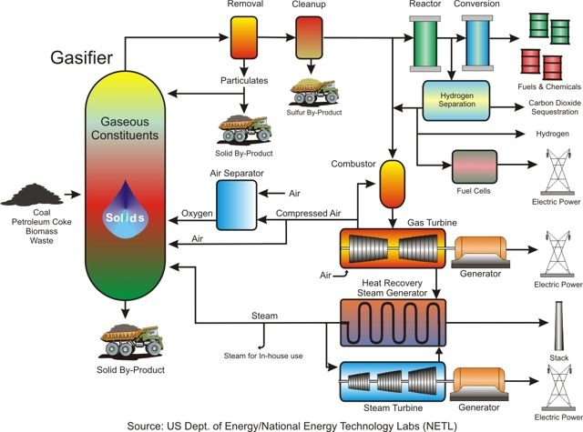

Slide 28
Show Stoppers
Sustainability
Environmental impact of biomass transport
Economics
Capital Cost
Cost of fuel/transportation
Price of electricity
≤10¢/kWh
For comparison with levelized cost of generating electricity
Permits/Regulations

Slide 29
DESIGN &
ECONOMICS

Slide 30
Fuel Requirements
10MW capacity, 85% Capacity Factor.
Assumed 40% efficiency
Calculated 50000 tons/year.

Slide 31
Procurement
Wood pellets acquired within 50 miles of state college preferred.
Energex American Inc. Mifflintown, PA
120,000 tons per year
45 miles from SC
Price/Availability

Slide 32
Location, Supply, and Handling
Location
Locate plant next to existing generating plant
Share electrical substation
Supply
Energex (<50 miles from SC)
Biomass delivered at $150/short ton
Handling
Wood storage designed to hold 3-week supply of biomass.
Biomass drying is unnecessary; pellets have 5 percent moisture content

Slide 33
Circulating Fluidized Bed Gasifier.
Dimensions
Height: 14.8 m
Diameter: 2.07 m
Primary Oxidant
Oxygen
Secondary Oxidant
Air
To increase the temperature in gasifier
Conditions
1000⁰C
18 bar
Circulating and Stationary Material
Silica sand
20-30 wt. % calcinated dolomite

Slide 34
Air Separator
Using oxygen prevents the dilution of fuel gas with nitrogen
Reduces formation of NOx
Produces Medium heating value gas rather than low heating value

Slide 35
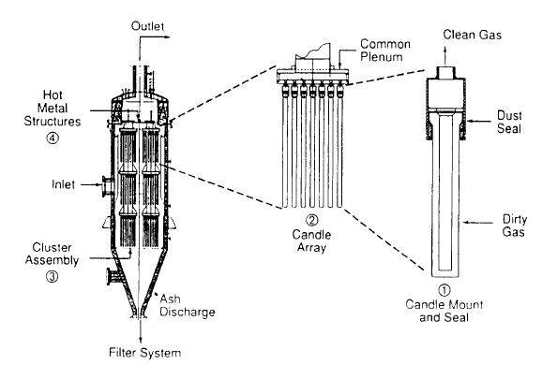
Gas Clean-up
Gas Cooling
Direct Injection of water to reduce gas temperature to 500C and condense alkali species.
Dilutes fuel gas but simplest and least expensive method.
Reduces NOx formation in combustor
Hot Candle Filter
Removes particulates
Deposits solids on the side of the candle.

Slide 36
CO₂ Capture
Separation of CO₂ from fuel gas
Impact on System Performance
Avoided CO₂ in the atmosphere: 0.14Kg/KwH (10424Kg)
Decreases efficiency by six percent
Increases capital cost by 38%
Increases O&M cost by 31%

Slide 37
Water Supply
Like PSU steam plant, use borough water as well as campus water.
Water Treatment
Water contains 550 ppm TDS and 350 ppm hardness
Softened to remove Ca & Mg; Demineralized
IGCC uses approximately 360-540 gallons/MwH
~27-40 million gallons/year

Slide 38
Other Considerations
Waste management
Environmental
Energy Balance
Economics

Slide 39
Financial Model for Feasibility study
Startup Costs
Financing Costs
Permits and Construction
Physical Plant and Equipment
Management
Operating Costs
Fuel, water, other consumables
Ash disposal
Equipment maintenance
Payroll
Taxes and Insurance
Financial Events
Changes in fuel supply cost
Changes in power contract
Refinancing
Changes in regulatory environment

Slide 40
Know the following:
Available quantity of fuel and long term contract to purchase
Quoted power system electricity price
Financing to cover plant construction, equipment purchases, startup expenses
Financial model for business for about 20 to 30 years

Slide 41
Some inputs into Financial Model
Type and size of plant (10MW)
Cost of plant equipment and construction
Operating costs
Operating efficiency, actual power produced
Inflation rate for important costs

Slide 42
Sensitivity Analysis
Disruptions in fuel supply, quantity and quality
Technology choice: capital costs, operating costs, efficiency, operating performance and reliability
Power contract terms
Financing terms
Subsidies
Ownership Structures

Slide 43
Also considered…
Tax schedule
Depreciation schedule based on government incentives

Slide 44
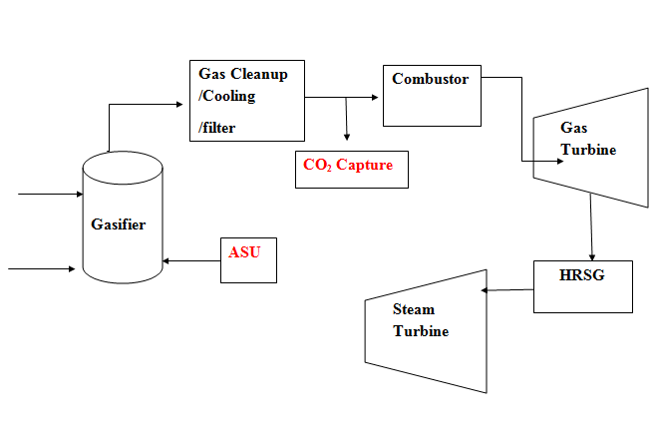
Conversion Technology-BIGCC
Secondary oxidant
Biomass

Slide 45
Air Separation Unit (Revisited)
Avoids nitrogen dilution of the fuel gas
Increases heating value of gas
Increases cold gas efficiency
10 MW plant is small
Integration of ASU in small plant is not a good investment
Air is the oxidant

Slide 46
CO₂ Capture
Separation of CO₂ from fuel gas
Impact on System Performance
Avoided CO₂ in the atmosphere: 0.14Kg/KwH (10424Kg)
Decreases efficiency by six percent
Increases capital cost by 38%
Increases O&M cost by 31%

Slide 47
Safety & Environmental
Biomass Absorbs about 890g CO₂/ kWh
BIGCC power plants releases 890g CO₂/kWh
Biomass Production
Transportation
Construction
Fossil Energy consumed: 231KJ/kwh
4049 g/kWh

Slide 48
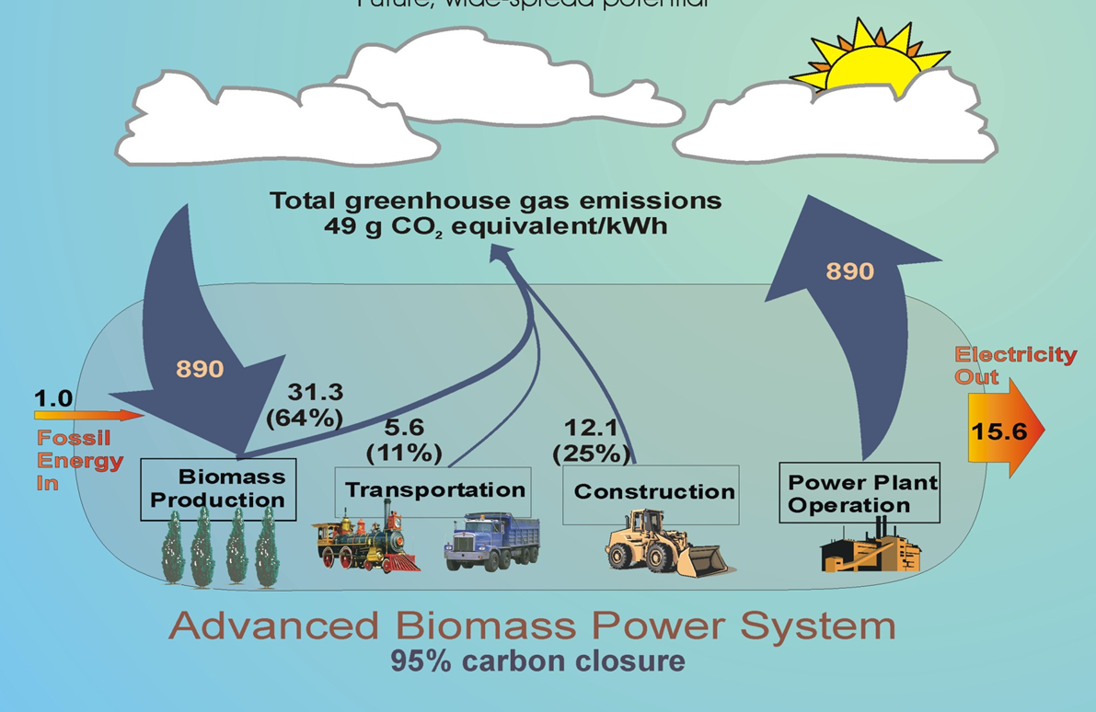
231 MJ/MwH Consumed
3600MJ/MwH
Energy Ratio=3600/231=15.6

Slide 49
Act 213
This act ensures that all qualified alternative energy sources meet all applicable environmental standards and shall verify that an alternative energy source meets the standards
Permits (Federal and State)
Compliance (Violations)

Slide 50
Permits
Major Permits for New Construction
PSU NPDES – National Pollutant Discharge Elimination System
PCSM- Post Construction Storm-water Management

Slide 51
Compliance
Air Pollution
Ambient Air Quality (EPA 40CFR 81.339)
Environmental Control Definition
Good Engineering Practice Stack height
Water pollution
Waste Management
Noise
Boiler and Pressure Vessels
Archeological, Historic and Cultural resources
Emergency Management Procedure
Flood Hazards Review
Well Drilling for Monitoring
Asbestos Abatement
Zoning

Slide 52
Discharges to wastewater systems should not exceed…
Substance | Concentration (mg/l)
Arsenic | 0.1
Cadmium | 0.07
Chromium | 0.2
Copper | 0.005
Lead | 0.1
Mercury | 0.02
Silver | 3.0
Zinc | 0.08
Cyanide | 0.1
Nickel | 0.25

Slide 53
Emission limits in US clear skies
Pollutant | Emission limit
Sulfur dioxide | 2.0 lb/MwH
Nitrogen oxides | 1.0 lb/Mwh
Particulate Matter | 0.2 lb/MwH
Mercury | 0.015 lb/GWh
Notes:
Gasification Chapter 9 page 378

Slide 54
Good Engineering Practice (GEP) Stack Height
The EPA has generated formulae for the calculation of the maximum stack height that does not exceed good engineering practice (40 CFR 51.100(ii)) which states that GEP stack height means the greater of:
213 feet, measured from the ground-level elevation at the base of the stack, or
Hg = H + 1.5L
where
Hg = GEP stack height, measured from the ground-level elevation at the base of the stack
H = Height of nearby structure(s) measured from the ground-level elevation at the base of the stack
L = Lesser dimension, height or projected width, of nearby structure(s)

Slide 55
Ambient Noise
 | Maximum Allowable hourly levels in dB(A)
Receptor | Daytime 7:00 – 22:00 | Nighttime 22:00 – 7:00
Residential; institutional; educational | 55 | 45
Industrial; Commercial | 70 | 70

Slide 56
Electrical capacity
10MW biomass plant
Existing 6MW equipment
Retro-fit

Slide 57
Retro-fit
Current rating of equipment may not be up to par for the new source
Equipment include
Wires
CT’s
Switch boxes

Slide 58
Contingency Incorporation
Penn State OPP policy is to have the allotted demand on the electrical network system
Each point of distribution has a normally open switch and a normally closed switch
This implies even distribution of load across the system

Slide 59
Incentives
Modified Accelerated Cost-Recovery System (MACRS) & Bonus Depreciation (2008-2012)
Federal
Commercial, Industrial, Agricultural
businesses may recover investments in certain property through depreciation deductions. A number of renewable energy technologies are classified as five-year property
Depreciation Schedule
 | Fraction
Year 1 | 0.2000
Year 2 | 0.3200
Year 3 | 0.1920
Year 4 | 0.1152
Year 5 | 0.1152
Year 6 | 0.0576
Year 7 | 0.0000
Year 8 | 0.0000
Year 9 | 0.0000
Year 10 | 0.0000
Year 11 | 0.0000
Year 12 | 0.0000
Year 13 | 0.0000
Year 14 | 0.0000
Year 15 | 0.0000
Year 16 | 0.0000
Year 17 | 0.0000
Year 18 | 0.0000
Year 19 | 0.0000
Year 20 | 0.0000
Total | 1.0000

Slide 60
Incentives
Renewable Electricity Production Tax Credit (PTC)
Federal
Commercial, Industrial
Resource Type | In-Service Deadline | Credit Amount
Wind | December 31, 2012 | 2.2¢/kWh
Closed-Loop Biomass | December 31, 2013 | 2.2¢/kWh
Open-Loop Biomass | December 31, 2013 | 1.1¢/kWh
Geothermal Energy | December 31, 2013 | 2.2¢/kWh
Landfill Gas | December 31, 2013 | 1.1¢/kWh
Municipal Solid Waste | December 31, 2013 | 1.1¢/kWh
Qualified Hydroelectric | December 31, 2013 | 1.1¢/kWh
Marine and Hydrokinetic (150 kW or larger)** | December 31, 2013 | 1.1¢/kWh

Slide 61
Key Assumptions
based on “overnight” costs
20 year economic life
3 week supply of fuel and consumable materials
Modified Accelerated Cost-Recovery System (MACRS) & Bonus Depreciation
Federal and State Income tax = 36.03%
Yearly inflation rate = 2.1%
No salvage value

Slide 62
Rate of Return…
Capital costs = $3565/kW=> $35,650,000 for a 10MW plant
This includes equipment, construction, electrical, fees and contingency costs.
Expenses including fuel = $13,243,524
This includes labor, maintenance, insurance, ash disposal, management and utility costs.
CO₂ capture increases capital costs by 38% bringing it to $4,9197,000 and also increases expenses by 31% totaling $17,349,016.44
Taxes are a combined 36.03% for federal and state
General inflation @ 2.1%

Slide 63
Capital Cost Details

Slide 64
Results
Assuming a 20 year life span, the NPV was calculated using
NPV = ∑Cash flows(1+i)^{N} (for N = 1,2,…,20) = $111,586,162
This implies the current Levelized Annual Revenue Requirement is $17,827,169/yr and the Current Levelized Annual Cost of Energy is $0.2394/kWh
The constant Levelized Annual Revenue Requirement is $15,537,106/yr and the constant Levelized Annual Cost of Energy is $0.2087/kWh.

Slide 65
Sensitivity Analysis
Disruptions in fuel supply, quantity and quality
Technology choice: capital costs, efficiency, operating performance and reliability
Financing terms

Slide 66
Capital Cost
Case | Relative Change | Capital Cost | LAC Current | LAC Constant | Relative Change in COE
 | (%) | ($) | ($/kWh) | ($/kWh) | (%)
Formula Values |  |  | 0.2394 | 0.2087
-10 | -100 | 0 | 0.1964 | 0.1712 | -18
-9 | -90 | 3,565,000 | 0.2007 | 0.1750 | -16
-8 | -80 | 7,130,000 | 0.2050 | 0.1787 | -14
-7 | -70 | 10,695,000 | 0.2093 | 0.1824 | -13
-6 | -60 | 14,260,000 | 0.2136 | 0.1862 | -11
-5 | -50 | 17,825,000 | 0.2179 | 0.1899 | -9
-4 | -40 | 21,390,000 | 0.2222 | 0.1937 | -7
-3 | -30 | 24,955,000 | 0.2265 | 0.1974 | -5
-2 | -20 | 28,520,000 | 0.2308 | 0.2012 | -4
-1 | -10 | 32,085,000 | 0.2351 | 0.2049 | -2
Base | 0 | 35,650,000 | 0.2394 | 0.2087 | 0
1 | 46 | 52,085,000 | 0.2592 | 0.2259 | 8
2 | 92 | 68,520,000 | 0.2790 | 0.2432 | 17
3 | 138 | 84,955,000 | 0.2989 | 0.2605 | 25
4 | 184 | 101,390,000 | 0.3187 | 0.2777 | 33
5 | 231 | 117,825,000 | 0.3385 | 0.2950 | 41
6 | 277 | 134,260,000 | 0.3583 | 0.3123 | 50
7 | 323 | 150,695,000 | 0.3781 | 0.3295 | 58
8 | 369 | 167,130,000 | 0.3979 | 0.3468 | 66
9 | 415 | 183,565,000 | 0.4177 | 0.3641 | 74
10 | 461 | 200,000,000 | 0.4376 | 0.3814 | 83
Increase in capital cost increases the current and constant levelized annual cost

Slide 67
Fuel Cost
Case | Relative Change | Fuel Cost | LAC Current | LAC Constant | Relative Change in COE
 | (%) | ($/t) | ($/kWh) | ($/kWh) | (%)
Formula Values |  |  | 0.2394 | 0.2087
-10 | -100 | 0.00 | 0.1271 | 0.1108 | -47
-9 | -90 | 16.54 | 0.1383 | 0.1205 | -42
-8 | -80 | 33.07 | 0.1495 | 0.1303 | -38
-7 | -70 | 49.61 | 0.1608 | 0.1401 | -33
-6 | -60 | 66.14 | 0.1720 | 0.1499 | -28
-5 | -50 | 82.68 | 0.1833 | 0.1597 | -23
-4 | -40 | 99.21 | 0.1945 | 0.1695 | -19
-3 | -30 | 115.75 | 0.2057 | 0.1793 | -14
-2 | -20 | 132.28 | 0.2170 | 0.1891 | -9
-1 | -10 | 148.82 | 0.2282 | 0.1989 | -5
Base | 0 | 165.35 | 0.2394 | 0.2087 | 0
1 | -4 | 158.82 | 0.2350 | 0.2048 | -2
2 | -8 | 152.28 | 0.2305 | 0.2009 | -4
3 | -12 | 145.75 | 0.2261 | 0.1971 | -6
4 | -16 | 139.21 | 0.2217 | 0.1932 | -7
5 | -20 | 132.68 | 0.2172 | 0.1893 | -9
6 | -24 | 126.14 | 0.2128 | 0.1854 | -11
7 | -28 | 119.61 | 0.2083 | 0.1816 | -13
8 | -32 | 113.07 | 0.2039 | 0.1777 | -15
9 | -36 | 106.54 | 0.1995 | 0.1738 | -17
10 | -40 | 100.00 | 0.1950 | 0.1700 | -19

Slide 68
Net Station Efficiency
Case | Relative Change | Efficiency | LAC Current | LAC Constant | Relative Change in COE
 | (%) | (%) | ($/kWh) | ($/kWh) | (%)
Formula Values |  |  | 0.2394 | 0.2087
-10 | -88 | 5.0 | 1.0258 | 0.8940 | 328
-9 | -79 | 8.5 | 0.6557 | 0.5715 | 174
-8 | -70 | 12.0 | 0.5016 | 0.4371 | 109
-7 | -61 | 15.5 | 0.4170 | 0.3634 | 74
-6 | -53 | 19.0 | 0.3636 | 0.3169 | 52
-5 | -44 | 22.5 | 0.3268 | 0.2848 | 36
-4 | -35 | 26.0 | 0.2999 | 0.2614 | 25
-3 | -26 | 29.5 | 0.2794 | 0.2435 | 17
-2 | -18 | 33.0 | 0.2632 | 0.2294 | 10
-1 | -9 | 36.5 | 0.2502 | 0.2181 | 4
Base | 0 | 40.0 | 0.2394 | 0.2087 | 0
1 | 3 | 41.0 | 0.2367 | 0.2063 | -1
2 | 5 | 42.0 | 0.2341 | 0.2040 | -2
3 | 8 | 43.0 | 0.2316 | 0.2018 | -3
4 | 10 | 44.0 | 0.2292 | 0.1998 | -4
5 | 13 | 45.0 | 0.2269 | 0.1978 | -5
6 | 15 | 46.0 | 0.2248 | 0.1959 | -6
7 | 18 | 47.0 | 0.2227 | 0.1941 | -7
8 | 20 | 48.0 | 0.2207 | 0.1923 | -8
9 | 23 | 49.0 | 0.2188 | 0.1907 | -9
10 | 25 | 50.0 | 0.2170 | 0.1891 | -9

Slide 69
Conclusion
The LCOE of this biomass plant is about twice the current market price for electricity at 10c/kWh which puts this plant at an economic disadvantage. However, with better incentives and an improvement of some factors such as the net station efficiency, interest rate and debt ratio, the proximity of the LCOE of this plant can be brought closer to the current market cost of electricity.

Slide 70
References
Power Scorecard. “Electricity from: Biomass” http://www.powerscorecard.org/tech_detail.cfm?resource_id=1
Centre County Comprehensive Plan “Physiographic Regions of Centre County” http://www.co.centre.pa.us/planning/compplan/cc_physiographic.pdf
National Renewable Energy Laboratory “Biomass Maps” http://www.nrel.gov/gis/biomass.html
Centre County Government http://www.co.centre.pa.us/commissioners/abc.asp
Clean Coal Briquette Inc. “Utilization of Biomass” May, 2010.
The California Energy Commission . “Municipal Solid Waste Power Plants” http://www.energy.ca.gov/biomass/msw.html
Techline Forest Products Laboratory “Wood Biomass for Energy” 2004.
Alexandra Dock “Biomass Project” http://www.alexandradockproject.co.uk/biomass-energy/what-is-biomass.aspx
Forced Green. “From Waste to Green Energy Power Plants” http://www.forcedgreen.com/2010/09/from-waste-to-green-energy-power-plants/
“Functioning Principles of a Biomass Combined Heat and Power (CHP) Staion. http://www.unendlich-viel-energie.de/en/biomass/details/article/103/functioning-principles-of-a-biomass-combined-heat-and-power-chp-station.html?&print=1&type=55&no_cache=1
Jeffrey Logan, Stan Mark Kaplan. “Wind Powe r in the United States: Technology, Economic, and Policy Issues” CRS Report for Congress, June 20, 2008.
Michael Schmidt. “Wind Turbine Design Optimization” Strategic Energy Institute
“Wind Electricity Generation”. Practical Action. http://practicalaction.org/docs/technical_information_service/wind_electricity_generation.pdfr
GE Power and Water Renewable Energy. “2.5MW Wind Turbine Series” 2010. http://www.gepower.com/prod_serv/products/wind_turbines/en/2xmw/index.htm
US Department of Energy: Increasing wind energy’s contribution to US electricity supply.
http://energybible.com/wind_energy/wind_speed.html
EIA “Renewable Biomass” http://www.eia.doe.gov/kids/energy.cfm?page=biomass_home-basics-k.cfm
European Biomass Industry Association . http://www.eubia.org/115.0.html
Sakthivale Roshan Dhaneswar Et. Al. “Implementation of Biogas or Biomass at the Pennsylvania State University’s West Campus Steam Plant”, 2010.
The California Energy Commission. “Waste to Energy (WTE) & Biomass in California. http://www.energy.ca.gov/biomass/index.html
Commonwealth of Pennsylvania.. Sandy Ridge Wind Farm Project. , Web. 24 Feb 2011. <http://recovery.pa.gov/portal/server.pt?open=514&objID=525527&mode=2&projectId=DEP35368>.
"Map of Taylor Township, Centre County, Pennsylvania Highlighted." WikiMedia Commons. Web. 24 Feb 2011. http://commons.wikimedia.org/wiki/File:Map_of_Taylor_Township,_Centre_County,_Pennsylvania_Highlighted.png
"Blair County wind projects reach peak." National Wind Watch. National Wind Watch, Inc., 28102010. Web. 24 Feb 2011. <http://www.wind-watch.org/news/2010/10/28/blair-county-wind-projects-reach-peak/>.
Centre County. Recreation & Greenway Plan-Land Resources. , Web. 24 Feb 2011. <http://co.centre.pa.us/gis/greenway_maps/public_lands.pdf>.
United States. Estimates of Windy1 Land Area and Wind Energy Potential by State for Areas >= 30% Capacity Factor at 80m. , Web. 24 Feb 2011. <http://www.windpoweringamerica.gov/pdfs/wind_maps/wind_potential_80m_30percent.pdf>.
"Technologies at work in RansonGreen." Ranson Green . Web. 24 Feb 2011. <http://www.ransongreen.com/Technology.htm>.
United States. Gasification-based Biomass. , Print
Commonwealth of Pennsylvania.. Electric Shopping Guide. , 2011. Print.

