Slide 1
PLASMA GASIFICATION FOR VOC DESTRUCTION
Debanjan Das
Amrita Mukherjee
Chethan Kumar Gaddam
Ganesh Rahul Bhimanapati

Slide 2
Problem Statement
By using a non-thermal plasma in conjunction with catalytic heterogeneous chemistry and optimization of energy coupling into the plasma, economic analyses are expected to show that a more energy efficient (and hence cost effective) method based upon plasma-remediation can be used for VOC cleanup.
Economic and technical comparison of traditional incineration based VOC removal system and our proposed device based on a case study approach.
Goal: To design a plasma-based system for volatile organic destruction.

Slide 3

Concept Map
Continuous parameters evaluation (Energy yield, g value, etc)
Economic Trade Off between NTP systems
Selectivity
Regenerability
Catalysts
Energy & Economic Analysis
Problem Statement
Chemistry
System Design
Reaction Mechanism & Pathways
Spectroscopic Evaluations
Electrodes
Choice of Reactor

Slide 4
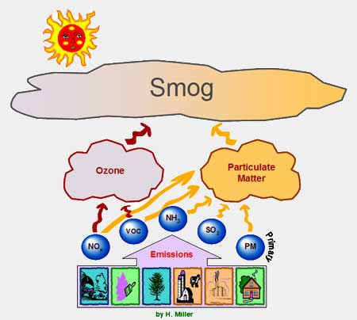
VOC
Volatile Organic Compounds (VOCs) are comprised of a variety of organic species that are readily reactive in the atmosphere.
Major source of VOCs include cleaning solutions, waxes, disinfectants, stored fuels, paint strippers and other solvents, and their emission from automobiles, paint industries, tanneries, petroleum distilleries, timber, and paper industries.
Examples: hydrocarbons, PAHs, Chlorinated Aromatic Compounds, etc.
http://www.epa.gov/iaq/voc.html

Slide 5
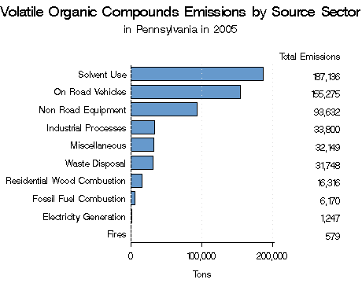
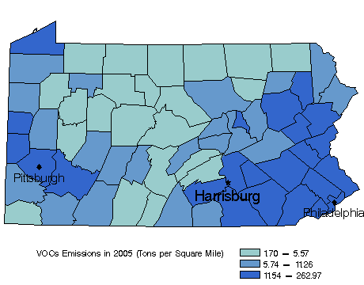
VOC
Volatile organic compounds are bad for the environment and human health. Therein many rules are regulated by the U.S. EPA but their control requires either catalytic destruction or downstream incineration. Both process contribute to product cost without adding value. Notably both approaches are thermally based and as such, are energy intensive.

Slide 6
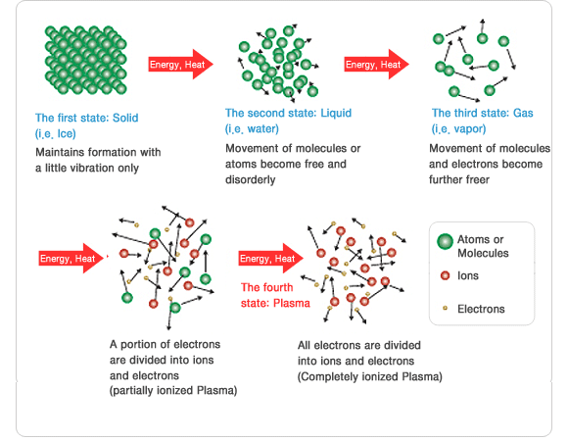
Plasma

Slide 7
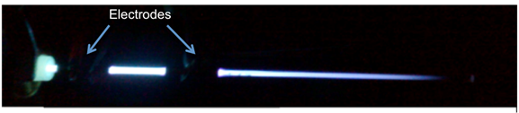
Plasma
  Plasma is a collection of free moving electrons and ions that are usually formed upon ionization of gases.
  To create plasma, energy is required which may be of various forms: thermal, electrical or light energy.
  Electrons in plasma may be in thermodynamic equilibrium with the surrounding gas. Such plasma is defined as equilibrium plasma. Usually such plasma is at a very high temperature, and is often known as Thermal Plasma.
  In industrial processes, the type of plasma used is mainly non-equilibrium plasma where the electrons are not in thermodynamic equilibrium with the surrounding medium. In such cases, the electrons are usually at a much higher energy level than the medium. Normally such plasma is at a lower temperature and usually generated from electrical energy. Such plasma is also known as Non-thermal Plasma

Slide 8
Non-Thermal Plasma
What Is Non-Thermal Plasma?
Everyone is familiar with static electricity that occurs when reaching for a metal door handle after walking across a carpet.
In technical terms, static electricity is the discharge of electricity that occurs when the potential (that is, voltage) exceeds the insulating effect of the air gap between your finger and the door handle. Non-thermal plasma uses a reactor that utilizes a similar effect.
The reactor consists of two electrodes (one electrode is in the form of a metal pipe, and the other electrode is a metal wire that runs down the middle of the pipe) separated by a void space that is lined with a dielectric material and is filled with glass beads. This type of reactor is called Dielectric-Barrier Discharge (DBD).

Slide 9
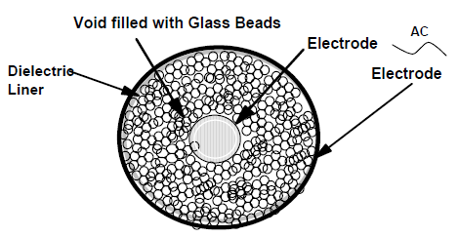
Non-Thermal Plasma
Emissions flow inside of the pipe. A phenomenon occurs when the voltage through the beads exceeds the insulating effect of the beads and millions of micro-discharges occur.
The duration of these discharges is measured in nano-seconds.
The individual discharges cannot be seen with the human eye, but the overall effect produces a silent glow. This effect will only occur when the power source is alternating current (AC). DBD cannot be induced with direct current (DC) power because the capacitive coupling of the dielectric necessitates an AC field.

Slide 10
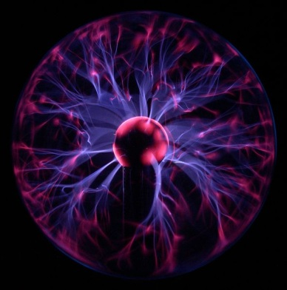
Non-Thermal Plasma
In this environment, in addition to electrons flying about, atoms are being separated from their molecules to become free radicals.
Since free radicals are highly reactive, they quickly recombine with other atoms and/or molecules to form new compounds.
Using oxygen as an example, the normal state of oxygen is a molecule containing two oxygen atoms. Thus, it is written as O₂.
In a DBD field, the oxygen molecules splits into two atoms of oxygen, O ⁺ and O ⁺. The elemental oxygen radical, being very reactive, will form ozone, O₃, when the radical oxygen atom reacts with a normal molecule of oxygen (O₂).

Slide 11
1
Chemistry
Summary of spectral transitions, chemistry equations

Slide 12
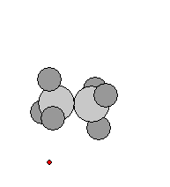
Electron Impact Ionization
Electron ionization (EI, formerly known as electron impact) is an ionization method in which energetic electrons interact with gas phase atoms or molecules to produce ions.
The following gas phase reaction describes the electron ionization process:
M + e⁻ → M^{+●} + 2e⁻
  where M is the analyte molecule being ionized, e− is the electron and M+• is the resulting ion.
http://en.wikipedia.org/wiki/Electron_ionization

Slide 13
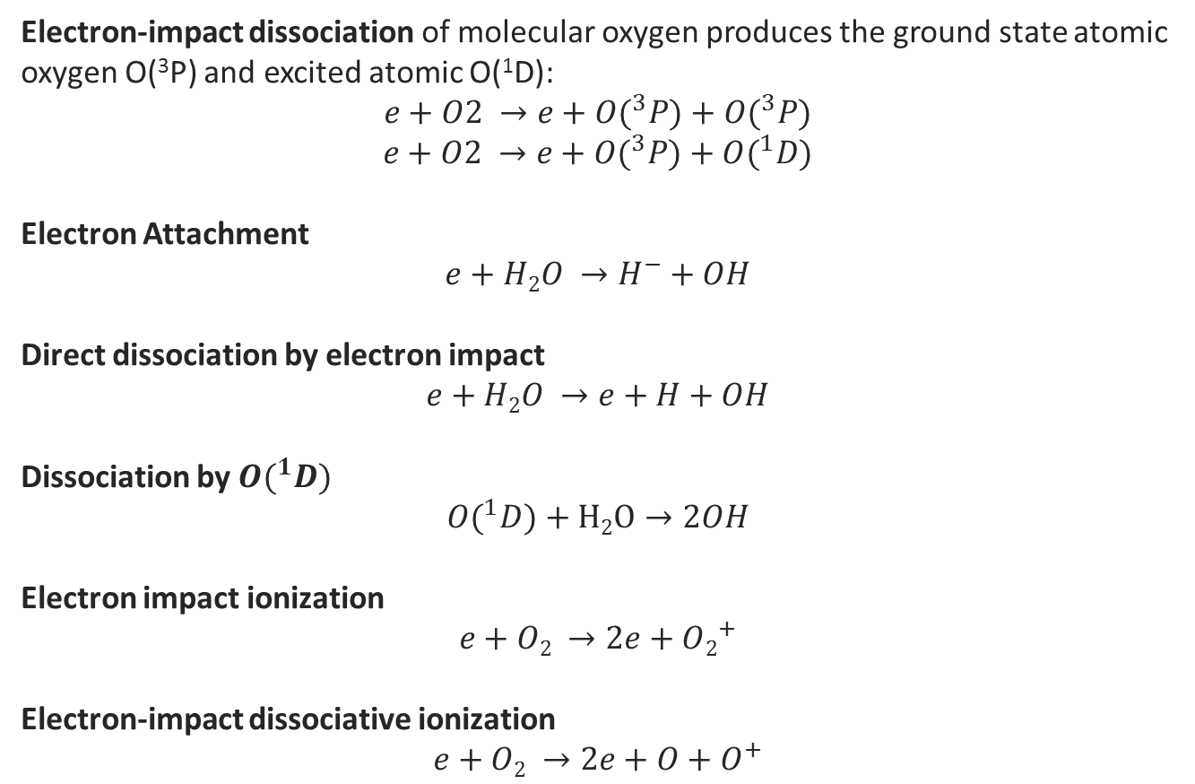
Electron Impact Processes
Electron-impact dissociation of molecular oxygen produces the ground state atomic oxygen O(³P) and excited atomic O(¹D):
$$e+O2 →e+O(^{3}P)+O(^{3}P)$$
$$e+O2 →e+O(^{3}P)+O(^{1}D)$$
Electron Attachment
$$e+H2O →H^{−}+OH$$
Direct dissociation by electron impact
$$e+H2O →e+H+OH$$
Dissociation by $O(^{1}D)$
$$O(^{1}D)+H2O→2OH$$
Electron impact ionization
$$e+O2 →2e+O2^{+}$$
Electron-impact dissociative ionization
$$e+O2 →2e+O+O^{+}$$
Effects of Oxygen and Water Vapor on Volatile Organic Compounds Decomposition Using Gliding Arc Gas Discharge
Plasma Chem Plasma Process (2007) 27:546–558

Slide 14
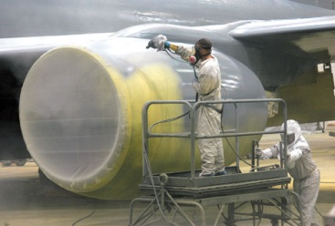
Plant
The Oklahoma Air Logistics Center at Tinker Air Force Base in Midwest City, Oklahoma requires a control technology to reduce the emission of Volatile Organic Compounds (VOCs) from its paint booths, to obtain compliance with Title III of the US Clean Air Act 1990 and MACT (Maximum Achievable Control Technology).
Tinker would like to switch to high pigment paint but the higher VOC emissions results in the need for a control technology.
There are of 42 paint booths that operate 5 – 6 hours a day. The entire painting operation is performed in 15 minute intervals.
Hence, Tinker needs a control technology that can be turned on and off when required and instantly operate to full capacity.

Slide 15
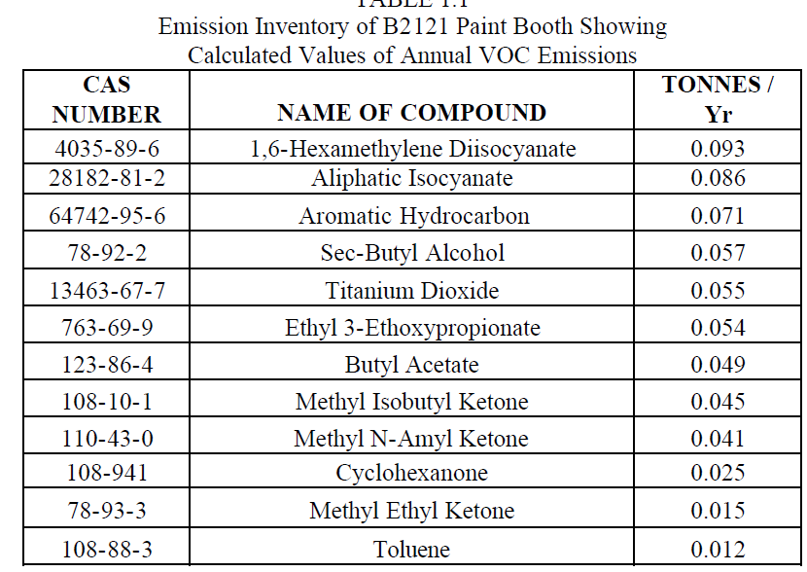
Emission Inventory
The VOC emission inventory obtained from Tinker is shown in Table . The inventory lists the major chemicals emitted from paint booth B2121 and their calculated emission rate in 2001

Slide 16
Destruction of Toluene
Alternative Methods of Toluene Destruction
Toluene can be removed by adsorption using activated carbon, thermal oxidation and incineration, bio-filtration and plasma destruction.
Carbon adsorption is cheap and effective (90%) compared with other methods but the presence of high concentrations of ketones and alcohols can causes fire in a carbon bed.
Finally, the destruction VOCs using an alternate current plasma reactor is effective (>95% Destruction Efficiency) and potentially less expensive than other competing technologies.

Slide 17
Destruction of Toluene
Numerous reactions may take place in a DBD plasma reactor that can lead to the formation of active species capable of reacting with pollutant molecules.
These species react with pollutant molecules, which can result in near complete oxidation of hydrocarbons into CO, CO₂, H2O and conversion of species such as Cl, S and NO into HCl, Cl₂, SO₂, H₂SO₄, HNO₃.
If the concentration of the active species is high enough to initiate the destruction reaction, the pollutant concentration decreases.

Slide 18
Destruction of Toluene
The complete reaction chemistry is extremely complicated. The reactant molecules are known to undergo a series of intricate intermediate reactions before breaking down completely destroying into combustion products.
Due to the complexities of these mechanisms for pollutant destruction in DBD plasma reactors, additional research needs to be done in the mechanism of the reaction.
The destruction of toluene in a plasma reactor occurs through oxidation. A possible free radical mechanism for the oxidation of toluene in the reactor is discussed below.
Toluene can either react with the atmospheric oxygen or the hydroxyl radical once a mixture of radicals is formed in the reactor. The following reactions show one possible mechanism of toluene destruction in the DBD plasma reactor.

Slide 19
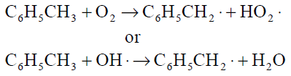
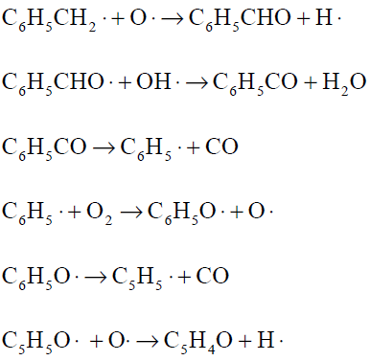
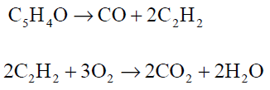
Chemistry of Toluene

Slide 20
Decomposition Toluene
The toluene decomposition process mainly includes the following reactions: Energetic electron induced decomposition reactions:
C₇H₈ +e → C₆H₅ + CH₃ + e
C₇H₈ + e → C₇H₇ + H + e
C₇H₈ + e → C₅H₆ + C₂H₂ + e
C₇H₈ + e → C3H₄ + C₄H₄ + e
Dissociation rate coefficients can be obtained from the solution of Boltzmann equation for the electron energy distribution.
Reactions between toluene and radicals:
C₇H₈ + O → products
K₄₀₀ = 3.67 10⁻¹³ cm³ mol⁻¹ s⁻¹
C₇H₈ + OH → C₇H₇ + H₂O
K₄₀₀ = 1.14 10⁻¹² cm³ mol⁻¹ s⁻¹
Effects of Oxygen and Water Vapor on Volatile Organic Compounds Decomposition Using Gliding Arc Gas Discharge
Plasma Chem Plasma Process (2007) 27:546–558

Slide 21
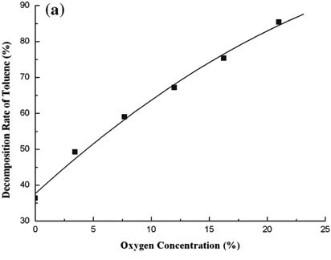
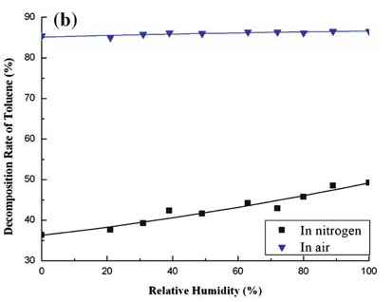
Decomposition of Toluene
The above figures show the variations of the toluene decomposition rate as a function of the oxygen volumetric fraction and RH: this reaction rate is markedly increasing from 36 to 85% when the oxygen density is increased in the treated gas.
It is also increasing by adding water vapor when the GA is working in dry nitrogen atmosphere.
By contrast, the toluene decomposition rate (*85%) is not obviously affected by the presence of water vapor in air atmosphere.
Plasma Chem Plasma Process (2007) 27:546–558

Slide 22
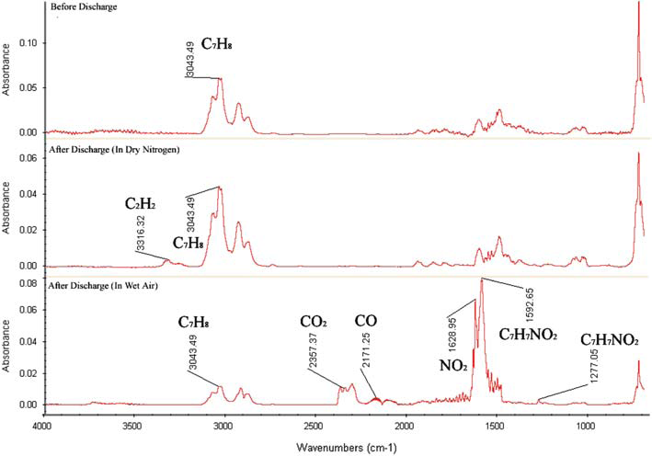
FTIR Absorption Spectra
The toluene decomposition efficiency is strongly influenced by the presence of the O and OH radicals in the plasma region, the addition of oxygen and water vapor in the treated gas enhances the decomposition of this volatile organic compound.
Plasma Chem Plasma Process (2007) 27:546–558

Slide 23
Spectroscopy tool
  Here is a spectra of a carbonaceous compound. We can clearly identify the species that are present in the compound.

Slide 24
2
Reactor Design
Comparing different types of plasma configurations, optimizing reactor performance

Slide 25
Reactor Design
Novel Configurations
Pulsed Corona Reactor
Dielectric Barrier Discharge
Surface Barrier Discharge
Capillary Plasma Discharge
Gliding Arc
Packed-bed Reactor

Slide 26
Dielectric Barrier Discharge Reactor
DBD:
Characterized by the presence of one or more insulating layers in the
current path between metal electrodes in addition to the discharge space
The discharge characteristics depend on the gas composition, type of dielectric material and operating conditions of voltage and frequency.
For air-like mixtures- short-lived filaments is dominant – microdischarges
For inert gases – glow-mode discharge is dominant – atmospheric pressure glow discharge (APGD)
The advantage of DBD over pulsed corona :
Simpler and cheaper power supply
Can be scaled up without difficulty.
Plasma Process. Polym. 2004, 1, 91–110

Slide 27
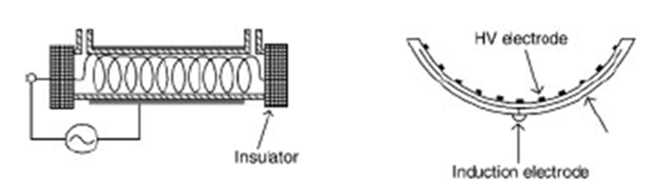
Surface Discharge Reactor
Surface Barrier Discharge:
It is a type of dielectric barrier discharge.
The electrodes are embedded in the dielectric.
The plasma will be generated on the surface of dielectric
Advantage:
It can analyze solid sample better than DBD.
Plasma Process. Polym. 2004, 1, 91–110

Slide 28
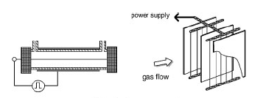
Pulsed Corona Reactor
Requires a pulse power supply with a fast voltage rising time of several tens of nanoseconds.
Pulse power reduces the energy consumption by a factor of 5.
The discharge mode is streamer mode.
Advantages:
The ionization zone spreads over the entire gap and that is favorable for large scale application.
Uses short width pulses, to minimize energy dissipation by ions.
By controlling pulse frequency , the volume of gas treated can be controlled
Nonthermal Plasma Processing for Air-Pollution Control: A Historical Review, Current Issues, and Future Prospects
Plasma Process. Polym. 2004, 1, 91–110

Slide 29
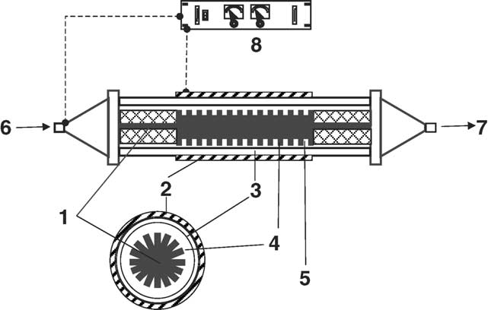
Capillary Plasma Discharge Concept
Annular plasma reactor with cylindrical electrodes
(1: aluminum bar electrode; 2: aluminum screen electrode; 3: dielectric material; 4: Pyrex glass body; 5: capillary; 6: gas inlet; 7: gas outlet; 8: power supply).
Rectangular reactor with hollow pin capillary electrodes.
The gas flows through the hollow pins, flow-through geometry
(1: gas inlet; 2: gas outlet; 3: spacer; 4: dielectric material; 5: stainless steel hollow pins; 6: copper electrode; 7: capillary; 8: power supply).
Destruction of hydrocarbons in non-thermal, ambient-pressure, capillary discharge plasmas
International Journal of Mass Spectrometry 233 (2004) 305–315

Slide 30
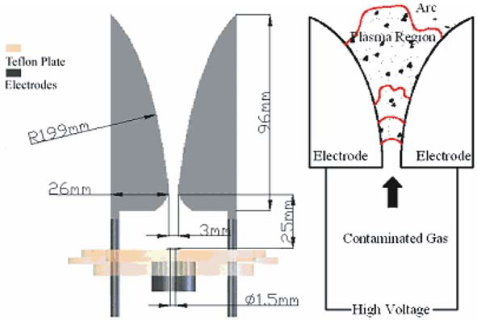
Gliding Arc Concept
Three main channels for VOCs decomposition are generally pointed out under non-thermal plasma conditions:
(I) Dissociation of VOCs molecules by energetic electrons impact;
(II) Reactions between VOCs molecules and ions;
(III) Reactions between VOCs molecules and radicals.
1) The increase of oxygen concentration enhances the production of O radicals, but
decreases the electron density in the discharge;
2) The addition of water vapor reduces the amount of electrons, suppresses the formation
of O radicals but gives rise to the formation of OH radicals.
Effects of Oxygen and Water Vapor on Volatile Organic Compounds Decomposition Using Gliding Arc Gas Discharge
Plasma Chem Plasma Process (2007) 27:546–558

Slide 31
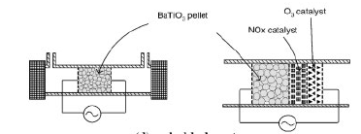
Packed-bed Reactor
SALIENT FEATURES:
Ferroelectric pellet packed-bed Reactors were first developed as a type of ESP and were found to be effective not only in collecting particles (99.99%removal) but also in destroying yeast cells.
Developed for VOCs decomposition, odor removal, and CO2 reduction.
The mostly widely used ferroelectric material is barium titanate (BaTiO3). Others include Mg2TiO4, CaTiO3, SrTiO3, and PbTiO3.
ADVANTAGES:
Uniform distribution of gas flow and the discharge in the reactor.
Modification of the reactor to include a catalyst is very easy.
DISADVANTAGES:
Pressure Drop, proper reactor design-energy efficiency.
Plasma Process. Polym. 2004, 1, 91–110

Slide 32
Catalyst
3
Comparing different catalysts, integrating catalyst in to the non-thermal plasma reactor

Slide 33
TYPES OF CATALYST SYSTEMS
Catalyst
Two-Stage
(TPC)
Multi-Stage
(MPC)
Single-Stage
(SPC)
PACKED BED Plasma SYSTEMS
ADVANTAGES OF CATALYST IN THE SYSTEM:
The existence of abundant short-lived active species (i.e., excited species, radicals, and positive/negative ions)-Changes the status of the gas phase reactants for the occurrence of plasma discharge on catalyst surface
voltage potential and a current flow across the catalyst-(Affects the physical and chemical Properties), higher residence time
Reduces the unwanted or harmful byproducts i.e., CO, NO_{x}, O₃ by selectivity of the catalyst

Slide 34
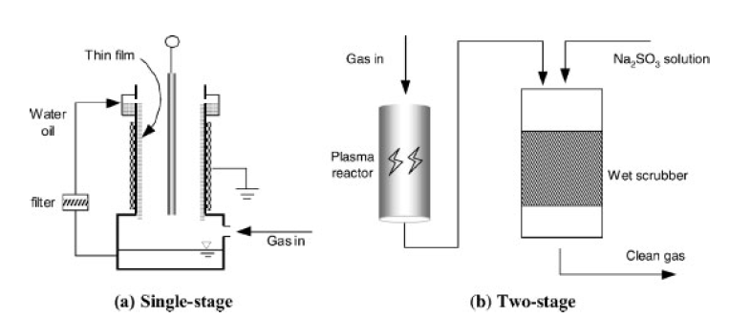
Type of Hybrid Reactors

Slide 35
SPC over TPC & MPC
SPC- Single stage Plasma Catalysis
TPC- Two stage Plasma Catalysis
MPC- Multistage Plasma Catalysis
Ions and electronically excited species would have de-excited before they reach the catalyst surface.
The internal energy of the species in rotational state is not sufficient to induce further reactions.
Although the internal energy of vibrationally excited species is not enough to induce plasma chemistry reactions, they are the active species produced in plasma with the minimum internal energy to improve catalytic reactions.
Radicals generally show a much higher sticking coefficient for chemisorption, an essential step of catalytic reactions.
Deactivation of catalyst in the case of TPC and MPC is easier.

Slide 36
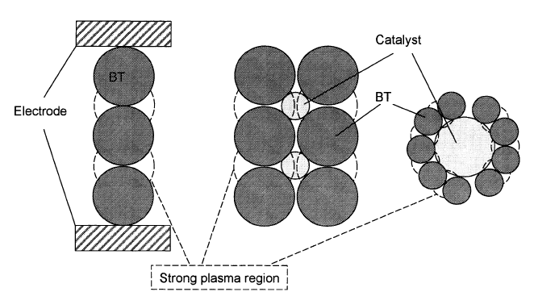
Catalyst Work
(a)
(b)
(c)
Image of plasma Discharge in hybrid reactors packed with BT
Conventional Reactor
BT> Catalyst (in r)
BT< Catalyst (in r)
A.Ogata Et. Al. J Applied Catalysis B: Environmental 46 (2003) 87-93

Slide 37
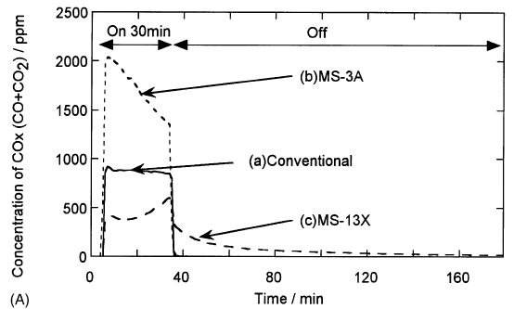
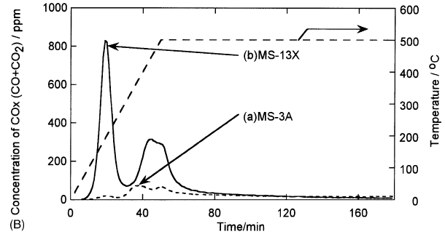
Particle Size Selection
MS-3A- BaTiO₃<Catalyst Particles
MS-13X- BaTiO₃> Catalyst Particles
Temperature Programmed Desorption
Under Plasma Discharge
MS-3A- BaTiO₃<Catalyst Particles
MS-13X- BaTiO₃> Catalyst Particles
A.Ogata Et. Al. J Applied Catalysis B: Environmental 46 (2003) 87-93

Slide 38
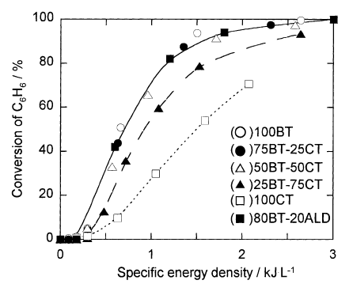
Selection of Packing material
A.Ogata Et. Al. J Applied Catalysis B: Environmental 46 (2003) 87-93

Slide 39
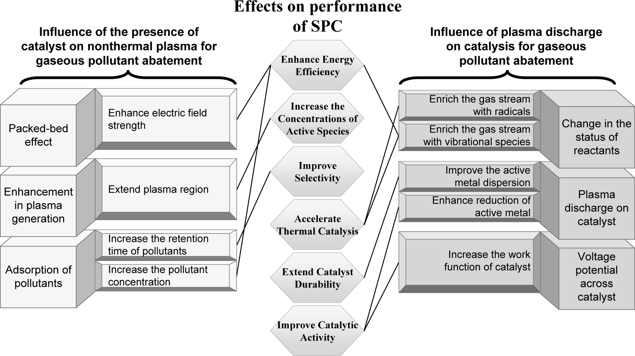
SPC PERFORMANCE
ENVIRONMENTAL SCIENCE & TECHNOLOGY / VOL. 43, NO. 7, 2009

Slide 40
SPC PERFORMANCE
ENVIRONMENTAL SCIENCE & TECHNOLOGY / VOL. 43, NO. 7, 2009

Slide 41
SPC PERFORMANCE
ENVIRONMENTAL SCIENCE & TECHNOLOGY / VOL. 43, NO. 7, 2009

Slide 42
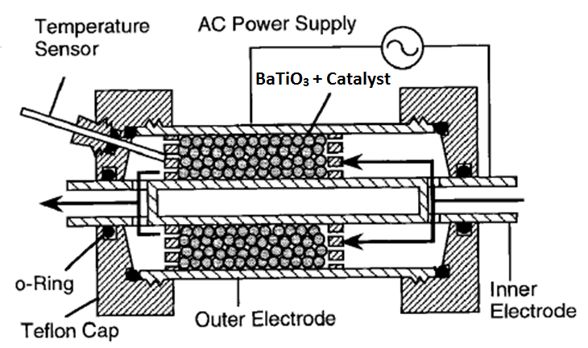
DESIGN OF PLASMA REACTOR

Slide 43
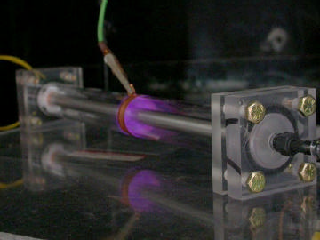
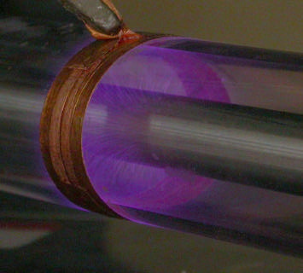
How will the Plasma look…

Slide 44
ASSUMPTIONS
The porosity(Ɛ) was calculated to be 0.733 assuming there are 5 particles in a cross section of 10mmX 2mm section of the experimental setup. We assume the scaled reactor is also having the same porosity.
The density(ρ) of the inlet gas was assumed to be 1.251 g/L ( Same as that of air).
The viscosity(µ) of the inlet gas was assumed to be .01781x10⁻² g/(cc.sec).
The flow in the lab scale reactor was laminar flow which is assumed to be the same in the modeled reactor.
All the particles are assumed to be perfect spheres. Hence sphericity (φ_{s}) is 1.
The target gas flow rate is 2000 L/min.

Slide 45
CALCULATIONS
EXPERIMENTAL SETUP:
Volume of the reactor (V)=(∏/4)*(L)*(d_{o}²-d_{i}²)
=31415.926 mm³
=31.415cm³
Porosity (Ɛ) =1-{(vol. fraction of spheres)}
= 1-{(n*4*∏*(0.2)3)/(3*31.415)}
=.733
Reynolds Number = R_{ep}= {(ρ*V_{s}*D_{p}* φ_{s}²)/[µ*(1-Ɛ)]}
={[1.251*(.2/60)*(1/25.1327)*.2*1]/(.01781*10⁻²*(1-.733)}
=0.6978
= Laminar flow

Slide 46
CALCULATIONS
From Korenzy-Carmen Equation
Superficial velocity=µ_{o}=
(Volumetric flow rate)/(Effective cross sectional area)
=(.2/60*25.1327) cm/sec
(∆P/L)= {[(150*µ*µ_{o}*(1-Ɛ)²]/[D_{p}* φ_{s}*Ɛ³]}
= {[150*.01781*10⁻²*.2*(1- .733)²]/[.2*60*25.1327*.733³]}
=1.602*10⁻² g/s

Slide 47
CALCULATIONS
Reynolds Number = R_{ep}= {(ρ*V_{s}*D_{p}* φ_{s}²)/[µ*(1-Ɛ)]}
={(1.251*2000*.2*1)/[60*.01781*10⁻² *∏*r_{e}²*(1-.733)]}
=55854.9/r_{e}2
From Korenzy-Carmen Equation
(∆P/L)= {[(150*µ*µ_{o}*(1-Ɛ)²]/[D_{p}* φ_{s}*Ɛ³]}
= {[150*.01781*10⁻²*2000*10³*(1- .733)²]/[.2*100*60*∏*r_{e}²*.733²]}
(∆P/L )=256.675/r²
The pressure drop across the bed is assumed to be increasing as the same rate as that of the flow rate because of the increasing in the packing material in the reactor.

Slide 48
CALCULATIONS
Hence,
R_{e}²= 1.603*L
From iterative calculations, the consideration for length is chosen to be 200 cm and the effective radius was
R_{e}²=320.24
R_{o}²-R_{i}²=320.24
From Solver which is run in excel, we get the radii as 30 cm and 24 cm (approximated to the next number and decimals are neglected)

Slide 49
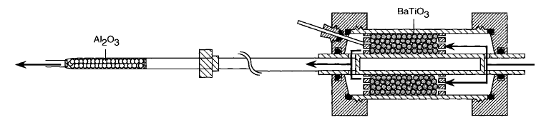
SCALED UP DESIGN OF PLASMA REACTOR
60 cm
48 cm
200 cm
300 cm

Slide 50
SCHEMATIC OF EXPERIMENTAL SETUP
F C U
Power meter
N2
CMSPS
GC
Benzene
Transformer
F C U
Mixing
Tube
Scrubber
Auto sampler
Plasma Reactor
F C U
Water
OES
F C U
Temperature
Control
O2
TERMS:
F C U- Flow Control Unit CMSPS-Control Mode Switching Power Supply
O E S- Optical Emission Spectrometer

Slide 51
SCRUBBER STAGES
To stack
2nd stage
WET ESP
1st stage
By-product to reclaim

Slide 52
4
Energy & Economic Analysis
Energy & sensitivity analysis, cost estimates

Slide 53
Cost Effectiveness & optimization
The problem with determining the cost of a new control technology is the lack of public information.
An NTP reactor will be a specialized custom made system
Optimizing the performance of an NTP reactor is a complicated process
Degree of removal of pollutant, decomposition products and energy consumption are critical evaluation parameters
Preliminary economic analysis indicates that the major cost of an NTP reactor system resides in the cost of the electrical power supply
In some cases the cost might be 75% of the plasma reactor cost
The cost is expected to fall with the development of,
  Better matched State-of-the-art power supplies
  Operation of the plasma reactor at more optimal treatment conditions

Slide 54
Figures of merit
Specific excitation power (P)
  P = 2faσE_{µ}
  Where f = frequency of the A.C. voltage supplied to the reactor, a = micro discharge area, σ = Number of micro discharge streamers per unit area, E_{µ} = Specific energy per micro discharge
Specific Energy (E)
  E = PƮ_{r}
  Where P= Specific Power, Ʈ_{r} = Active volume of the reactor
Production efficiency (G)
  G = f (K_{rad})/(v_{d}E/N)
  Where K_{rad} = effective rate constant for radical generation, v_{d}= electron drift velocity, E/N = reduced electrical field
Energy Density parameter of a given compound (β)
  β = - E/ln([X]/[X₀])
  Where E = Energy Density, [X]_{O} = Initial Pollution concentration , [X] = Final Pollution concentration
Average energy cost per removed molecule (γ)
  γ = - βln ([X]/[X]₀)/[X]₀(1- [X]/[X]₀)
  Where β = Energy density parameter, [X]₀ = initial concentration, [X] = Final concentration

Slide 55
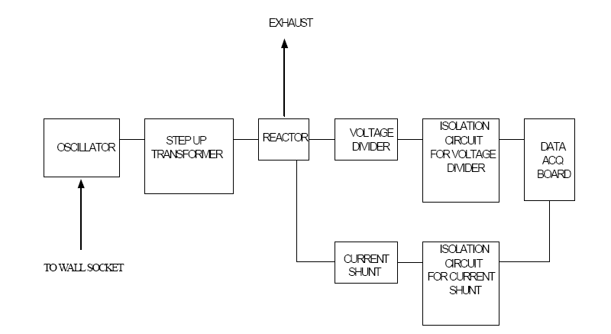
Electrical system of Plasma Unit

Slide 56
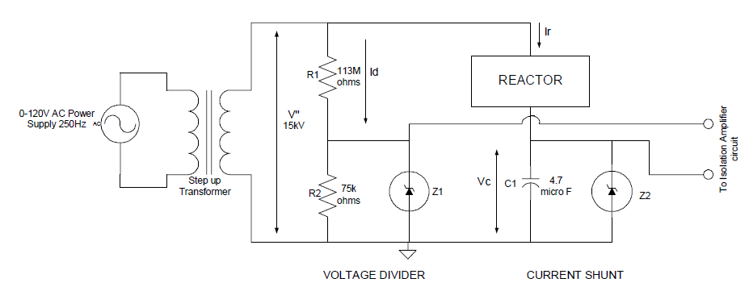
Voltage and Current Measuring Circuit

Slide 57
Sensitivity Analysis
A technique used to determine how different values of an independent variable will impact a particular dependent variable under a given set of assumptions
This technique is used within specific boundaries that will depend on one or more input variables
The four major parameters that influence the NTP reactor cost of ownership are
  Flow Rate
  Energy density (power requirement)
  Target effluent concentration (DRE)
  Duty Cycle (Percentage of time that exhaust output is actually being emitted)
The cells and support equipment are made from simple inexpensive materials and are minor components of capital cost
Total annual costs and unit costs are dependent upon values given for the important 4 parameters
Due to the dynamic influence of these parameters on the cost, a sensitivity analysis is essential showing their relationship to the cost of ownership

Slide 58
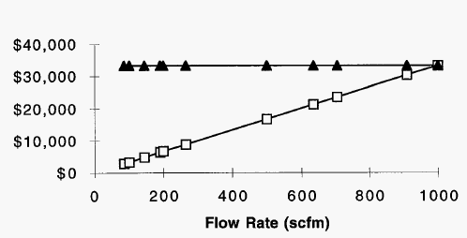
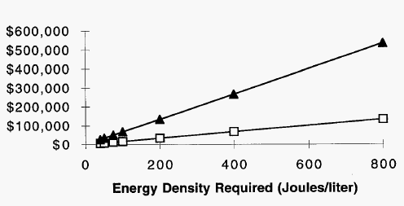
Performance Parameters

Slide 59
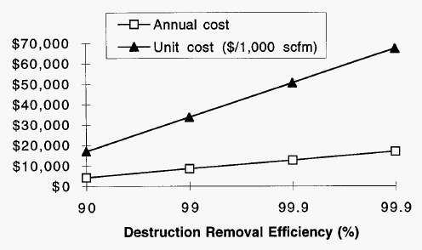
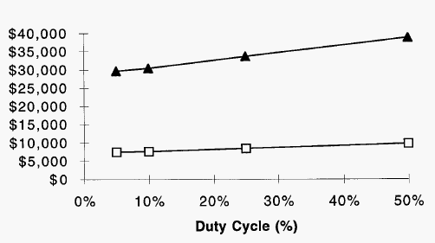
Performance Parameters

Slide 60
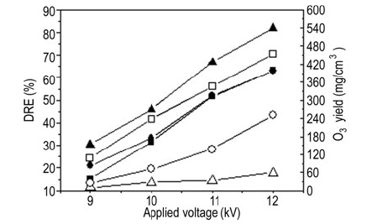
Performance Parameters

Slide 61
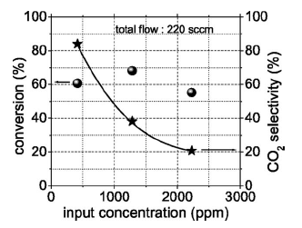
Performance Parameters

Slide 62
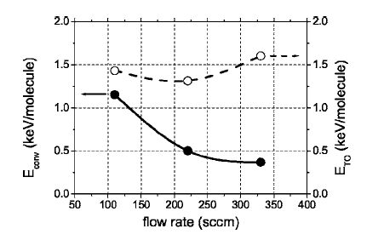
Performance Parameters

Slide 63
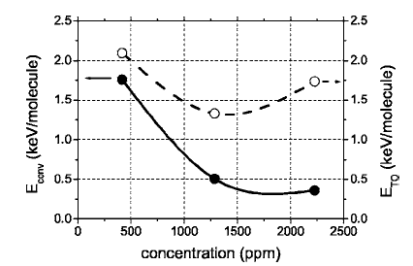
Performance Parameters

Slide 64
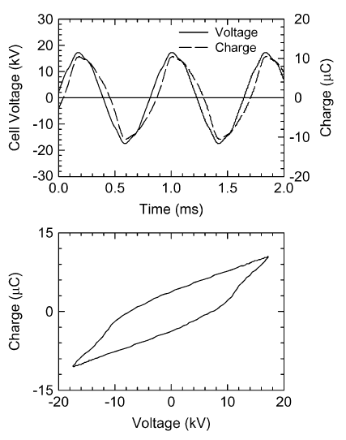
Typical voltage waveforms

Slide 65
Capital Cost
Unit | Quantity | Cost, $ | Vendor
Blower | 1 (2000 L/min) | 1480 | Matches
Oscillator | 1 | 795 | Texas Instruments
Transformer | 1 (1500 KVA)-GE PROLEC | 14,000 | Carrier Electric
Plasma Reactor
Dielectric Quartz tubes | 1 (61.5 cm *60 cm) | 15,234 | Technical Glass Products
Inner Electrode (stainless steel) | 1 (48 cm*300 cm) | 5,126 | Small Parts Inc
Outer Electrode (copper foil) | 1000 cm (bundle) | 50 | Sigma-Aldrich
Ferro electric packing material (barium titanate) | 979 kg | 29,370 | Sigma-Aldrich
Fiberglass case for the reactor | 1 (62 cm* 310 cm) | 200 | Niemiac Marine Inc
Alumina | 244.8 kg | 10,184 | Sigma Aldrich

Slide 66
Capital Cost-Piping Cost
Unit | Quantity | Cost, $ | Vendor
1. Carbon Steel
16-10 inch RFSO 150-flange | 1 | 744 | Lamons Gasket Company
96-B7 Studs | 1 | 192
8-10 inch gaskets | 1 | 168
4-10 inch SK20 LR 90’s | 1 | 358
40’-10’ SK20 pipe | 1 | 460

Slide 67
Capital Cost-Electrical Cost
Unit | Quantity | Cost, $ | Vendor
Voltage divider | 1 | 8 | Radioshack
Optical Isolators | 1 | 15 | Radioshack
Isolation Amplifiers | 1 | 118 | Radioshack
Breadboard wires | 1 | 15 | Radioshack
18AWG test lead wires | 1 | 8 | Radioshack
DAQ board PCI6023E | 1 | 395 | Radioshack
R6868 Ribbon cable | 1 | 65 | Radioshack
LAB view software | 1 | 495 | Techtronix

Slide 68
Capital Cost-Sensors & Spectrometer
Unit | Quantity | Cost, $ | Vendor
Temperature | 1 | 80 | Omega
Pressure | 1 | 85 | MKS Instruments
Humidity | 1 | 35 | MKS Instruments
Power | 1 | 150 | Techtronix
Voltage | 1 | 40 | Techtronix
Spectrometer | 1 | 1300 | Stellar Net
Spectrometer | 1 | 2400 | Ocean Optics
GC-MS | 1 | 9950 | Thermo Scientific

Slide 69
Total Capital Cost
Unit | Quantity | Cost, $ | Vendor
Plasma reactor |  | 76,439
Piping |  | 1,922
Electrical |  | 1,119
Sensors & Accessories |  | 14,040
Total |  | 93,520

Slide 70
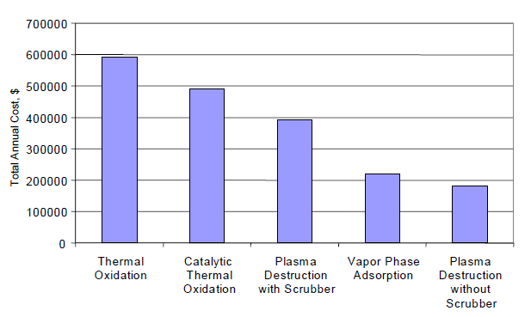
Total Annual Cost Comparison of Control Techniques

Slide 71
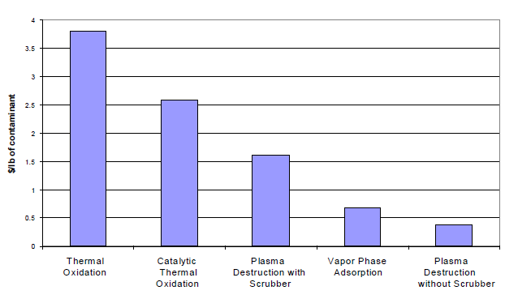
Removal Cost per Unit Contaminant at 2000 L/min and 2000 ppm

Slide 72
Operating Cost
Assume optimum energy density = 1500 J/L = 1500 watt-s/L
= 0.84 kw-hr/2000 slm
Total Flow = 2000 slm = 120, 000 sl/hr
Assume electricity cost = 0.09 $/kw-hr
Operational Cost = (0.084 * 0.09) / 2000 slm = 0.075 $/2000 slm

Slide 73
SUMMARY
Low-T plasmas can be used effectively for the treatment of gaseous waste streams containing VOCs in a bench-scale R&D environment
It appears that non-thermal plasma technology works to reduce certain pollutants from emissions. However the technology is still in the early developmental stage. The control cost and control efficiencies need to be documented and published by an independent third party.
Capital and operating costs for a turn-key installation are probably not available and can only be determined by the installation and operation of a pilot plant at the individual facility.
Low-T plasmas for Environmental Applications:
High Percentage of VOC Destruction in Low-Flow Applications
Reasonable Destruction Efficiency in High-Flow Applications
Extensive Characterization of By-Products
High Level of Carbon Closure

Slide 74
Challenges
But: Challenges Remain
Scale-up to high gas flow is non-trivial
Cost and energy efficiency (vs. competing technologies)
Materials for long-term, maintenance-free operation
Control of by-product formation
Poorly understood plasma chemistry
Coupling of discharge physics to plasma chemistry
→ Large-scale industrial utilization is still some time away !

Slide 75

References
B M Penetrantey, M C Hsiaoy, J N Bardsleyy, B T Merritty, G E Vogtliny, A Kuthiz, C P Burkhartz and J R Baylessz Plasma Sources Sci. Technol. 6 (1997) 251–259
Hyun-Ha Kim Plasma Process. Polym. 2004, 1, 91–110
A. Koutsospyros, S.-M. Yin, C. Christodoulatos, K. Becker International Journal of Mass Spectrometry 233 (2004) 305–315
R. G. Tonkyn, S. E. Barlow, T. M. Orlando J. Appl. Phys. 80 (9), 1 November 1996
Zh. Bo, J. H. Yan, X. D. Li, Y. Chi, K. F. Cen, B. G. Che´ron Plasma Chem Plasma Process (2007) 27:546–558
Hyun-Ha Kim, Seung-Min Oh, Atsushi Ogata, Shigeru Futamura Applied Catalysis B: Environmental 56 (2005) 213–220
Hui-Xian Ding, Ai-Min Zhu, Fu-Gong Lu, Yong Xu, Jing Zhang, Xue-Feng Yang J. Phys. D: Appl. Phys. 39 (2006) 3603–3608
B. M. Penetrante, R. M. Brusasco, B. T. Merritt and G. E. Vogtlin Pure Appl. Chem., Vol. 71, No. 10, pp. 1829±1835, 1999
H H Kim, K Takashima, S Katsura and A Mizuno J. Phys. D: Appl. Phys. 34 (2001) 604–613
Jim Van Durme, Jo Dewulf, Christophe Leys, Herman Van Langenhove Applied Catalysis B: Environmental 78 (2008) 324–333
Hyun-Ha Kim, Seung-Min Oh, Atsushi Ogata, Shigeru Futamura Catalysis Letters Vol. 96, Nos. 3–4, July 2004 (2004)

Slide 76
References
A l i c e M. H a r l i n g, D a v i d J. G l o v e r, J. C h r i s t o p h e r w h i t e h e a d, K u i z h a n g Environ. Sci. Technol. 2008, 42, 4546–4550
Duan Li, Daisuke Yakushiji, Seiji Kanazawa, Toshikazu Ohkubo, Yukiharu Nomoto 0-7803-7116-X/01/$10.00 (C) 2001 IEEE
R. G. Tonkyn, S. E. Barlow, T. M. Orlando J. Appl. Phys. 80 (9), 1 November 1996
Atsushi Ogata, Daisuke Ito, Koichi Mizuno, Satoshi Kushiyama, Arkadi Gal, Toshiaki Yamamoto Applied Catalysis A: General 236 (2002) 9–15
Applied Catalysis A: General 236 (2002) 9–15 J. Appl. Phys., Vol. 85, No. 1, 1 January 1999
Monica Magureanu, Nicolae B. Mandache, Pierre Eloy, Eric M. Gaigneaux, Vasile I. Parvulescu Applied Catalysis B: Environmental 61 (2005) 12–20
H. Huang, L. Tang 2006 Published by Elsevier Ltd.
R. G. Tonkyn, S. E. Barlow, and T. M. Orlando J. Appl. Phys. 80 (9), 1 November 1996
Hyun-Ha Kim, Seung-Min Oh, Atsushi Ogata, Shigeru Futamura Catalysis Letters Vol. 96, Nos. 3–4, July 2004 (2004)
R. Rudolph, K.-P. Francke, H. Miessner 0272-4324 02 0900-0401 2002 Plenum Publishing Corporation
W. Mista, R. Kacprzyk Catalysis Today 137 (2008) 345–349
Ch. Subrahmanyam, M. Magureanu, A. Renken, L. Kiwi-Minsker Applied Catalysis B: Environmental 65 (2006) 150–156
K. Moustakas, D. Fatta, S. Malamis, K. Haralambous, M. Loizidou Journal of Hazardous Materials B123 (2005) 120–126

Slide 77

THANK YOU.

